Slide 1
THE MOON
Michaela Sorrentino

Slide 2
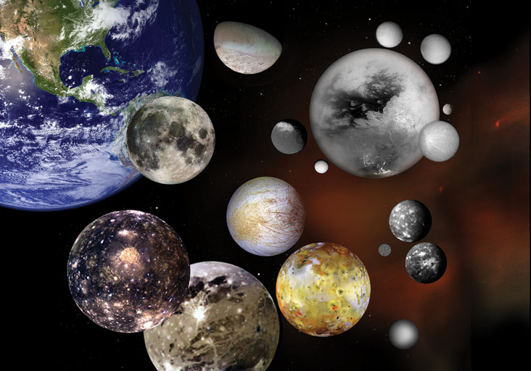
What is a Moon?
Natural satellites that orbit planets and asteroids
Vary in shape, size, and make-up
Moons in our solar system
Mercury and Venus = 0
Earth = 1
Mars = 2
Jupiter = 79*
Saturn = 53*
Uranus = 27*
Neptune = 13*
Pluto = 5
* Have been officially confirmed
https://solarsystem.nasa.gov/moons/in-depth/

Slide 3
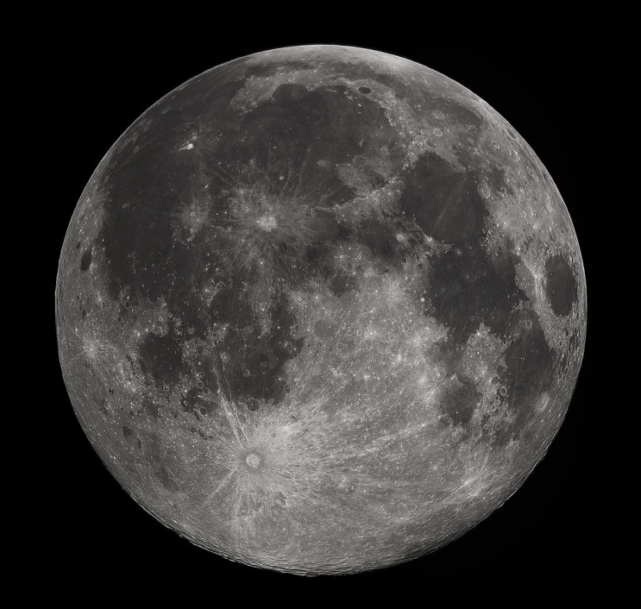
Our Moon
238,519 miles from Earth
2,158 miles in diameter
Approx. 4.5 billion years old
Orbit around Earth = 27 Earth days
Synodic period = 29 days (full moon to full moon)
Gravity = 1.62 m/s² (1/6th of Earth’s)
https://en.wikipedia.org/wiki/Moon
Notes:
Full Moon photograph taken 10-22-2010 from Madison, Alabama, USA. Photographed with a Celestron 9.25 Schmidt-Cassegrain telescope. Acquired with a Canon EOS Rebel T1i (EOS 500D), 20 images stacked to reduce noise. 200 ISO 1/640 sec.
Retrieved from Wikipedia

Slide 4
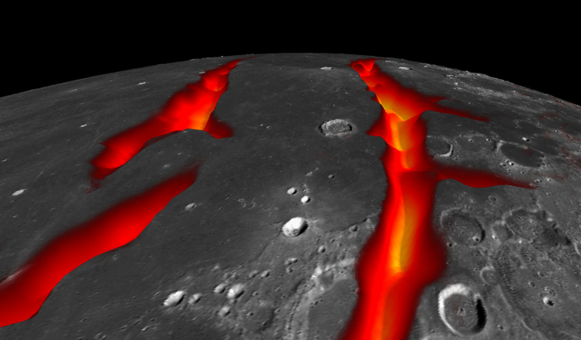
Formation
Theory: Mars-sized body (Theia) collided with Earth 4.5 billion years ago
Debris from impact accumulated and formed our moon
“Magma ocean” – took 100 million years to crystallize (surface is now covered in “dark volcanic maria”)
https://en.wikipedia.org/wiki/Moon#/media/File:PIA18821-LunarGrailMission-OceanusProcellarum-Rifts-Closeup-20141001.jpg

Slide 5
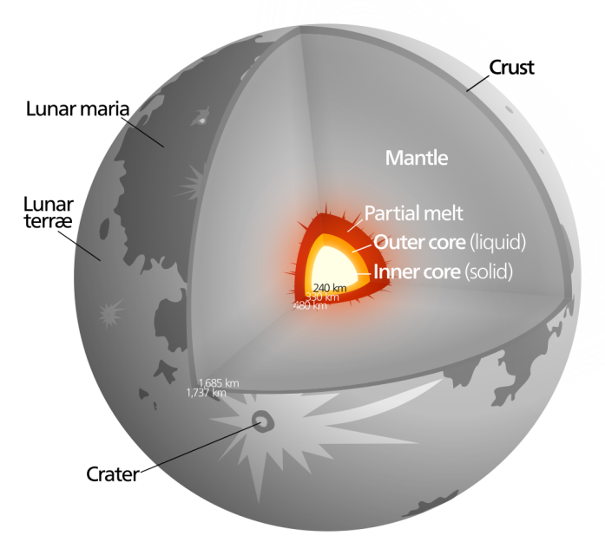
Physical Composition
Has a core, mantle and a crust (just like Earth!)
Core consists of solid, liquid, and partially-molten iron
Very thin atmosphere
Made of helium, argon, neon,
sodium, potassium, hydrogen,
and radon
https://en.wikipedia.org/wiki/Moon#/media/File:Moon_diagram.svg

Slide 6
Viewing the Moon
https://www.telescopesplus.com/blogs/helpful-information/18963396-how-filters-can-better-your-view
Apparent magnitude ranges from -2.5 to
-12.9 (full moon)
Second-brightest “regularly visible” celestial object in Earth’s sky (the Sun is the brightest)
Apparent size is about the same as the Sun’s
Can be viewed with or without telescope (<50x shows the whole moon, >150x lets you see details of terrain)
Best viewed through a telescope with neutral density filter (dims w/o coloring), well above the horizon
Can view during the day

Slide 7
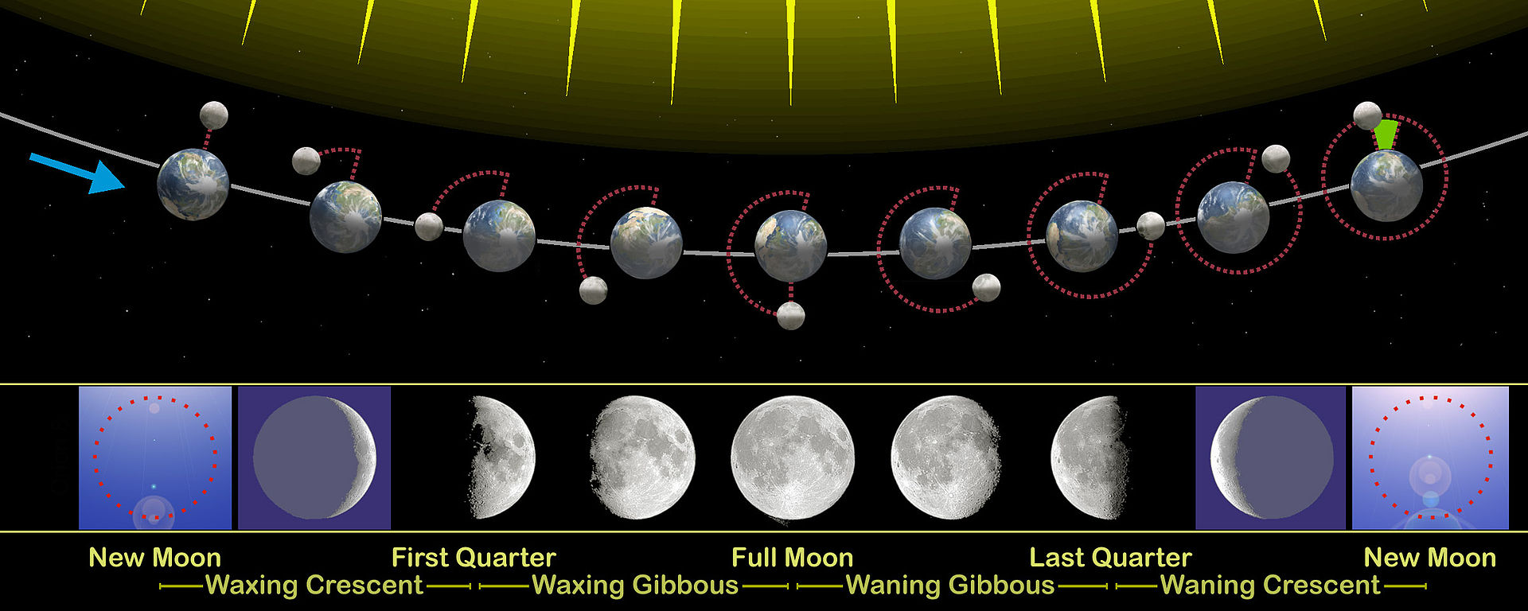
Lunar Phases
https://en.wikipedia.org/wiki/Moon#/media/File:Moon_phases_en.jpg

Slide 8
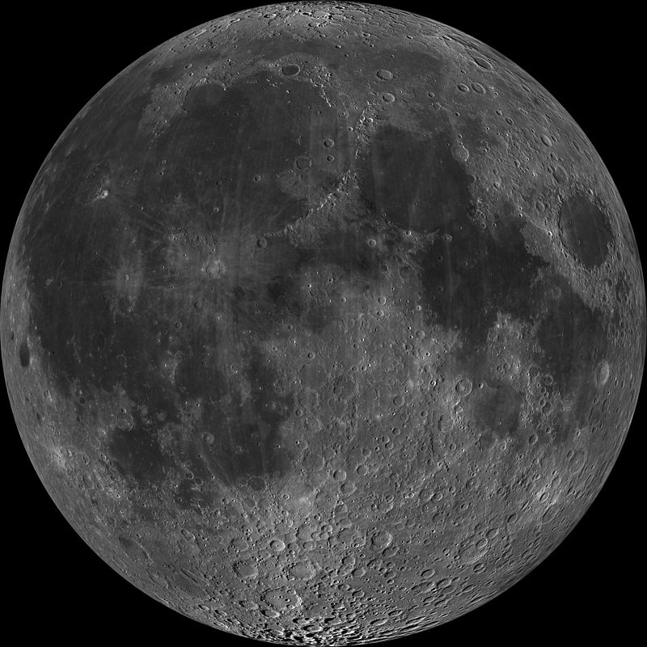
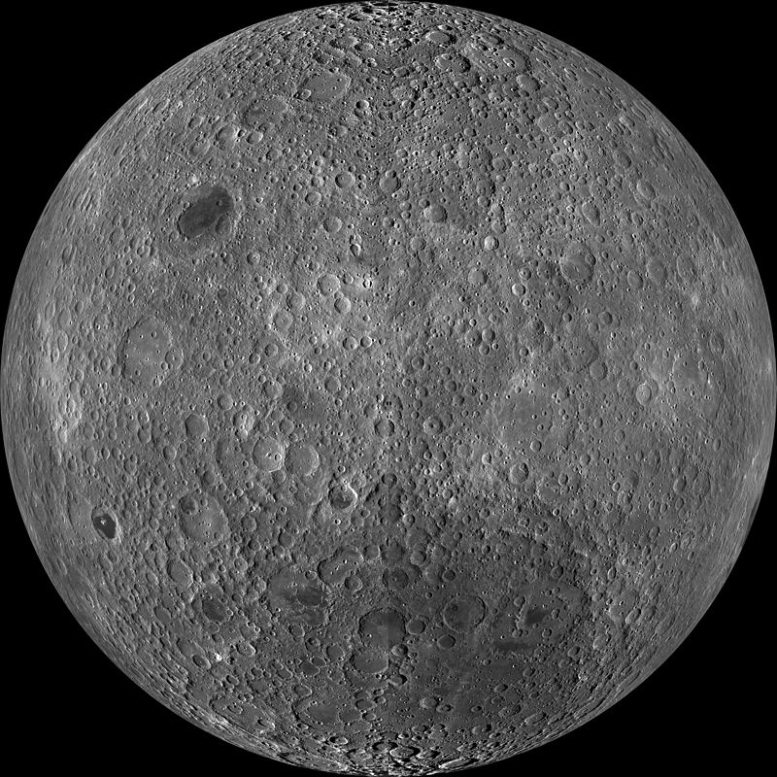
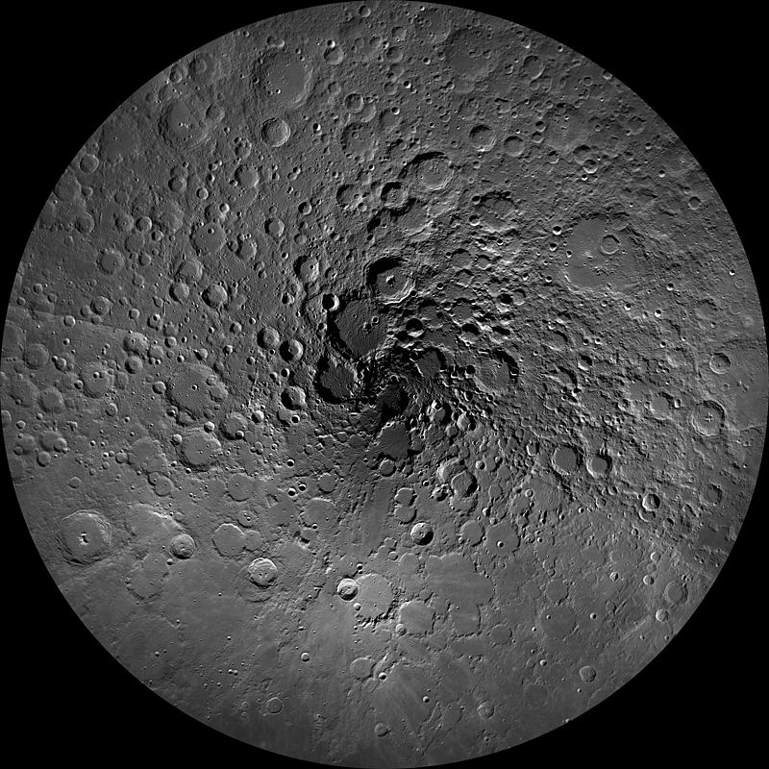
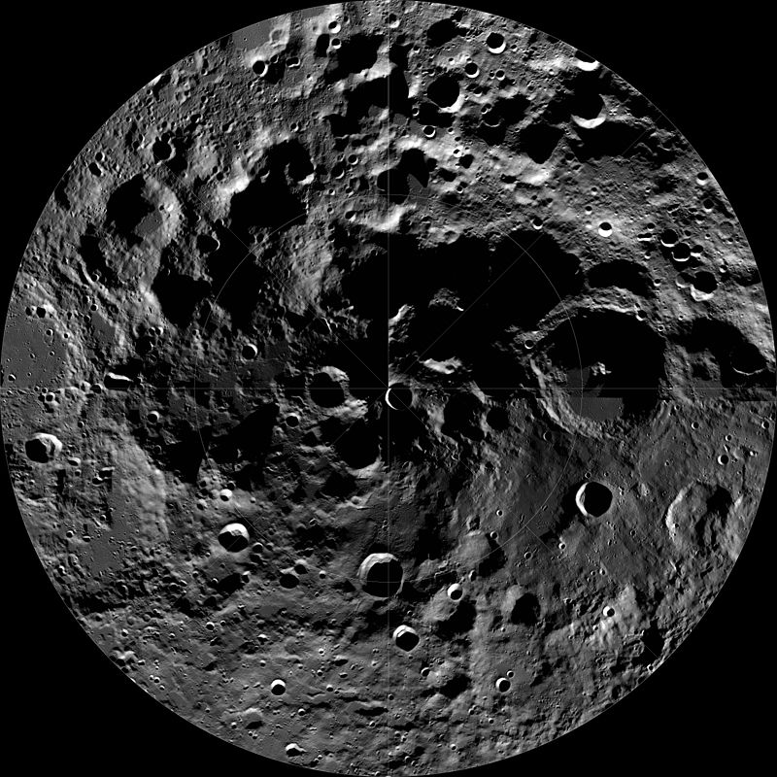
~All~ sides of the Moon
Near Side
Far Side
North Pole
South Pole
http://lroc.sese.asu.edu/posts/298
Notes:
Taken with LROC WAC (Lunar Reconnaissance Orbiter Camera) (Wide Angle Camera) – cameras on the Lunar Reconnaissance Orbiter that was launched in 2009
South pole looks that way bc of impact craters (the biggest one is the South Pole-Aitken basin)

Slide 9
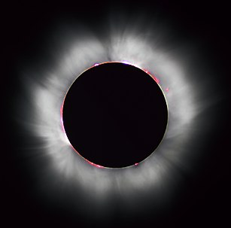
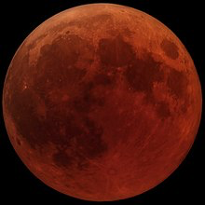
Eclipses
https://en.wikipedia.org/wiki/Solar_eclipse
https://en.wikipedia.org/wiki/Lunar_eclipse

Slide 10
Lunar Missions
100+ spacecraft have explored the Moon
Soviet’s Luna program
U.S.’s Apollo, Lunar Prospector, and GRAIL
24 people have visited the Moon (12 have actually walked on it)
Future exploration
Moon Express: private start-up trying to land on the Moon
SpaceX, Vodafone, Nokia and Audi are working to install a 4G wireless network to stream live footage of lunar surface
Notes:
GRAIL – Gravity Recovery and Interior Laboratory: program to map the gravitational fields of the Moon in order to determine its interior structure

Slide 11
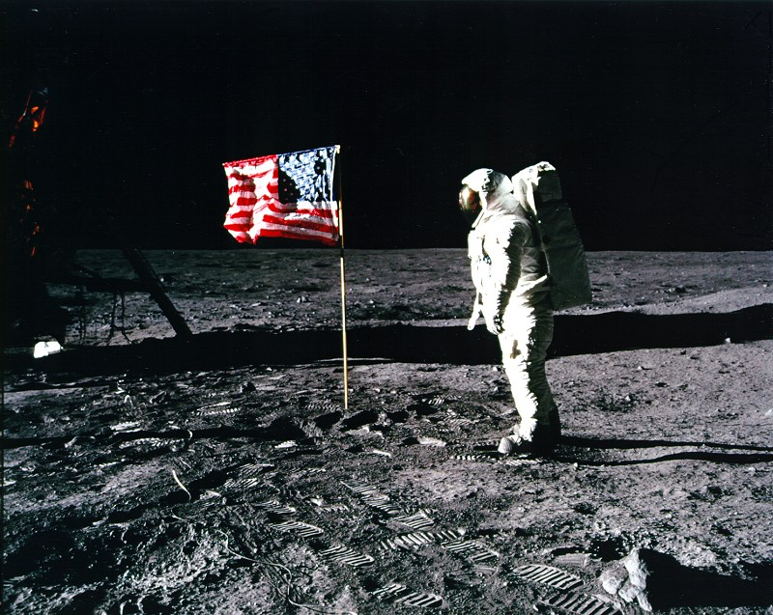
https://history.nasa.gov/ap11ann/kippsphotos/5875.jpg

Slide 12
Can we see lunar landing sites from Earth?
Yes!
Objects too
small to be seen
with Hubble
Lunar
Reconnaissance
Orbiter can!
Apollo 17 Lunar Module

Slide 13
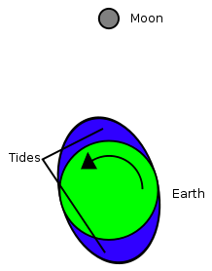
Fun Facts!
Moon currently rotates at same rate
that it revolves around Earth
(synchronous rotation)
We only see one side of the Moon!
Each year, the Moon moves an inch further away from the Earth
The gravitational forces of the Sun and the Moon create tides on Earth
High tides + Moon's gravity = tidal bulging
Earth's rotation causes torque on the Moon; Moon moves further away from Earth & days become longer
Earth used to rotate at faster rate (days are ~2 hours longer than they were 600 million years ago)
https://en.wikipedia.org/wiki/Tidal_acceleration

Slide 14
References
https://en.wikipedia.org/wiki/Moon
https://solarsystem.nasa.gov/moons/earths-moon/overview/
https://www.space.com/14296-moon-telescope-viewing-skywatching-tips.html
https://history.nasa.gov/ap11ann/kippsphotos/apollo.html
http://lroc.sese.asu.edu/about
https://astrobob.areavoices.com/2012/07/28/can-you-see-the-american-flag-on-the-moon-yes/
https://www.telescopesplus.com/blogs/helpful-information/18963396-how-filters-can-better-your-view
https://en.wikipedia.org/wiki/Lunar_south_pole
https://en.wikipedia.org/wiki/Tidal_acceleration
https://en.wikipedia.org/wiki/Tide

Slide 15
Thank you for your time!
Questions?

