Slide 1
Adaptive Optics
Jessica Cherry

Slide 2
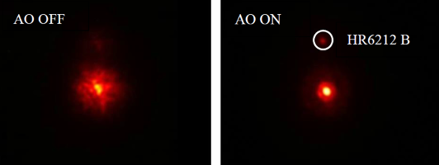
Viewing
Turbulence in the Earth's atmosphere limits the performance of ground-based astronomical telescopes
This is what can cause stars to twinkle or appear fuzzy

Slide 3
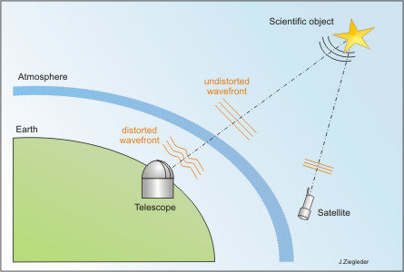
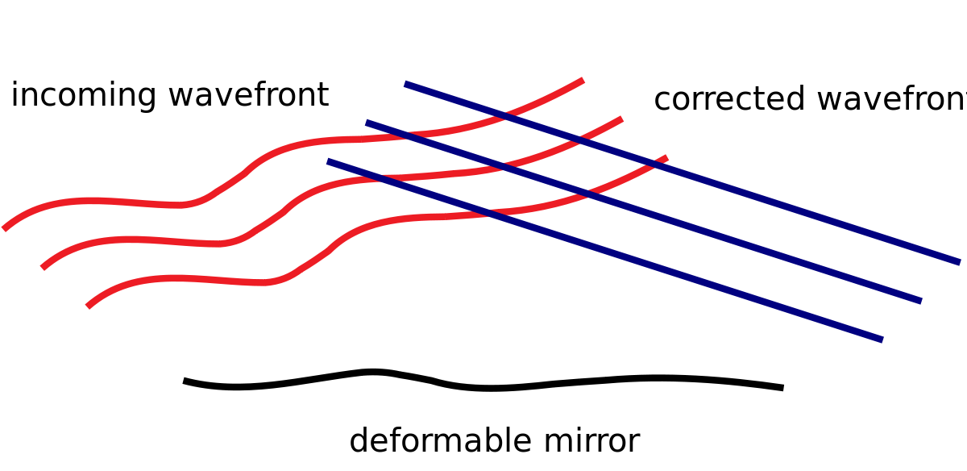
What is adaptive optics ?
It’s a system that allows for the mirrors of telescopes to be adjusted in real time
Helps with distortion caused by the earth's atmosphere
As light travels slightly faster in less dense warm air, the resultant refraction is non-uniform waves
Allows for the optical system to be corrected in order to observe finer objects than could be seen from on earth
The system is a feedback loop/ controlled loop so it constantly updating to get a better image
Corrected wavefront

Slide 4
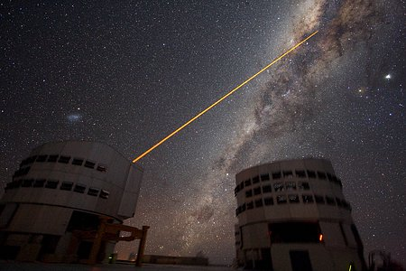
How it works?
Requires a bright refences star that is very close to the object you want to study
Reference star is used to help adjust with the blurring cause by the atmosphere
Used to help measure the distortion cause by turbulence through a “waveform sensor“
Once calculated by a computer, the deformable mirror is corrected/adjusted
now light from the guide star and the galaxy is reflected off the deformable mirror and the image is sharpened
Due to the remove of turbulence from the atmosphere

Slide 5
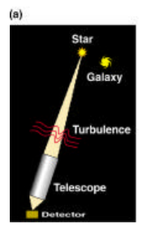
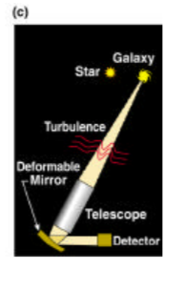
Diagram of how to adjust for turbulence (finding a guide star)

Slide 6
Full diagram of adaptive optics process

Slide 7
What to do if you have no guide star
Requirements
Laser guide stars
Relatively new technology
Used to have to wait/look for a bright close star to your object
The guide star must lie within about 30 seconds of arc of the astronomical target
For visible-light observations the "guide star" must be within about 10 seconds of arc.
The concept of "laser guide stars" was suggested in the early 1980's in both the military and astronomical communities
If no stars are present to be used a reference, a powerful laser can be used in earth upper atmosphere to help locate the object and adjust the deformable mirror.
these laser guide stars, almost the entire sky can now be observed with adaptive optics.

Slide 8
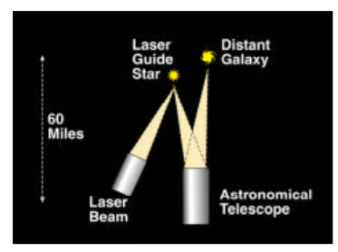
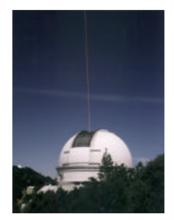
Laser guide stars (sodium)
A laser beam is mounted on the telescope and pointed at the object to be observed.
In this "sodium laser guide star" concept, the laser light is tuned to a yellow color that excites a layer of sodium atoms about 60 miles up in the atmosphere.
The sodium atoms glow in a small spot on the sky, making an "artificial star" that can be used to measure atmospheric turbulence.
This concept is currently implemented on the ALFA system at Calar Alto in Spain, and at the Lick Observatory in California

Slide 9
Laser guide stars (Rayleigh beacon)
Was successfully implemented on air force telescopes
uses a pulsed green laser focused at an altitude of about 15 km.
The green laser light scatters from molecules in the air, and the detector measuring the turbulence
This is done by observing the scattered laser light at just the time when a laser pulse has traveled up and back from the desired 15-km altitude.
Named after the type of scattering from air molecules
currently being implemented for astronomy at the Mt. Wilson 100-inch telescope by Laird Thompson (University of Illinois)

Slide 10
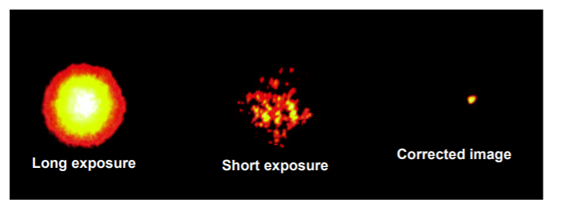
Why are these optics important?
It allows for correction of an object, so it appears to more like a point source instead of fuzzy or blurry

Slide 11
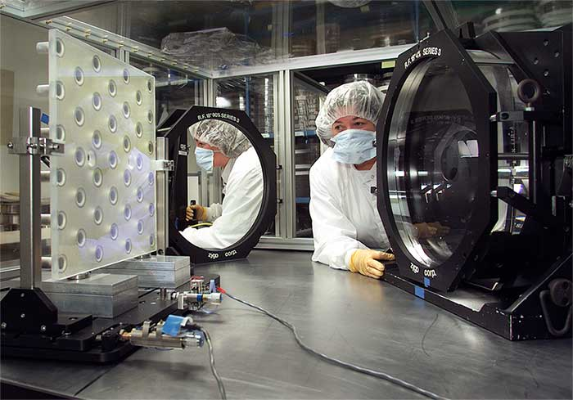
Deformable Mirror
Its an array of actuators to bend its surface to compensate for wavefront errors in the NIF laser beams.
Each mirror is located at the end of the main amplifier/ main mirror of the telescope
Adaptive optics are used in some telescopes to “straighten” the wavefronts of light, thereby improving the image resolution and contrast.
Based on the given inputs, the mirror can adjust 100-1000 corrections per second
real time adjustments

Slide 12
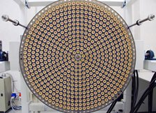
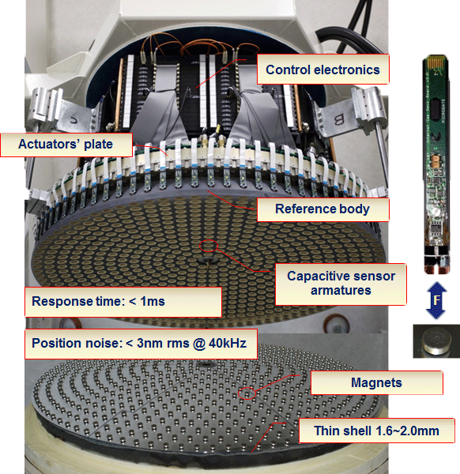
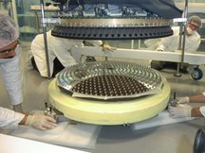
Deformable mirror

Slide 13
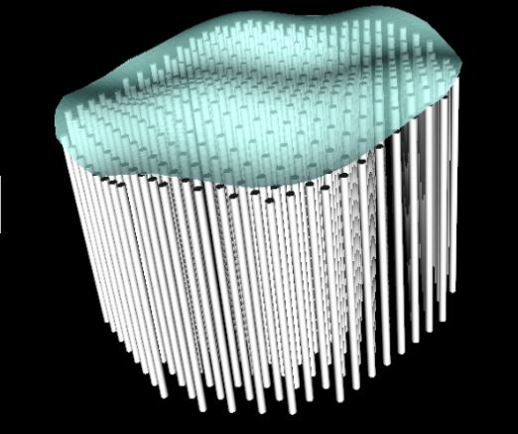

Slide 14
History
First proposed in 1953 by astronomer Horace Babcock
was not implemented due to limited technology
Late 1960's and early 1970's, the military and aerospace communities built the first significant adaptive optics systems
This development led to the air force system at Starfire Optical Range in Albuquerque NM
Also led to the Advanced Electro- Optical Facility on Maui in Hawaii
Luis Alvarez's research group at DOE's Lawrence Berkeley Laboratory performed one of the first astronomy experiments,
they built a simple deformable mirror that corrected only in one dimension but was a proof of concept that it could sharpen the image of a star
Early theoretical work on the capabilities and limitations of adaptive optics systems were done by Freeman Dyson, Francois Roddier and John Hardy
VLT Laser Guide Star Facility was the first of its kind in the southern hemisphere
The Paranal Observatory has the most advanced and the largest number of adaptive optics systems in operation today.

Slide 15
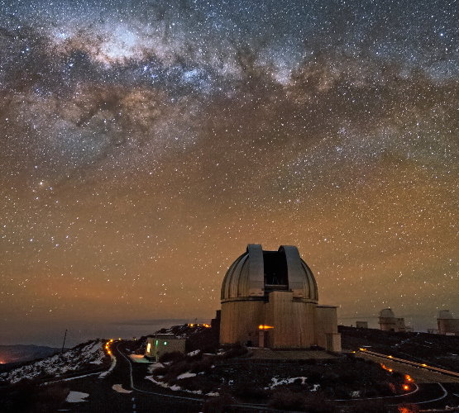
European Southern Observatory (ESO)
Established in 1989
The telescopes are located in Atacama Desert region of Chile: La Silla, Paranal and Chajnantor
The ESO Headquarters are located in Garching, Germany
Each year, about 2000 research proposals are made for the use of ESO telescopes, requesting between four and six times more nights than are available.

Slide 16
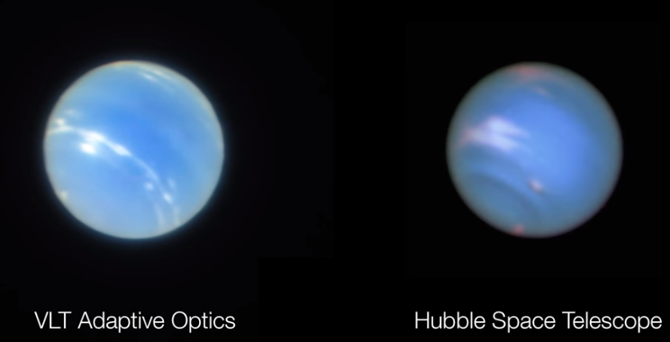
How does this technology compare?
Adaptive optics on the new generation of 8-10 m ground-based telescopes is complementary to the capabilities of the 2.4 m diameter Hubble Space Telescope.

Slide 17
Can amateurs make this?
Unfortunately, they cannot make the same real time adjustments that are needed for this type of optics.
Due to the lack or real time feedback found in adaptive optics
Possible use of a tip/tilt device however has been included in amateur telescopes and has been called adaptive optics
However the tip/tilt is simple a reposition of the telescope so that the object stays in the correct view.

Slide 18
References
http://adoptica.com/
https://en.wikipedia.org/wiki/Adaptive_optics
http://www.mpe.mpg.de/373204/Introduction
https://www.eso.org/public/usa/teles-instr/technology/adaptive_optics/
http://www.cfht.hawaii.edu/Instruments/Imaging/AOB/local_tutorial.html
https://www.edmundoptics.com/resources/application-notes/optics/introduction-to-adaptive-optics-and-deformable-mirrors/
http://hoffman.cm.utexas.edu/courses/History_AO_Max.pdf
https://www.eso.org/public/about-eso/esoglance/
http://www.microgate.it/Engineering/Adaptive-Deformable-Mirrors/Projects/MAG-585
https://scitechdaily.com/esos-vlt-captures-remarkably-sharp-test-images-of-neptune/
https://lasers.llnl.gov/about/how-nif-works/seven-wonders/deformable-mirror
https://www.youtube.com/watch?v=F6hmLcJOkzM
https://www.youtube.com/watch?v=r8f1750R0X0
https://astronomytechnologytoday.com/2017/07/04/10372/
https://www.alpao.com/adaptive-optics/alpao-applications.html
https://www.electronicspecifier.com/cms/images/Figure%203%20-%20A%20deformable%20this%20mirror%20spread%20over%208000%20actuators.jpg
https://ars.electronica.art/aeblog/en/2015/01/21/residency-bei-der-eso/
https://www.atnf.csiro.au/outreach/education/senior/astrophysics/adaptive_optics.html
http://www.ctio.noao.edu/~atokovin/tutorial/part2/dm.html
http://hoffman.cm.utexas.edu/courses/History_AO_Max.pdf
Questions?

