Slide 1
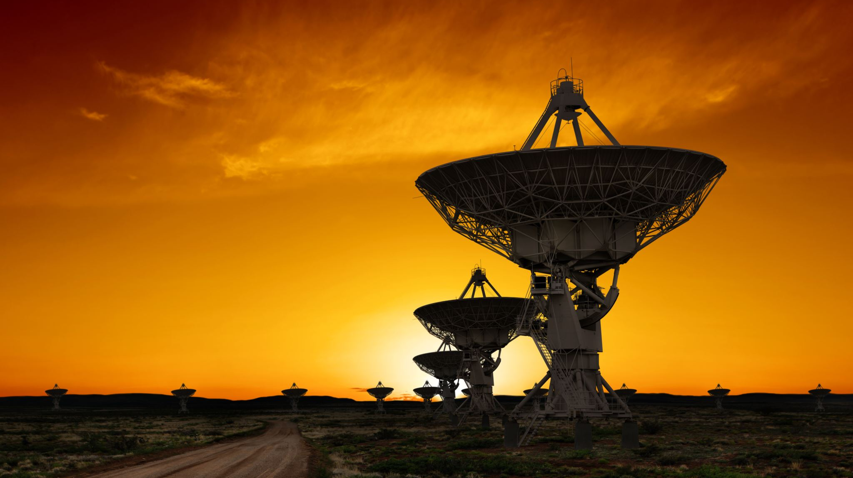
Radio Astronomy and Telescope Arrays
Steven Ledbetter
November 19, 2019

Slide 2
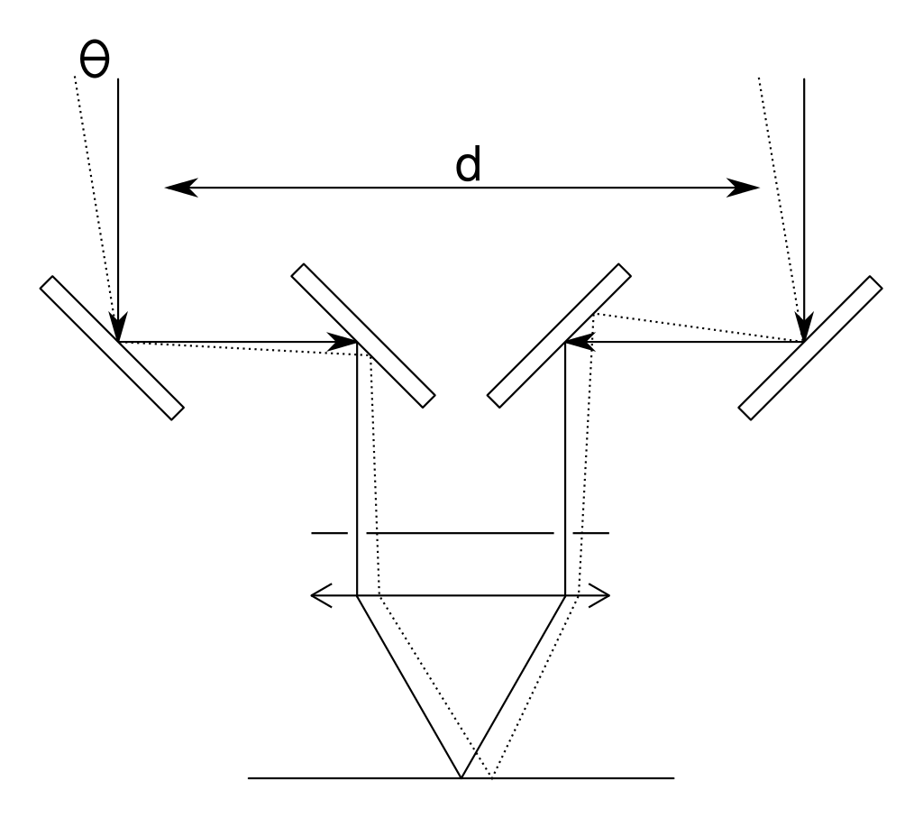
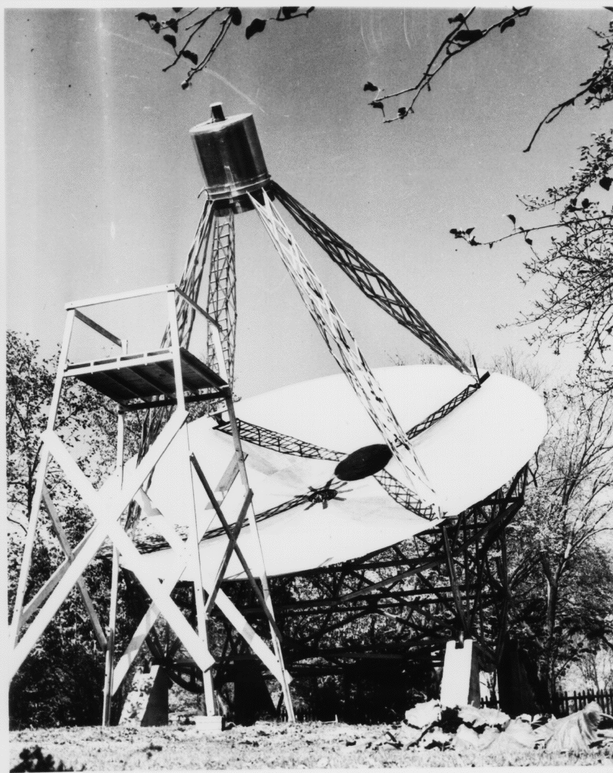
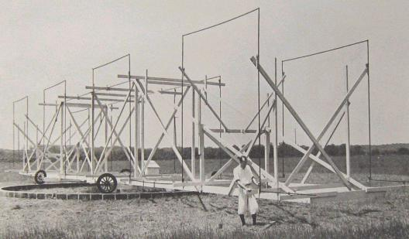
History of Radio Astronomy and Array Telescopes
1920: Early optical interferometer used to measure star diameters
1932: First radio antenna was built by Karl Jansky to discover source of static in transatlantic transmissions
Found a steady radio source from the center of the galaxy
1937: Grote Reber built a 10 meter telescope in his backyard and conducted the first radio survey of the sky

Slide 3
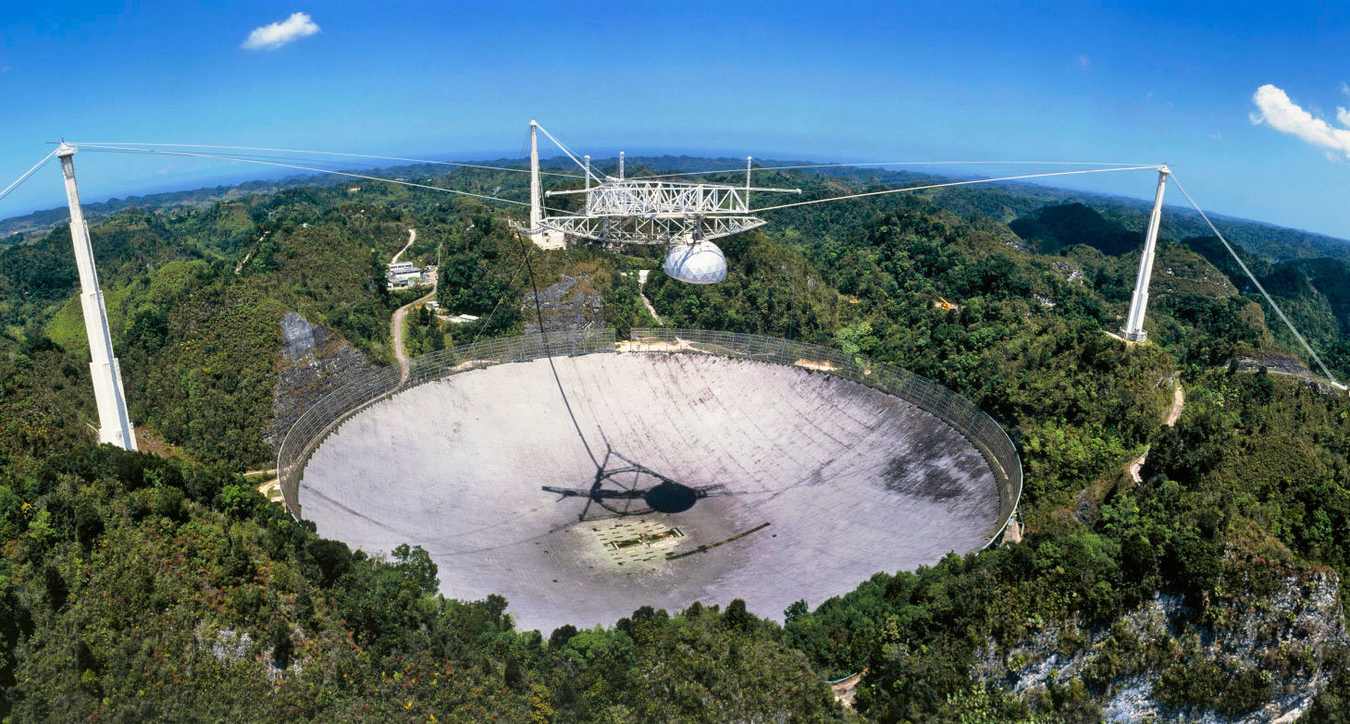
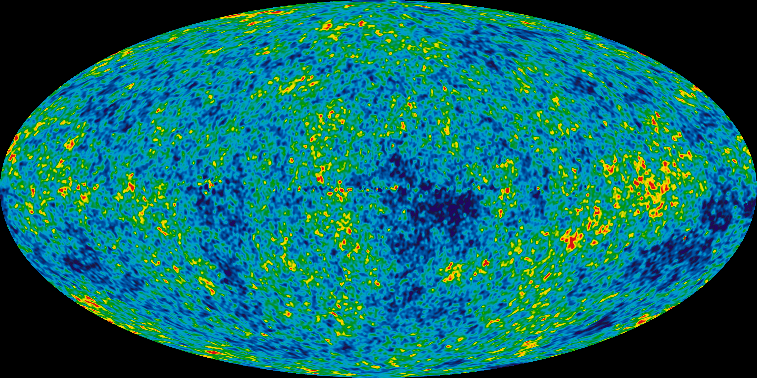
History
Post-WWII radar technology led to the exploration of higher frequencies and shorter wavelengths, first radio arrays are built
1963: Arecibo Observatory in Puerto Rico is completed, it remains the largest single-aperture telescope in the world (305 meter diameter) until 2016
1965: Cosmic Microwave Background discovered by Penzias and Wilson validating the Big Bang
1970s: Very Large Array is built

Slide 4
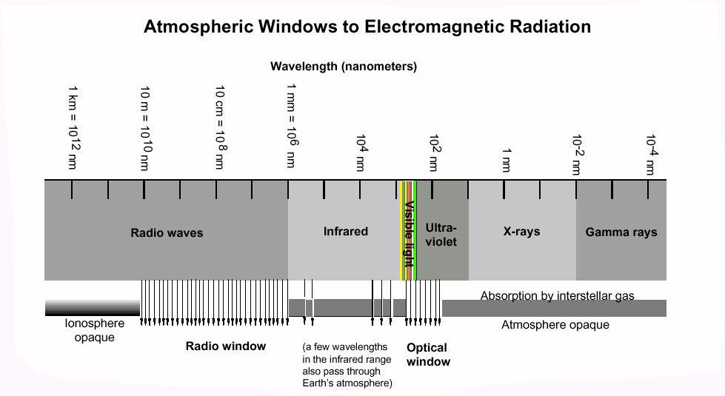
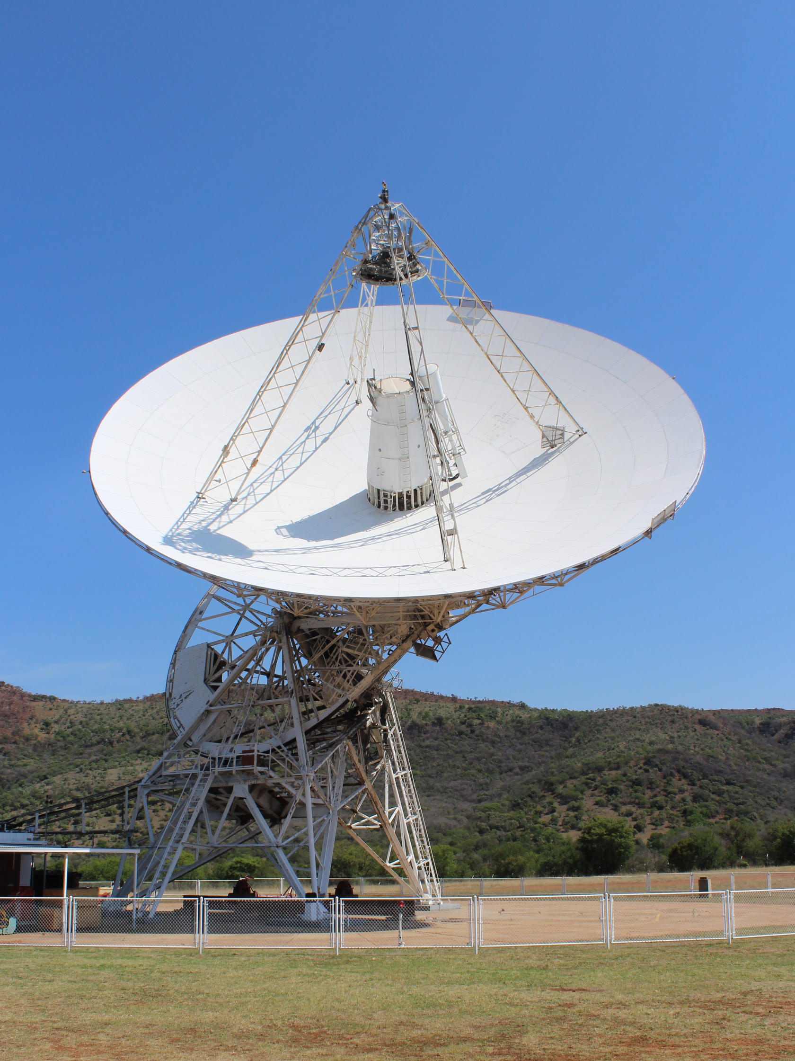
Radio Astronomy
Radio waves have wavelengths of 1 mm to 100 km+ or a frequency of 30 Hz to 300 MHz+
Examples of frequencies emitted:
Pulsars: 440-660 MHz
Atomic hydrogen: 1420 MHz
Methanol and water: 6-12 GHz
Ammonia in star-forming regions: 23 GHz
Radio telescopes require much larger collecting areas to achieve comparative resolution with optical telescopes
Longer wavelengths have lower resolutions -> need larger dishes/arrays
25 meter dish is typical

Slide 5
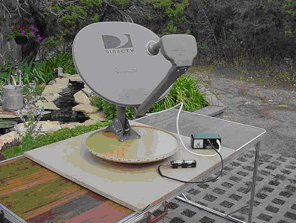
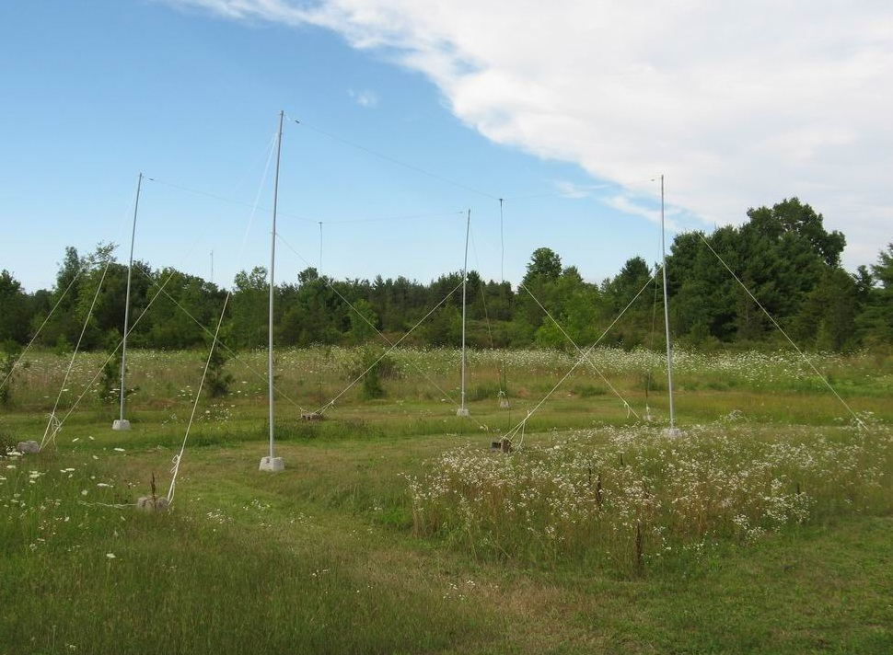
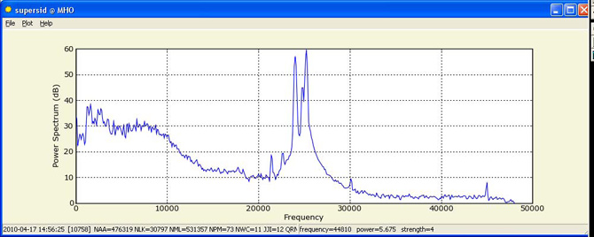
Amateur Radio Astronomy
Due to size constraints, amateur dishes are typically restricted to viewing within the solar system
The Itty Bitty Telescope (IBT) design repurposes a TV dish to track satellites
A Radio Jove setup uses dipole antennae to measure Jupiter's ionosphere

Slide 6
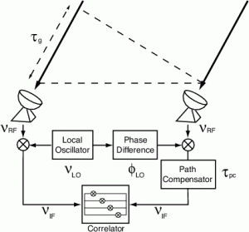
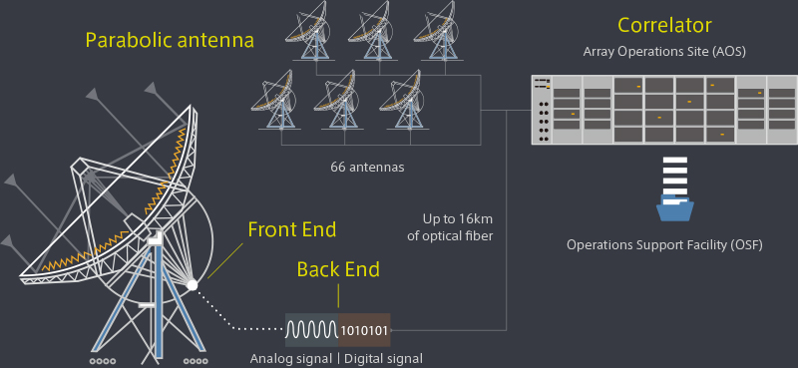
Interferometry
Interferometry observes interference patterns in signals from multiple apertures
Signals are slightly out of sync due to distances between elements and must be corrected
Where θ is the range of angular sizes that the array can distinguish, λ is the wavelength of the light, and B the separation between a pair of elements in the array (baseline): λ/B_{max} < θ < λ/B_{min}
Traditional telescope: λ/D < θ < AFOV/M
Total amount of light is equal to combined area of collectors

Slide 7
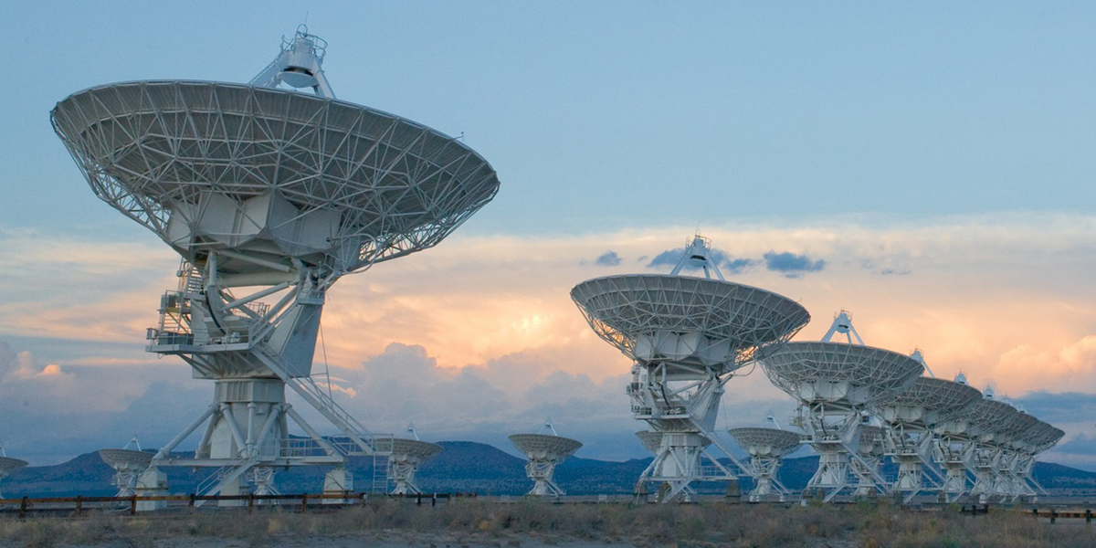
Very Large Array
Built between 1973-80
27 active elements
Resolution of 0.2 to 0.04 arcseconds
Frequency of 1 GHz to 50 GHz

Slide 8
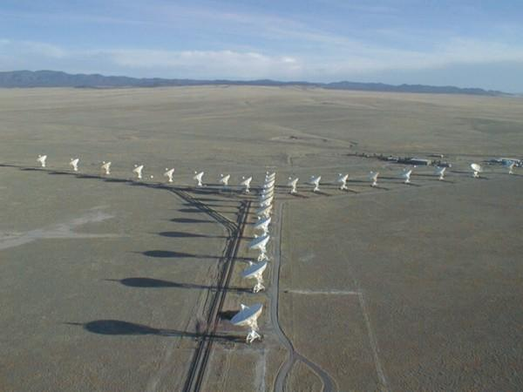
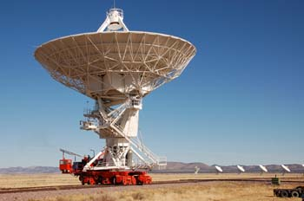
Very Large Array
Most widely used radio telescope in the world
11000+ observing projects
Discovered ice on Mercury, Einstein rings around stars, gamma ray bursts, etc
Located in New Mexico desert to avoid humidity
Array elements arranged in a Y shape, arms can expand or contract from 1 km long to 37 km long via rails
Technology was upgraded in 2011

Slide 9
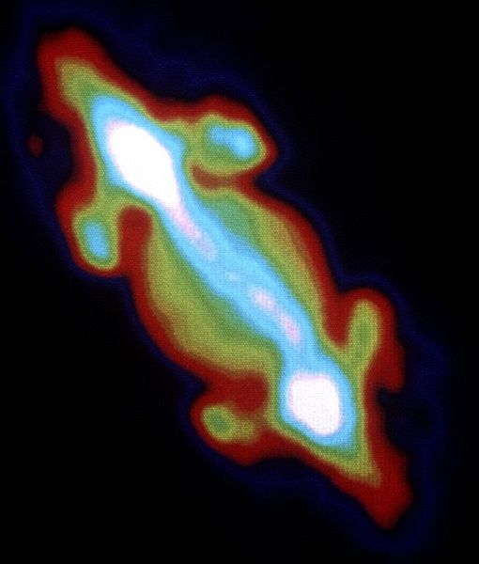
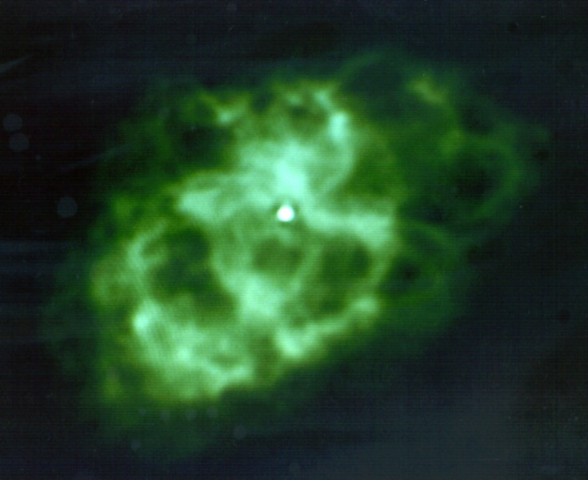
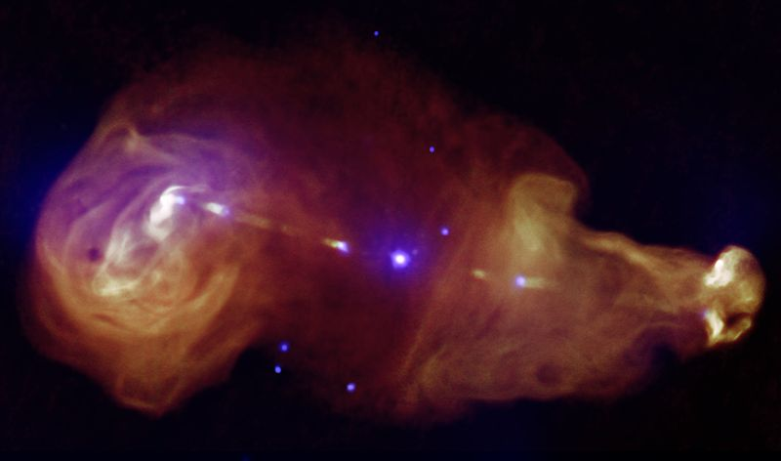
Radiation belts around Jupiter
Pulsar in the Crab Nebula
Plumes of radiation around galaxy 3C353 (4 arcseconds wide, 2 arcminutes long)
VLA Images

Slide 10
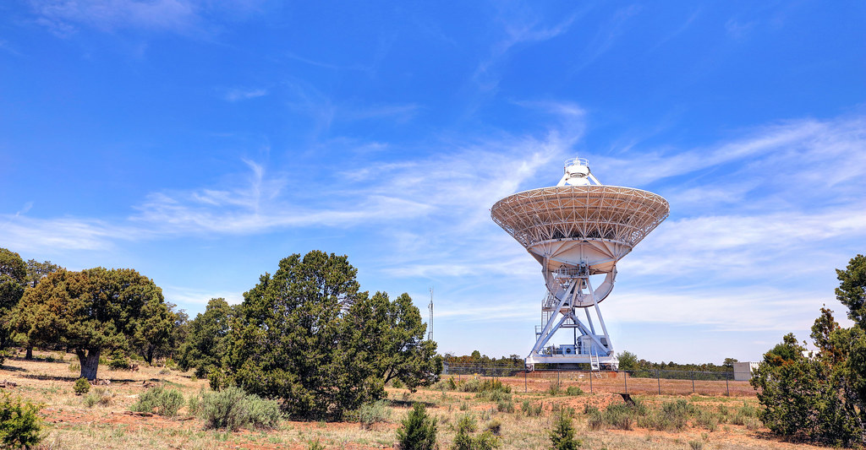
Very Long Baseline Array
Built between 1986-93
10 elements
Resolution of 0.2 to 22 milliarcseconds
Frequency of 3 MHz to 96 GHz

Slide 11
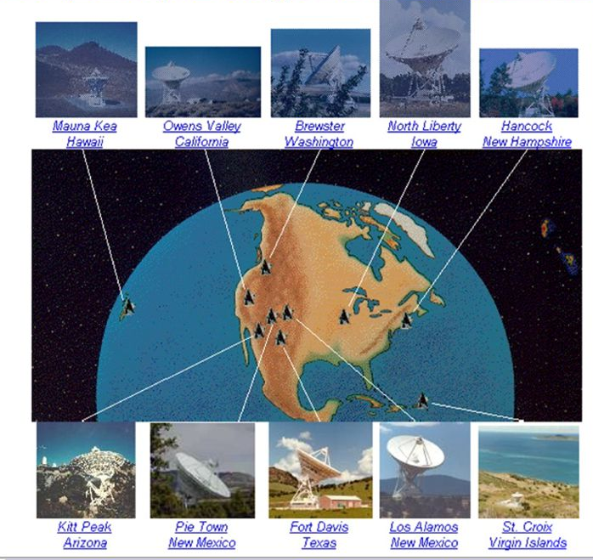
Very Long Baseline Array
Consists of ten identical elements that span 8600 km from Hawaii to the Virgin Islands
Central control is in Socorro, New Mexico (only 80 km from VLA)
Very long baseline interferometry allows for farther objects to be seen and can also be used for geodesy
The VLBA can be combined with other arrays like the VLA for greater resolution
VLBA, VLA, Arecibo Telescope, Green Bank Telescope in WV, and the Effelsberg Radio Telescope in Germany all coordinate for 100 hours every 4 months to form the High Sensitivity Array
Half of the time on the VLBA is reserved by the US Naval Observatory

Slide 12
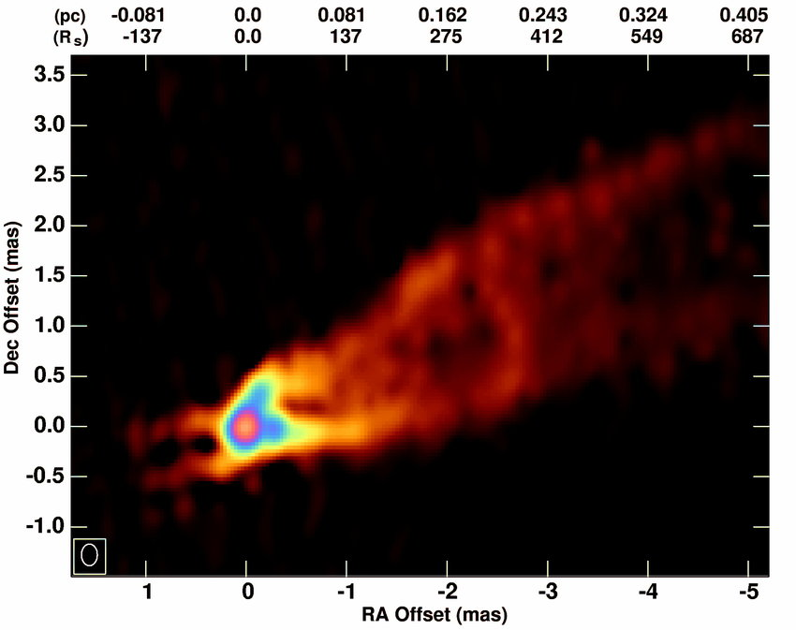
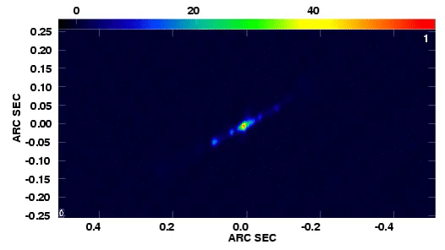
Exploring X-ray jets from binary star SS433
Radiation jet (43 GHz) from black hole in M87
VLBA Images

Slide 13
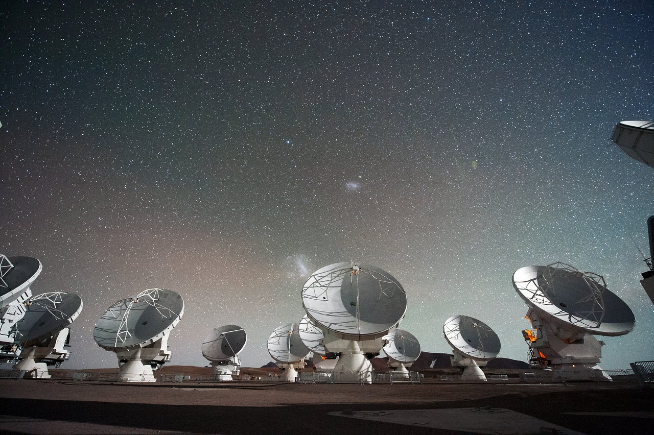
Atacama Large Millimeter/submillimeter Array
Built between 2004-13
66 active elements
Resolution of 0.2 to 0.004 arcseconds
Frequency of 31 GHz to 950 GHz

Slide 14
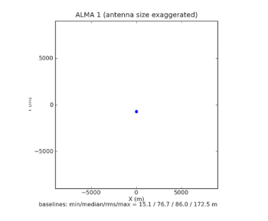
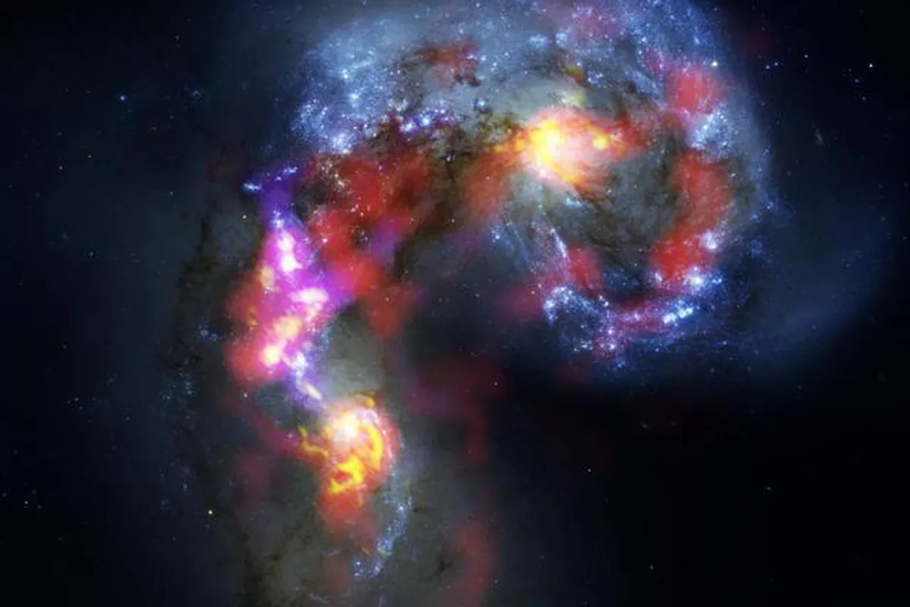
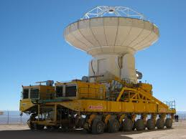
Atacama Large Millimeter/submillimeter Array
Collaboration between the space agencies of Europe, the US, Canada, Japan, Taiwan, South Korea, and Chile
Located in the Atacama Desert in Chile (5000 m elevation) to avoid humidity
Maximum baseline in the array can vary from 150 m to 16 km
Used to explore very cold and dark objects such as comets and protoplanetary disks

Slide 15
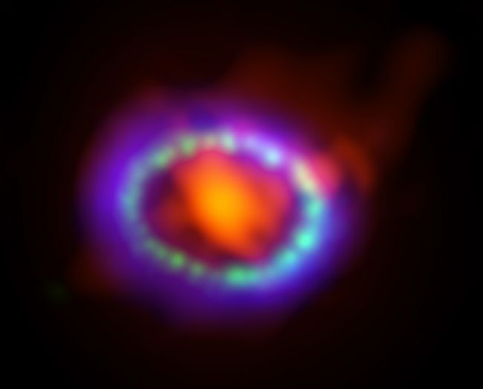
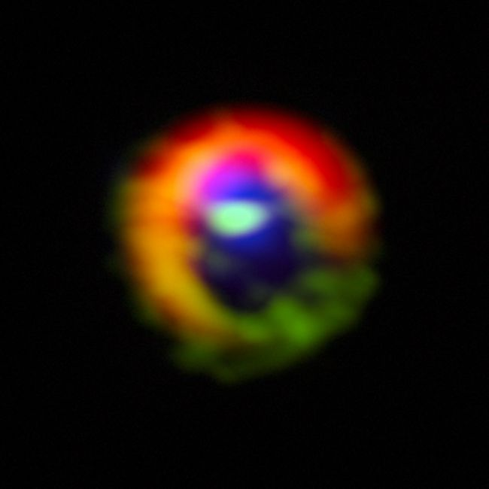
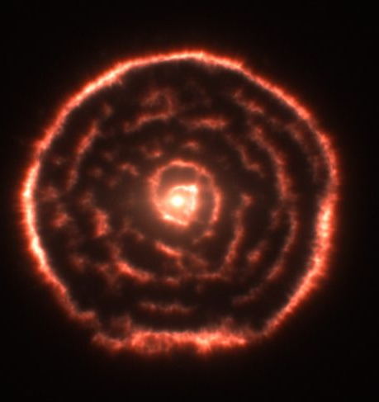
Remnant of supernova 1987A, ALMA data (in red) shows dust cloud, shockwave shown in blue
Gas and dust ring around new star HD 142527
Spiral dust clouds around red giant star R Sculptoris
ALMA Images

Slide 16
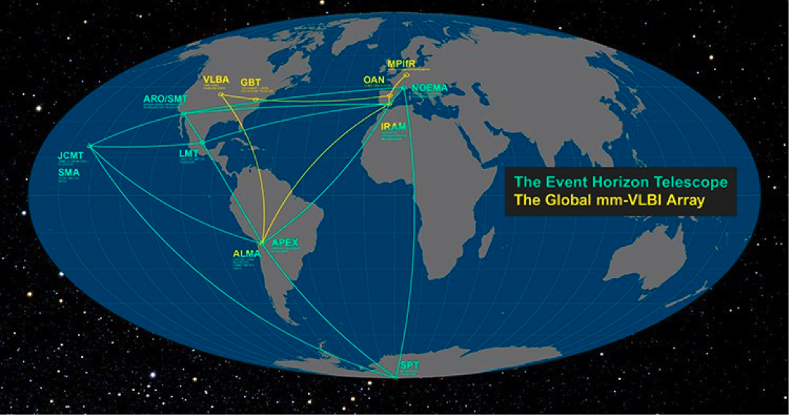
Black Hole Photo
Supermassive black hole is 55 million light years away in M87 (an elliptical galaxy)
8 telescopes/telescope arrays from around the world, including ALMA, contributed to the Event Horizon Telescope
The EHT observed a frequency of 230 GHz with an angular resolution of 35 micro arcseconds using very long baseline interferometry with a high recording rate (64 Gb/s vs 2 Gb/s)

Slide 17
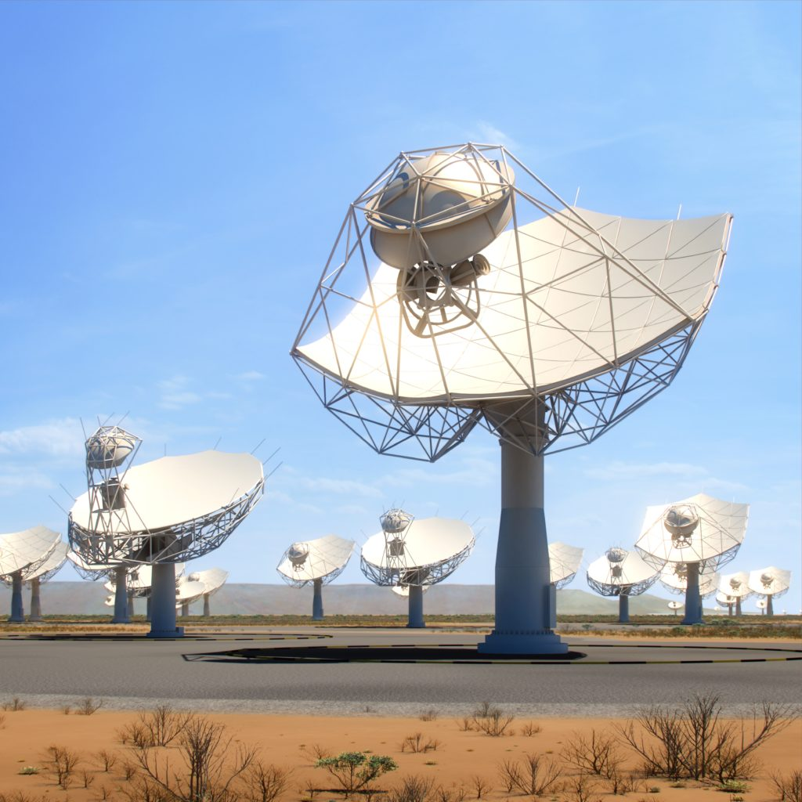
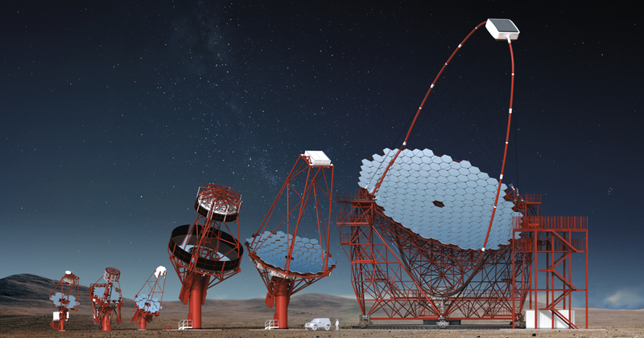
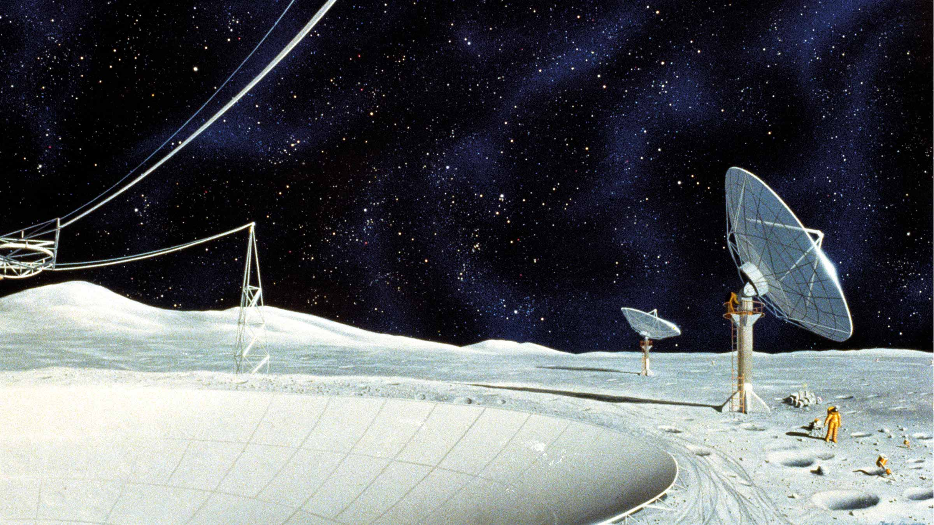
Future Arrays
Square Kilometer Array
Located in South Africa and Western Australia
Will have a combined collecting area of one square kilometer
13 member countries and dozens of organizations involved
Expected to begin construction in 2020
Cherenkov Telescope Array
Located in Spain and Chile
Focused on observing high energy events such as gamma ray bursts
Expected to begin construction in 2020
Lunar Radio Array
No plans in the short-term
Earth's ionosphere heavily disperses the 50 MHz range, a lunar array would bypass this

Slide 18
References
https://ethw.org/Radio_Telescope
https://www.skatelescope.org/radio-astronomy/
https://www.ncbi.nlm.nih.gov/pmc/articles/PMC1084808/?
https://www.universetoday.com/110705/adventures-in-radio-amateur-astronomy/
https://archive.briankoberlein.com/2015/10/14/how-does-interferometry-work/index.html
https://www.atnf.csiro.au/outreach/education/pulseatparkes/radiotelescopeintro.html
https://www.eso.org/public/about-eso/faq/faq-vlt-paranal/
https://science.nrao.edu/facilities/alma/naasc-workshops/nrao-cd-fit/BasicsInterf.pdf
https://science.nrao.edu/facilities/vlba/introduction-to-the-VLBA
https://www.eso.org/public/usa/teles-instr/alma/
https://public.nrao.edu/telescopes/vla/
https://www.almaobservatory.org
https://public.nrao.edu/telescopes/alma/
https://www.nasa.gov/mission_pages/chandra/news/black-hole-image-makes-history

Slide 19
References
https://eventhorizontelescope.org/
https://www.skatelescope.org
https://www.cta-observatory.org/about/
https://www.sciencemag.org/news/2019/07/could-humanity-s-return-moon-spark-new-age-lunar-telescopes
https://www.naic.edu/ao/
https://science.nrao.edu/facilities/vlba
https://www.researchgate.net/figure/M87-43-GHz-radio-image-of-the-inner-region-including-dominant-and-counterpropagating_fig2_323594901
https://www.space.com/19098-alma-telescope-array-photos.html
http://www.radio-astronomy.org/node/248

