Slide 1
Astrology

Slide 2
Astrology
An attempt to make sense of the world in which we live
Maybe the first attempt at science?

Slide 3
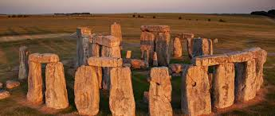
Ancient “astrological temples”

Slide 4
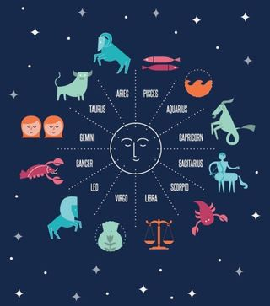
Zodiac
When are the “water signs”?
Constellations within the ecliptic
Sun, Moon and Planets were “stars”
That moved through the other stars

