Slide 1
Dark Nebula
Joseph Gregory

Slide 2
Dark nebula
A type of interstellar cloud that is too dense for light to pass through
Mostly comprised of tiny dust particles coated in frozen carbon monoxide and nitrogen
Irregular form, no defined boundaries
Most notable is the Coalsack Nebula
Very easily seen against bright Milky Way
Serves as a precursor to “stellar nurseries”
Earliest stage of star’s development occurs here
Protostars begin to coalesce from dust

Slide 3
Protostars
Formation begins in densest region of dark nebula
Process lasts about 1 million years for a star of one solar mass (the mass of our sun)
Begins when the dust in a molecular cloud first collapses under its own gravity
A disk of dense gas forms around the new protostar
Energy initially comes not from nuclear fusion, but radiation caused by shocked gas impacting the protostar’s surface
Ends when the protostar has enough energy to blow back the gas trying to fall in

Slide 4
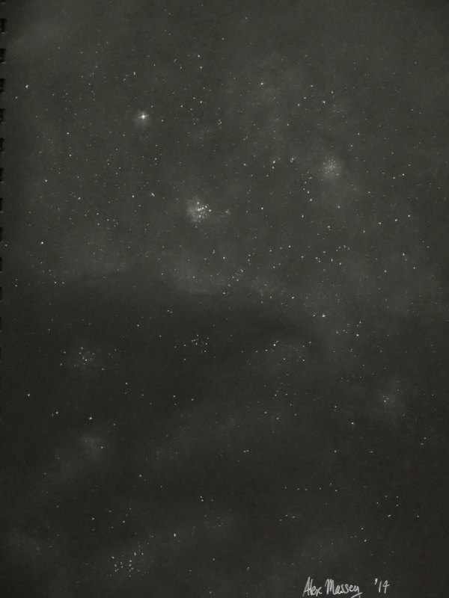
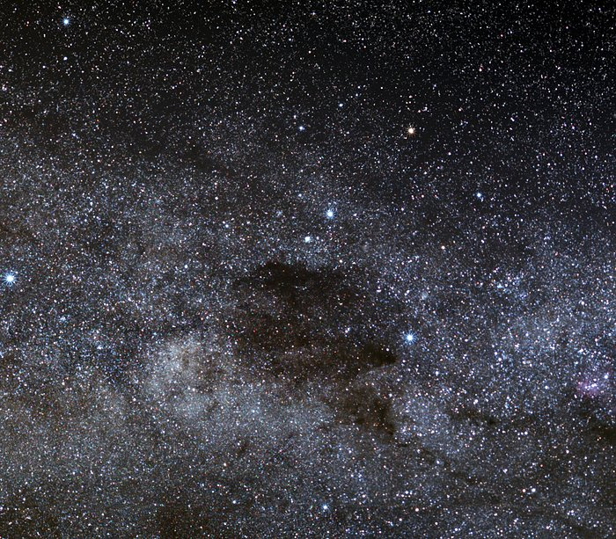
The Coalsack nebula
ESO/S. Brunier
Hand Sketch

Slide 5
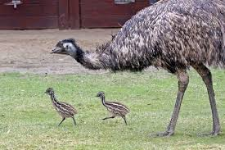
The Coalsack nebula
Located in the Southern Cross
Located about 610 light-years from Earth
Is about 50 light years in across
Angular size of 400x300 arc-minutes
Dims starlight behind by an apparent magnitude of 1 to 1.5
Can easily be seen with the naked eye
If using telescope best at low magnification
Commonly appears in aborigine folklore as an emu
Coalsack is head of emu
By en:User:Rayd8 - en-wp, CC BY 2.5, https://commons.wikimedia.org/w/index.php?curid=5444580

Slide 6
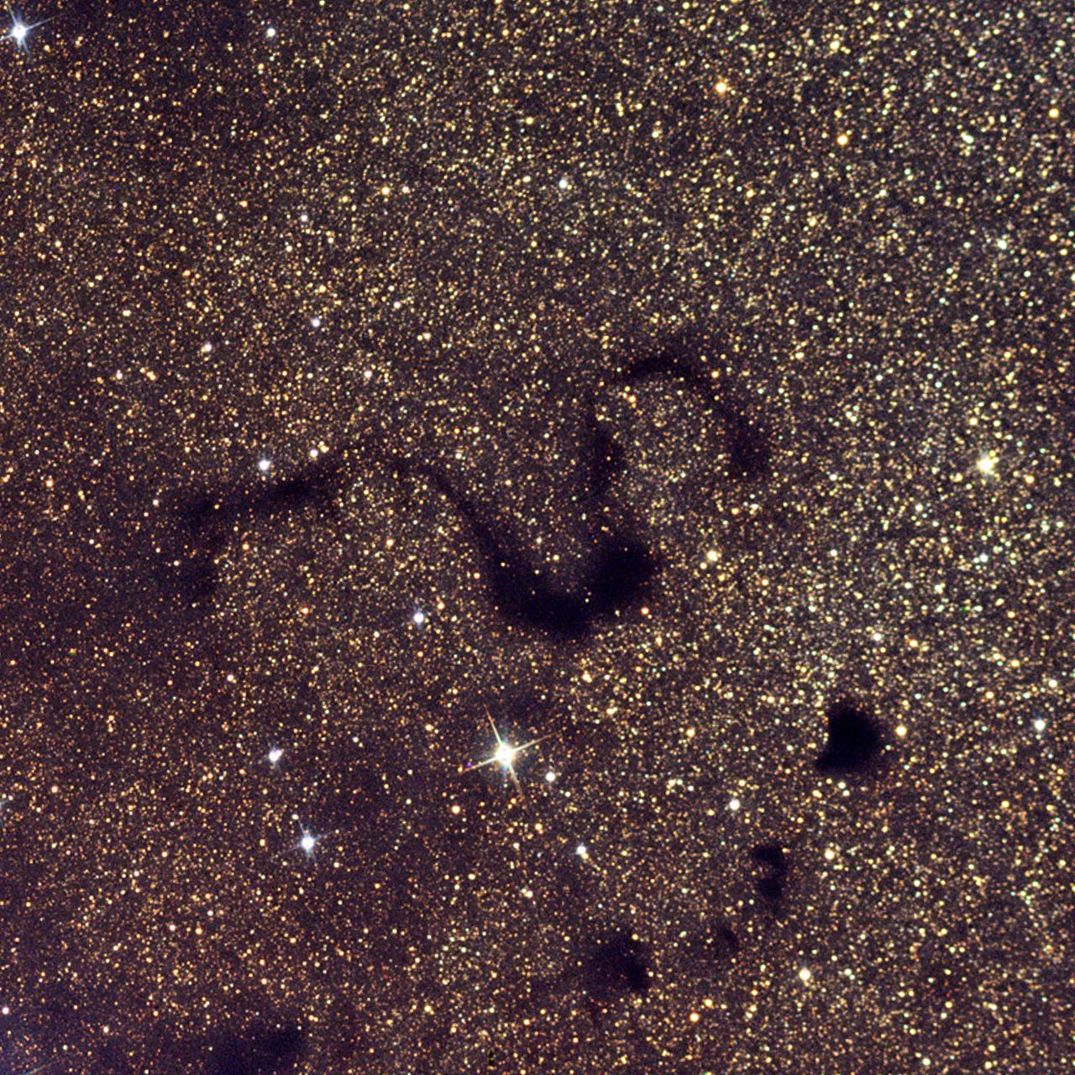
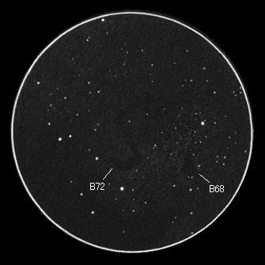
B72 “snake” nebula
By en:user:Friendlystar - English Wikipedia, CC BY 3.0, https://commons.wikimedia.org/w/index.php?curid=4986855
Hand Sketch

Slide 7
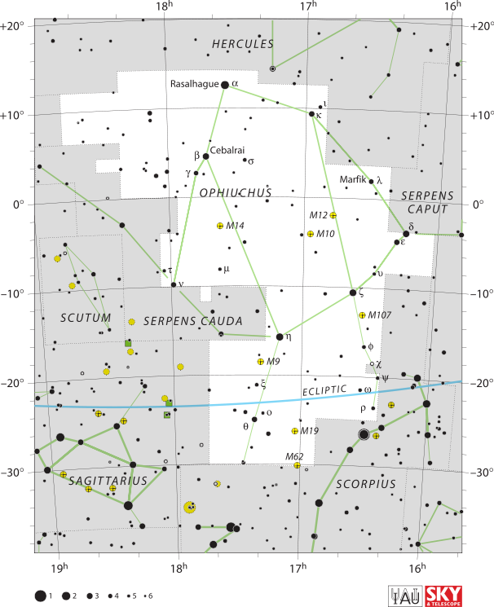
B72 “snake” nebula
Located in Ophiuchus constellation (pictured right) →
Located about 650 light-years from Earth
Is about 5 light-years across
Angular size of about 37x17 arc-minutes
Recognizable by distinctive snakelike “S” shape
Requires clear dark skies to be seen
Can be seen well with medium sized telescopes (4”-6”)
By IAU and Sky & Telescope magazine (Roger Sinnott & Rick Fienberg) - [1], CC BY 3.0, https://commons.wikimedia.org/w/index.php?curid=15407822

Slide 8
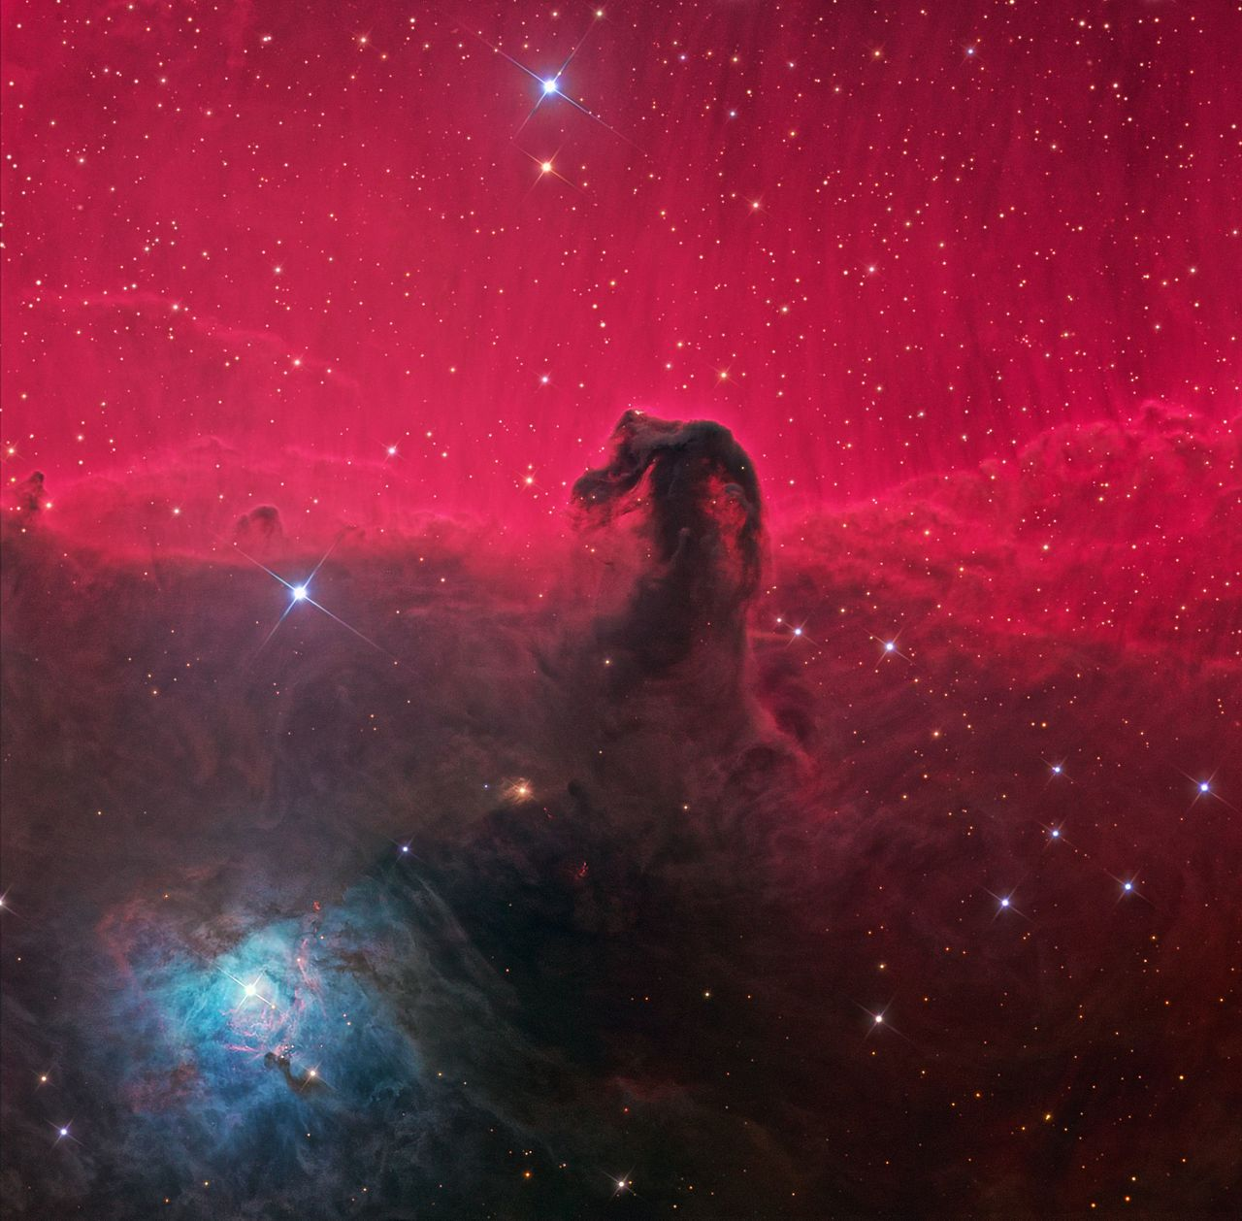
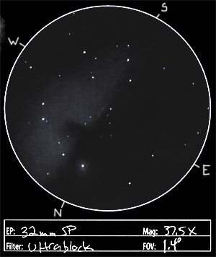
Horsehead Nebula
By Ken Crawford, CC BY-SA 3.0, https://commons.wikimedia.org/w/index.php?curid=31584618
Hand sketch

Slide 9
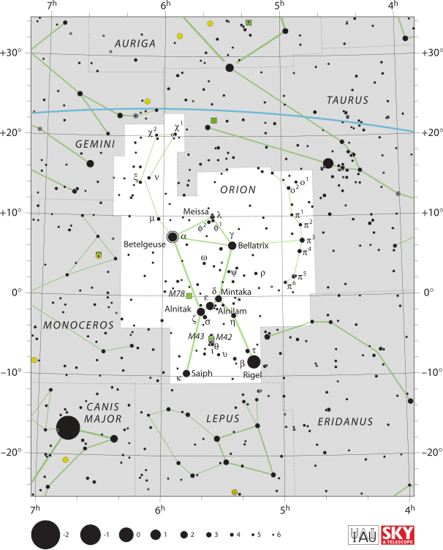
B33 “HorseHead” Nebula
Located South of Alnitak in Orion’s Belt →
Located about 1,500 light-years from Earth
is about 7 light-years in diameter
Angular size of about 8x6 arc-minutes
Distinctive horsehead shape
eyecatching because it is juxtaposed against other bright nebulae
Bright spots in the base are young stars forming in its “stellar nursery”
Best seen in clear dark skies
Can be seen well through a 10” telescope
By IAU and Sky & Telescope magazine (Roger Sinnott & Rick Fienberg) - [1], CC BY 3.0, https://commons.wikimedia.org/w/index.php?curid=15407823

Slide 10
references
https://www.eso.org/public/images/potw1612a/
https://en.wikipedia.org/wiki/Dark_nebula
https://en.wikipedia.org/wiki/Protostar#Protostellar_evolution
https://en.wikipedia.org/wiki/Snake_Nebula
https://en.wikipedia.org/wiki/Horsehead_Nebula
https://www.britannica.com/science/star-astronomy/Star-formation-and-evolution#ref52848
https://www.britannica.com/place/Coalsack
https://freestarcharts.com/orion

Slide 11
QuestionS?

