Slide 1
Dwarf Planets, Asteroids, & The Asteroid Belt
Colin Tanner

Slide 2
What is a Dwarf Planet?
Definition: “A celestial body orbiting a star that is massive enough to be rounded by its own gravity but has not cleared its neighboring region of planetesimals and is not a satellite.” – International Astronomical Union
A dwarf planet must have sufficient mass to over its compressive strength.
A dwarf planet must have achieved hydrostatic equilibrium
Planet vs Dwarf Planet: A planet has cleared the neighborhood around its orbit, where as a dwarf planet has not.

Slide 3
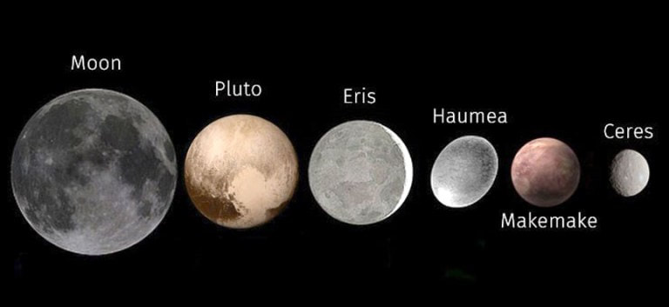
Dwarf planets within our solar system
Figure 1: Dwarf Planets compared to the Moon

Slide 4
The Kuiper Belt
A region of icy bodies beyond Neptune's orbit.
Extends from about 30 -1000 AU.
Contains all known dwarf planets, except Ceres.
Figure 2: Diagram of the Kuiper Belt

Slide 5
Pluto
Discovered February 18, 1930. – Clyde W. Tombaugh.
Wobbles in the orbits of Uranus and Neptune led to its theorized existence.
Charon is the only moon which orbits Pluto. -Discovered June 22, 1978 by James Christy
Classified as a “Dwarf Planet” in 2006 when the International Astronomical Union, because Pluto has not “cleared its orbit.”
Pluto was named for the Roman god of death.
Viewing: Pluto is not visible to the naked eye and requires a telescope with a mirror at least 8 in. in diameter.
Will be visible moving in front of the constellation Sagittarius from June 2019 to December 2020.
Figure 3: Pluto and Charon seen from New Horizons spacecraft (2015)

Slide 6
Pluto
DIA: 1,430 miles.
Located within the Kuiper Belt.
Distance from Sun varies between 29.7 – 39.5 AU due to its elliptical orbit.
Orbital Period: 247.9 Years.
Rotational Period: 6.39 Days.
Composition: Consists of a rocky core, and ice mantle, with frozen methane and nitrogen on the surface.
Charon’s DIA: 753.1 miles.
Figure 4: Pluto seen from New Horizons spacecraft (2015)

Slide 7
Eris
Discovered: January 5, 2005 by Michael E. Brown.
DIA: 1,445 miles
Orbital Period: 561.4 years
Rotational Period: 25.9 hours
Distance from Sun: 96.4 AU
Composition: Consists of a rocky core, with a thin layer of nitrogen-rich ice and frozen methane on the surface.
Moon: Dysnomia
Figure 5: Eris and Dysnomia seen from Hubble space telescope (2006)

Slide 8
Haumea
Discovered March 7, 2003 by Michael E. Brown
Surface: Rock and Ice
DIA: 892.3 miles
Orbital Period: 281.9 years
Rotational Period: 3.9 hours
Haumea is football-shaped due to its high rate of rotation.
Haumea is the only dwarf planet to have rings.
Composition: Haumea’s surface has a layer of crystalline ice similar to Pluto’s moon, Charon.
Moons:
Inner moon: Namaka
Outer moon: Hi’aka
Named for Hawaiian goddess of fertility.
Figure 6: Artist’s rendering of Haumea

Slide 9
Makemake
Discovered: March 31, 2005 by Michael E. Brown.
DIA: 882 miles
Orbital Period: 305.34 years
Rotational Period: 22.5 hours
Distance from Sun: 45.3 AU
Composition: The surface is covered in frozen methane, ethane, and potentially nitrogen.
Moon: MK2
Named for the creation god of the Rapa Nui people of Easter Island.
Figure 7: Makemake and MK 2 seen from Hubble Telescope (April 2015)
Credits: NASA, ESA, A. Parker, M. Buie

Slide 10
Ceres
Only dwarf planet located in the Asteroid Belt.
Discovered: January 1, 1801 by Giuseppe Piazzi
First dwarf planet to be discovered.
Originally classified as an asteroid, Ceres was named a dwarf planet in 2006.
DIA: 587 miles
Orbital Period: 4.6 years
Rotational Period: 9.1 hours
Distance from the Sun: 2.8 AU
Composed of a rocky core and icy mantle, with materials such as carbonates & clay similar to C-type asteroids.
Comprises 25% of the Asteroid Belt’s total mass.
Ceres is visible to the naked eye under optimal conditions. Its opposition occurred in May 2019.
Can be seen approaching the constellation Sagittarius through November.
Exploration: Ceres was orbited by Dawn spacecraft in 2015.
Figure 8: Ceres seen from Dawn spacecraft (May 4, 2015)

Slide 11
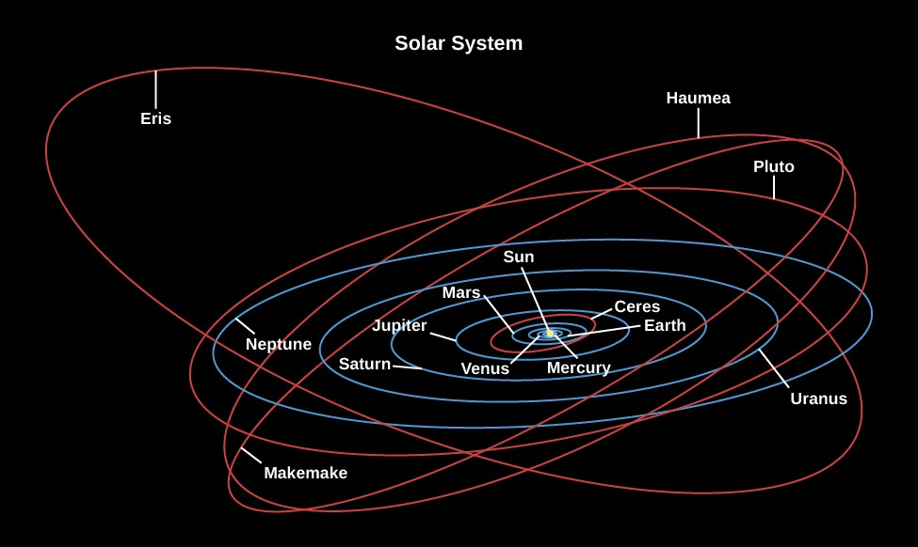
Orbital Paths
In red are the orbital paths of the dwarf planets.
Orbital Inclinations are compared to the Ecliptic.
The Ecliptic: The circular plane on which the 8 planets in our solar system orbits.
Ceres: 10.6˚
Pluto: 17.14 ˚
Haumea: 28.2 ˚
Makemake: 29 ˚
Eris: 46.9 ˚
Figure 9: Diagram displaying the orbital paths of planets and dwarf planets.

Slide 12
Exploration of Dwarf Planets

Slide 13
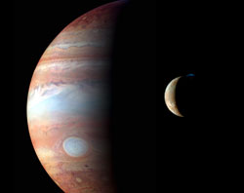
New Horizons
NASA’s New Frontiers Program
Launched in 2006
Mission:
Flyby study of Jupiter in 2007
Flyby study of Pluto in 2015
Further observation of Kuiper belt objects.
Figure 10: NASA engineers with New Horizons spacecraft.
Figure 11: Image from New Horizon’s flyby of Jupiter (2007)

Slide 14
Dawn Spacecraft
Launch date: September 27, 2007
Mission: Orbit the asteroid Vesta and dwarf planet Ceres within the Asteroid Belt.
First mission to orbit two destinations.
Record-breaking use of solar-electric propulsion at 25,700 mph.
Dawn orbited Vesta from July 2011 to September 2012.
Dawn entered orbit around Ceres in March 2015 and has remained their since.
Figure 13: Rendering of Dawn spacecraft – NASA/JPL

Slide 15
Asteroids
Definition: A small, rocky object that orbits the Sun.
Formation: Asteroids are leftover masses of rock from the formation of the solar system ~4.5 billion years ago.
Size Ranges between the largest asteroid, Vesta (329 miles), to objects <10 meters.

Slide 16
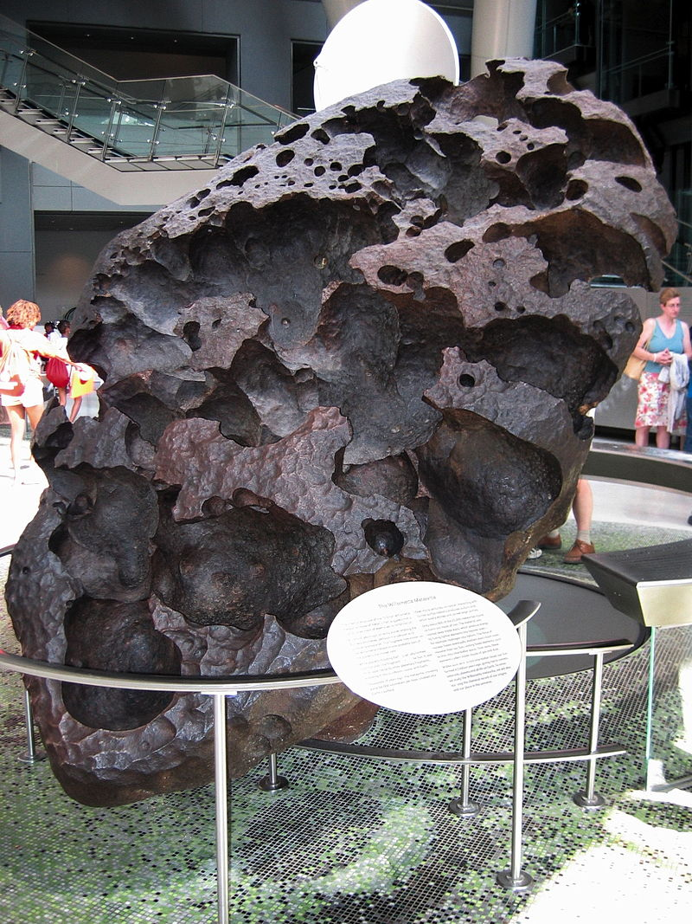
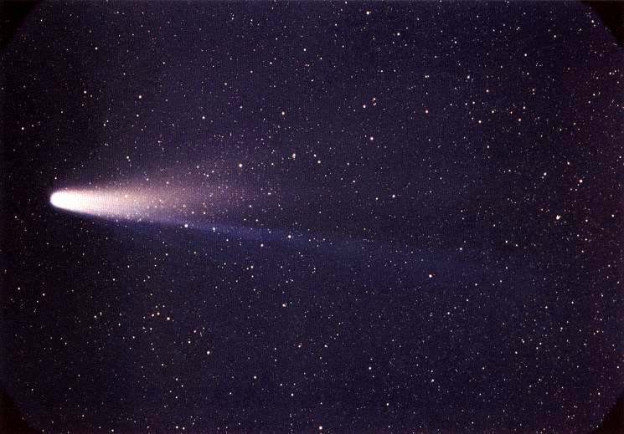
Meteoroids
Comet: A body of ice, dust, and rock that orbits the sun.
Meteoroid: A small piece of rock which break off from asteroids and comets.
Meteor: A meteoroid that enters the earth’s atmosphere and is vaporized.
Meteorite: A meteor that penetrates Earth’s atmosphere and lands on the surface.
Figure 14: Photo of Halley’s Comet, taken March 8, 1986
Figure 15: Willamette Meteorite, found in West Linn, Oregon, 1902.

Slide 17
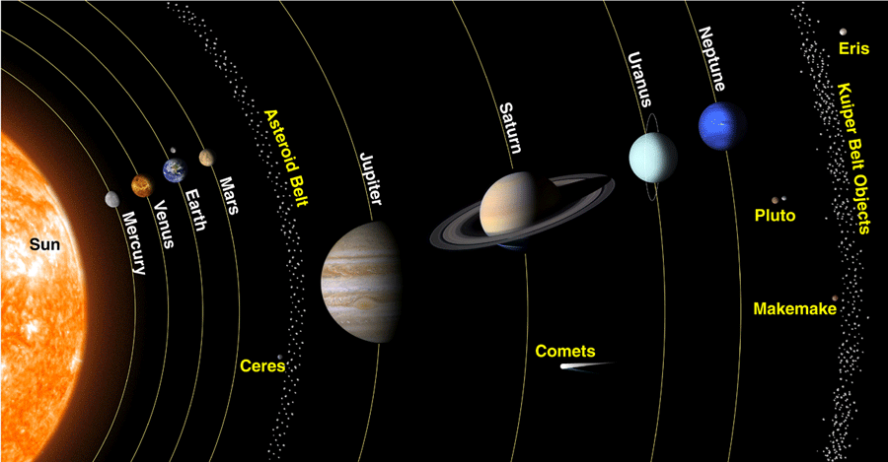
The Asteroid Belt
The Asteroid Belt is a region between Mars and Jupiter which contains most of the known asteroids in the Solar System.
Spans a distance of ~2-4 AU.
Discovery began with dwarf planet Ceres in 1801.
Estimated to contain up to 1.9 million large asteroids (>1km), and millions of smaller ones.
Figure 16: Diagram displaying location of planets, asteroid belt, and Kuiper belt.

Slide 18
Formation & Composition
Asteroids formed from the accretion of dust and rock into planetesimals in early stages of the solar system. Jupiter’s gravity disrupted the accretion process preventing the formation of planets.
The total combined mass of all asteroids is less than that of Earth’s moon.
C-types – (Chondrite) asteroids are most common, composed of clay and silicate rocks.
S-types – (Stony) asteroids are made up of silicate and nickel-iron.
M-types – (Metallic) asteroids have compositional difference relating to their distance from the sun.

Slide 19
Asteroid Exploration

Slide 20
NEAR
NEAR (Near-Earth Asteroid Rendezvous) is the first spacecraft to land on an asteroid.
Launched February 17, 1996, NEAR touched down on Eros on February 12, 2001.
Reported that Eros had no magnetic field and mapped more than 70 percent of the surface using the near-infrared spectrometer.
Figure 17: Artist’s rendering of NASA’s NEAR spacecraft at asteroid Eros.

Slide 21
Deep Impact
Launched January 12, 2005, Deep Impact released an impactor which landed on the comet Tempel 1 on July 4, 2005.
The impact created a great flash caused by ice and debris ejecting from the impact crator.
Discovery of carbon-containing materials and water ice, indicates that comets may have brought organic material to Earth at one time.
Figure 18: Photo of July 4, 2005 impact on comet Tempel 1.

Slide 22
Thank You Questions?

Slide 23
Work Cited
https://www.universetoday.com/72717/what-is-a-dwarf-planet/
http://www.geditorial.com/blog/sunday-science-pluto-and-the-dwarf-planets
https://www.nasa.gov/sites/default/files/thumbnails/image/nh-pluto_charon_color_final.png
https://solarsystem.nasa.gov/solar-system/kuiper-belt/overview/
https://space-facts.com/eris/
http://mentalfloss.com/article/519236/facts-about-dwarf-planet-haumea
https://www.daviddarling.info/encyclopedia/D/dwarf_planet.html
https://en.wikipedia.org/wiki/Makemake#Satellite
https://www.nasa.gov/feature/goddard/2016/hubble-discovers-moon-orbiting-the-dwarf-planet-makemake
https://courses.lumenlearning.com/astronomy/chapter/overview-of-our-planetary-system/
https://abcnews.go.com/Technology/horizons-spacecraft-stay-powered-20-years-pluto/story?id=32489580
https://www.history.com/this-day-in-history/pluto-discovered
https://en.wikipedia.org/wiki/New_Horizons
https://www.nasa.gov/mission_pages/newhorizons/news/nh_jupiter_oct09.html
https://www.nasa.gov/mission_pages/dawn/images/index.html
https://www.space.com/16105-asteroid-belt.html
https://ast.wikipedia.org/wiki/Cometa_Halley
https://en.wikipedia.org/wiki/Willamette_Meteorite
https://solarsystem.nasa.gov/missions/near-shoemaker/in-depth/
https://solarsystem.nasa.gov/asteroids-comets-and-meteors/asteroids/in-depth/
https://www.astrobio.net/also-in-news/deep-impact-mission-comes-to-an-end/

