Slide 1
Electromagnetic spectrum
Telescope Design – 2019 – Matt Haney

Slide 2
Electromagnetic spectrum basics
Human Eye: 400nm - 700nm
Astronomical Observations: (10^8)m - (10^-16)m
Not all wavelengths are observable from Earth’s surface
Notes:
- Because atmosphere blocks out certain wavelengths
- Blocked wavelengths are only observable from satellites in outer space

Slide 3
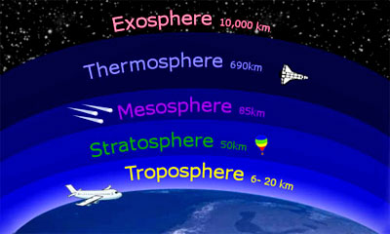
Earth’s atmospheric structure
Troposphere
Stratosphere
Mesosphere
Thermosphere
Exosphere
Outer Space
Van Allen Belts

Slide 4
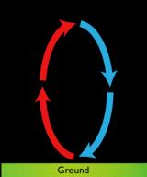
Troposphere
Range:
Ground to 7-20km / 23,000-65,000ft / 4-11mi
Contents:
Clouds, Moisture, Dust
Air Composition:
Warmest near surface / Colder at higher elevations
“Inversion” Event:
Cold air near surface / Warm trapped at high elevation
Notes:
Creates convection currents that drive the weather we experience
Inhibits convection current and traps dirty air near ground

Slide 5
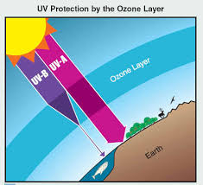
Stratosphere
Range:
Troposphere to 50km / 160,000ft / 31mi
Contents:
Mostly Ozone (O₃)
Air Composition:
Colder near bottom / Warmer near top
Notes:
Ozone is known to absorb UV energy produced by the sun, resulting in… AIR COMPOSITION
Because of this, there are very few convection currents, making for perfectly “smooth” aircraft flying conditions

Slide 6
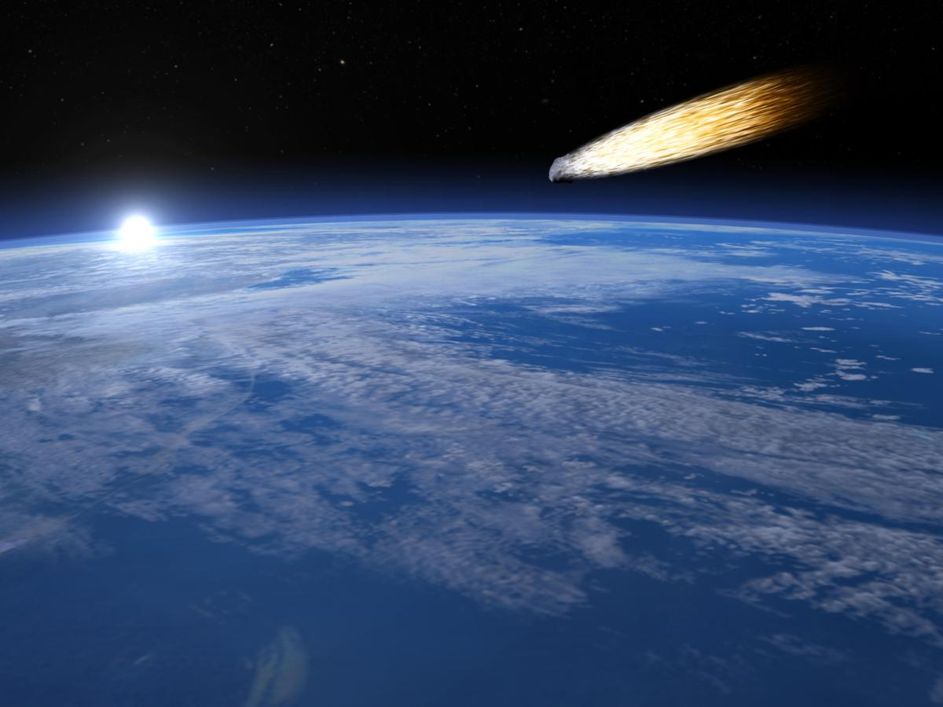
Mesosphere
Range:
Stratosphere to 80km / 260,000ft / 49mi
Contents:
Burning Up Meteors
Easily Excitable Sodium Atoms
Air Composition:
Very Thin
Notes:
The excess Sodium comes from the ablation of meteors
Can be excited by Sunlight, Solar Winds, & a 589nm Laser
Useful in adaptive optics for telescopes that account for atmospheric movements

Slide 7
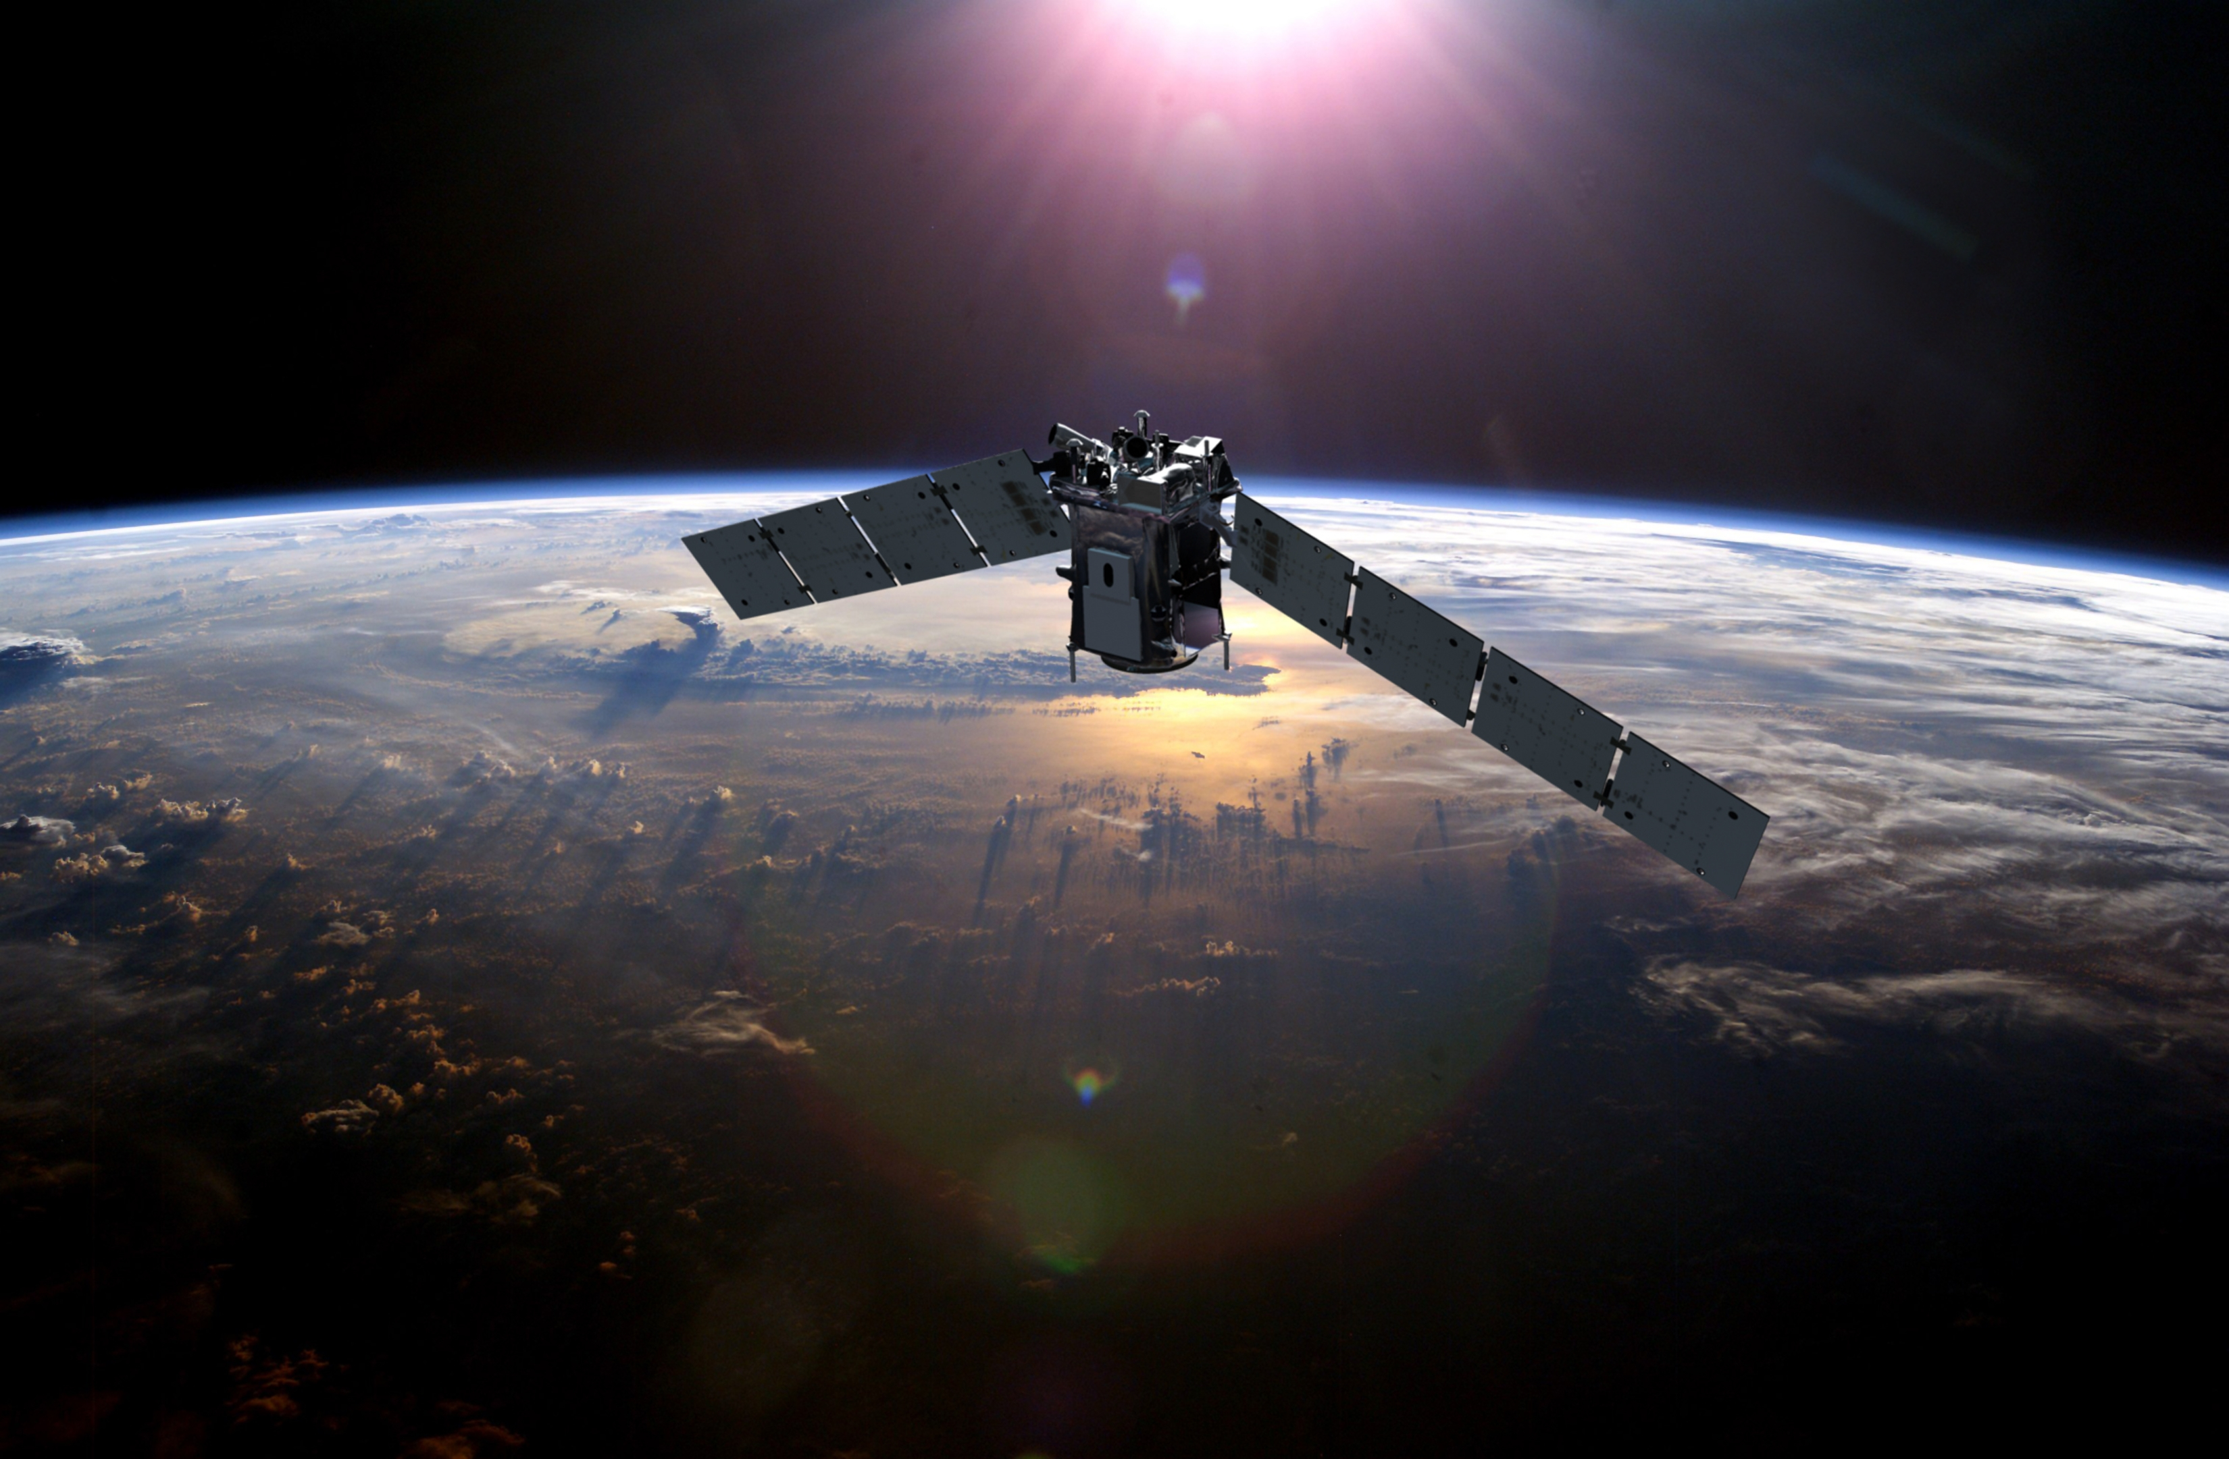
Thermosphere
Range:
Mesosphere to 500-1,000km / 300-600mi
Contents:
Regions with Ionized Gas Particles
Temperature: 2,500C / 4,500F
Air Composition:
Extremely Thin
Notes:
Many atoms in this region have lost their electrons, making them electrically charged ions that are influenced by the Earth’s magnetic field
Ionized Gas Particle Regions reflect radio waves; used as a means of communication before satellites
Air is so thin that some satellites orbit in this region

Slide 8
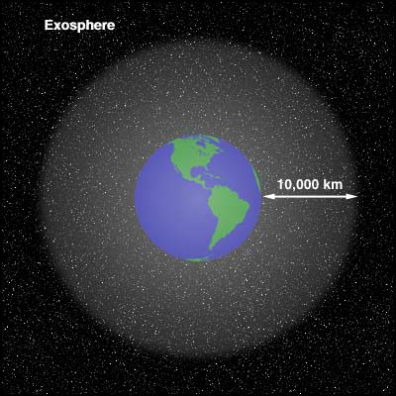
Exosphere & Outer space
Exosphere
Gradual Transition Layer
Outer Space
Karman Line: 100km / 328,000ft / 62.1mi
Low-Orbit Satellites: 160-2,000km / 100-1,200mi
International Space Station: 254mi / 400km
Notes:
Exosphere not universally recognized as an actual layer of the atmosphere
Transition layer between Thermosphere & vacuum of interplanetary space
No defined starting altitude for “outer space”

Slide 9
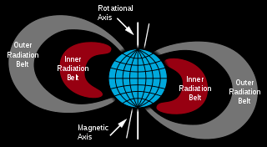
Van allen belts
Who?
Discovery credited to James Van Allen
What?
Radiation belts of charged particles
Where?
500-58,000km / 310-36,040mi
How Many?
2, but occasionally more
Why?
Protects Earth’s atmosphere
Notes:
Charged particles typically come from solar wind and cosmic rays
Belts can occasionally be formed, but only temporarily
In 2013, NASA discovered a third “transient” Van Allen belt, but it was destroyed 4 weeks later by a shock wave from the Sun
Belts trap energetic protons and electrons from solar wind and allows the Earth’s magnetic field to deflect the particles
This saves the atmosphere from total destruction

Slide 10
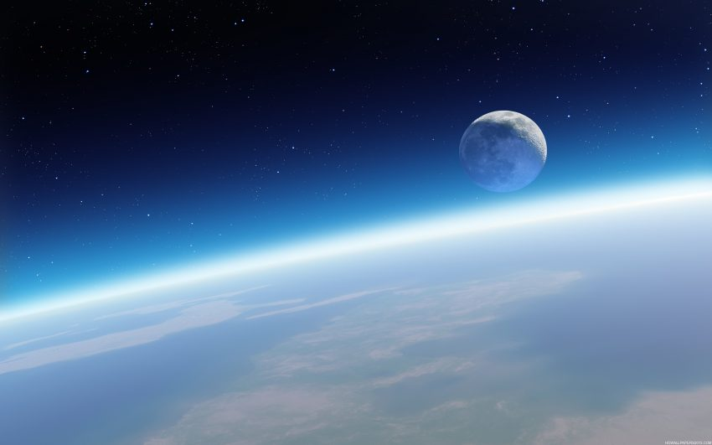
Earth’s atmospheric effects
Filtering of Frequencies
Astronomical Object Viewing
“Seeing” vs. “Transparency”
Clear Sky Chart

Slide 11
Filtering of frequencies
Not Filtered:
Visible Light
Most Radio Waves
Filtered:
Gamma Rays
X-Rays
Some UV Rays
Some IR Rays

Slide 12
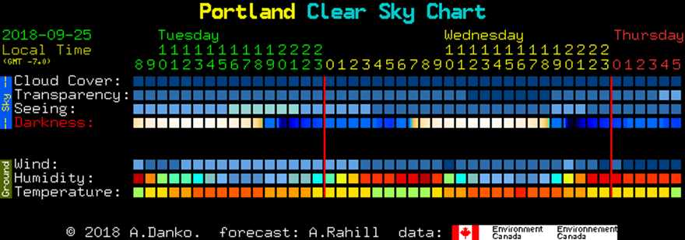
Astronomical object viewing
Viewing Tips
Look Up! There is less atmosphere straight up than at the horizon
Use Clear Sky Chart to get an accurate forecast 1-2 days before
“Seeing” vs. “Transparency”
Seeing: how steady the air is
Transparency: how clear the air is
Notes:
Poor seeing = Atmospheric Turbulence = Twinkling Stars
Low Transparency = Starlight is blocked by atmosphere
Moisture, humidity, smoke, dust, and other forms of pollution decrease transparency
Poor transparency amplifies light pollution by spreading out the light
Clear Sky Chart also lists: wind, humidity, temperature, cloud cover, and darkness. All of which are relevant to viewing any given night

Slide 13
Beyond earth’s atmosphere
The Sun
Sunspots
Coronal Mass Ejections
Solar Flares
Solar Event Effects
Other EM Wave Sources
Galactic Center of the Milky Way
Quasars
Blazars
Pulsars
Crab Nebula

Slide 14
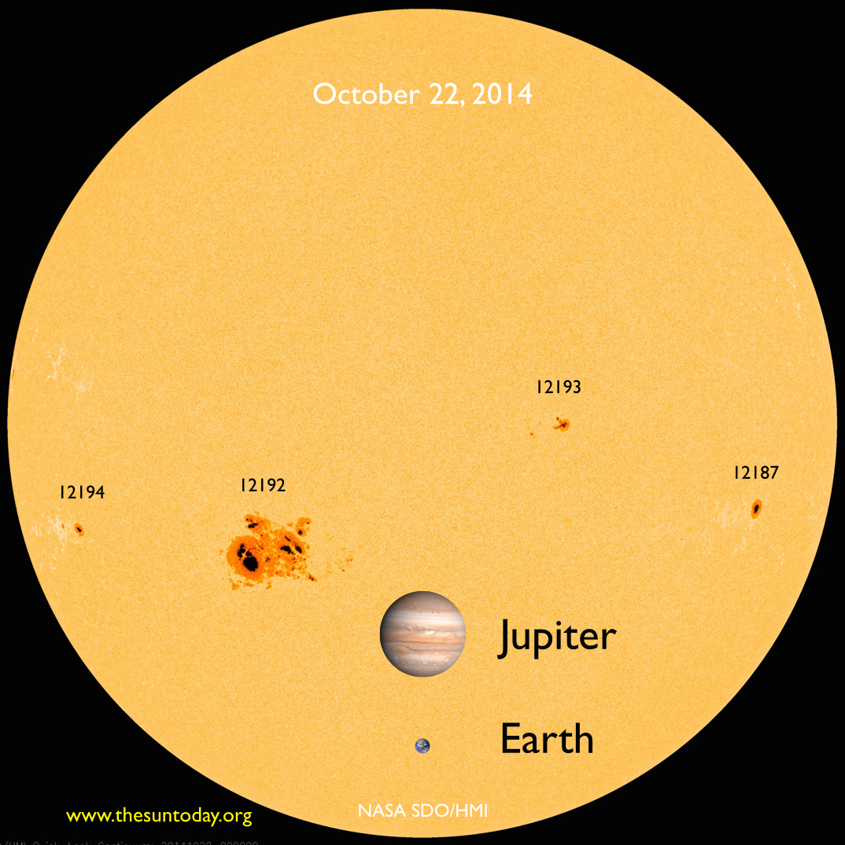
sunspots
Description:
Spots that appear darker than surroundings
Temperature
Sun: ~5800K / Sunspots: ~3800K
Cause:
Magnetic field inconsistencies
Frequency:
Appearances vary within 11-year solar cycle
Usually appear in pairs with opposite polarity
Diameter:
16-160,000km / 10-100,000mi
Notes:
Caused by concentrations of magnetic field flux that inhibit convection
Sunspots can last anywhere from a few days to a few months, but eventually decay
Strong sources of radio waves (from magnetic field and charged particles, rather than blackbody radiation)
Most solar flares and coronal mass ejections occur around magnetically active sunspot regions
Sunspots can happen on other stars, but then they are called starspots

Slide 15
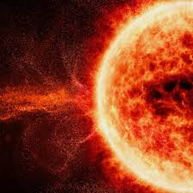
Coronal mass ejections
Description:
Ejection of large quantities of EM radiation
Interplanetary CME (ICME):
Ejections travel beyond Sun’s surface to other planets
Causes geomagnetic storm in Earth’s atmosphere
Also causes strong aurorae (Northern/Southern Lights)
Can damage satellites, electrical lines, and radio waves
Notes:
Sometimes called solar prominences
Majority of the ejected material is magnetized plasma consisting of mainly protons and electrons
Geomagnetic storm releases energy on the order of Terawatts

Slide 16
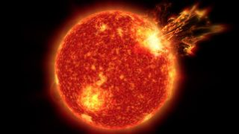
Solar flares
Description:
Sudden flash of increased brightness
Ejection of ionized atoms into space
Power:
Median Event ~ 10^20J
Major Event ~ 10^25J
Effects:
One cause of bright aurorae
Causes strong solar winds
Interferes with electrical power grid
Increases drag on satellites
Particles are harmful to humans
Notes:
Often times, solar flares are accompanied by coronal mass ejections, but not always
Solar flares also emit radio waves
Solar flares that occur on other stars are termed “stellar flares”
Increased drag on satellites leads to orbital decay
These events must be considered when planning missions to Mars because of the health risks they pose
January 20th, 2005 – Highest concentration of protons ever recorded (astronauts had 15 minutes to find shelter)

Slide 17
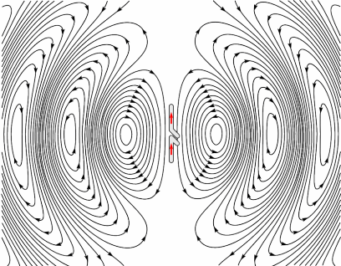
Galactic center of milky way
First radio source to be detected beyond our solar system
Sources of Radio Waves:
Sagittarius A*
Supermassive Black Hole
Supernova Remnants
Pulsars
Complex molecules in star forming regions
Radio Galaxies
Notes:
- Called radio galaxies because they are strong radio wave emitters

Slide 18
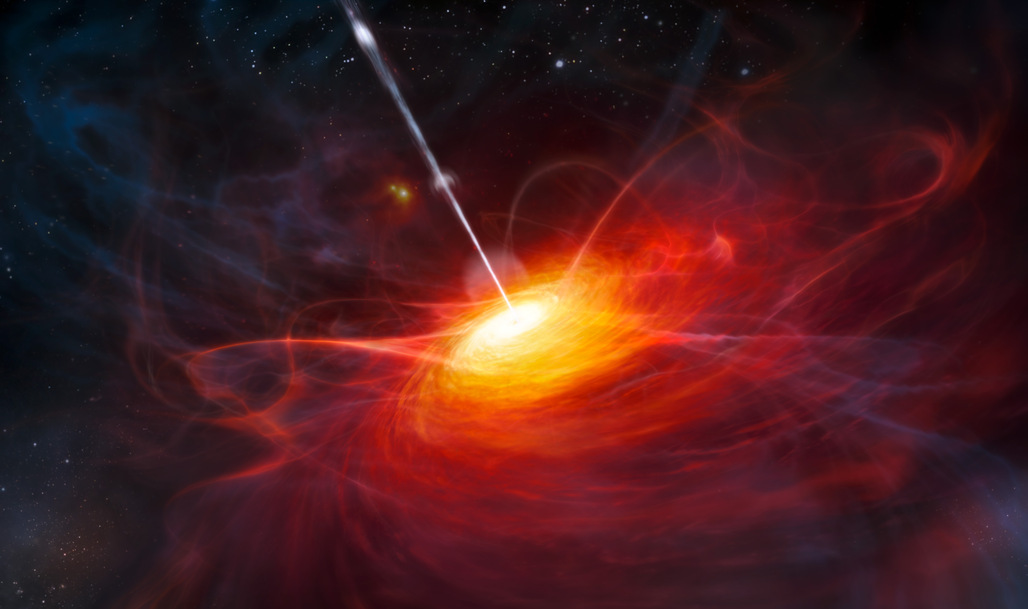
quasars
Short for “quasi-stellar” radio source
First “point-like” radio sources discovered
Extreme Red Shift
3C 273 – Brightest Quasar
Notes:
Because of the extreme red shift, we believe quasars are distant galactic nuclei and are powered by black holes
Active galactic nuclei give off jets of charged particles that emit synchrotron radiation (example – 3C 273)

Slide 19
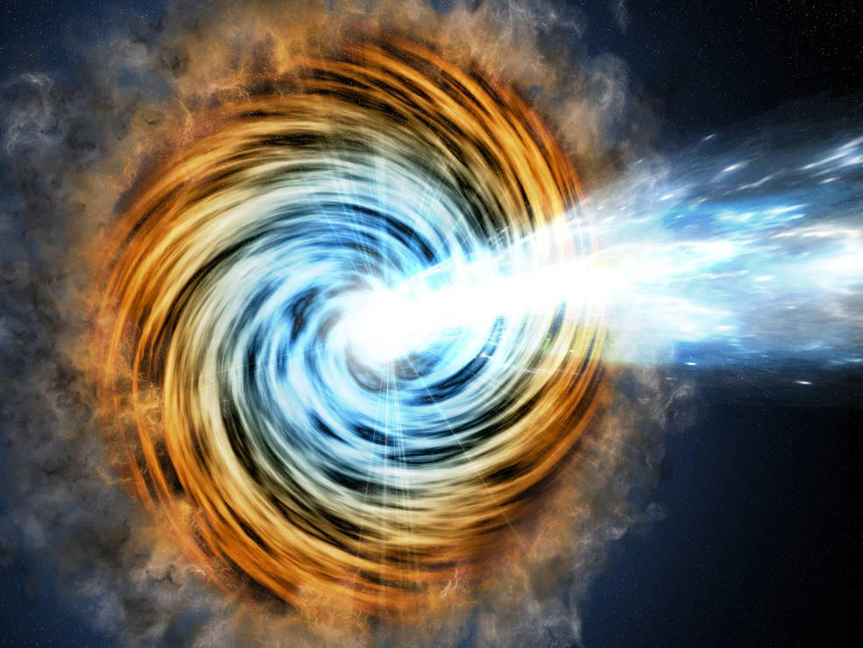
blazars
Source of high energy Gamma-Rays
Active Galactic Nucleus with a Relativistic Jet
Highly Variable
Can exhibit apparent Superluminal Motion
Notes:
A relativistic jet is composed of ionized matter traveling at nearly the speed of light
Radiation from these jets make blazars appear brighter than if they were pointed away from Earth
Rapid & dramatic fluctuations in brightness occur in a time-frame of hours/days
Superluminal motion is when an object appears to travel faster than the speed of light

Slide 20
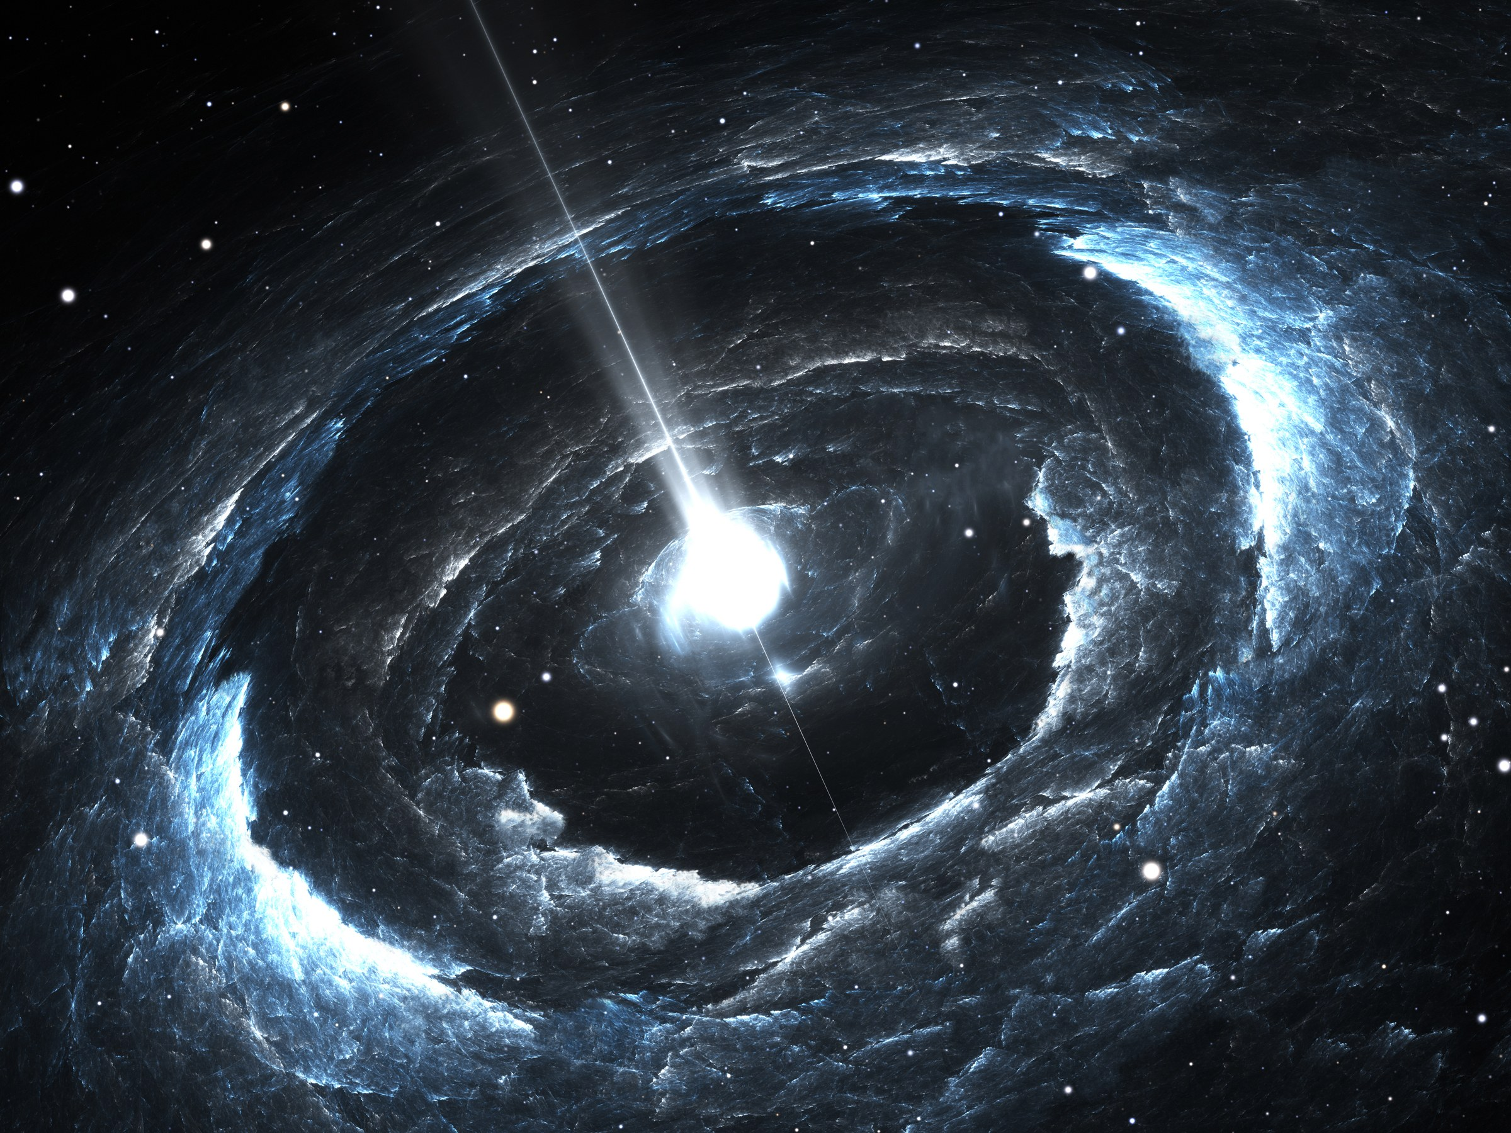
pulsars
Highly magnetized, rotating neutron star
Emits electromagnetic radiation from its magnetic poles
Indirectly used to confirm gravitational radiation
Rivals the atomic clock
Notes:
Emissions appear as pulses, hence the name “pulsar”
Pulses range from milliseconds to seconds in magnitude
Rivals the atomic clock in precision of keeping time

Slide 21
Crab nebula
First Messier Object (M1)
Supernova Remnant
Fast-Spinning Neutron Star at Center (aka Pulsar)
Image Recorded Using:
Very Large Array Spitzer Telescope Hubble Telescope Swift Telescope Chandra X-Ray Fermi Gamma-Ray
Notes:
Formed by the remains of a star that went supernova and appeared as a bright “new star” in 1054 AD
Spins about 30 times per second
Gamma rays are not produced with constant brightness
Gamma ray image from April 12, 2011 (outburst of synchrotron emissions that lasted 6 days)
Scientists think the flares occur when the magnetic field near the pulsar undergoes sudden restructuring
Accelerates electrons to energies up to 100 times greater than any particle accelerator on Earth can

