Slide 1
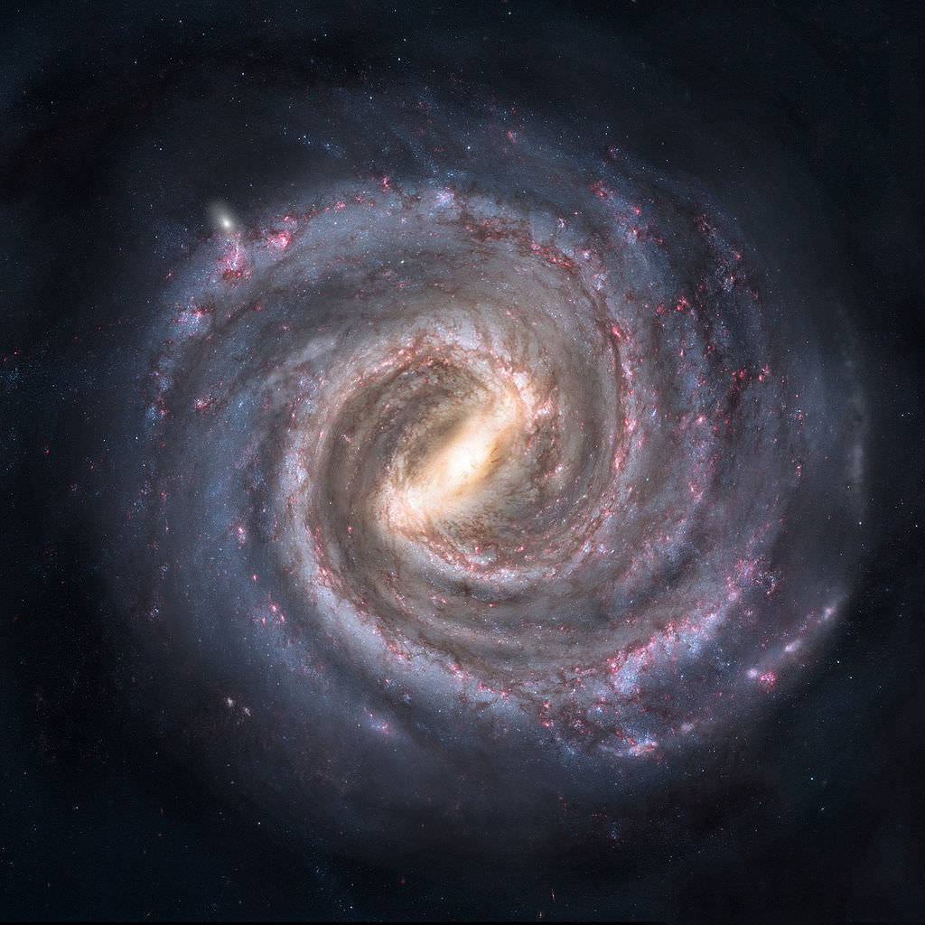
Galaxies
By: Daniel Henderson

Slide 2
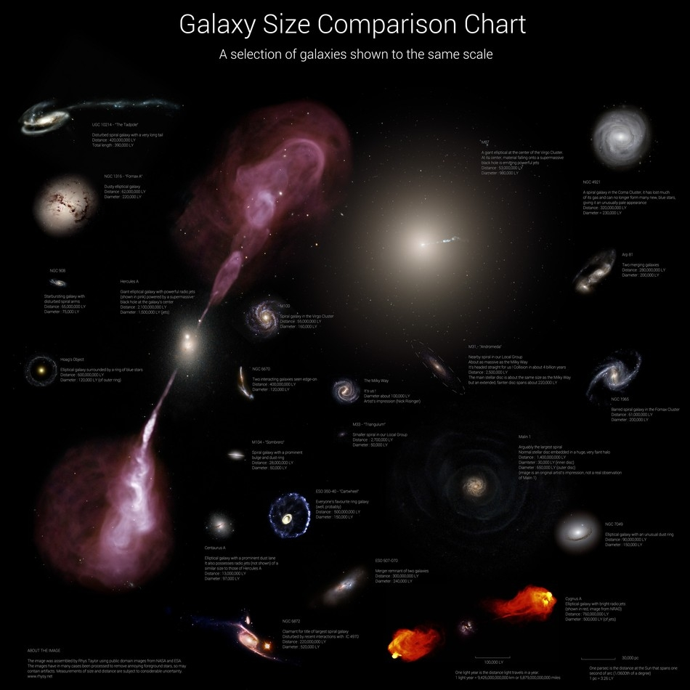
What is a galaxy?
A collection of dark matter, gas, dust, solar systems
Size ranges from 50,000-1,500,000 Light Years in Diameter
Milky way is an average sized star (Diameter: 100,000 LY)
Held together by large sources of gravity (supermassive black holes)

Slide 3
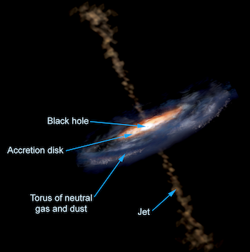
The Structure of galaxies
A supermassive black hole holds the matter together
This is known as the nucleus
The rotation of the nucleus causes the disk shape
Gas, dust, and solar systems accumulate more densely closer to the nucleus
The black hole emits jets of radio waves
Black holes that emit strong jets are quasars and blazars

Slide 4
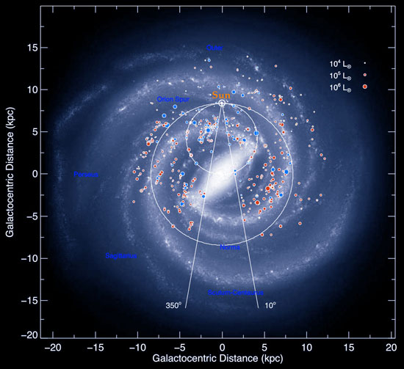
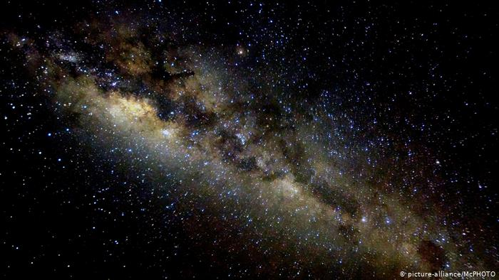
The milky way galaxy
Our home
About 100,000 light years across
We are 30,000 light years from the galactic center
Contains over 200 billion stars

Slide 5
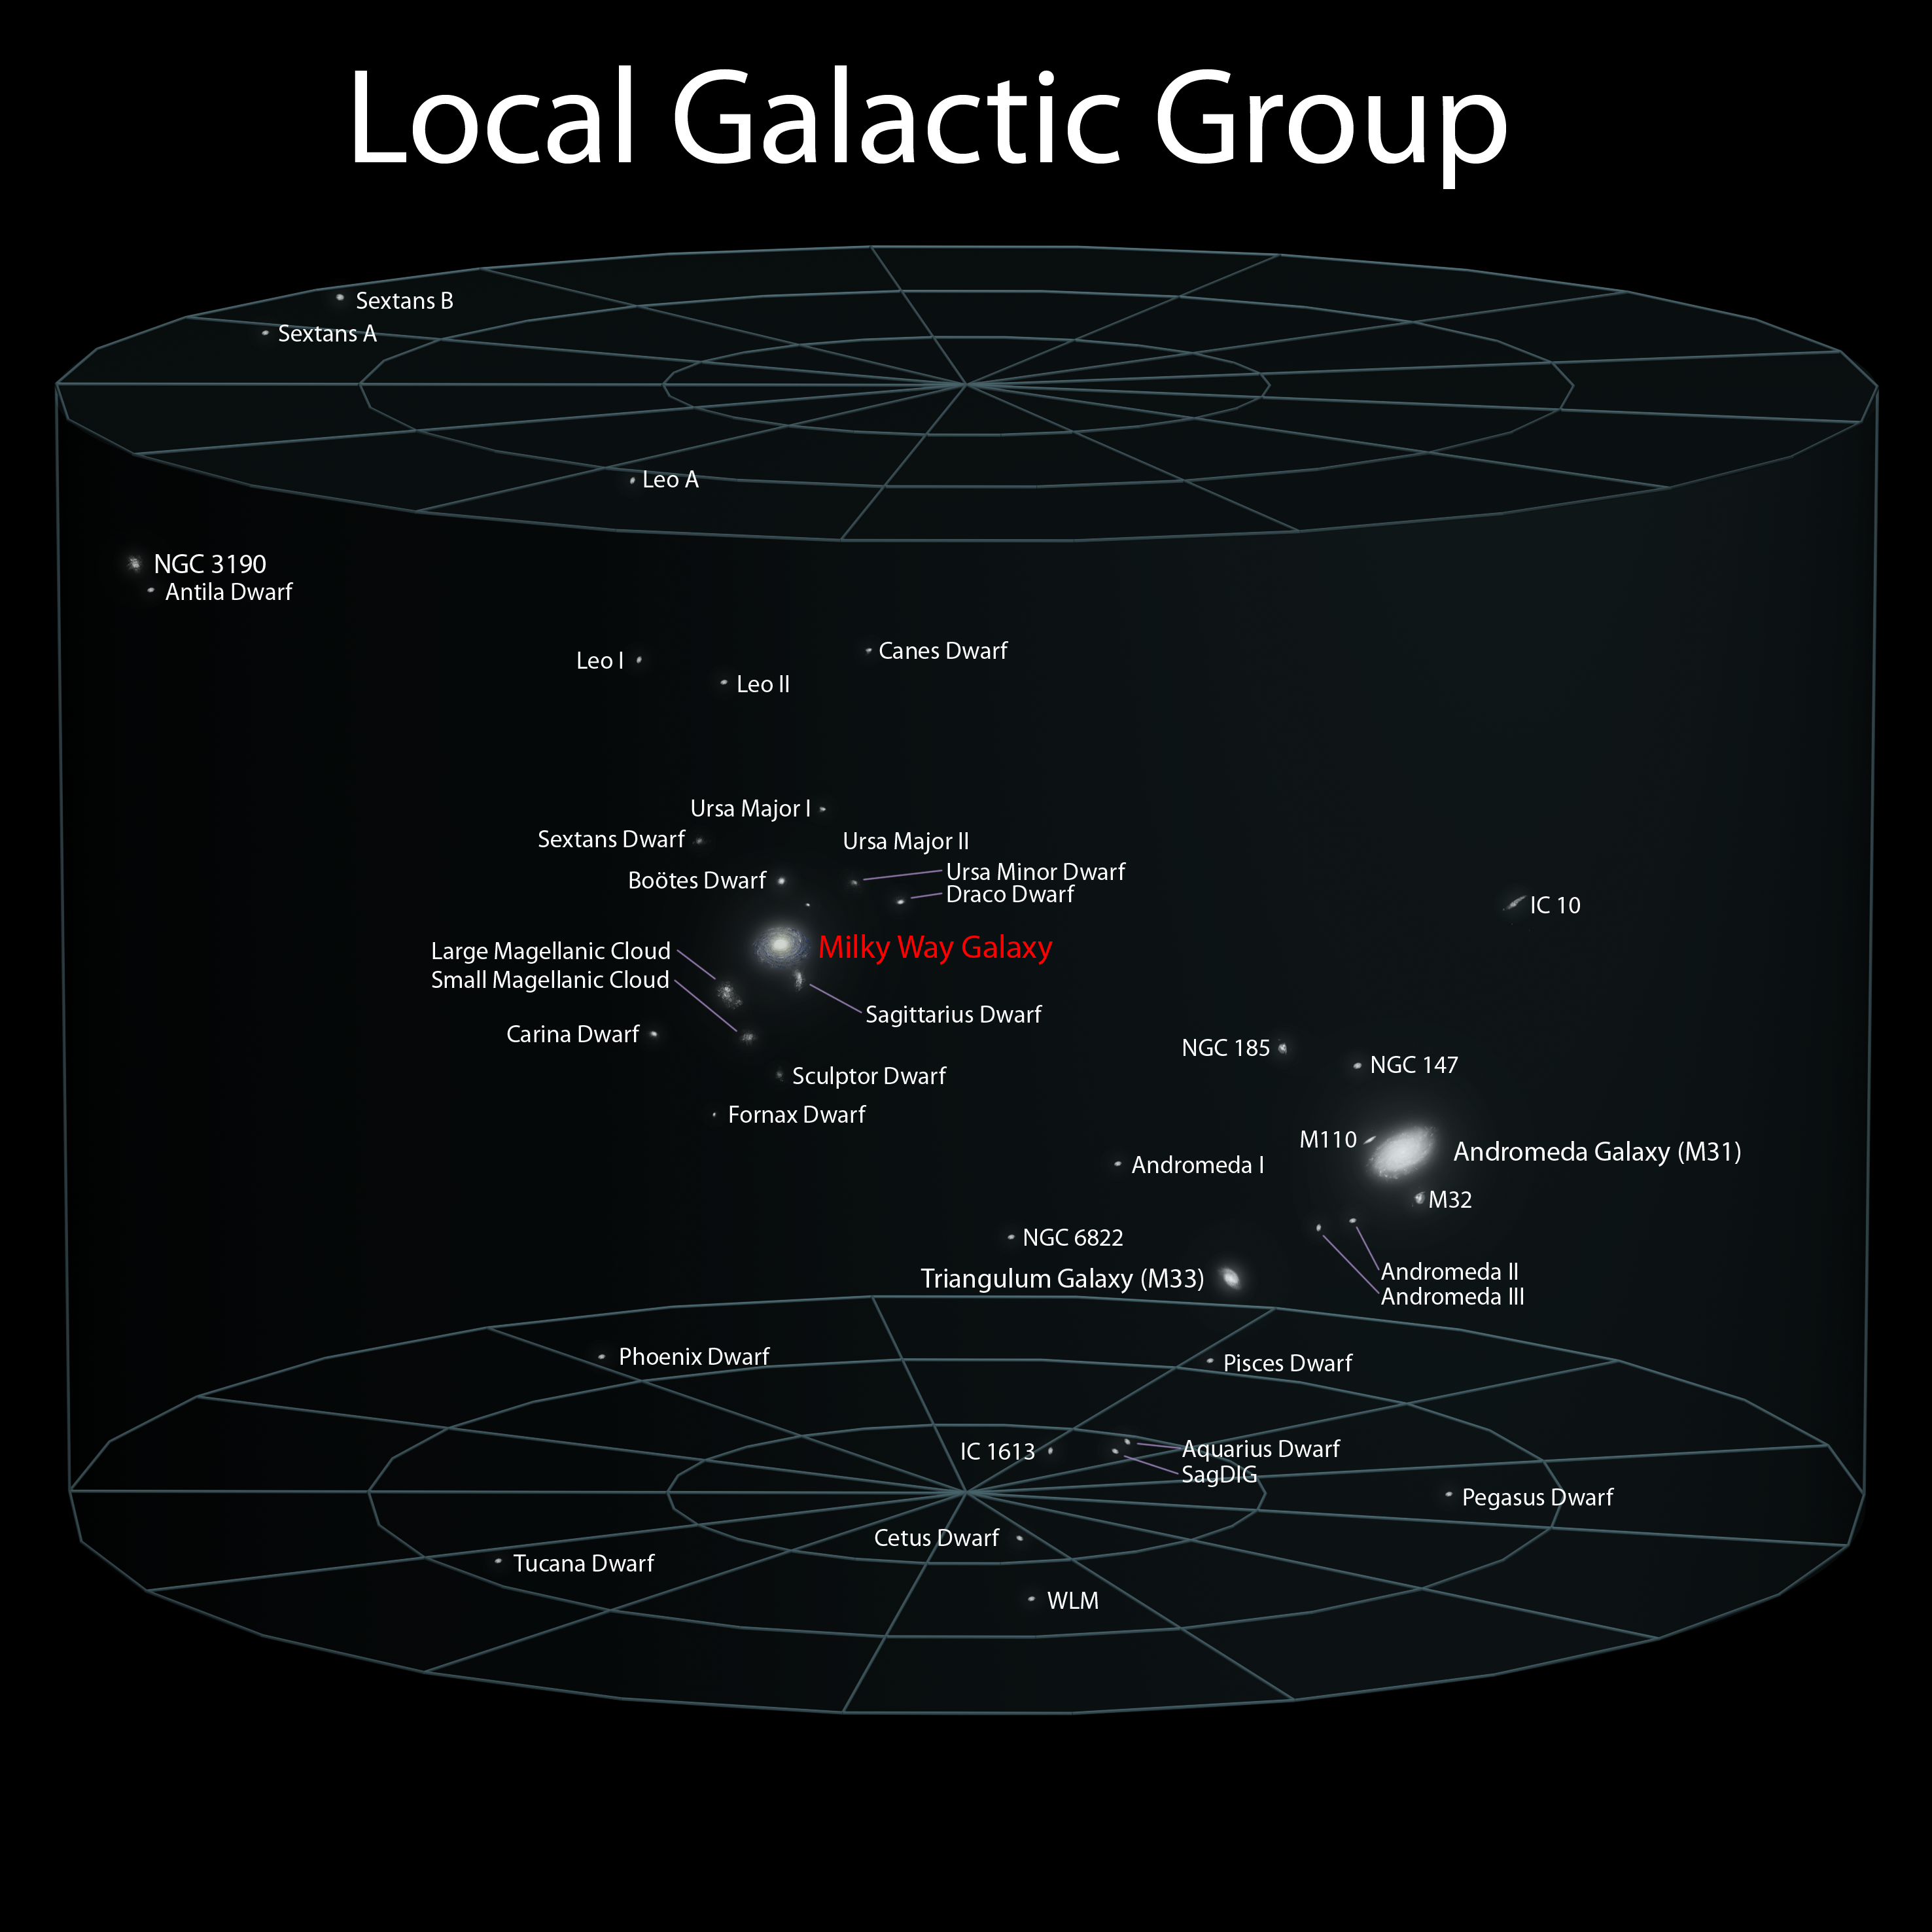
Our local group
Spans 10 million light years in diameter
Contains over 30 galaxies
Milky way and Andromeda are the 2 major galaxies
Each are surrounded by dwarf (satellite) galaxies
Triangulum is the next major galaxy in the local group

Slide 6
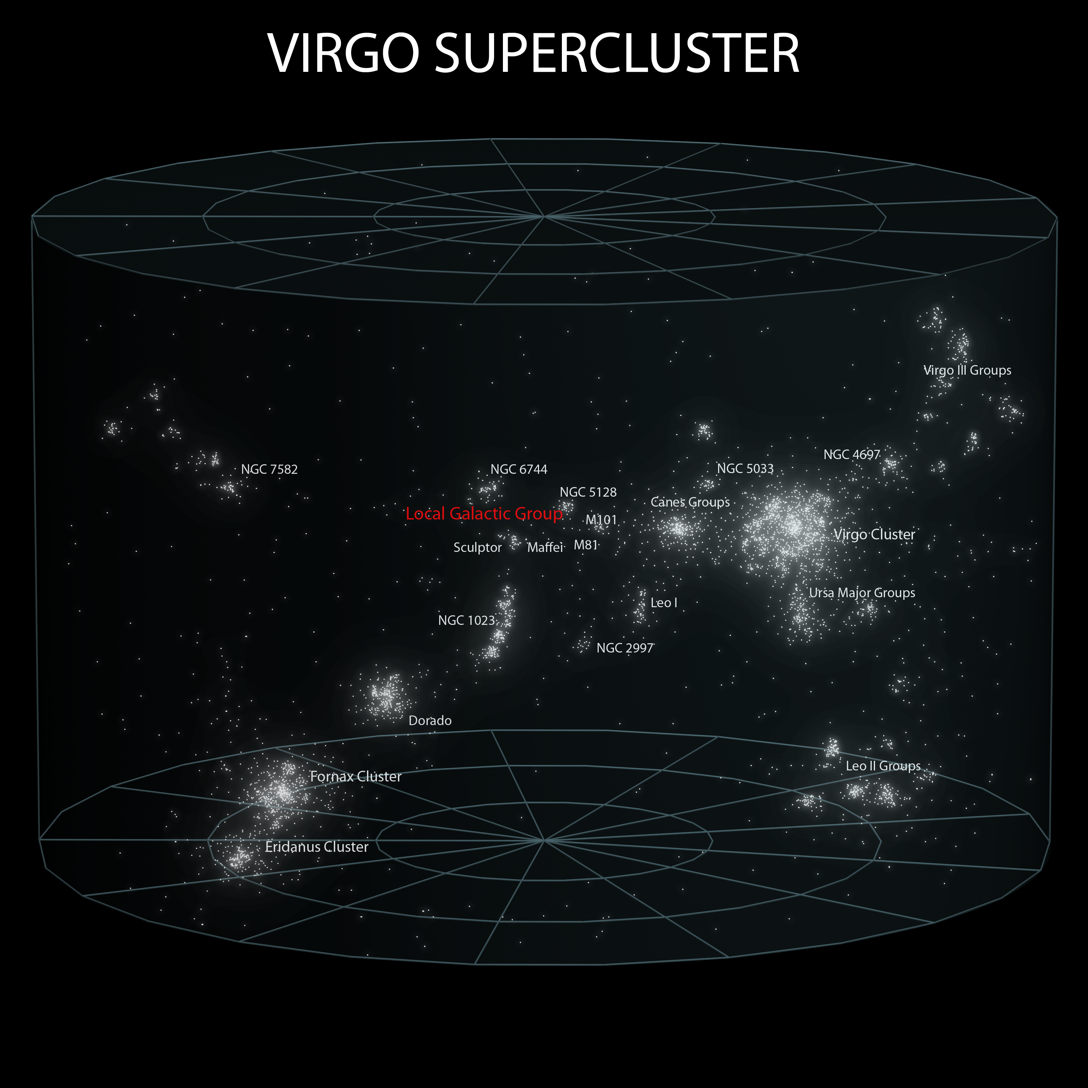
Virgo supercluster
Stretches across 110 million light years
Contains over a million galaxies
Named after the large, central Virgo Cluster

Slide 7
Virgo cluster in Markarian’s chain

Slide 8
scale
Stellar groups are defined by how objects (or groups of objects) are gravitationally bound
Solar systems are planets, moons, and asteroids bounded by a sun (or suns)
Galaxies are solar systems, stars, gas, and dust bounded by a supermassive black hole
Groups and clusters are galaxies that are bounded by each other
Superclusters are a collection of groups and clusters that are bounded to one another
All of these things interact and shape one another

Slide 9
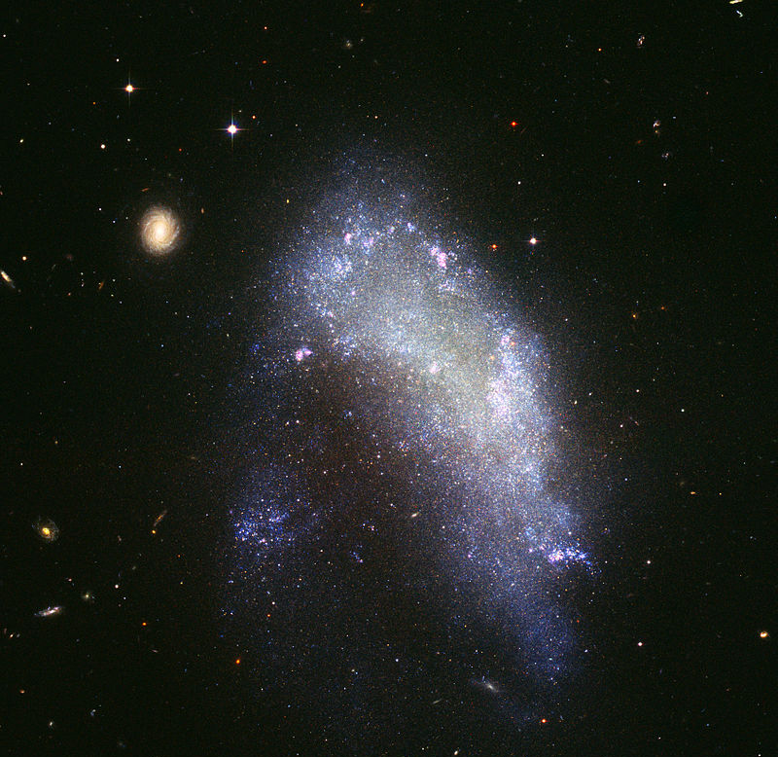
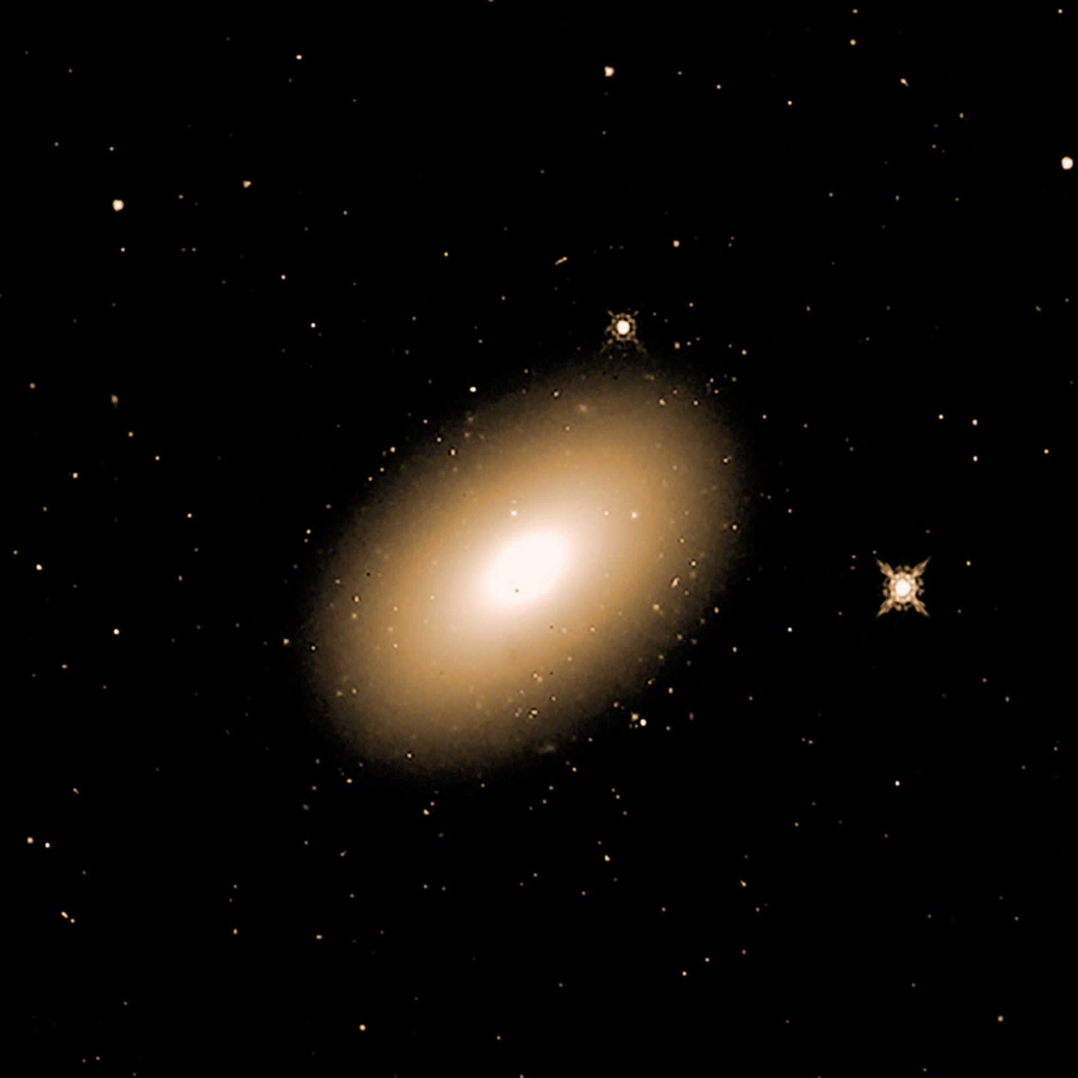
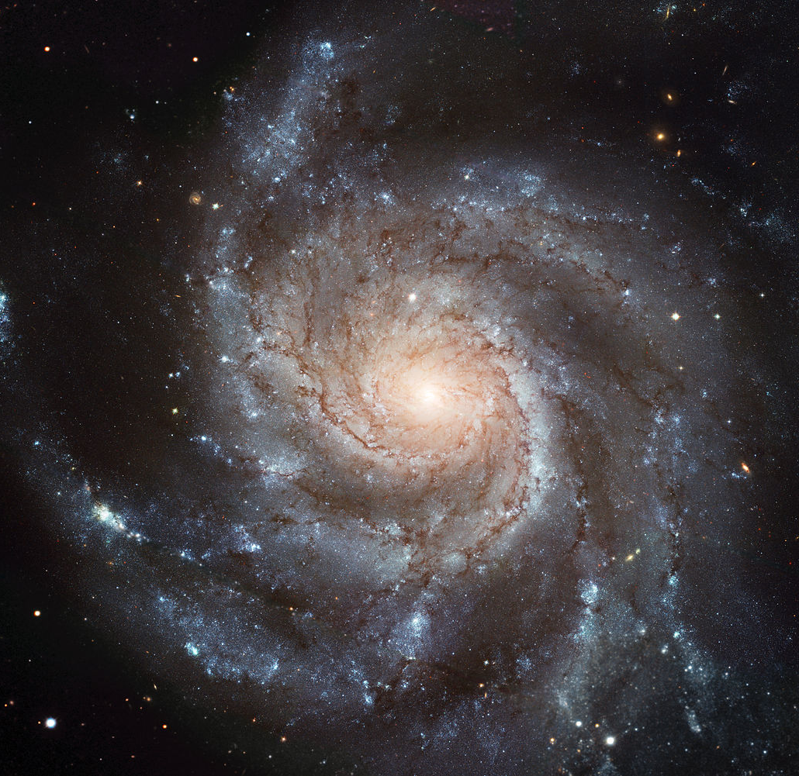
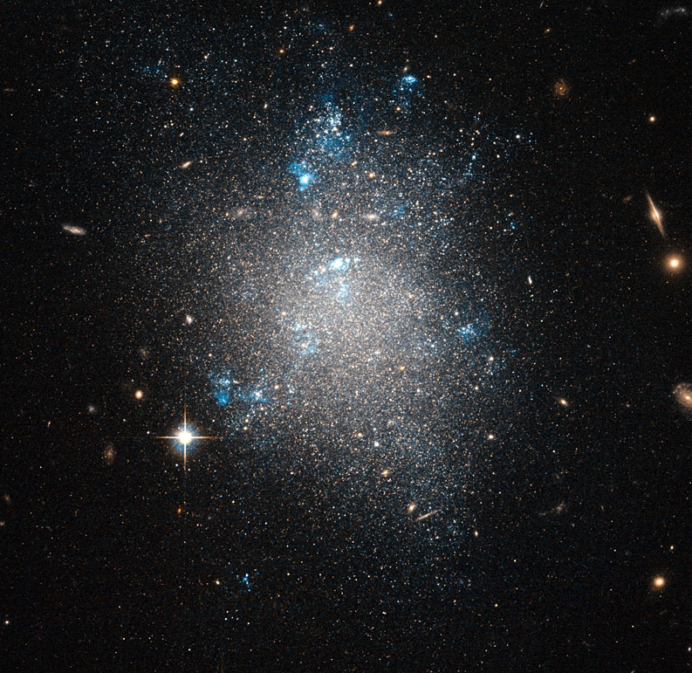
Types of galaxies
Irregular Galaxies
Spiral Galaxies
Elliptical Galaxies
Dwarf Galaxies

Slide 10
Spiral Galaxies
The spirals are caused by gravitational interactions with neighboring galaxies
Denser spirals of dust promotes star birth
This makes spiral galaxies brighter than most galaxies

Slide 11
Andromeda
Spiral Galaxy
Can be seen during August through October
Located between Cassiopeia and The Great Square of Pegasus
Nearest major galaxy (2,500,000 light years from us)
The furthest object you can see unaided
110,000 Light years in diameter
Has apparent size of about 1-3 degrees
The moon is only 0.5 degrees

Slide 12
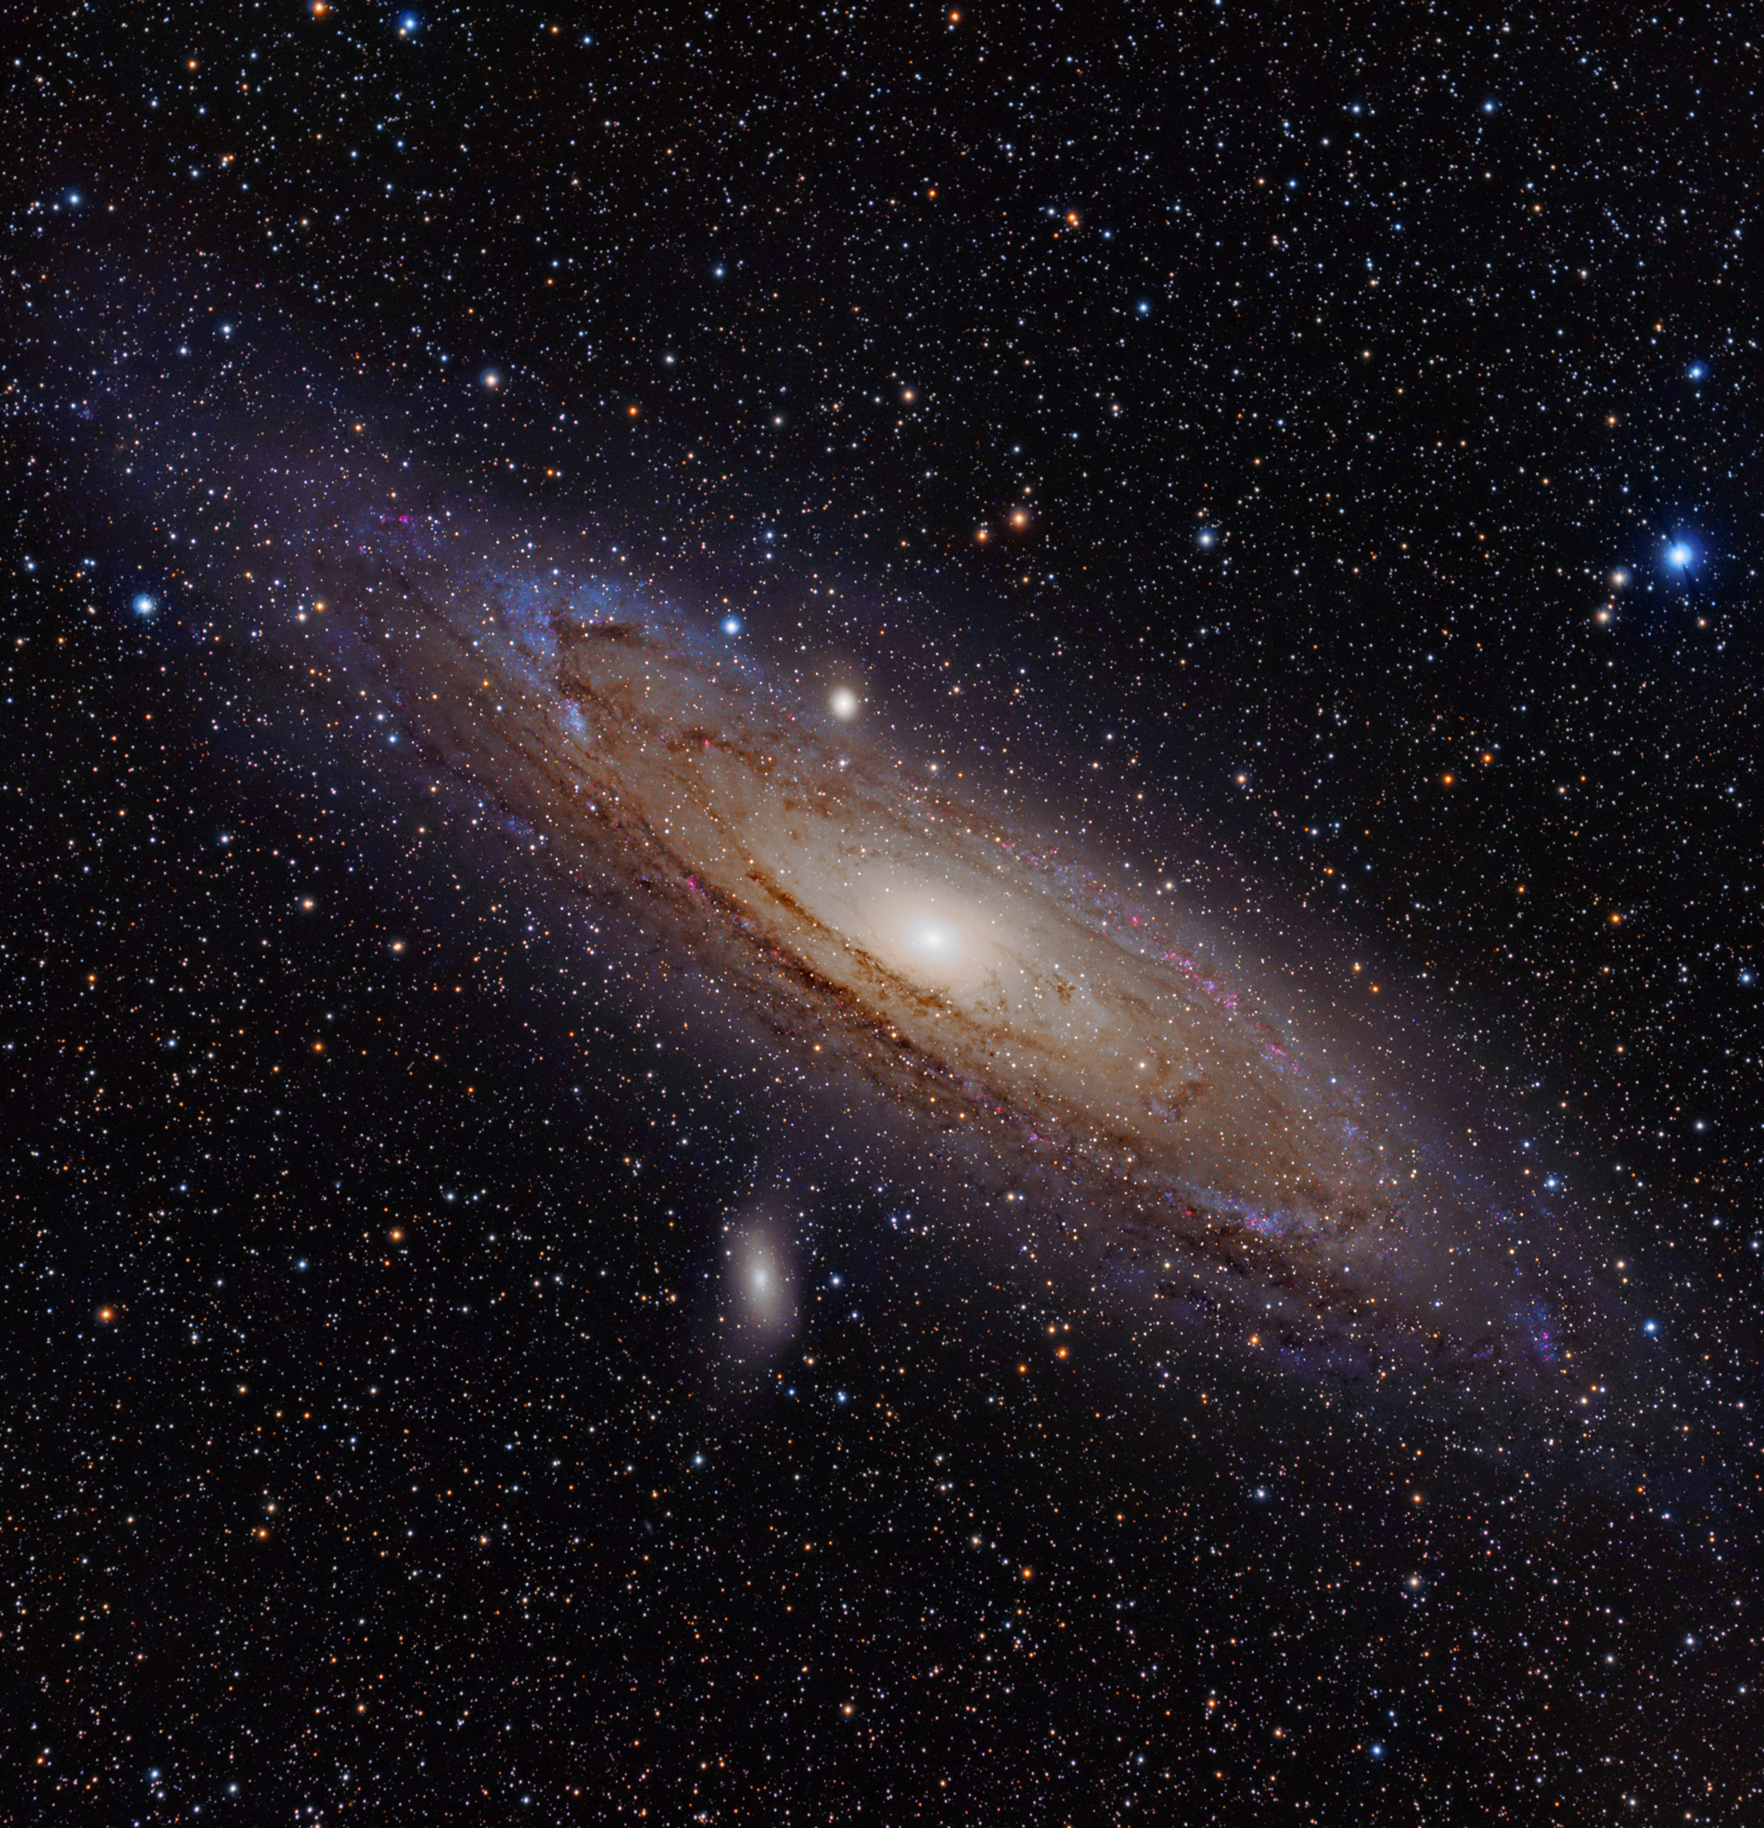
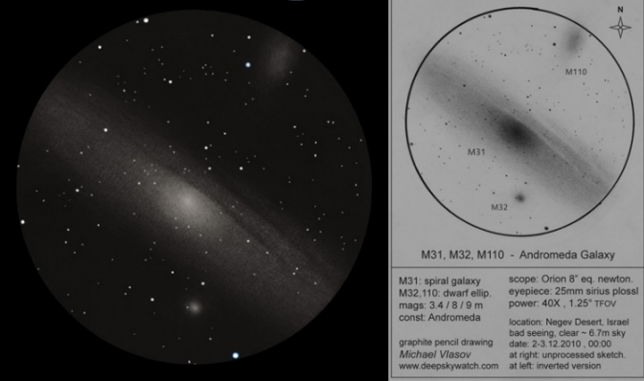

Slide 13
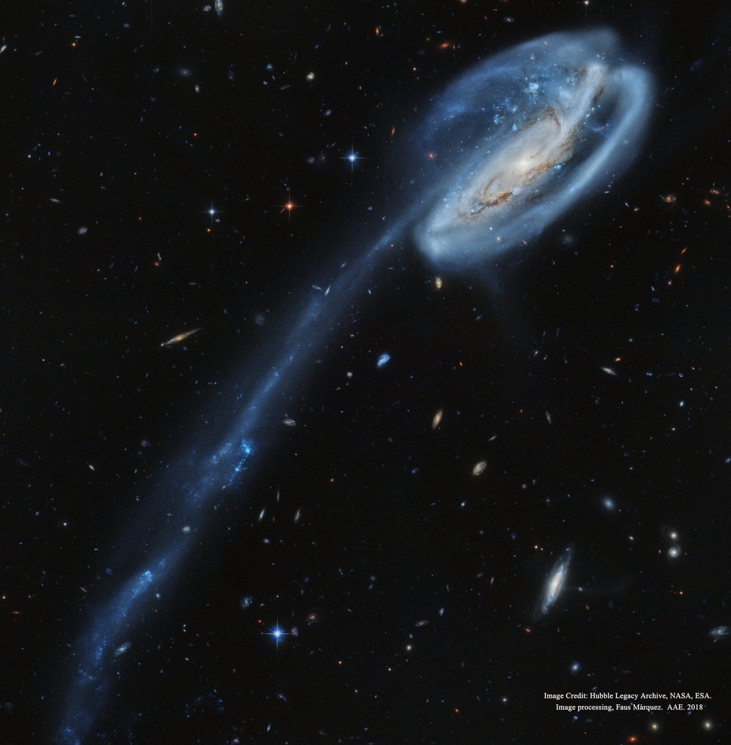
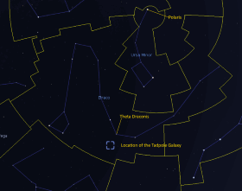
Tadpole Galaxy
Spiral galaxy
Located below the constellation Draco
Tail was created by a collision with a smaller galaxy
Tail is 250,000 light years long
Is 420,000,000 light years away from us
Not easily viewed with an amateur telescope

Slide 14
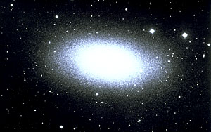
Elliptical galaxies
Dimmer than spiral galaxies
Less gas and dust than spiral galaxies
Have fewer star birthing regions
Known to have more old stars than young stars

Slide 15
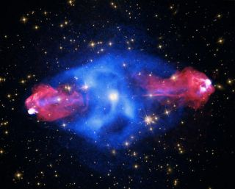
Cygnus a
Elliptical galaxy
One of the brightest sources of radio waves
Clouded by interstellar dust
Only seen in the infrared spectrum
Emits large jets of plasma
Is 600,000,000 light years from us

Slide 16
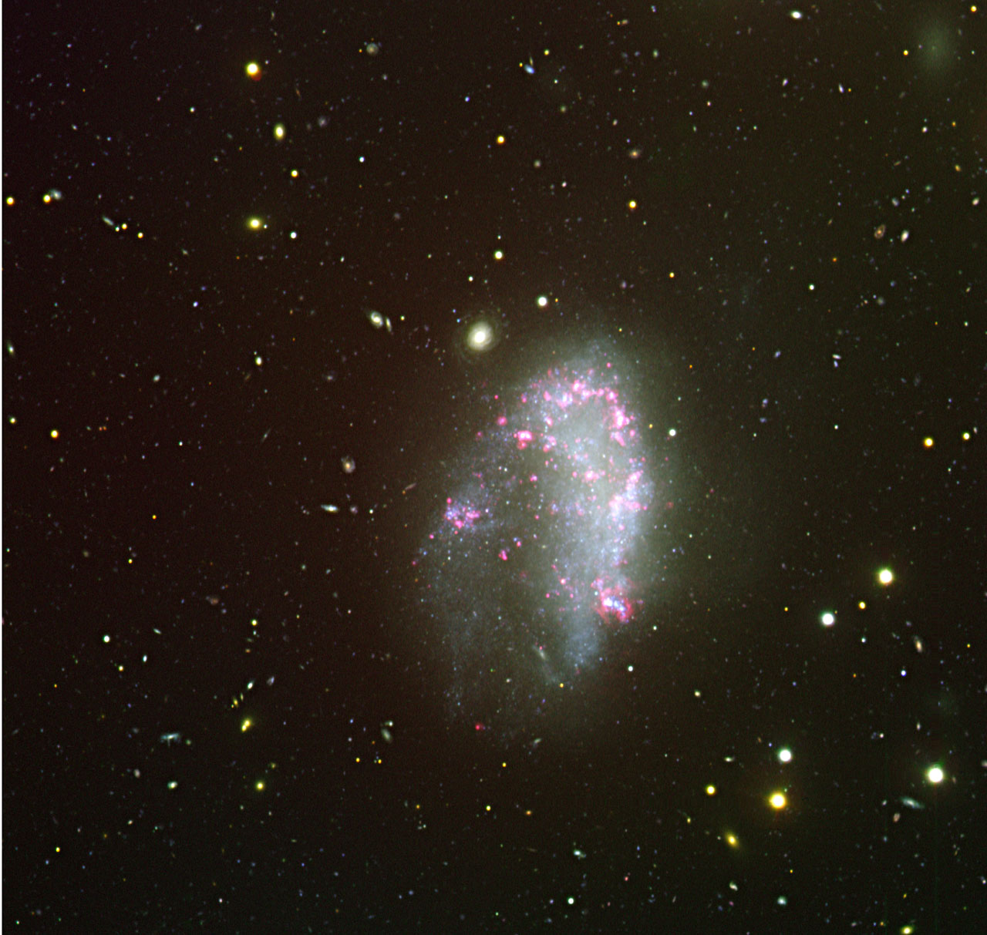
Irregular galaxies
No definite structure
Patches of bunched together stars, with gas and dust
Small and faint
Do not have a defined nucleus
NGC 1427A

Slide 17
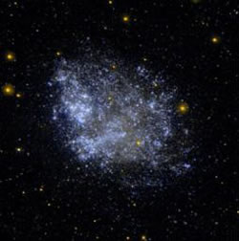
Dwarf galaxies
Small and dim
Can be elliptical, spherical, and irregular in shape
Largest dwarf galaxies are only 30,000 light years in diameter
Contain little gas and dust, with the exception of irregular dwarf galaxies
Dwarf irregular galaxies with enough gas and dust turn blue due to the heavy amount of star formations
Dwarf irregular galaxy IC1613

Slide 18
References
https://spaceplace.nasa.gov/galaxy/en/
http://astronomy.swin.edu.au/cosmos/G/Galaxy
http://www.sun.org/images/sizes-of-galaxies
https://www.messier-objects.com/messier-74-phantom-galaxy/
https://www.space.com/22395-elliptical-galaxies.html
https://stardate.org/radio/program/tadpole-galaxy
https://earthsky.org/clusters-nebulae-galaxies/andromeda-galaxy-closest-spiral-to-milky-way
https://imagine.gsfc.nasa.gov/science/objects/active_galaxies1.html
https://www.universetoday.com/30217/spiral-galaxy/
https://www.space.com/33700-monster-black-hole-secrets-revealed.html
https://www.astronomynotes.com/galaxy/s5.htm
http://astronomy.swin.edu.au/cosmos/D/Dwarf+Galaxy
https://www.space.com/19915-milky-way-galaxy.html

