Slide 1
Star birth: Open clusters and H II regions
Lillia Smith
Notes:
Wont be talking about planetary nebula, which the source of energy for ionizing the hydrogen atoms is a hot white dwarf, the remnant of a sun-like star that has burned all its fuel.

Slide 2
Some Definitions
Open Cluster:
An open cluster is a group of up to a few thousand stars that were formed from the same giant molecular cloud, and are still loosely gravitationally bound to each other.
H II Region:
Emission nebulae created when young, massive stars ionize nearby gas clouds with high-energy UV radiation. They are primarily composed of hydrogen.

Slide 3
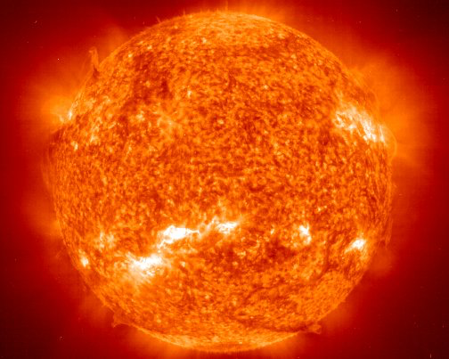
What is a star?
A star is a luminous ball of gas, mostly hydrogen and helium, held together by its own gravity.
Nuclear fusion reactions in its core support the star against gravity and produce photons, heat, and small amount of heavier elements.

Slide 4
Star Birth Cycle in General
Born in a region of high density Nebula
Condenses into huge globule of gas/dust and collapses under its own gravity
It will begin to heat up and start to glow, which forms protostars
Once the temperature hits about 10 millions Kelvin, nuclear reactions start
The star begins to release energy, stopping it from contracting even more and causes it to shine. It is now considered main sequence star.

Slide 5
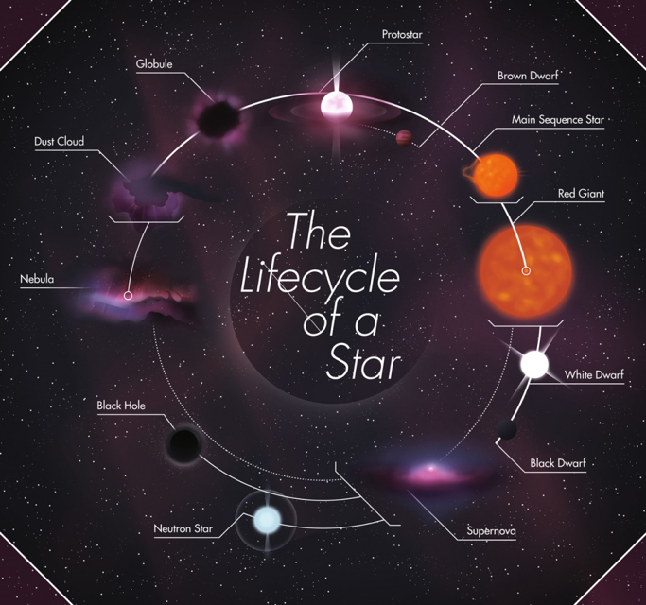

Slide 6
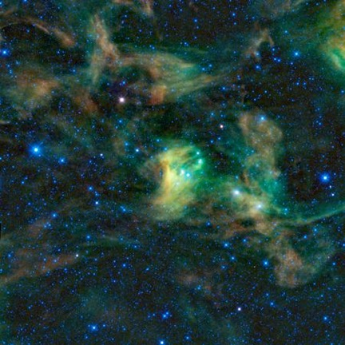
Building Blocks of Stars
Stars are formed from the simplest elements:
Huge clouds of gas and dust, aka nebula, permeate the Galaxy
There is more Hydrogen gas than dust in interstellar space, so we know that the Hydrogen gas is especially dense when we see a dust cloud.
Pictured is a dust cloud in constellation of Scorpius. age captured by Wide-field Infrared Survey Explorer (WISE)

Slide 7
More about Nebula
Latin for cloud
Nebulae are clouds of gas and/or dust in space
They are part of births, lives, and deaths of stars
Typical density of gas nebula contains only a couple thousand of atoms per cubic centimeter
In the air we breathe in, there are about 10¹⁹ atoms per cubic centimeter

Slide 8
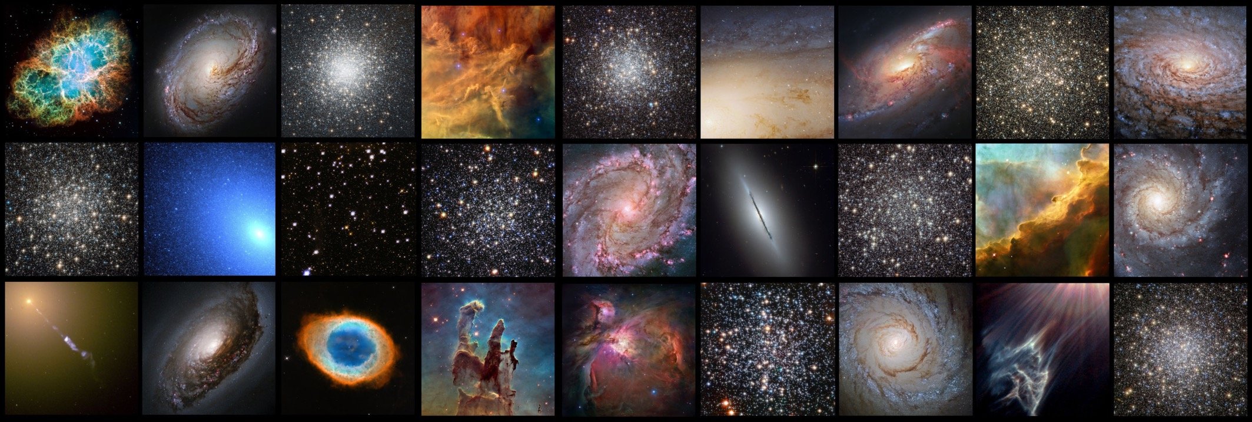

Slide 9
Massive Globule of Gas and Dust
The big clouds of dust and gas can lay dormant for many millions and perhaps billions of years
Eventually, the clouds are disturbed
As an example, the clouds can be disturbed by the approach of the Milky way’s spiral arms, or a sudden event, like a nearby supernova explosion that blasts a shockwave through the cloud

Slide 10
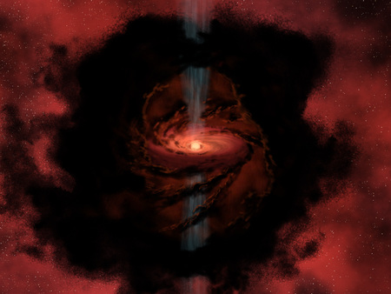
Formation of Protostar
Protostar is a contracting mass of gas which represents an early stage in the formation of a star, before nucleosynthesis has begun
Can last between 100,000 and 10 million years
Protostars are not detectable at visible wavelengths, so infrared or microwave wavelengths must be used to view them
An artist’s rendering of a protostars

Slide 11
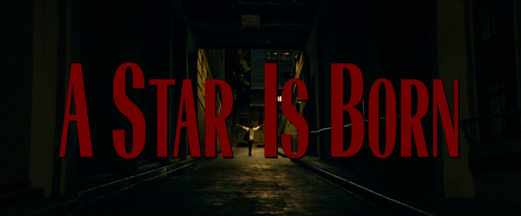
Once the protostar hits 10 million K, there are nuclear reactions that fuse hydrogen and helium
It is finally considered a star
It is considered a main sequence star as long as it completes this process
If the protostar never reaches the final temperature and starts the hydrogen fusion process, it is considered a Brown Dwarf.

Slide 12
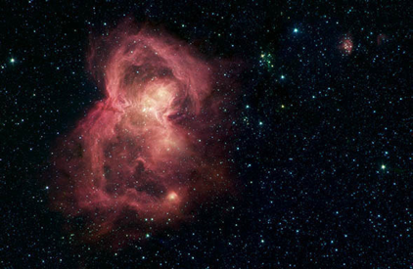
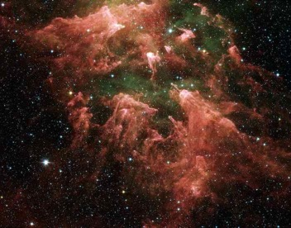
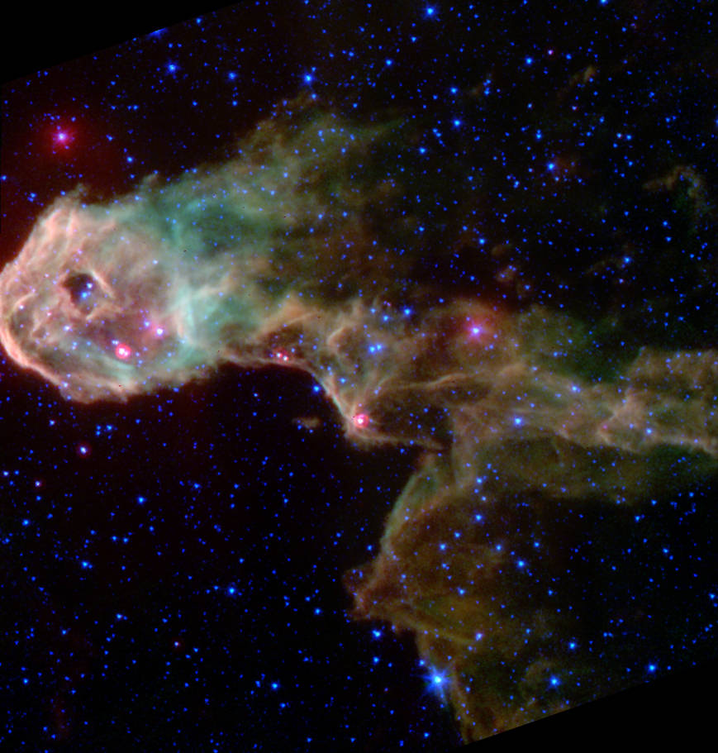
On to the Nebula
The Space Butterfly
Carina Nebula
The Elephant’s Trunk Nebula

Slide 13
The Orion Nebula (M42)
An emission and reflection nebula with an open cluster
It is the closest large star forming region to Earth at 1,500 ly from Earth
It is about 24 ly in diameter
Notes:
Emission nebula is a cloud of interstellar gas and dust that emits light in different colours

Slide 14
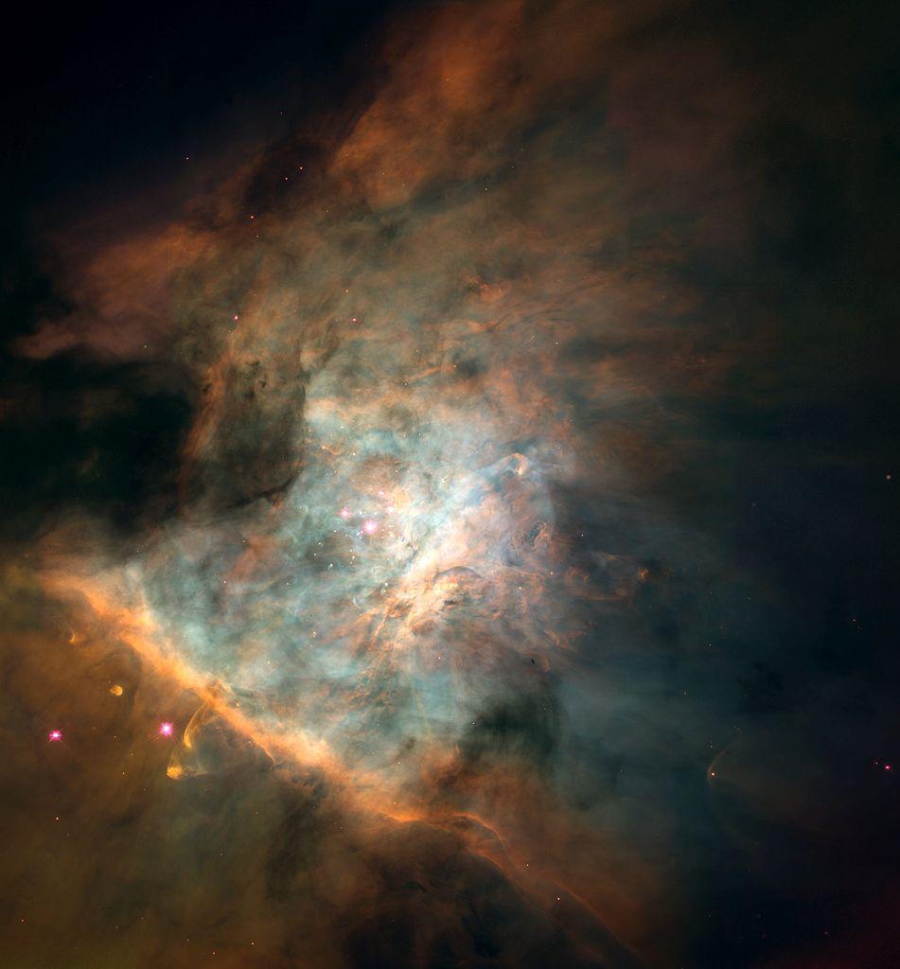
More about M42
The nebula is home to about 700 stars in different stages of formation
Because of its brightness and its prominent location just below Orion’s belt, the Orion Nebula can be spotted with the naked eye
The Trapezium Cluster is a part of M42, which is a cluster in the center of M42

Slide 15
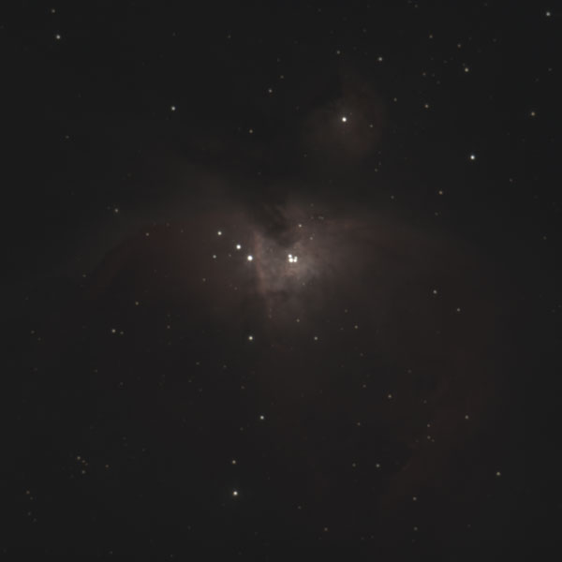
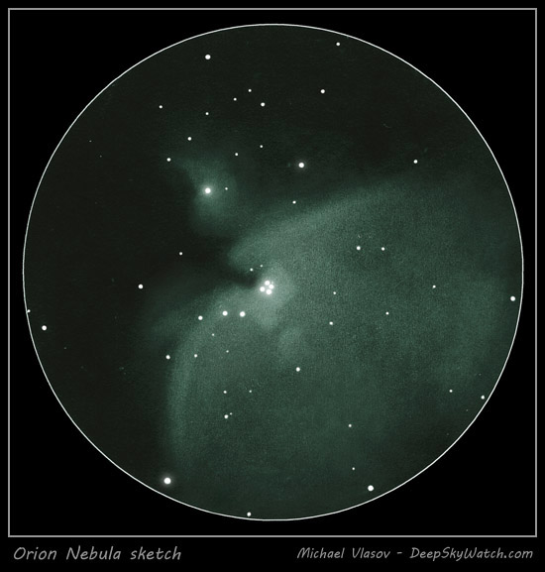
Unedited Picture and Hand Sketch of M42

Slide 16
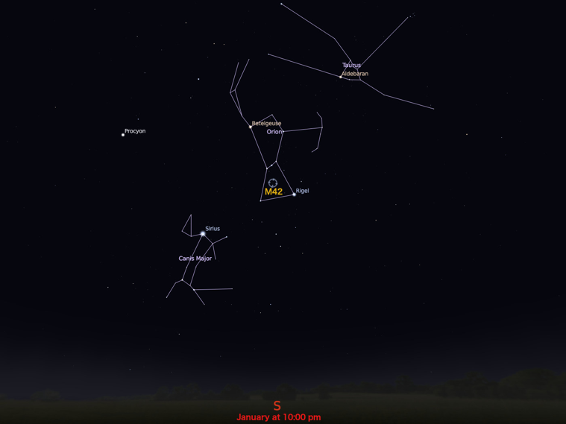
M42 Location
Orion’s Nebula is best observed in January (winter months)
Viewing it with a telescope provides an excellent look at stellar birth

Slide 17
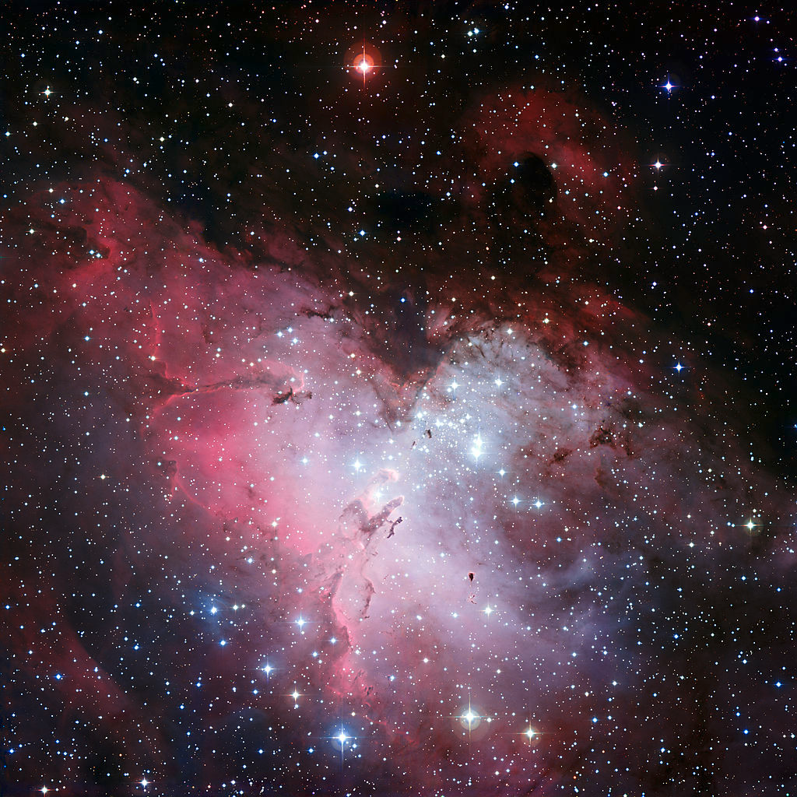
The Eagle Nebula (M16)
An active star-forming region (H II Region)
Spans 70 by 55 ly
Located 7,000 ly from Earth in the constellation Serpens
Discovered in 1745 by the Swiss astronomer Jean-Philippe Loys de Chéseau
Notes:
Pillars of creation first imaged by Hubble in 1995. pillars are 5 light years tall

Slide 18
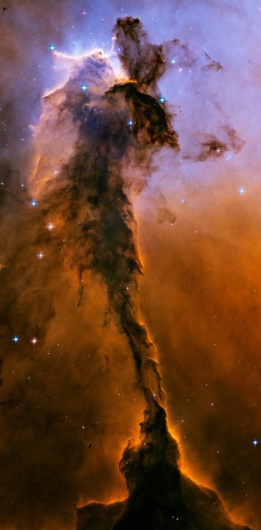
Part of Eagle Nebula
Pictured to the right is Stellar Spire
The tower of gas is about 9.5 ly tall (which is roughly about twice the distance from the sun to the nearest star system, Alpha Centauri

Slide 19
https://www.youtube.com/watch?v=4DoxwB5kWT4#action=share
More about M16
The famous Pillars of Creation are a prominent feature of M16, but they are a relatively small part of the entire nebula.

Slide 20
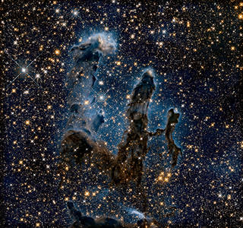
M16 Continued
Looking at the obscuring gas and dust of M16’s Pillars of Creation in infrared light
The benefit of looking in infrared light is that it uncovers a myriad of background stars that were hidden at visible wavelengths
Intense radiation from nearby stars heats and evaporates the gas into space (Pillars of Destruction)
Imaged in 2014 by Hubble to celebrate

Slide 21
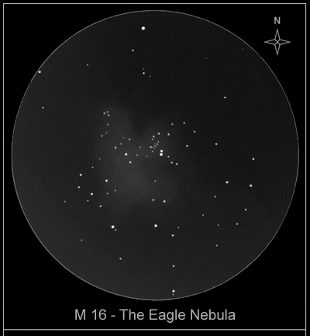
Hand Sketch of M16

Slide 22
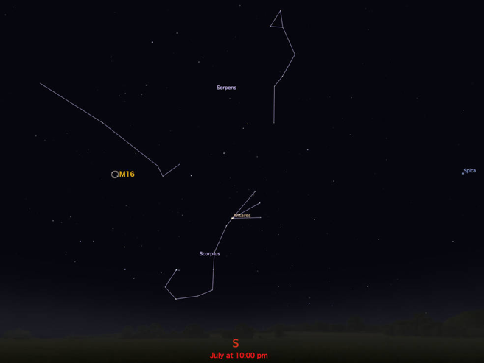
Location of M16
Eagle Nebula can be spotted through a small telescope (best seen in July when Serpens can be seen above the horizon in the southern sky after sunset)
Messier 16 is best seen in a low powered telescope
A large telescope (at least 12-in) and optimal viewing conditions are necessary to resolve the Pillars of Creation

Slide 23
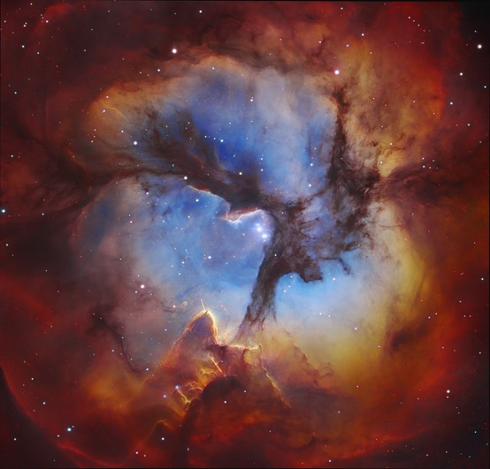
The Trifid Nebula (M20)
Named because of its three-lobed appearance
An H II Region
About 5,000 ly from Earth
Over 300,000 years old
Charles Messier discovered this nebula in 1764
42 ly in diameter

Slide 24
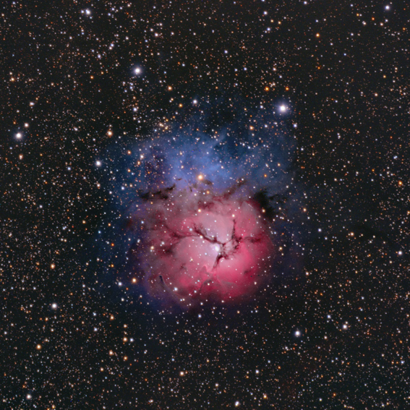
More about M20
Encompasses 3 nebula and an open star cluster
Reflection Nebula
Dark Nebula
Emission Nebula
Open star cluster
Notes:
these hot, young stars becomes too weak to ionize the hydrogen. Now the gas and dust glows blue by reflection! Emission nebula emit their own light. Reflection nebule reflect light from other stars. Dark nebula is so dense that it obscures the light from objects behind it

Slide 25
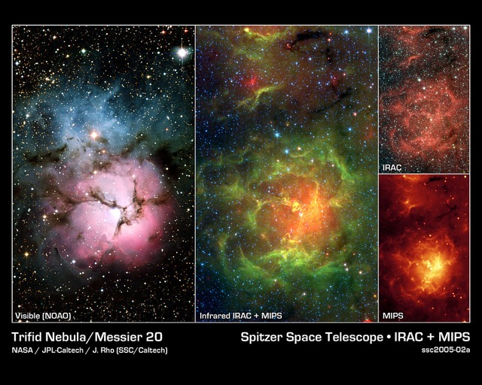
Viewing M20
Can be seen as a hazy patch of light by the naked eye
The nebula’s features can only be seen in telescopes and the object itself doesn’t appear particularly notable in visible light

Slide 26
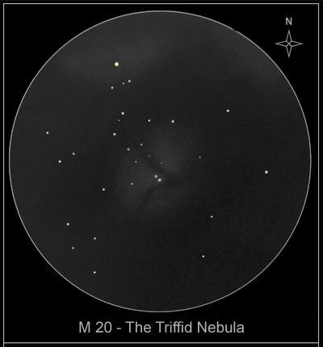
Hand Sketch of M20

Slide 27
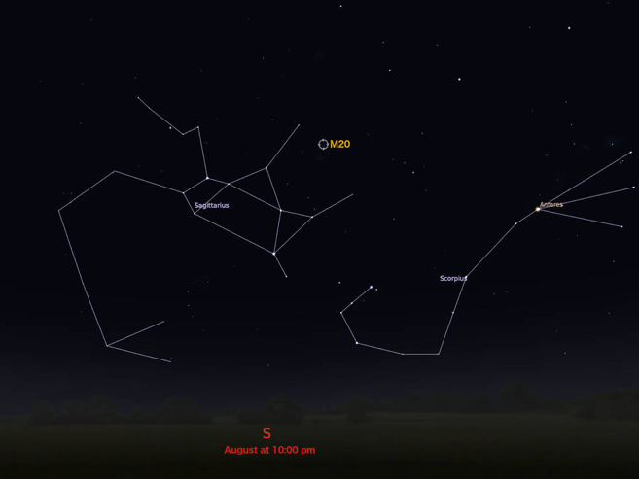
M20 Location
The best time to observe is summer months when Sagittarius is rising over the southern hemisphere in the evening

Slide 28
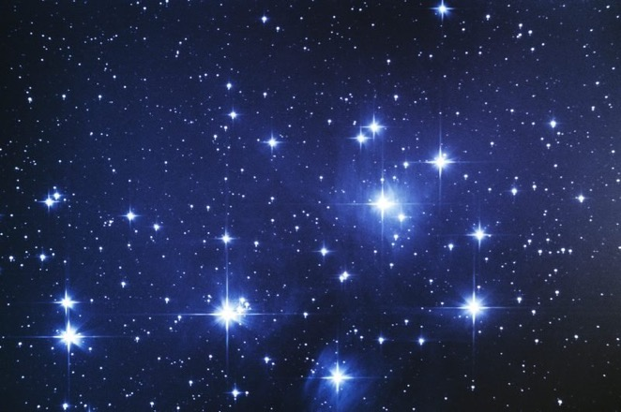
Pleiades (M45)
Also called the seven sisters because of because of the nine very prominent stars (two are the parents of the sisters)
A bright open star cluster located in the constellation Taurus
About 445 ly from Earth
Catalogued by Charles Messier in 1769

Slide 29
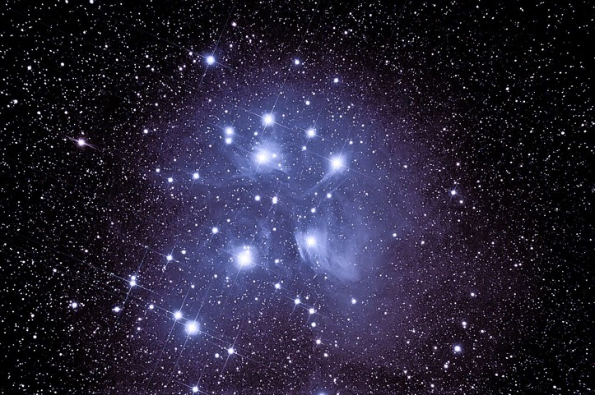
More About Pleiades
The stars in the cluster are physically related because they are all travelling in the same direction at the same rate
The brightest star in the cluster is 8.2x larger than the sun and 2,400x more luminous

Slide 30
Fun Fact about Pleiades!
The Japanese name for Pleiades is Subaru, which is why the logo for Subaru is blue with six stars

Slide 31
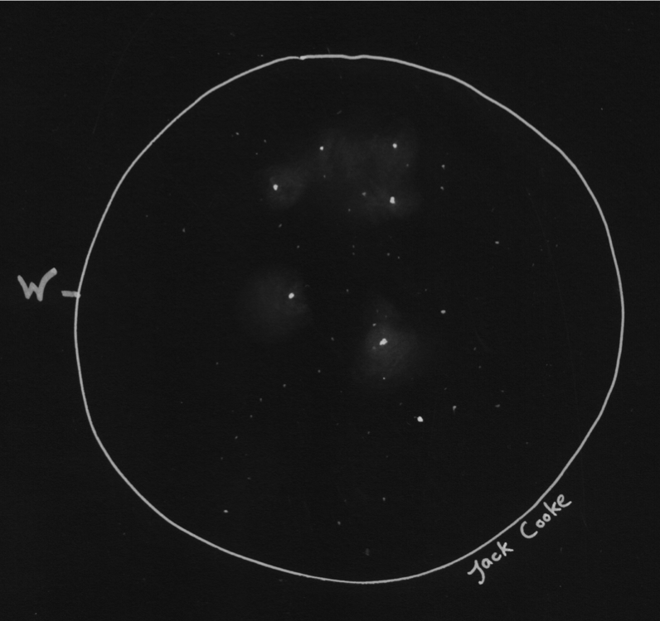
Hand Sketch of M45

Slide 32
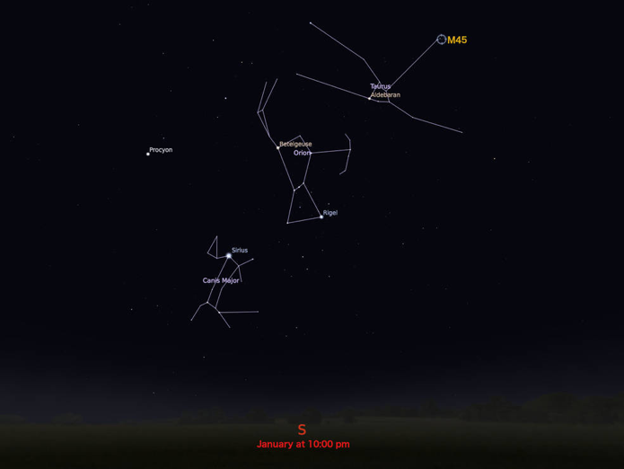
M45 Location
Can be seen with the naked eye, but it it best viewed with binoculars, small or wide telescopes
Higher magnification is only recommended for studying individual stars
The cluster is best observed during January (winter months in general)

Slide 33
References
https://www.sciencedaily.com/terms/open_cluster.htm
http://astronomy.swin.edu.au/cosmos/H/HII+Region
https://www.skyandtelescope.com/astronomy-resources/what-is-a-star/
http://coolcosmos.ipac.caltech.edu/images/174
https://futurism.com/the-life-cycle-of-a-star
http://annyas.com/screenshots/updates/a-star-is-born-2018-bradley-cooper/
http://astronomy.swin.edu.au/cosmos/P/Protostar
https://www.youtube.com/watch?v=W8UI7F43_Yk&list=PL8dPuuaLjXtPAJr1ysd5yGIyiSFuh0mIL&index=36
http://coolcosmos.ipac.caltech.edu/images/173
https://www.jpl.nasa.gov/news/news.php?feature=7359
https://spaceplace.nasa.gov/nebula/en/
https://www.nasa.gov/multimedia/imagegallery/image_feature_643.html
https://spaceplace.nasa.gov/nebula/en/
https://www.nasa.gov/feature/goddard/2017/messier-42-the-orion-nebula
https://www.messier-objects.com/messier-42-orion-nebula/
http://www.waloszek.de/inhalt_astro_dso_m42_e.html
https://www.astro.keele.ac.uk/workx/starlife/StarpageS_26M.html
https://www.nasa.gov/feature/goddard/2017/messier-16-the-eagle-nebula
https://www.messier-objects.com/messier-16-eagle-nebula/
http://www.deepskywatch.com/Astrosketches/eagle-nebula-sketch.html
http://sunshine.chpc.utah.edu/Labs/StarLife/protostars.html
https://hubblesite.org/contents/media/images/2015/01/3468-Image.html?news=true
https://www.messier-objects.com/messier-20-trifid-nebula/
http://www.deepskywatch.com/Astrosketches/triffid-nebula-sketch.html
https://www.nasa.gov/feature/goddard/2017/messier-20-the-trifid-nebula
https://www.messier-objects.com/messier-45-pleiades/
http://www.indigotide.com/astronomy/m45.html
http://www.subaru-global.com
https://star-name-registry.com/blog/item/the-secret-connection-between-the-pleiades-star-cluster-and-a-2500-year-old-scandal
https://stargazerslounge.com/topic/325188-first-sketch-m45/
https://www.nasa.gov/feature/goddard/2017/messier-45-the-pleiades

Slide 34
Questions?

