Slide 1
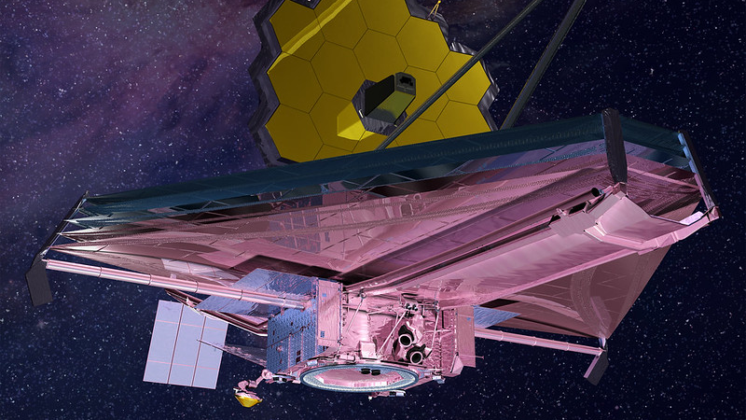
James Webb Space Telescope
Matt Haney – Telescope Design – 2019

Slide 2
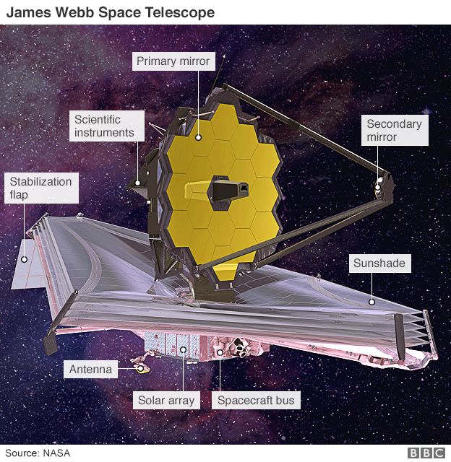
Overview
What is the JWST?
Space-Based Observatory
Optimized for Infrared Wavelengths
Named after James E. Webb
Sponsored by 20+ Countries
What is the purpose of Webb?
Complement Discoveries from the Hubble Space Telescope
Uncover New Information about the Origins of the Universe
Notes:
Webb was the Administrator of NASA from 1961-68
Sponsored by over 20 countries, and spearheaded by NASA, the ESA, and the CSA, which stand for European and Canadian Space Agencies
Specifically to observe the “first light” from the Big Bang and how that played into formation of galaxies

Slide 3
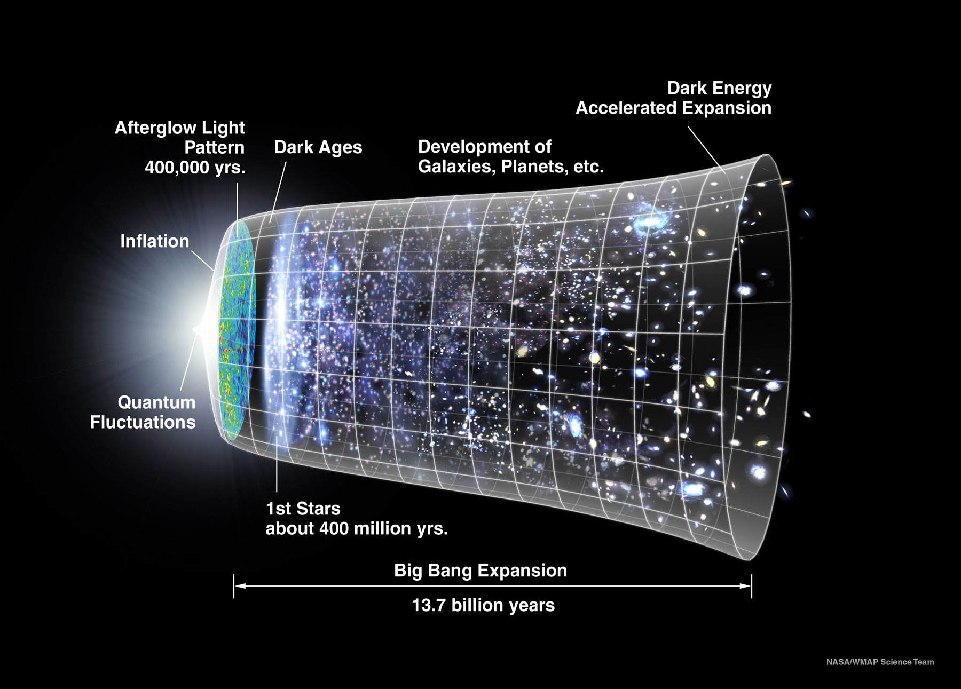
Infrared Astronomy in Space
Why Infrared?
Cosmological Redshift
Penetrates Dust & Gas
Why not on Earth?
Atmosphere blocks Infrared
Absorbed by Water Vapor & Carbon Dioxide
Notes:
Objects from the formation of the Universe undergo a Cosmological Redshift, which basically means wavelength increases as light travels due to electromagnetic radiation

Slide 4
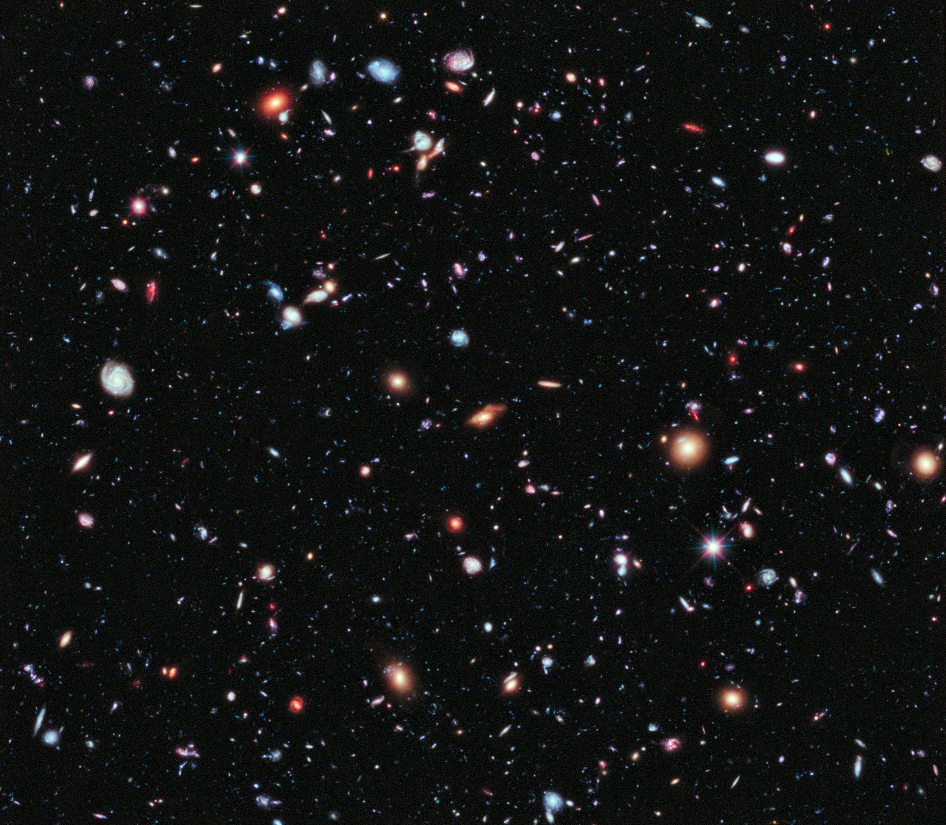
Predecessor: Hubble
Launch Date:
April 24, 1990
Status:
Operational
Mirror Size:
2.4m / 7.9ft
EM Observation Range:
UV to Near-Infrared (0.1m-1μm)
Total Cost:
$4.7 billion USD (at Launch)
“Hubble Deep Field”
Notes:
- Over $10 billion USD to maintain operational costs to-date

Slide 5
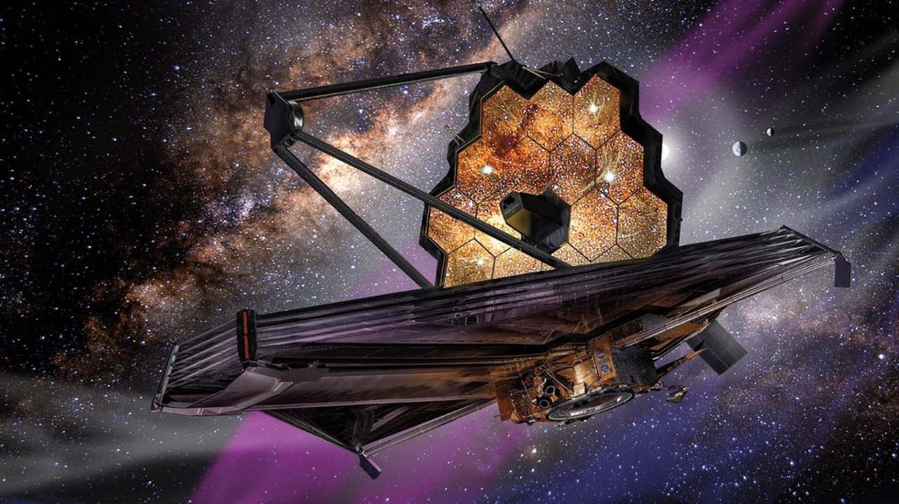
Timeline
Planning Begins: 1996
Named JWST: 2002
Major Redesign: 2005
Cancellation Scare: 2011
Construction Completion: 2016
Testing Launch Delays:
March 2018 - Sunshield Rip
June 2018 – Independent Review Board
Current Planned Launch Date: March 30, 2021
Notes:
- At onset of planning in 1996, the original launch year was scheduled to be in 2007

Slide 6
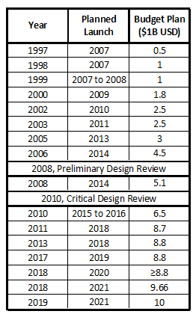
Budget Evolution
Initial Budget: $500M USD (1997)
Start of Construction: $5.1B USD (2008)
Critical Design Review: $6.5B USD (2010)
Cancellation Scare: 2011
Support for JWST: $8B USD (2011)
Current Budget: $10B USD (2019)
Notes:
By the time construction began, the budget had grown 10 times over, from $500 million to $5 billion
In 2010, after the Critical Design Review of the project, the budget grew by another $1.5 billion and the launch date was pushed to late 2015
A year later, due to poor management and a history of being over-budget, the US House of Representatives moved to cancel the project altogether, as well as cut NASA’s overall budget by $1.9 billion
In response, the American Astronomical Society, as well as members of the Senate and press, pushed to continue the project
As a result, Congress reversed plans to cancel and capped the budget at $8 billion

Slide 7
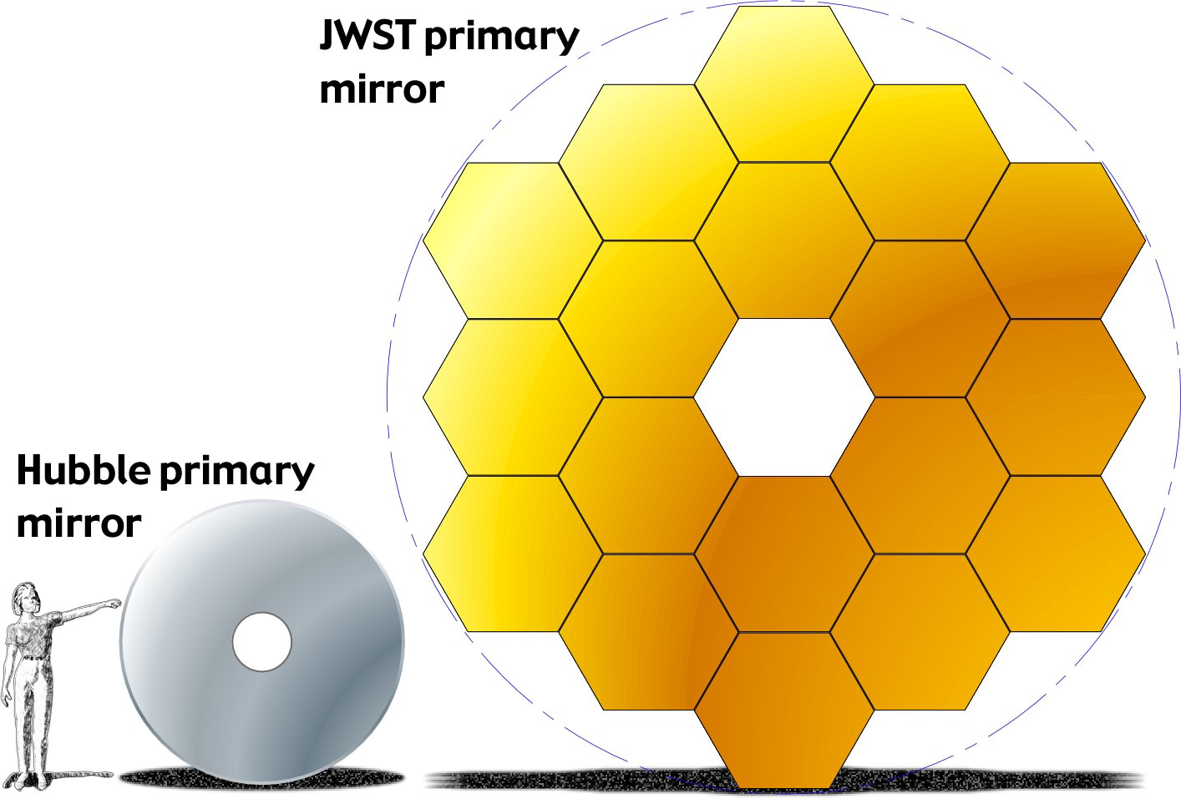
Features: Optics
18 Hexagonal Segments
Gold-Coated Beryllium
Diameter: 6.5m
Surface Area: 25m^2
Precision Micro Motors
Secondary & Tertiary Mirrors
Animation: https://jwst.nasa.gov/content/observatory/ote/mirrors/index.html#1a
Notes:
- Uses precision micro motors for very fine adjustments to the alignment of the mirrors
- Design called “Three Mirror Anastigmat” which utilizes a specific geometry to reduce optical aberrations

Slide 8
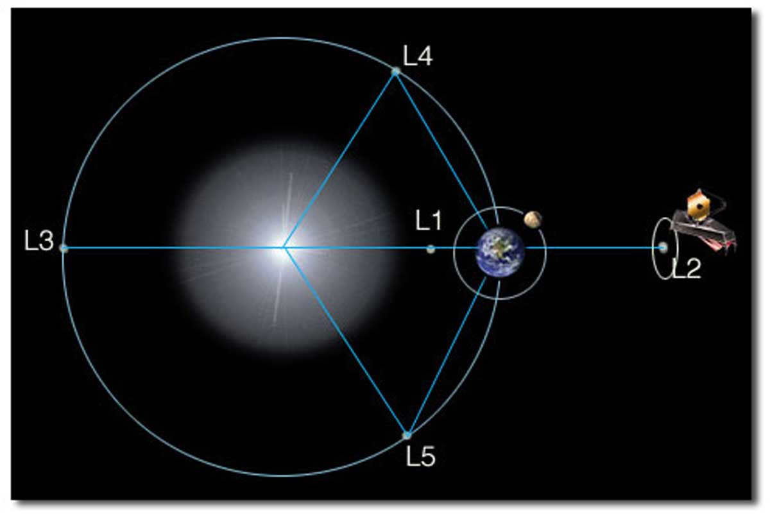
Features: Sunshield
Temperature for Infrared:
Below 50K / −220°C / −370°F
Sunshield Blocks Light & Heat
Lagrange Point Geometry Design
Made of Aluminum & Silicon
Delicate Film subject to Tears
Notes:
Purpose of the Sunshield is to provide the correct environment for infrared observations, which occurs at temperatures below 50K
Anything above this temperature would allow infrared radiation from the telescope itself to disrupt the instruments
So the Sunshield blocks light and heat from the Sun, Moon, and Earth
Lagrange Points – Earth, Sun, Moon, and L2 – create a diamond-shaped geometry that keeps all three points on the same side of the spacecraft at all times to provide very stable operating temperatures (basically creates a hot side and a cold side of the Webb)
Aluminum on one side, silicon on the other
Accidental tears during testing are attributed to slowing down the project

Slide 9
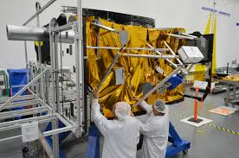
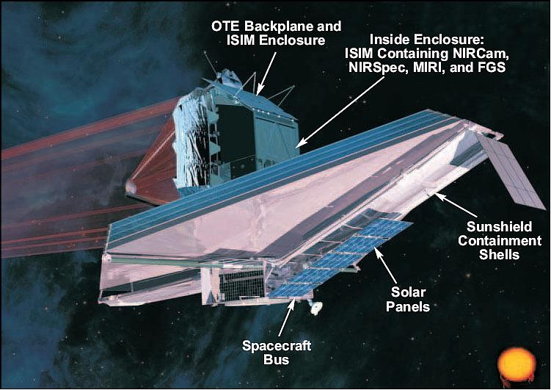
Features: Spacecraft Bus
Primary Support Component
Computing
Communication
Propulsion
Structure
Supports 6.5tons; Weighs 770lb
Material: Graphite Composite Material
Operating Temperature: 300K / 27°C / 80°F
Notes:
- The Spacecraft Bus is the primary support component, as it is where the majority of computing, communication, propulsion and structural mechanisms reside

Slide 10
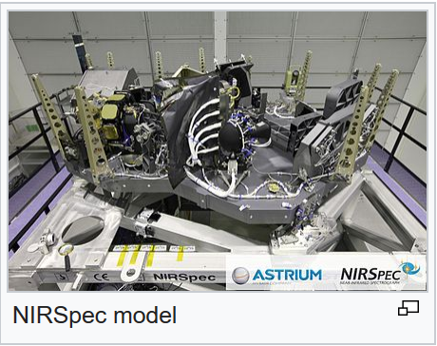
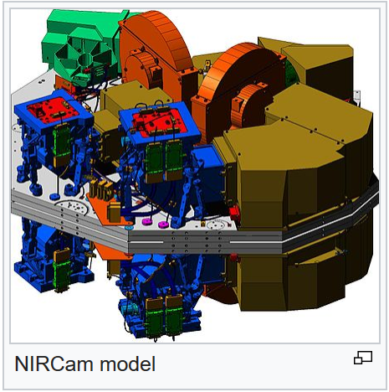
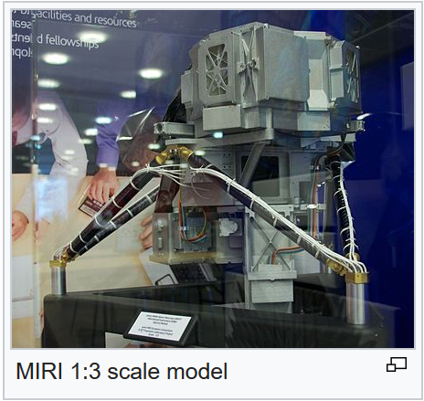
Features: Instrumentation
Integrated Science Instrument Module (ISIM)
Electrical Power
Computing Resources
Cooling Capabilities
Structural Stability
Components
NIRCam
NIRSpec
MIRI
FGS/NIRISS
Notes:
NIRCam stands for Near Infrared Camera, and it has a spectral range of 0.6 to 5 micrometers
NIRSpec stands for Near Infrared Spectography, and it provides three different observation modes: low-resolution, multi-object, and integral field
MIRI stands for Mid Infrared Instrument, and it has a spectral range of 5 to 27 micrometers
FGS/NIRISS stands for Fine Guidance Sensor & Near Infrared Imager & Slitless Spectrograph, which essentially finely steers the mirrors for image stabilization

Slide 11
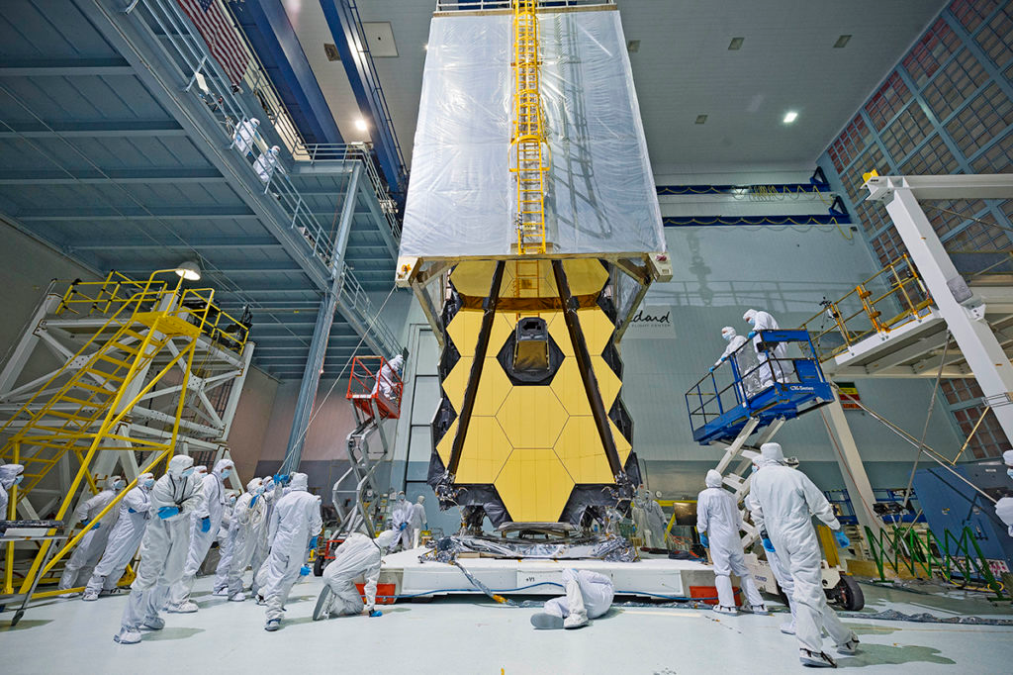
Mission: Goals
Answer Questions About:
The First Light & Reionization
How Galaxies are Assembled
Birth of Stars & Protoplanetary Systems
Origins of Planets & Life
Notes:
When the universe started cooling after the Big Bang, protons and neutrons became ionized atoms of Hydrogen and Helium attracted electrons, making them neutral atoms and simultaneously allowing light to travel for the first time
Scientists plan to compare today’s spiral and elliptical galaxies to the faintest and earliest galaxies that can be observed
The Webb will be able to “see” through dust and gas clouds that appear opaque to the likes of Hubble ST and make new conclusions about the birth of stars
Overall, the goal is to achieve some fresh insight into how and why life exists here on Earth, and if it does elsewhere

Slide 12
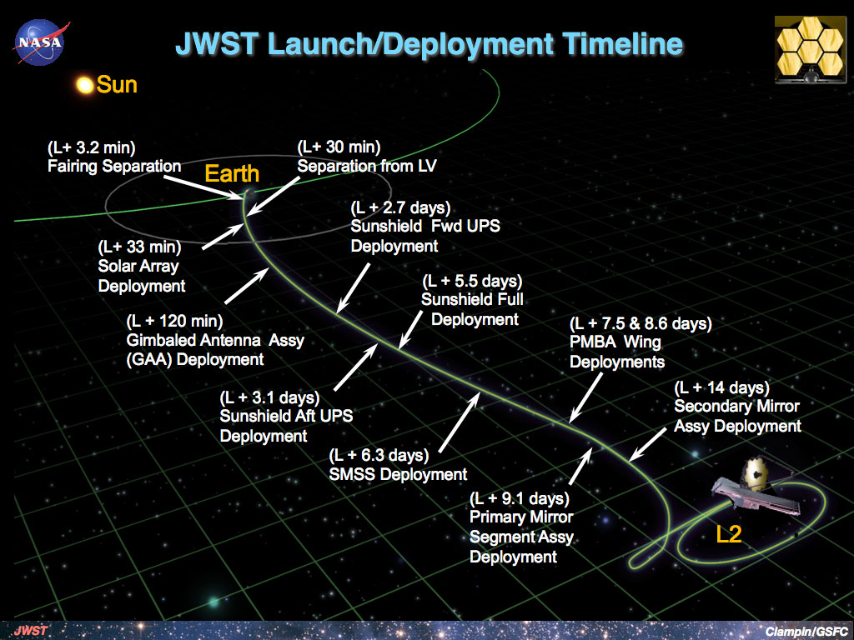
Mission: Launch & Deployment
Launch Details:
Ariane 5 Rocket (ESA)
Kourou, French Guiana
Journey:
30 Days
Notes:
- The Ariane 5 Rocket was a contribution by the ESA, or European Space Agency, and is one of the most reliable launch vehicles
- This specific launch location uses the spin of the Earth near the equator to give the launch an additional push (1670km/hr)
The journey to L2 will take a total of 30 days (roughly 1 million miles), during which the JWST will deploy to full size, as you can see in the picture on the right

Slide 13
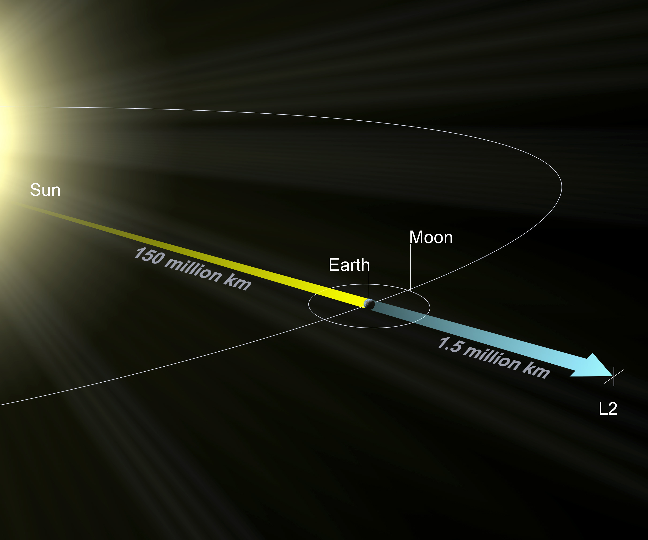
Mission: Orbit Location
Lagrange Point 2 (L2) for Earth-Sun-Moon System
Distance:
930,000mi / 1,500,000km
Trajectory:
Halo Orbit
Adjustments:
2-4m/s per year
Notes:
- L2 is the point in the Earth-Sun-Moon system that is known to gravitational equilibrium
The orbit, however, is not a traditional one. The Webb is actually orbiting the sun at an equilibrium point with no gravitational pull, so its “halo” orbit is more like controlled drifting
Adjustments to keep the Webb in position range from 2-4 m/s per year and occur via onboard thrusters

Slide 14
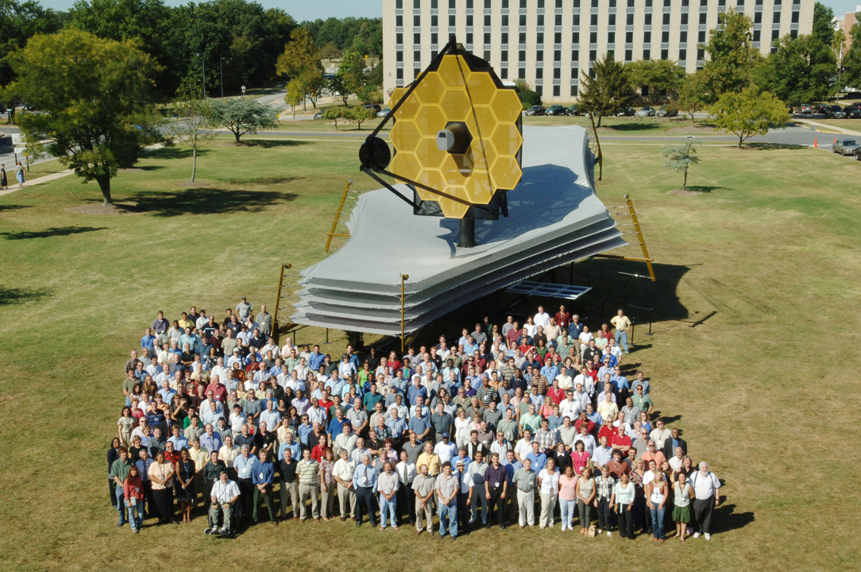
Mission: Ground Support
Headquarters:
Space Telescope Science Institute (STScI)
Collection & Distribution
Bandwith:
458 Gigabits / Day
Proposals
Notes:
Headquarters of the ground-based operations are located at the Space Telescope Science Institute in Baltimore, Maryland, near Johns Hopkins University
The operations are responsible for receiving transmissions with scientific data and distributing online to the astronomical community
Similar to the Hubble Space Telescope, anyone can submit proposals for observations

Slide 15
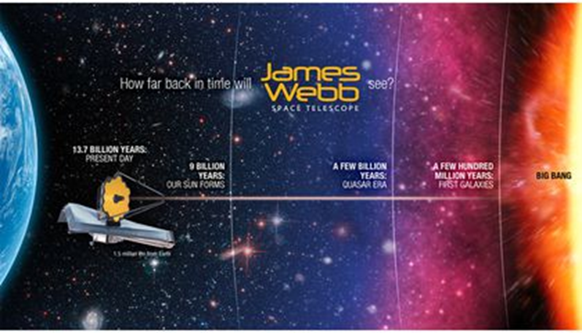
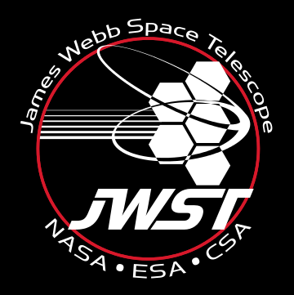
Video
https://www.youtube.com/watch?v=rlz2nNfknww

Slide 16
References
https://www.jwst.nasa.gov/
https://www.nasa.gov/mission_pages/hubble/science/xdf.html
https://en.wikipedia.org/wiki/Hubble_Space_Telescope
https://bigthink.com/jazzy-quick/the-james-webb-space-telescope-will-bring-us-closer-to-a-galaxy-far-far-away
https://www.nasa.gov/images/content/463480main_lagrange_point_lg_1.jpg
https://jwst.nasa.gov/content/observatory/ote/mirrors/index.html#1a
https://jwst.nasa.gov/content/science/firstLight.html
https://jwst.nasa.gov/content/science/galaxies.html
https://jwst.nasa.gov/content/science/index.html
https://en.wikipedia.org/wiki/James_Webb_Space_Telescope_timeline
https://jwst.nasa.gov/content/about/launch.html
https://www.youtube.com/watch?v=rlz2nNfknww

