Slide 1
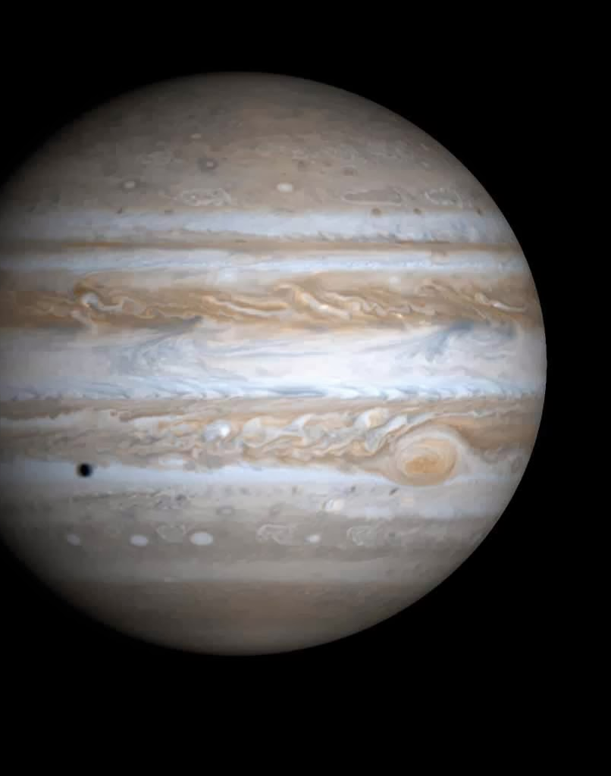
Jupiter & Its 4 Galilean Moons
Melissa Chan-Jones
10/3/2019
https://solarsystem.nasa.gov/planets/jupiter/galleries/?page=0&per_page=25&order=created_at+desc&search=&href_query_params=category%3Dplanets_jupiter&button_class=big_more_button&tags=jupiter&condition_1=1%3Ais_in_resource_list&category=51

Slide 2
Jupiter
Largest planet in our solar System
Gas Giant
5th planet from the sun
Fastest rotating planet

Slide 3
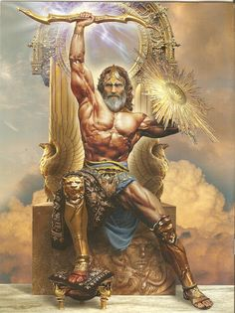
King of The Gods (Zeus Equivalent)
Roman God
Biggest and most powerful god
Leader of all gods
https://www.pinterest.com/braxtonclaypool/jupiter/
Notes:
Due to Jupiter's massive size, it was named after this Roman God.

Slide 4
Discovery
One of the 5 planets seen w/o a telescope
Ancients: first to see Jupiter as a star in the sky w/ naked eye
Galileo: discovered Jupiter as a planet in 1610 w/ a telescope

Slide 5
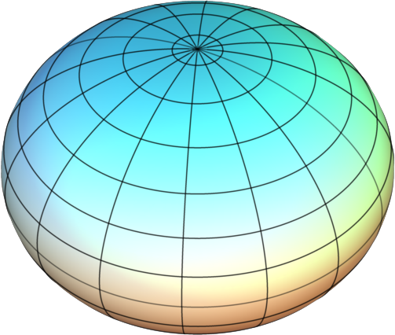
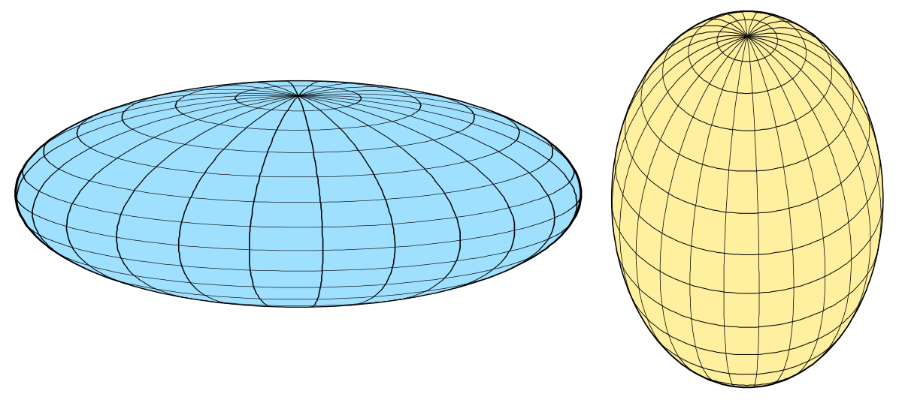
Size & Shape
Largest of the 4 Gas Giants
Oblate Spheroid
Diameter = 88,846 miles
(143,000 km)
11 X Earth's Diameter
Volume = 3.43×10¹⁴ cubic miles
(1.43×10¹⁵ km³)
1,300 X Earth's Volume
Rapid rotation
28,273 mph (43,000 kmph)
Lacks defined solid surface
http://mathworld.wolfram.com/OblateSpheroid.html
https://en.wikipedia.org/wiki/Spheroid

Slide 6
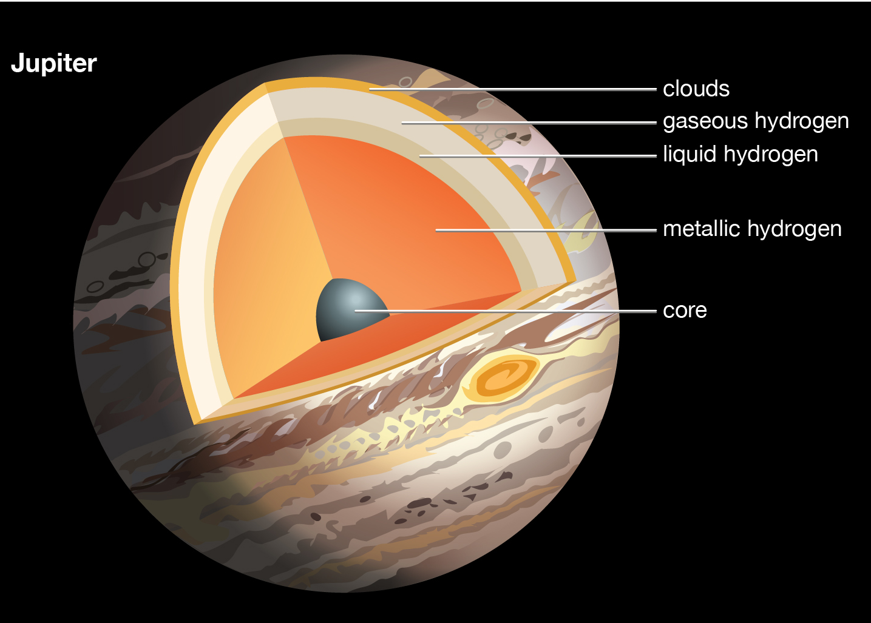
Mass & Composition
1.9 × 10²⁷ kg (4.2 × 10²⁷ lb)
318 x Earth's mass
Atmosphere
75% Hydrogen
25% Helium
Internal
71% Metallic Hydrogen
24% Helium
Metallic hydrogen 78% of radius
Possible rocky solid core
Acts as an electrical conductor
https://www.britannica.com/place/Jupiter-planet

Slide 7
Temperature & Pressure
Atmosphere
67 C (152 F)
Metallic Hydrogen Zone
9,700 C (17,500 F)
Core Boundary
35,700 C (64,300 F)
Atmosphere
1 MPa
Metallic Hydrogen Zone
200 GPa
Core Boundary
3,000 – 4,500 GPa

Slide 8
Gravity
2.4 X greater than Earth's gravity
100 lbs. on Earth = 214 lbs. on Jupiter
Why isn't Jupiter's gravity stronger?
Composition is mostly gas
http://www.cashadvance6online.com/jupiter-from-the-window-wallpapers/4060324246.html

Slide 9
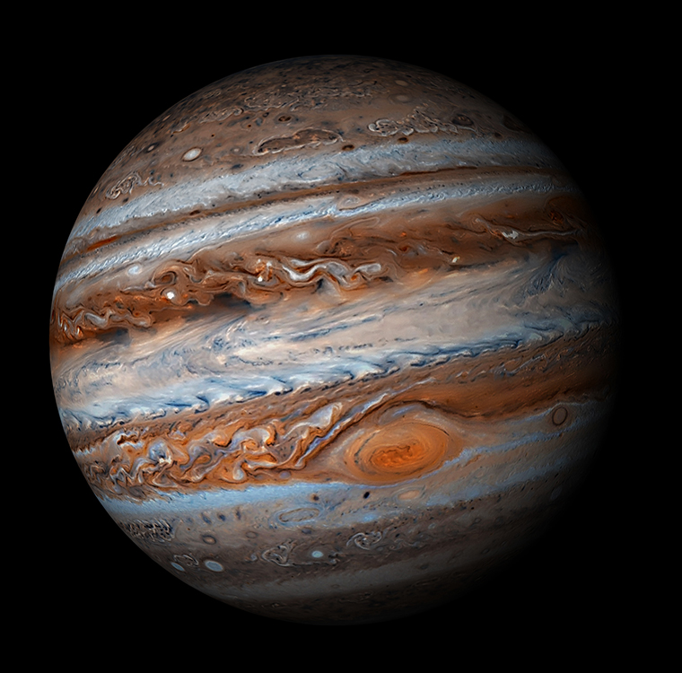
Jupiter's Bands
Zones
Light colored stripes
Regions where the atmosphere is rising
Belts
Dark colored stripes
Sections where the atmosphere is falling
Flows in opposite direction
https://www.mnn.com/earth-matters/space/blogs/jupiters-famous-red-spot-insanely-hot-scientists-probe-explanations

Slide 10
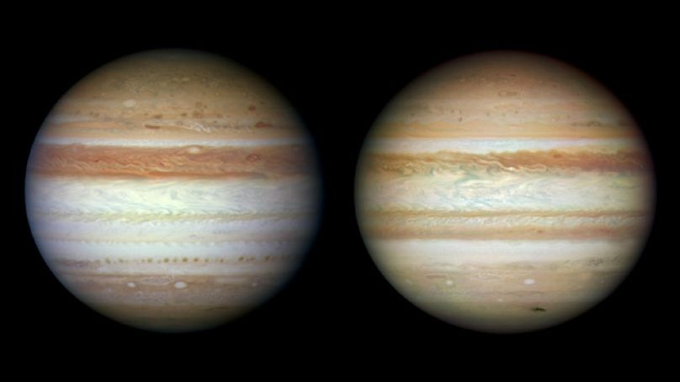
Brown Belts
Disappears every few years
Observed between 2009 and 2010
Changes in the upwelling circulation inside Jupiter somehow brought ammonia-rich material
Obscured by wispy white clouds of icy ammonia crystals
https://www.missionjuno.swri.edu/jupiter/atmosphere?show=hs_jupiter_atmosphere_story_the-stripe-that-disappeared

Slide 11
Great Red Spot
Massive, long lasting storm since the 17th Century
Resulted from Jupiter's bands
Turbulence at their borders
Located: Southern Hemisphere
Discovered: Robert Hooke in 1664
Voyager 1: 1st detailed image in 1979
https://www-m.cnn.com/2019/08/08/world/hubble-new-jupiter-images-scn-trnd/index.html?r=https%3A%2F%2Fwww.google.com%2F

Slide 12
Great Red Spot: Anticyclonic
https://cloudman23.wordpress.com/tag/anticyclonic-circulation/

Slide 13
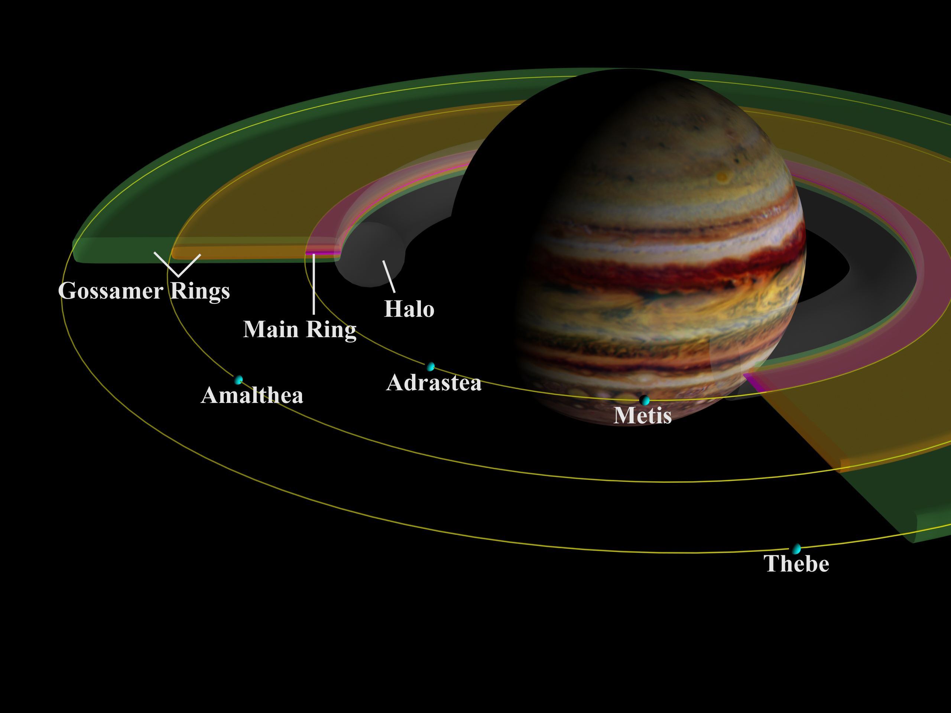
Jupiter's Rings (Jovian Ring System)
3 Segment ring system
Halo
Main Ring
Gossamer
Composed of dust
Unlike Saturn's ice ring
Discovered: 1979 Voyager 1 Space Probe
Investigated: 1992 by the Galileo Orbiter
https://en.wikipedia.org/wiki/Rings_of_Jupiter

Slide 14
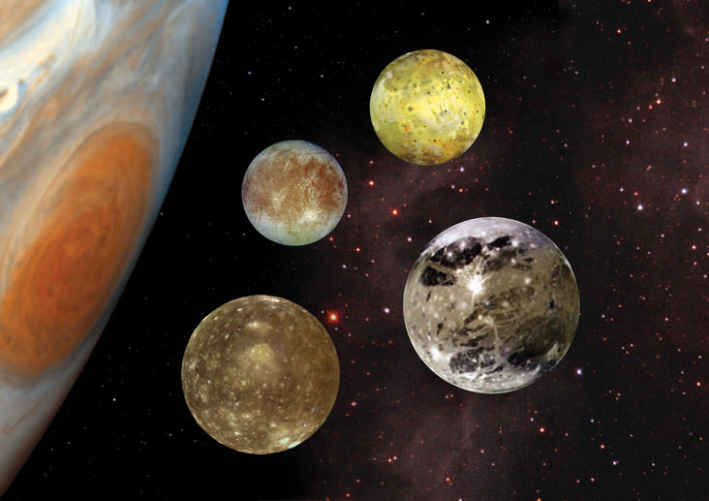
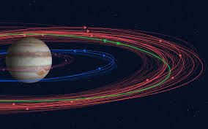
Moons of Jupiter
79 Confirmed moons
Most massive:
Galilean Moons
Io
Europa
Ganymede
Callisto
Discovered: Galileo Galilei in 1610
Moons were first orbiting objects after the sun, earth, & earth's moon
https://www.universetoday.com/15182/interesting-facts-about-jupiter/
https://carnegiescience.edu/news/dozen-new-moons-jupiter-discovered-including-one-%E2%80%9Coddball%E2%80%9D

Slide 15
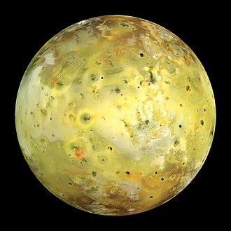
Io
Intermost moon
Highest density: silicate rock surrounding molten iron
Least amount of water in the solar system
Most geologically active: over 400 active volcanoes
Tidal heating from friction inside Io as it orbits Jupiter with other moons
History
Copernican model of solar system
Kepler's laws of motion
1st measurement of the speed of light
https://en.wikipedia.org/wiki/Io_(moon)

Slide 16
Tidal Heating
Io
http://large.stanford.edu/courses/2007/ph210/pavlichin2/

Slide 17
Orbital Resonance
https://www.newunivars.com/2019/07/orbital-resonance.html

Slide 18
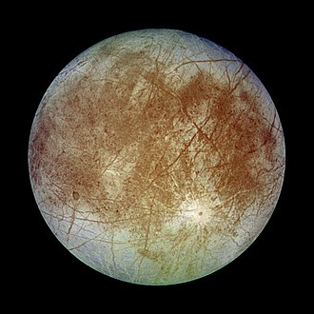
Europa
Smallest of the Galilean Moons
Composed of silicate rock w/ ice crust
Smoothest moon in our Solar System
Hubble Space telescope detected water plumes
Possible salty ocean beneath crust from observed deep magnetic field during Galileo flyby
Could harbor extraterrestrial life
Liquid Water, chemical elements, energy source: NASA Europa Clipper
https://en.wikipedia.org/wiki/Europa_(moon)

Slide 19
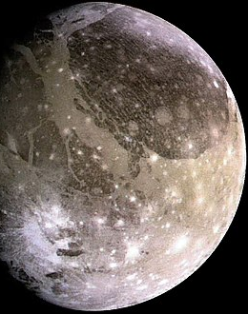
Ganymede
Largest Moon in our Solar System
Diameter: 5,268 km (3,273 miles)
Only moon with a magnetic field
Convection of iquid iron core
Lowest moment of inertia factor in our solar system
Composed of silicate rock & watery ice
Large ocean (more water than Earth's oceans)
Liquid iron core
European Space Agency's Jupiter Icy Moon Explorer (JUICE)
Launches in 2022
https://en.wikipedia.org/wiki/Ganymede_(moon)

Slide 20
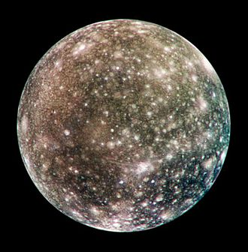
Callisto
Composed of rock and ice
Most heavily cratered object in our Solar System
No signs of plate tectonics or volcanism
Not in orbital resonance with other Galilean Moons
Not tidal heated
Tidally locked
Low radiation levels
Human exploration of the Jovian System
Internal ocean
Could harbor life
Not as ideal as Europa
https://en.wikipedia.org/wiki/Callisto_(moon)

Slide 21
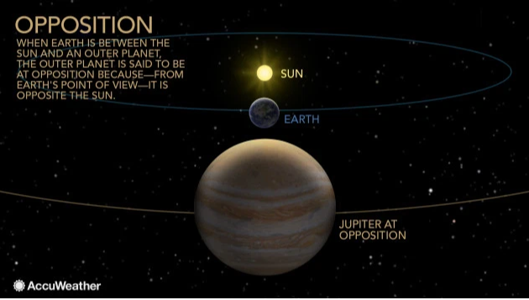
Opposition of Jupiter
Best time to observe
June 12, 2019
Viewable all night
Closest to Earth
Occurs every 13 months
https://www.accuweather.com/en/weather-news/jupiter-opposition-the-planet-will-be-at-its-brightest-on-tuesday-night/70004871

Slide 22
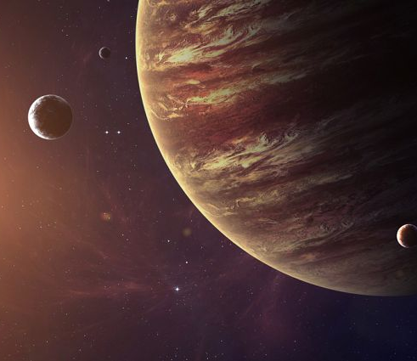
Fun Facts!
Protector
Gravitational field pushes comets & asteroids away from the inner planets
2nd brightest planet after Venus
Planet & its moons can be seen w/ powerful binoculars from Earth
https://www.worldatlas.com/articles/interesting-facts-about-jupiter.html

Slide 23
Thank you! Questions?

Slide 24
References
https://solarsystem.nasa.gov/planets/jupiter/overview/
https://en.wikipedia.org/wiki/Jupiter
https://www.space.com/7-jupiter-largest-planet-solar-system.html
https://nineplanets.org/jupiter.html
https://www.universetoday.com/15182/interesting-facts-about-jupiter/
https://theplanets.org/jupiter/
https://www.timeanddate.com/astronomy/planets/distance

