Slide 1
Gravitational Wave Astronomy
LIGO – LASER Interferometry Gravitational-Wave Observatory

Slide 2
Interferometry
A method based on constructive/destructive nature of waves
A common method to measure lengths precisely
How precise is LIGO (LASER Interferometry Gravitation Observatory)…
detects changes in length of 1/10,000 the diameter of a proton!!!
1/10,000 the diameter of a proton!!!
1/10,000 the diameter of a proton!!!

Slide 3
Virgo (Italy) LIGO (US, 2 locations) KAGRA (Japan)
The world's three principal gravitational-wave detectors - LIGO in the US, VIRGO* in Italy, and now KAGRA in Japan – on the 4th of October, 2019, signed a memorandum of agreement (MoA) that covers scientific collaboration.

Slide 4
The 2017 Nobel Prize in Physics awarded to three key players in the development and ultimate success of the Laser Interferometer Gravitational-wave Observatory (LIGO): Barry C. Barish, Kip S. Thorn, Rainer Weiss.

Slide 5
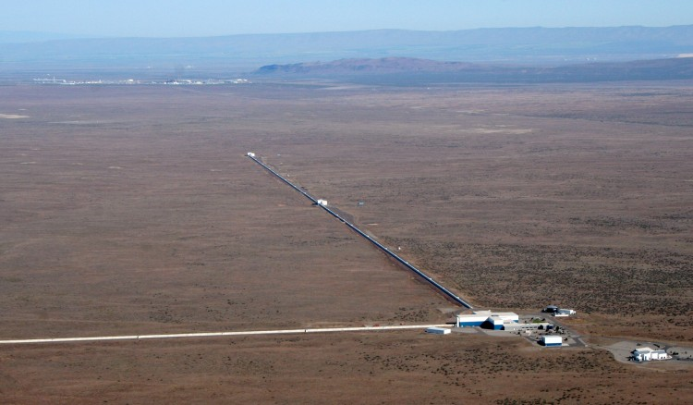
LIGO – Hanford, Washington and Louisiana
WHY 2 DETECTORS?

Slide 6
LIGO's Extreme Engineering
Two “blind” L-shaped detectors with 4 km long vacuum chambers...
situated 3000 kilometers apart and operating in unison...
to measure a motion 10,000 times smaller than an atomic nucleus (the smallest measurement ever attempted by science)...
caused by the most violent and cataclysmic events in the Universe...
occurring tens-of-millions or billions of light years away!
https://www.ligo.caltech.edu/page/facts
https://www.youtube.com/watch?v=wrqbfT8qcBc

Slide 7
LIGO’s first detection, Sept. 14 2015:
https://www.youtube.com/watch?v=0HxYBMD48Jc
2 years later…On October 16, 2017, the LIGO Scientific Collaboration, Virgo Collaboration, and its partners announced the first observation of gravitational-waves from a pair of in-spiraling neutron stars. Electromagnetic emission from the resulting collision was also observed in multiple wavelength bands. This occurred on August 17, 2017 and represents the first time a cosmic event was observed with both gravitational waves and light:
https://www.ligo.org/detections/GW170817.php

Slide 8
LIGO Today
Improvements continue to be made on the detectors
Now on its Third Observing session. Started April 2019 and continues.

Slide 9
Visit to LIGO
Visit LIGO near Hanford, Washington:
https://www.ligo.caltech.edu/WA/page/lho-tours-and-events
While in the neighborhood, consider visiting Hanford nuclear site (part of the Manhattan Project, now open to the public):
https://www.hanford.gov/page.cfm/HanfordSiteTours

