Slide 1
MarS
Dylan Silva
September 24, 2019

Slide 2
History (Red Planet, Ares, Her Desher)
Recorded observations of Mars date as far back as the era of ancient Egypt over 4,000 years ago
The reason Mars looks reddish is due to oxidization—or rusting—of iron in the rocks, regolith (Martian “soil”), and dust of Mars
By the 2nd millennium BCE they were familiar with the apparent retrograde motion
The Babylonians associated Mars with Nergal, their god of war and pestilence

Slide 3
History
Some features suggest that Mars experienced huge floods about 3.5 billion years ago
Appears to have had a watery past, with ancient river valley networks, deltas and lakebeds, as well as rocks and minerals on the surface that could only have formed in liquid water
Areas of the Martian crust in the southern hemisphere are highly magnetized, indicating traces of a magnetic field from 4 billion years ago.

Slide 4
Today
Top and bottom of the planet both experience growth of polar ice caps during the respective northern and southern winters
Occasionally, winds on Mars are strong enough to create dust storms that cover much of the planet. After such storms, it can be months before all the dust settles.
Large features such as Valles Marineris and Olympus Mons can be seen
Mares (dark areas) can be seen with a smaller backyard telescope

Slide 5
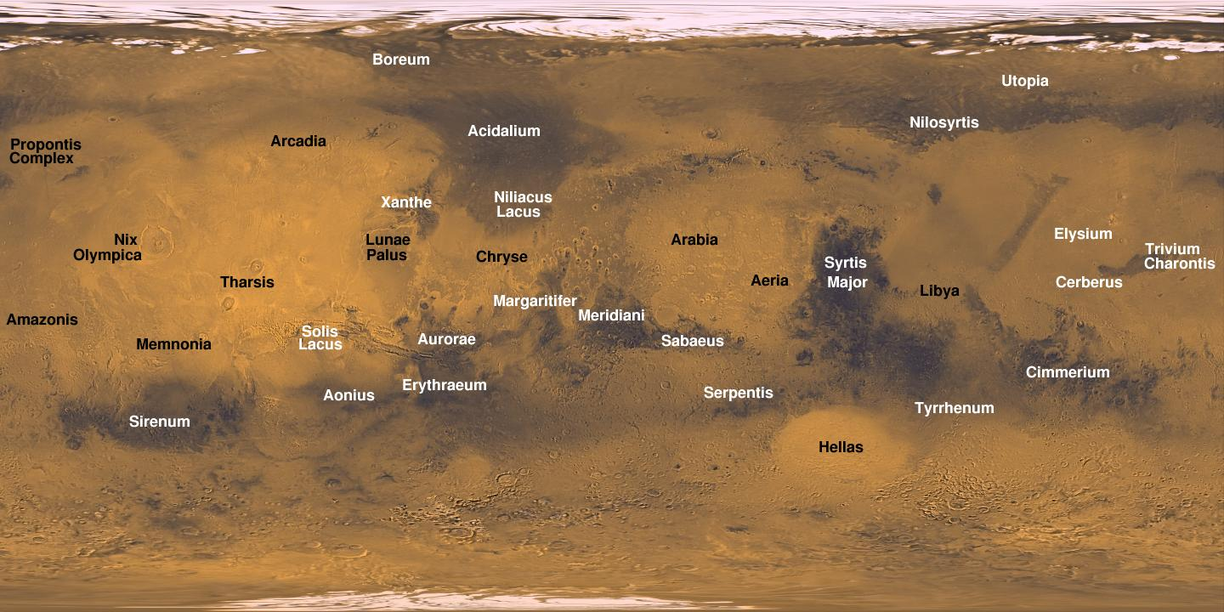
Notes:
Valles Marineris, a valley deeper and longer than the Grand Canyon, and the tallest Volcano in the solar system – Olympus Mons

Slide 6
Surface Features
Wind-formed dunes
Sedimentary deposits
Recurring Slope Lineae (RSL)
Thought to be salty water flows during the warmest months or dry grains that flow downwards
Olympus Mons
Large basaltic shield volcano
374 mi. diameter
16 mi. High (3x taller than Mt. Everest)

Slide 7
Meteorites and Minerals
Most meteorites from Mars are igneous rocks known as basalt
The oldest Mars meteorite is 4.1 billion years old
The oldest known minerals from Mars are 4.4 billion years old zircons (zirconium silicate)
The youngest known rocks from Mars are basaltic meteorites, found to be 180 million years old
Rock types: igneous basalt, sedimentary sandstone, mudstone, impactites, etc.
Minerals: feldspar, carbonates, silica, phosphates, iron oxides, sulfates, etc.

Slide 8
Similarities and Differences to Earth
Majority of rocks on surface are basalt
Has an atmosphere, crust, mantle and core
Has four seasons and weather patterns
No active plate tectonics or magnetic field
Liquid water is not stable on Mars
Atmosphere is thin (pressure is 0.6% of Earth's)

Slide 9
Mars vs. Earth
Avg. Dist: 142 million miles (93 million miles)
Avg. Speed: 14.5 miles per sec (18.5)
Diameter: 4,220 miles (7,926)
Revolution around Sun: 687 Earth days (365.25)
Day: 24 hr 37 min (23 hr 56 min)
0.375 of Earth's gravity
Avg. Temp: –81 F (57 F)
Atmosphere: 96% CO2, nitrogen, argon, some water vapor
2 moons (Phobos and Deimos)

Slide 10
Phobos and Deimos
Phobos (fear), Deimos (panic)
Named after the two horses that pulled the chariot of Ares
Discovered in 1877 by American astronomer Asaph Hall
Surface materials similar to many asteroids in the outer asteroid belt
Scientists believe they are captured asteroids
Visible with amateur telescopes
Notes:
moons are visible with amateur scopes (points of light/star like)

Slide 11
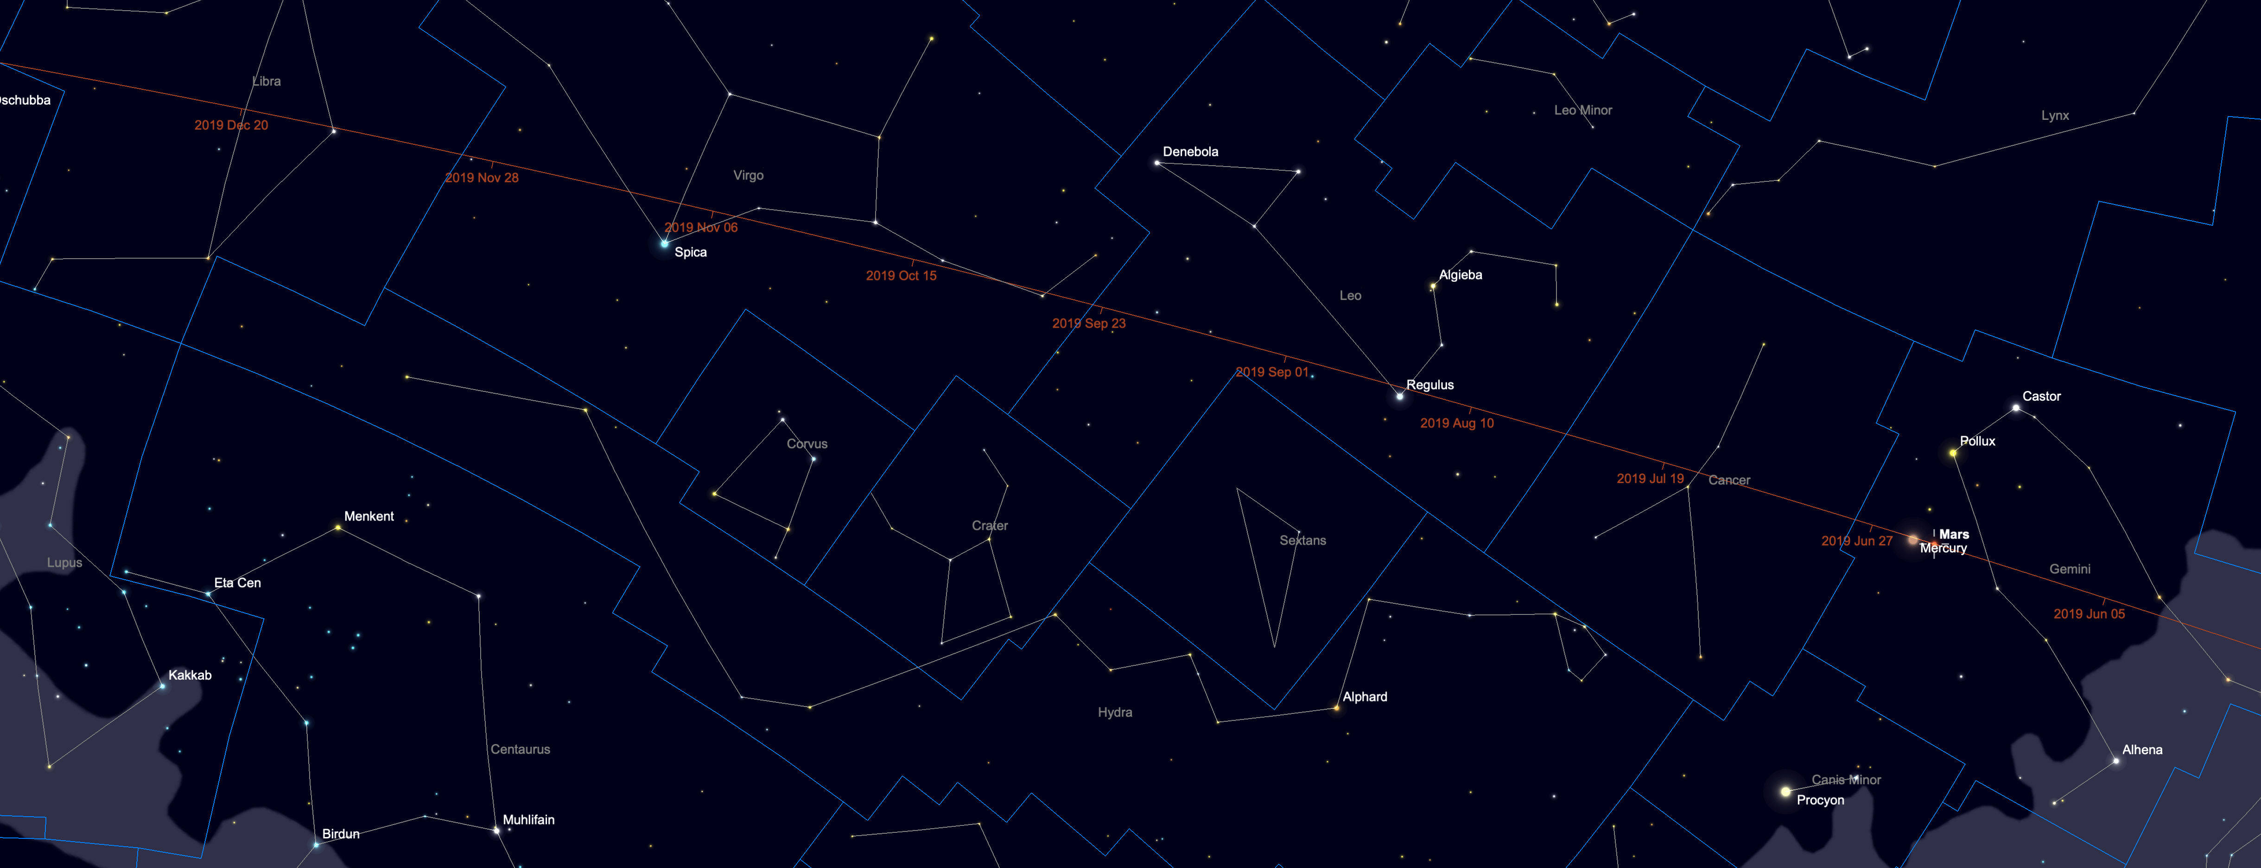
Observation
Path of Mars in 2019
You can see that it will travel from Gemini in early summer, through Cancer, Leo, Virgo and ending the year in Libra.
Mars reappears in the morning sky, rising an hour before the sun in the middle of the month.
A decent telescope will struggle to show any detail

Slide 12
Observation
In November, look east in Virgo an hour before sunrise and, in December, look 20° above the southeast horizon an hour before sunrise
Mars will appear as a very small distinct disc
Use a bright green eyepiece filter to increase surface contrast
8" Telescope, a few days after Mars opposition on April 8th, 2014

Slide 13
Mars Close Approach
When Mars and Earth come nearest to each other in their orbits around the sun
When Mars and Earth are close to each other, Mars appears very bright in our sky. It also makes it easier to see with telescopes or the naked eye.
Exceptional viewing only once or twice every 15 or 17 years
It is closely related to Mars Opposition and Mars Retrograde
Notes:
very good view on a very good night with a very good amateur telescope

Slide 14
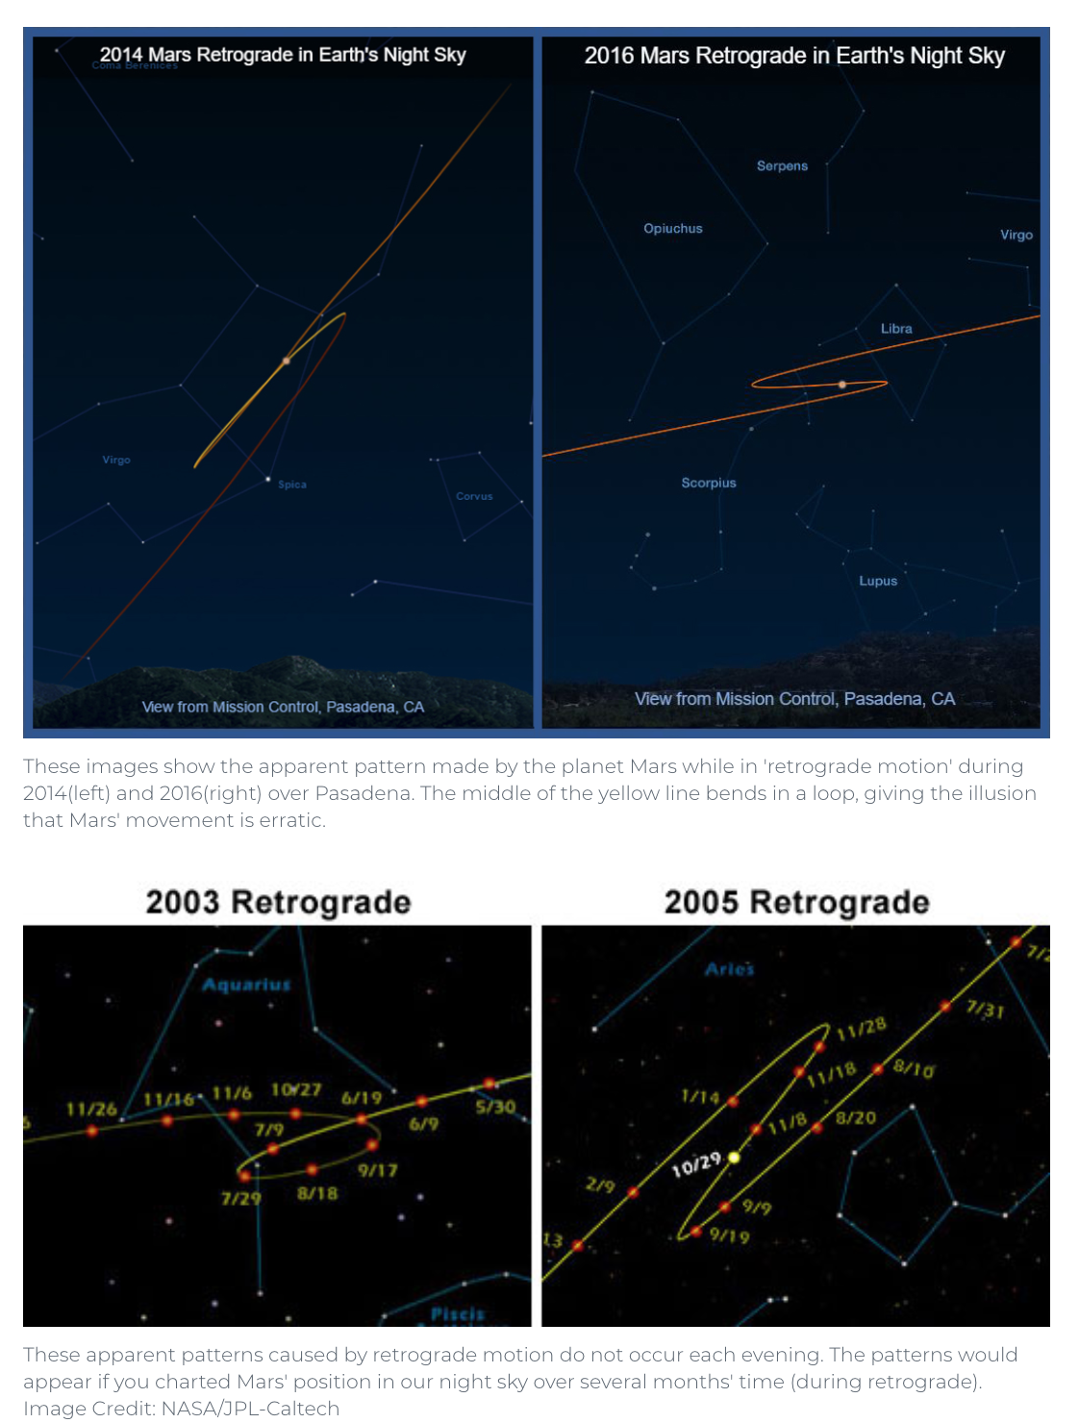
Mars Retrograde
Every two years or so, there are a couple of months when Mars' position from night to night seems to change direction and move east to west
https://www.youtube.com/watch?v=72FrZz_zJFU

Slide 15
Mars Opposition
Mars and the sun are on directly opposite sides of Earth.
From our perspective on our spinning world, Mars rises in the east just as the sun sets in the west
Mars oppositions happen about every 26 months
When it happens while the red planet is closest to the sun (called "perihelic opposition"), Mars is particularly close to Earth
The 2003 opposition was the closest approach in almost 60,000 years; our 2003 record will stand until August 28, 2287
Appears bigger and brighter

Slide 16
Exploration
Mariner 4 collected the first up-close photographs of Mars lunar type impact craters and studied the solar winds (1964)
Mariner 9 had the first close up pictures of Phobos and Deimos (1971)
NASA's Viking Project was the first U.S. mission to land a spacecraft safely on Mars surface (1975)

Slide 17
Rovers
Pathfinder rover collected samples and suggested a warm, wet, thick atmosphere in Mars past (1996)
Spirit and Opportunity Rovers provided high res pictures (2003)
Curiosity Rover found chemical and mineral evidence of past habitable environments (2011)

Slide 18
Orbiters
Viking 1&2 conducted biology experiments to find possible signs of life (1975)
Mars Global Surveyor provided 3-D pictures of the polar ice caps (1996)
Mars Odyssey found data on radiation in low Mars orbit (2001)
Mars Express found data on glacial activity, explosive volcanism, and methane gas (2003)
Mars Reconnaissance provided detailed view of the geology and structure, identifying obstacles that could jeopardize future landings and rovers (2005)
Maven obtains critical measurements on the atmosphere and understand drastic climate change on Mars and how fast it loses gases to space (2013)

Slide 19
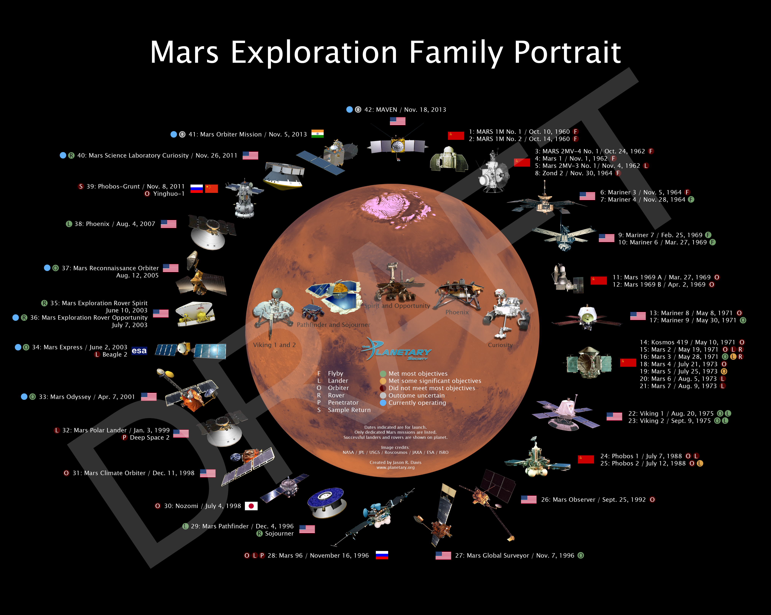

Slide 20
Works Cited:
Baalke, Ron. “The Los Angeles Meteorite.” NASA, NASA, 30 Jan. 2000, www2.jpl.nasa.gov/snc/la.html.
“Mars Facts | All About Mars – NASA's Mars Exploration Program.” NASA Science Mars Exploration Program, NASA, 27 July 2019, mars.nasa.gov/all-about-mars/facts/.
“Mars Opposition | Mars in Our Night Sky – NASA's Mars Exploration Program.” NASA Science Mars Exploration Program, NASA, 21 June 2018, mars.nasa.gov/all-about-mars/night-sky/.
“Mars.” NASA Science Solar System Exploration, NASA, 6 June 2019, solarsystem.nasa.gov/planets/mars/in-depth/.
“NASA's Mars Exploration Program.” NASA Science Mars Exploration Program, NASA, 3 June 2014, mars.nasa.gov/#red_planet/2.
“Olympus Mons.” NASA Mars Exploration Program, NASA, mars.jpl.nasa.gov/gallery/atlas/olympus-mons.html.
“Seasonal Flows on Warm Martian Slopes.” Wikipedia, Wikimedia Foundation, 7 Sept. 2019, en.wikipedia.org/wiki/Seasonal_flows_on_warm_Martian_slopes.
“Summary | Martian Moons – NASA's Mars Exploration Program.” NASA Science Mars Exploration Program, NASA, 21 June 2018, mars.nasa.gov/all-about-mars/moons/summary/.
Witze, Alexandra. “Mars Rover Detects 'Excitingly Huge' Methane Spike.” Nature News, Nature Publishing Group, 24 June 2019, www.nature.com/articles/d41586-019-01981-2.
Madrigal, Alexis C. “From Sojourner to Curiosity: A Mars Rover Family Portrait.” The Atlantic, Atlantic Media Company, 6 Aug. 2012, www.theatlantic.com/technology/archive/2012/08/from-sojourner-to-curiosity-a-mars-rover-family-portrait/260779/.
“The Mars Exploration Family Portrait Is Expanding, and I Need Your Help.” The Planetary Society Blog, www.planetary.org/blogs/jason-davis/20140204-mars-portrait-expanding.html.
“Mars Facts.” Nine Planets, nineplanets.org/mars.html.
“See Mars With A Telescope [Easy Guide to Finding And Observing Mars].” Love the Night Sky, 15 Aug. 2019, lovethenightsky.com/how-to-see-mars/.
“Timeline of Mars Exploration | Mars Exploration Section – NASA's Mars Exploration Program.” NASA, NASA, 26 June 2017, mars.nasa.gov/mars-exploration/timeline/.
RichardB1983, director. Planet Mars Through a Telescope. YouTube, YouTube, 13 Apr. 2014, www.youtube.com/watch?v=jdecDSzLYnE.
Astrogirlwest, director. Retrograde Motion and the Opposition of Mars. YouTube, YouTube, 4 Nov. 2009, https://www.youtube.com/watch?v=72FrZz_zJFU
“Mars MAVEN Orbiter.” NASA, NASA, mars.nasa.gov/maven/.
Rueb, Jeanette. “May 30, 1971: Mariner 9 Heads for Mars.” History 101, History 101, 31 May 2019, www.history101.com/may-30-1971-mariner-9-heads-mars/.

