Slide 1
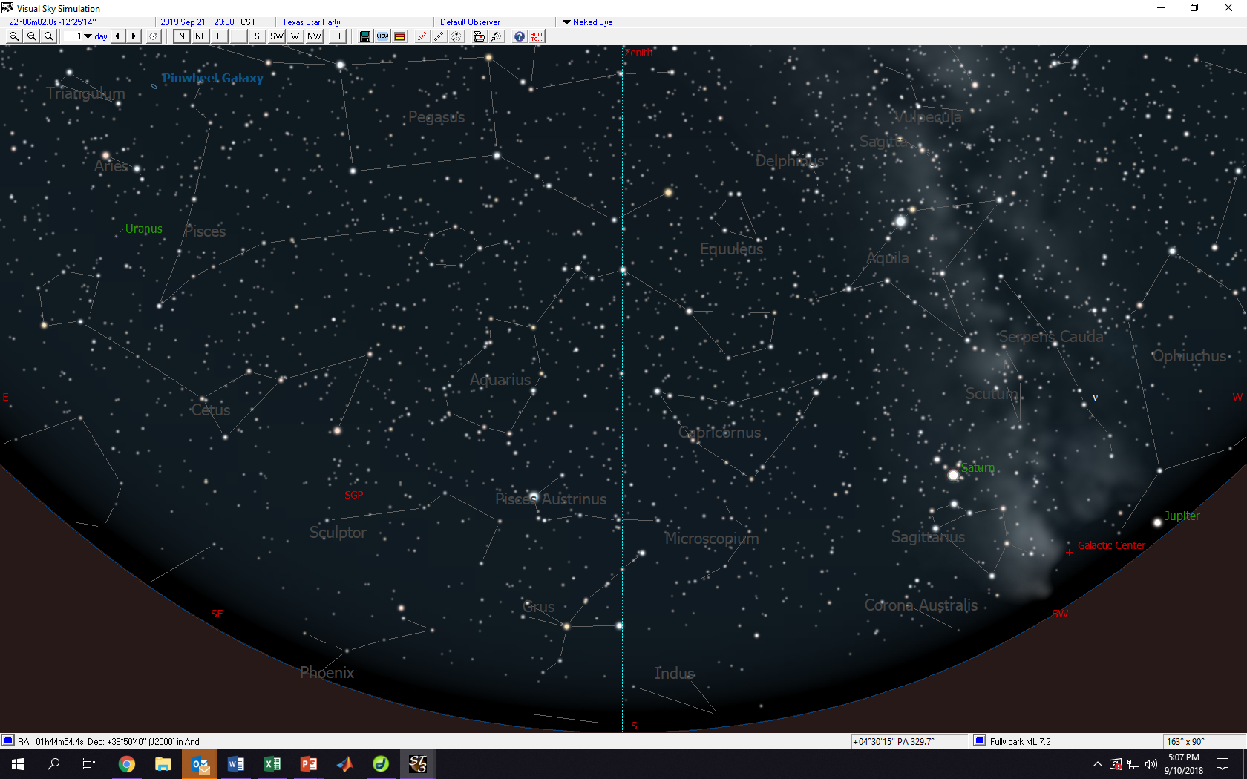
2300 (11PM) September 21
Blue line is meridian.

Slide 2
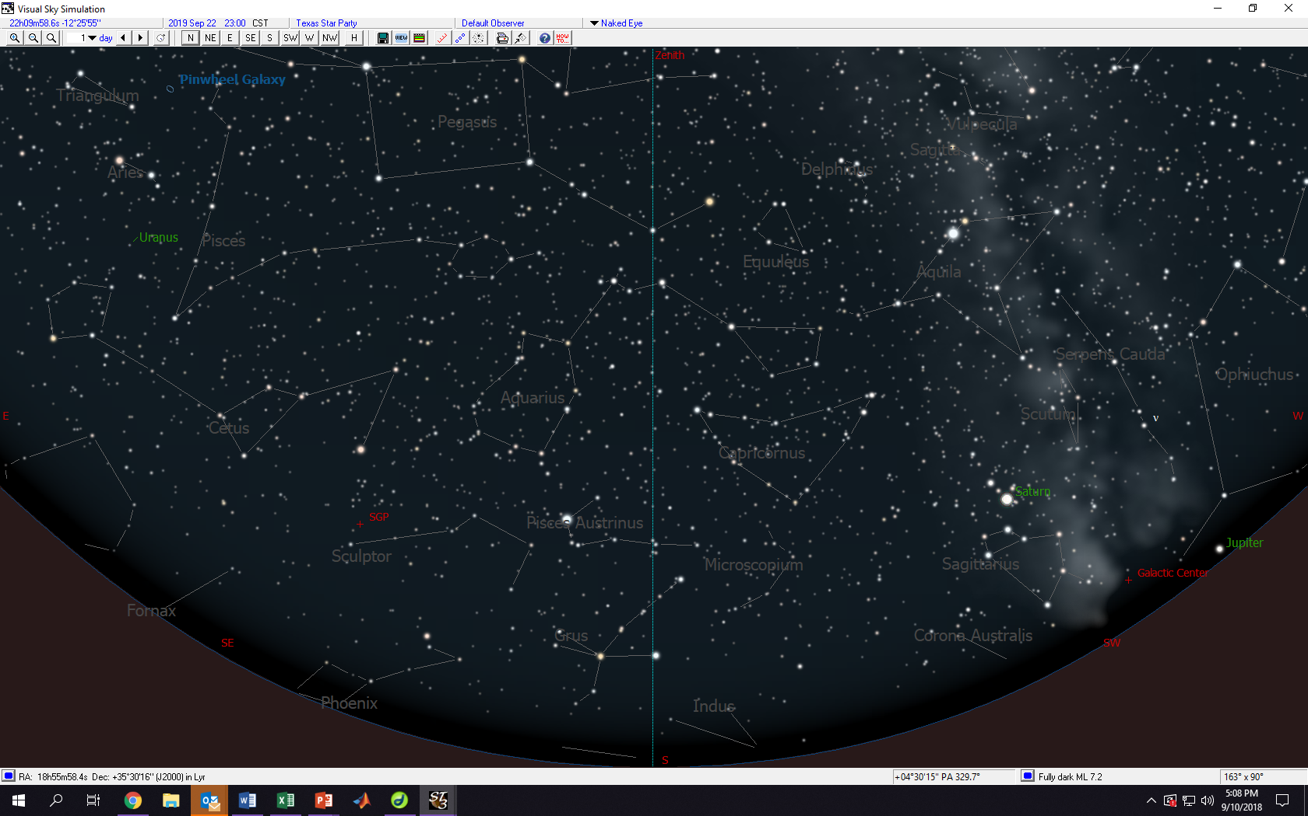
2300 (11PM) September 22
Blue line is meridian.

Slide 3
2300 (11PM) September 23
Blue line is meridian.

Slide 4
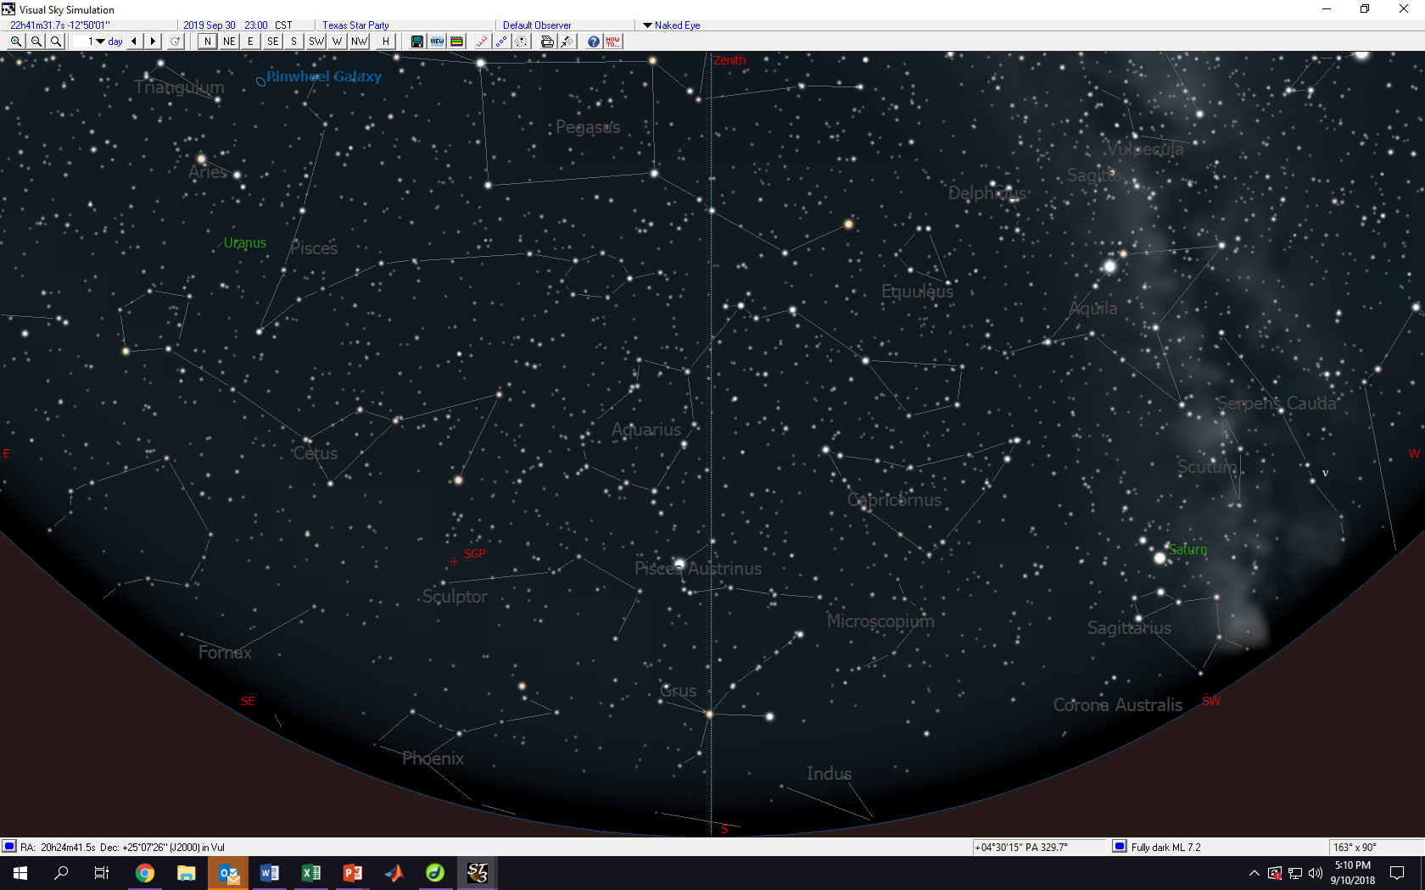
2300 (11PM) September 30 (skipped a few days)

Slide 5
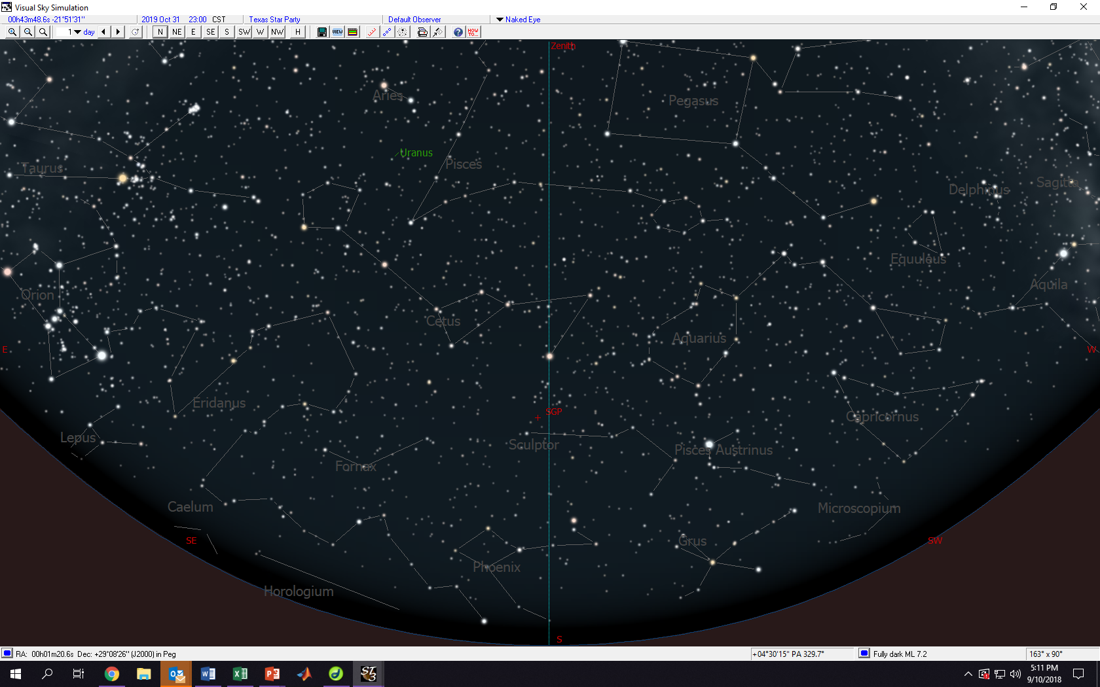
2300 (11PM) October 31 (skipped a month)

Slide 6
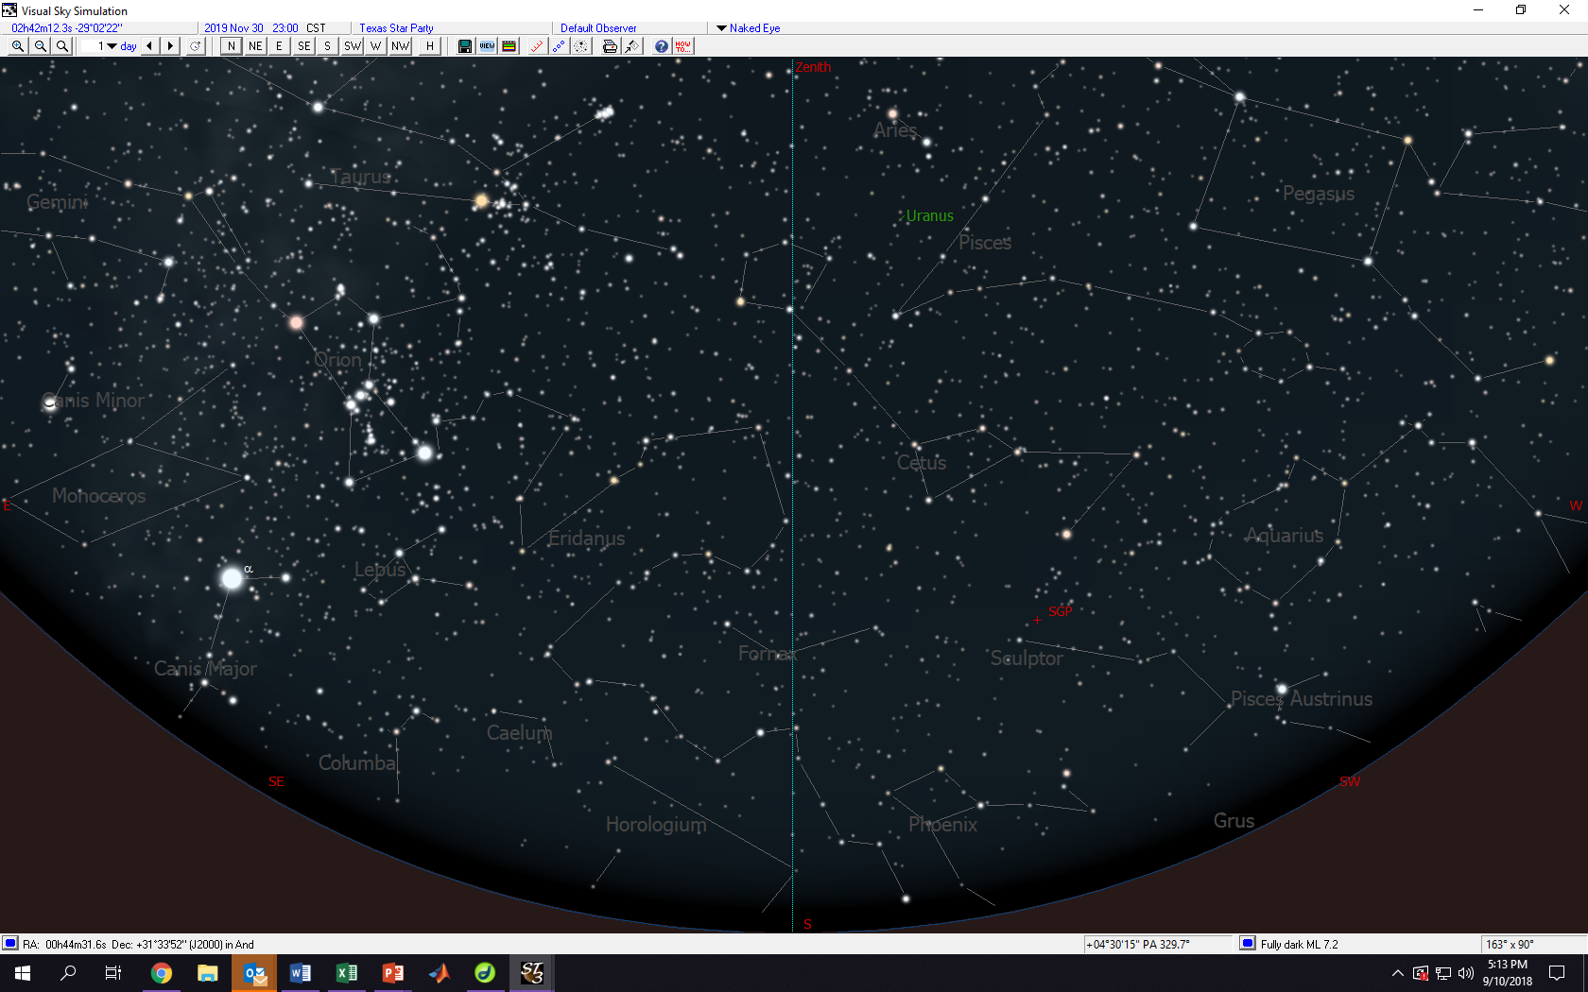
2300 (11PM) November 30

Slide 7
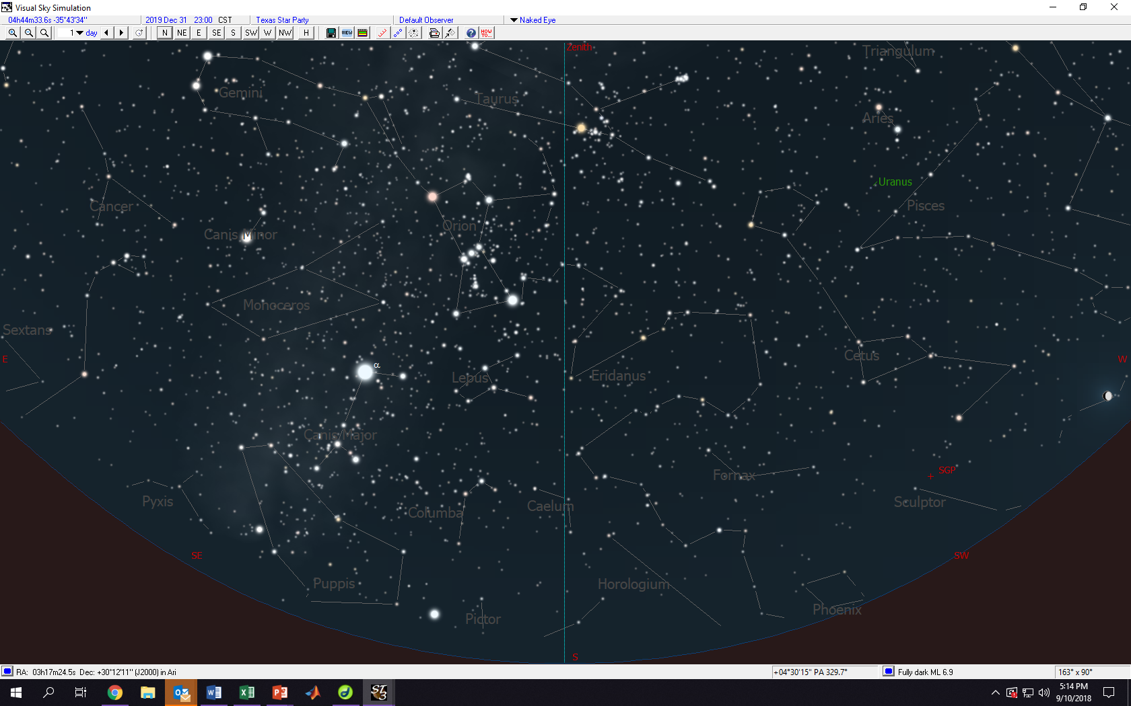
2300 (11PM) December 31

Slide 8
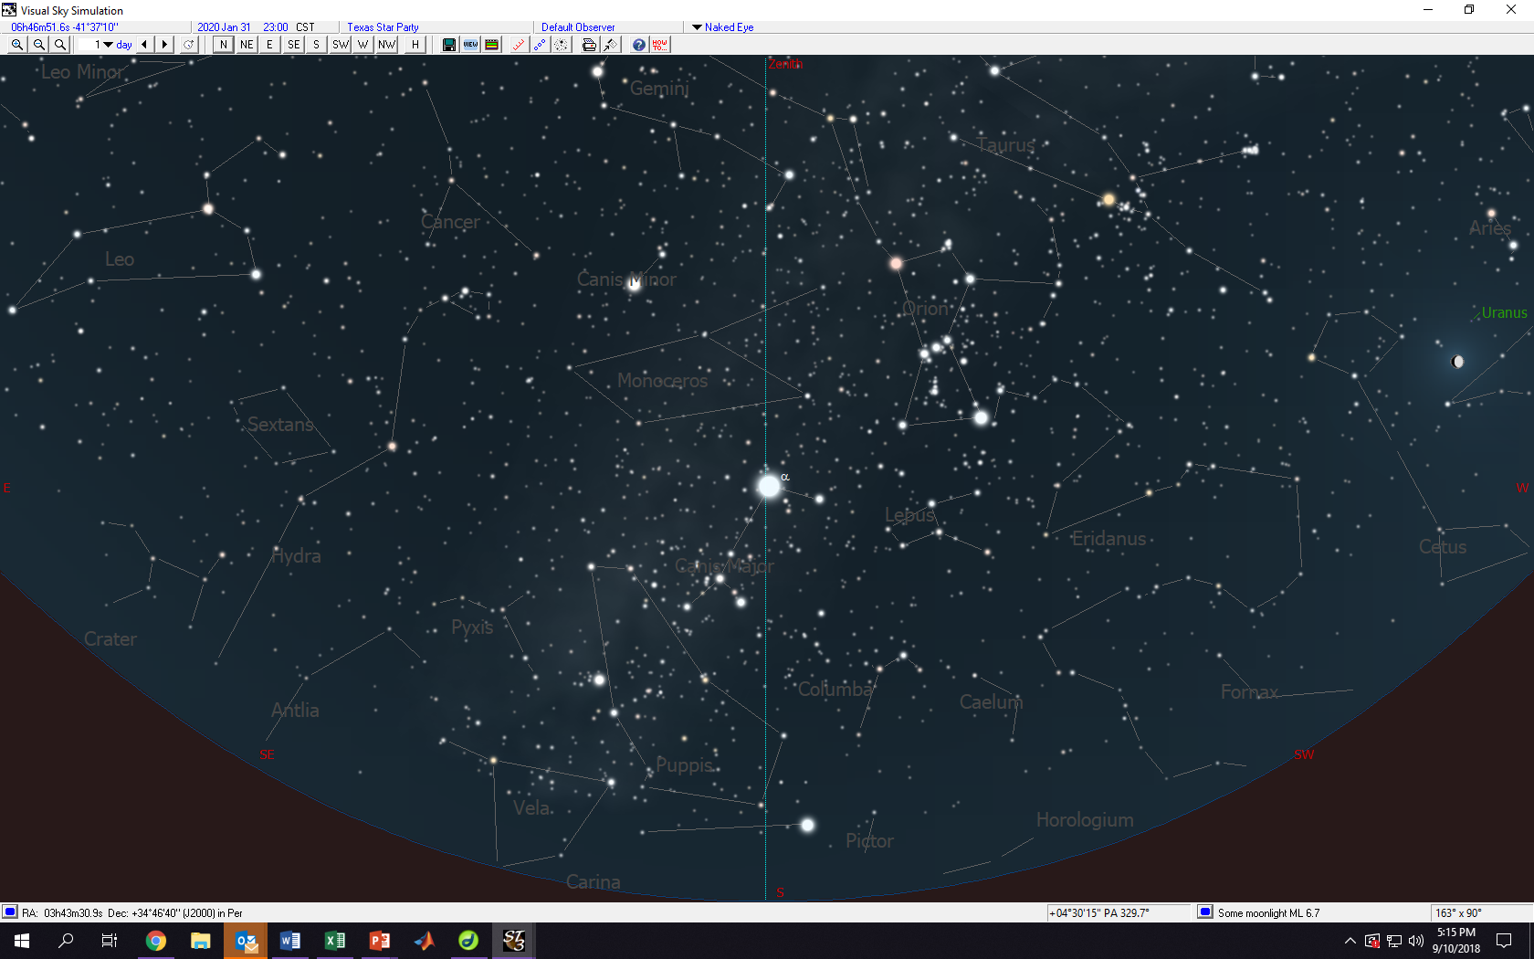
2300 (11PM) January 30

Slide 9
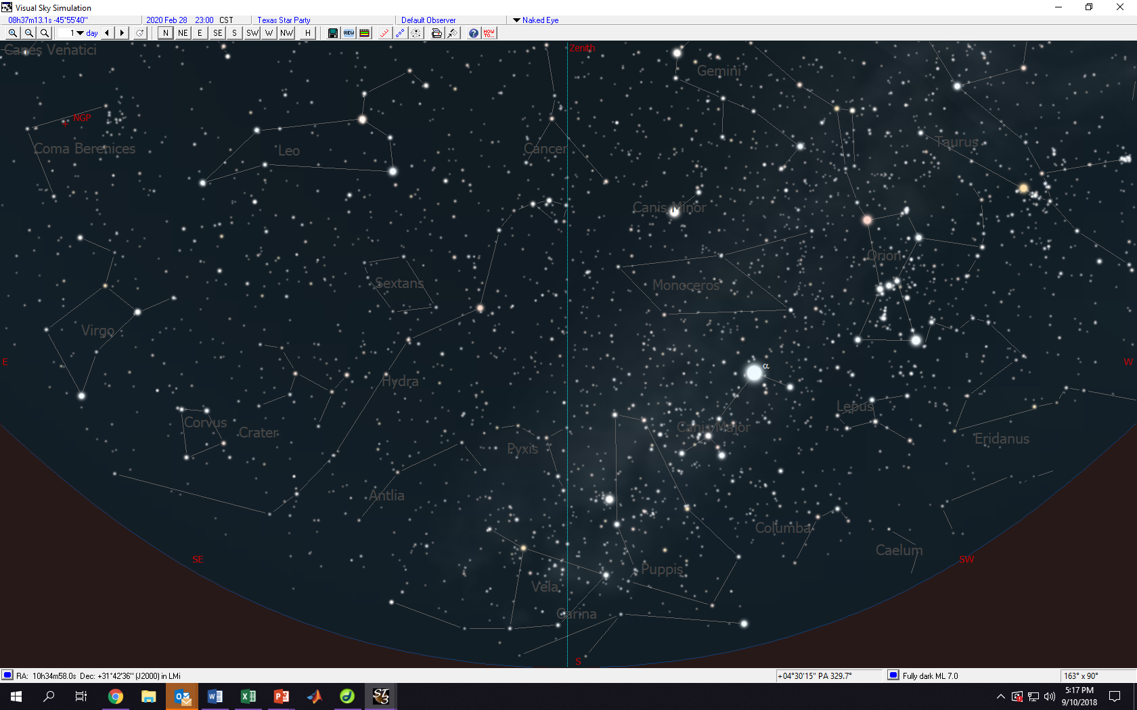
2300 (11PM) February 28

Slide 10
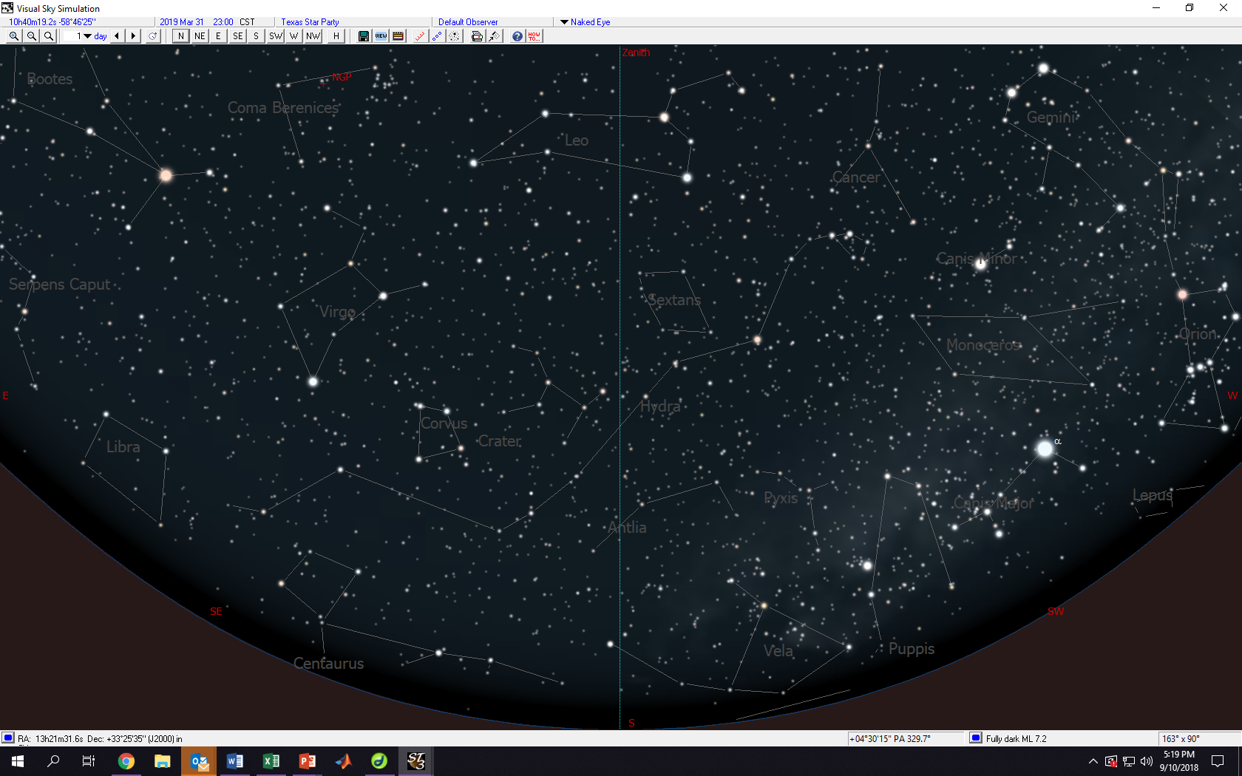
2300 (11PM) March 31
2300 (11PM) March 31

Slide 11
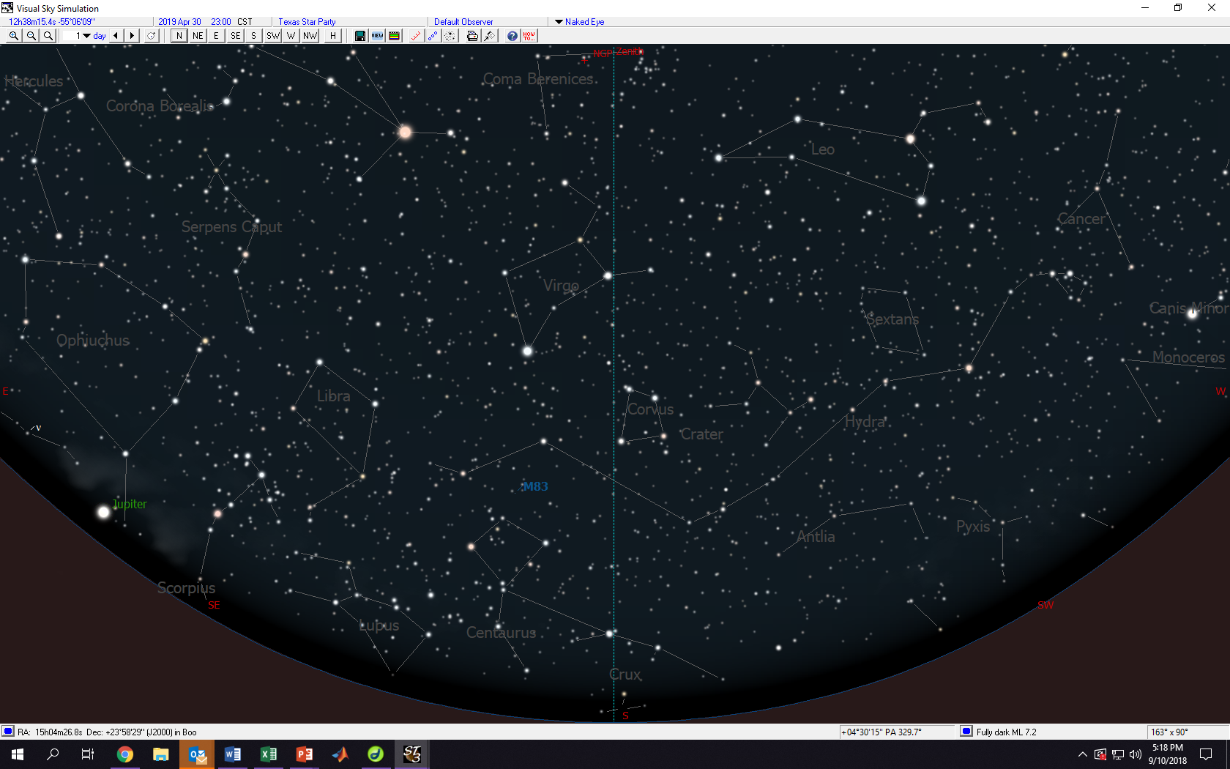
2300 (11PM) April 30

Slide 12
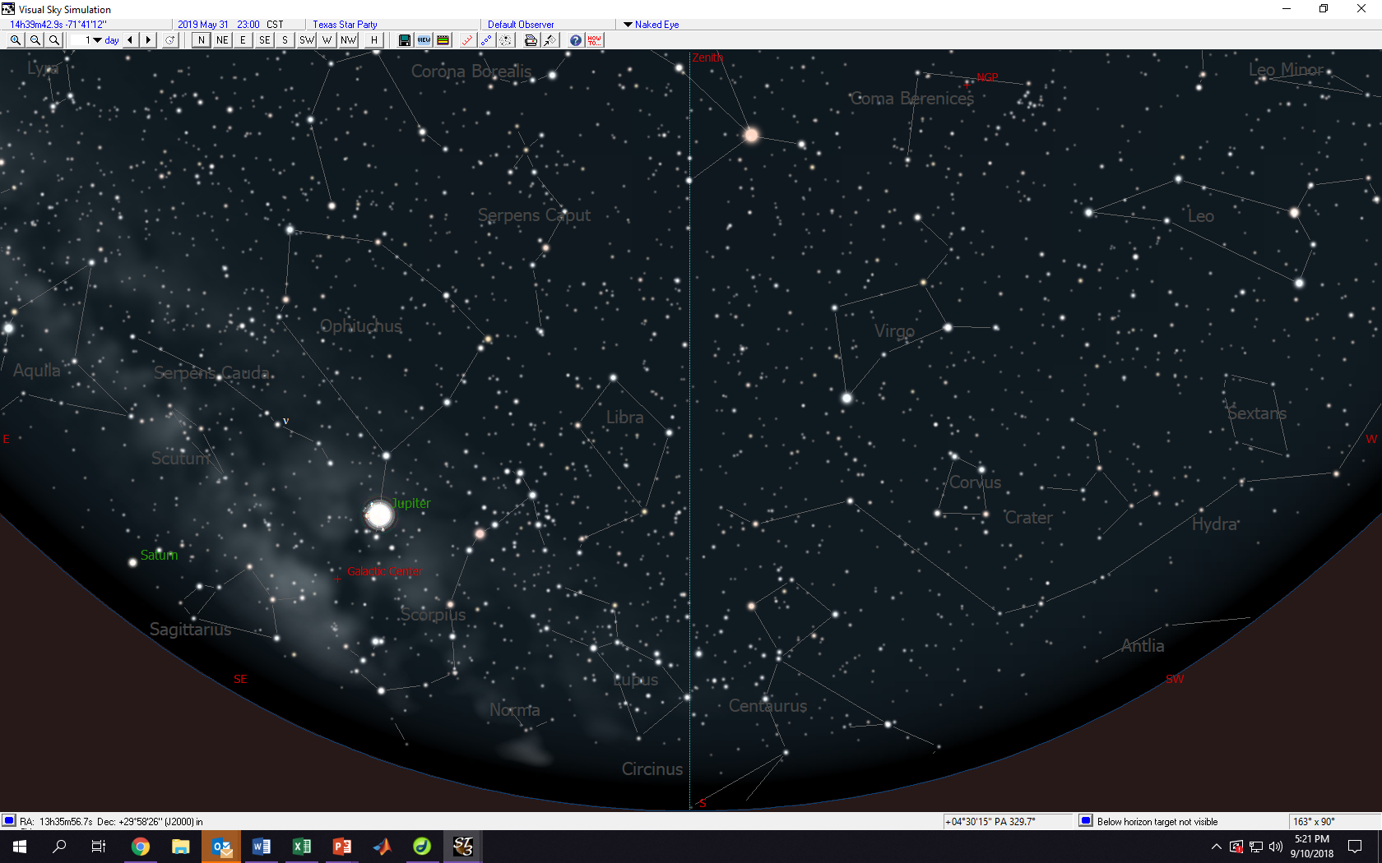
2300 (11PM) May 31 (2019)

Slide 13
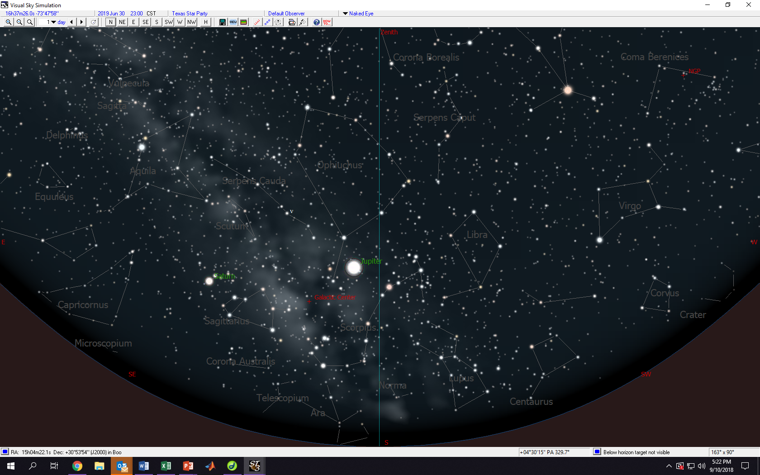
2300 (11PM) June 30 (2019)

Slide 14
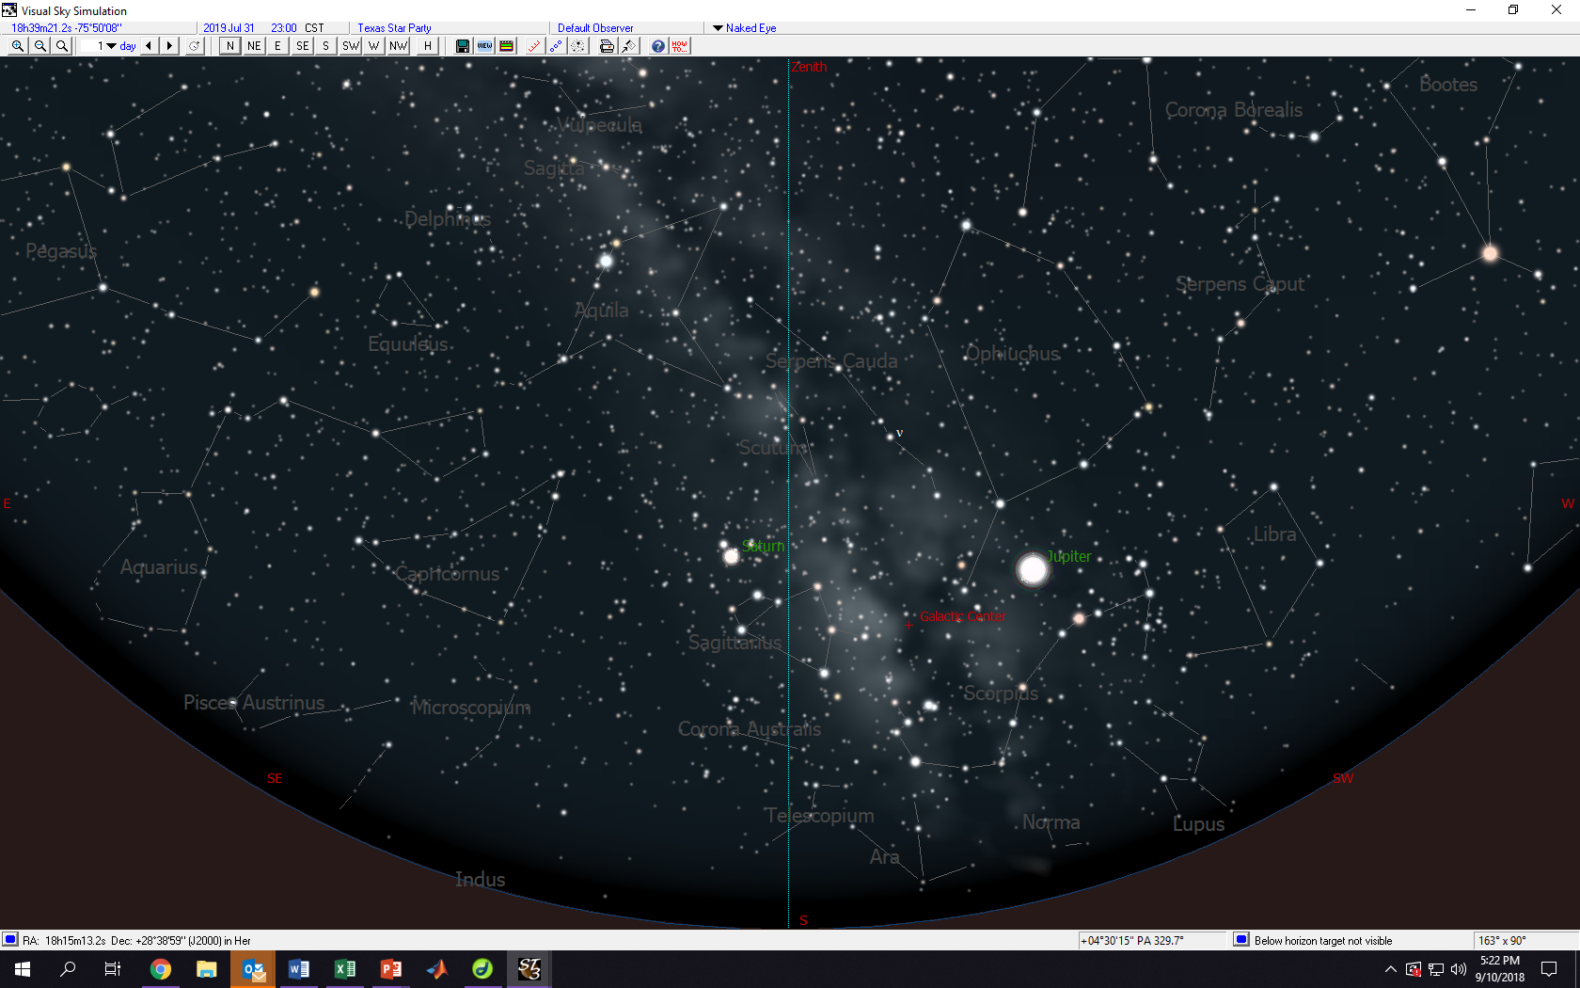
2300 (11PM) July 31 (2019)

Slide 15
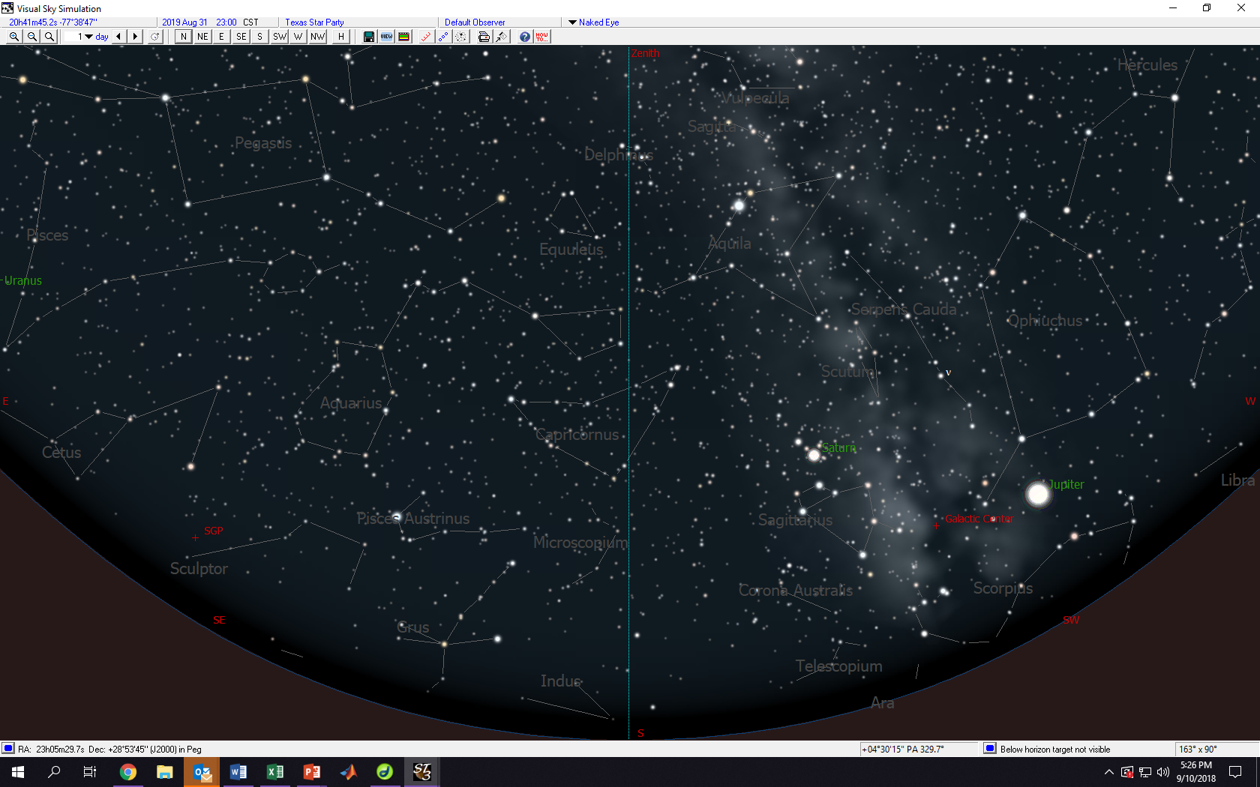
2300 (11PM) August 30 (2019)

Slide 16
2300 (11PM) September 30 (2019)

Slide 17
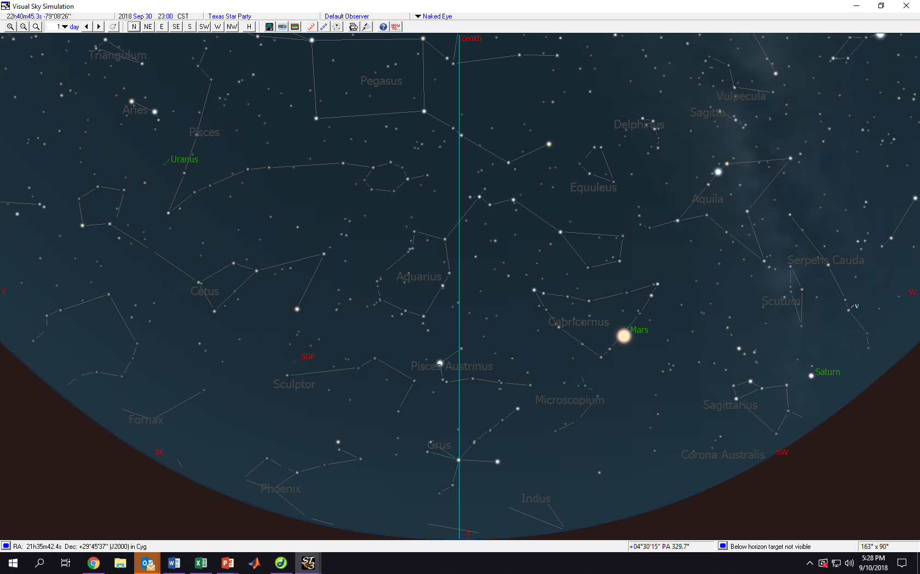
2300 (11PM) September 30 (2018)

