Slide 1
Orbiting Telescopes
By Aymon Klem

Slide 2
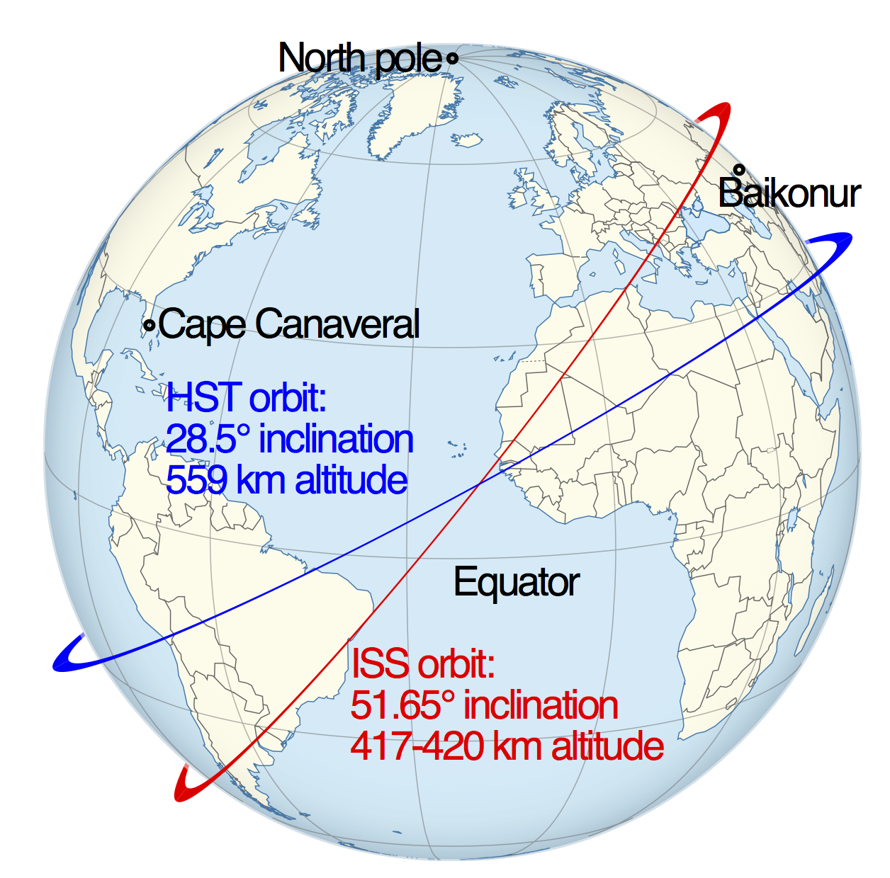
What is an Orbiting Telescope?
Any telescope that is put into orbit around a planet
Also called a space telescope or observatory
Negates atmospheric interference that interferes with ground-based telescopes
No concern for weather, always dark & clear, more wavelengths to study
HST & ISS Orbit Path

Slide 3
FIRST ORBITING TELESCOPES

Slide 4
Orbiting Astronomical Observatory Missions
NASA ultraviolet telescopes
OAO-1
first ultraviolet telescope launched into space, April 1966
Mission was terminated after 3 days (20 orbits)
High voltage arcing and battery depletion, instruments never fully worked
OAO-2 “Stargazer” was the first working telescope in space, launched on December 1968
The WEP (Wisconsin Experiment Package) experienced fewer problems
WEP is a suite consisting of 7 telescopes

Slide 5
OAO-2 “Stargazer”

Slide 6
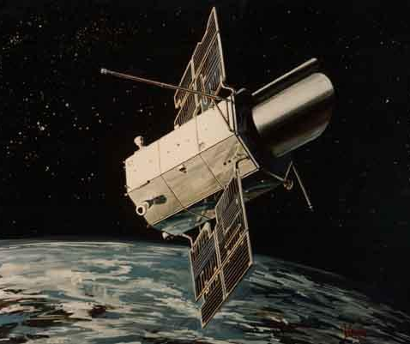
OAO-3 “Copernicus”
Launched on August 1972
Primary optic: Ultraviolet telescope
Secondary optic: X-ray detectors
Used Princeton Experiment Package (PEP) instead of WEP
82 cm parabolic mirror
High-res spectrograph
Terminated in February 1981

Slide 7
MAJOR ORBITING TELESCOPES

Slide 8
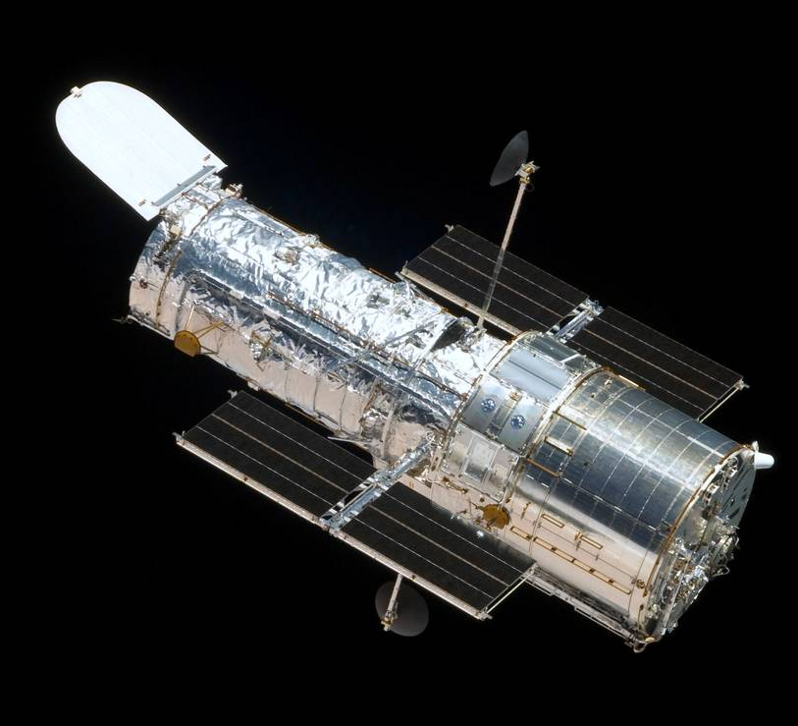
Hubble Space Telescope
Launched April 24, 1990
Deployed from STS-31 Discovery
Visible light telescope
Low Earth Orbit
Altitude of 340 miles
1 orbit = 95 minutes
Transmits about 19 GB per week
Total archive is 150 TB

Slide 9
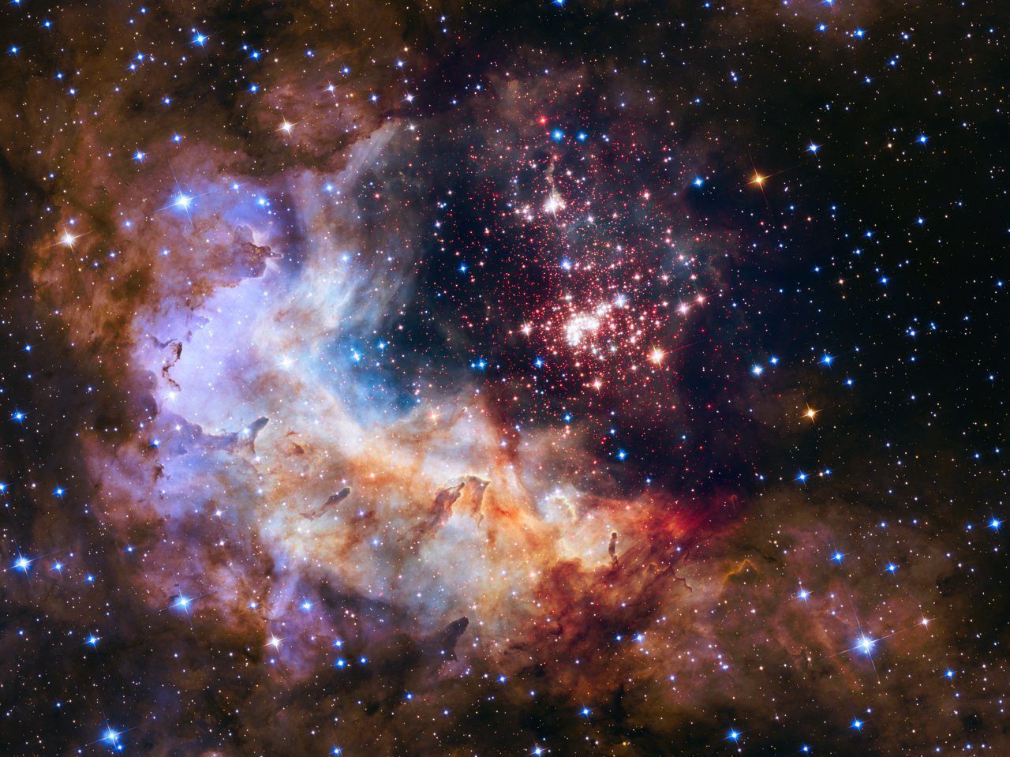
HST Images
Westerlund 2 Cluster – 25th anniversary image
Bubble Nebula – 26th anniversary image

Slide 10
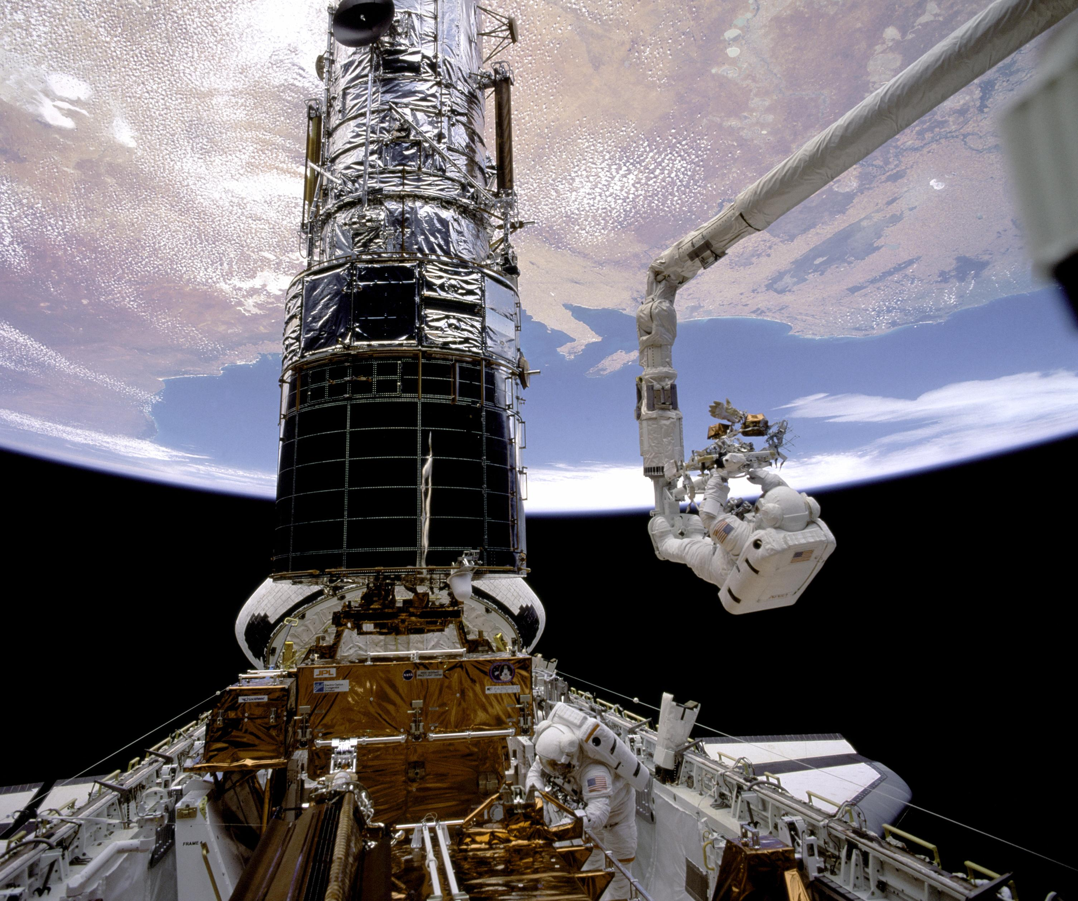
Initial Problem with HST
Initial images were too out of focus
Miscalibrated equipment caused a spherical aberration 1/50th the thickness of a human hair
Replaced instruments instead of entire mirror
COSTAR fixed flatness problem in mirror’s outer edge
5 pairs of corrective mirrors that remedied blurry vision

Slide 11
Before and After Repairs
M100 Galaxy

Slide 12
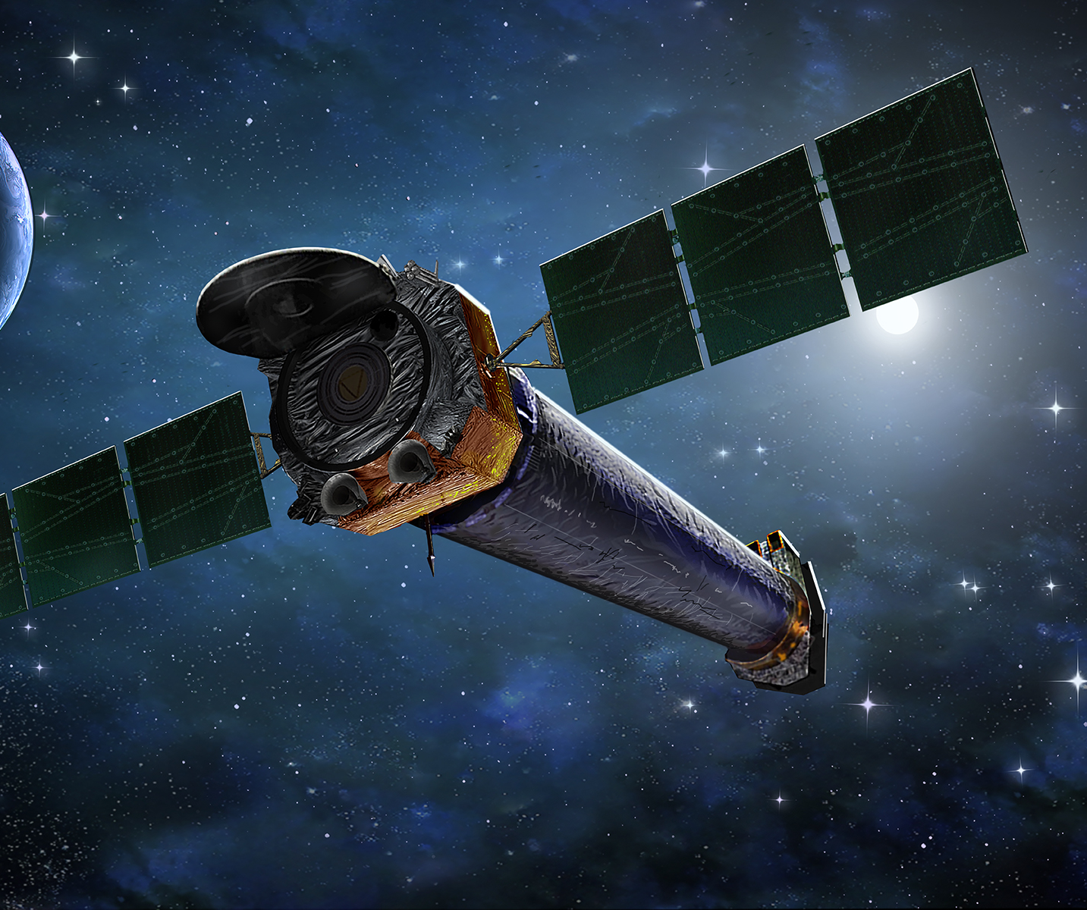
Chandra Observatory
Launched in July 23, 1999 by STS-93 Columbia
Studies X-rays
Allows scientists to observe x-ray images from exotic environments
Helps scientists understand “…origin, evolution, and destiny of the universe.” (NASA)

Slide 13
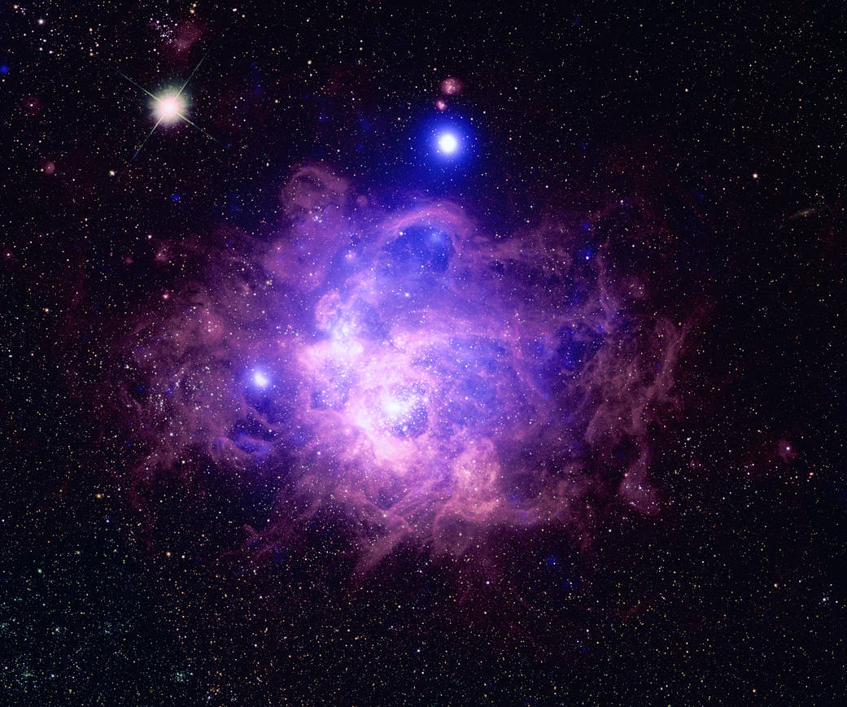
CXO Images
Cygnus OB2
NGC 604

Slide 14
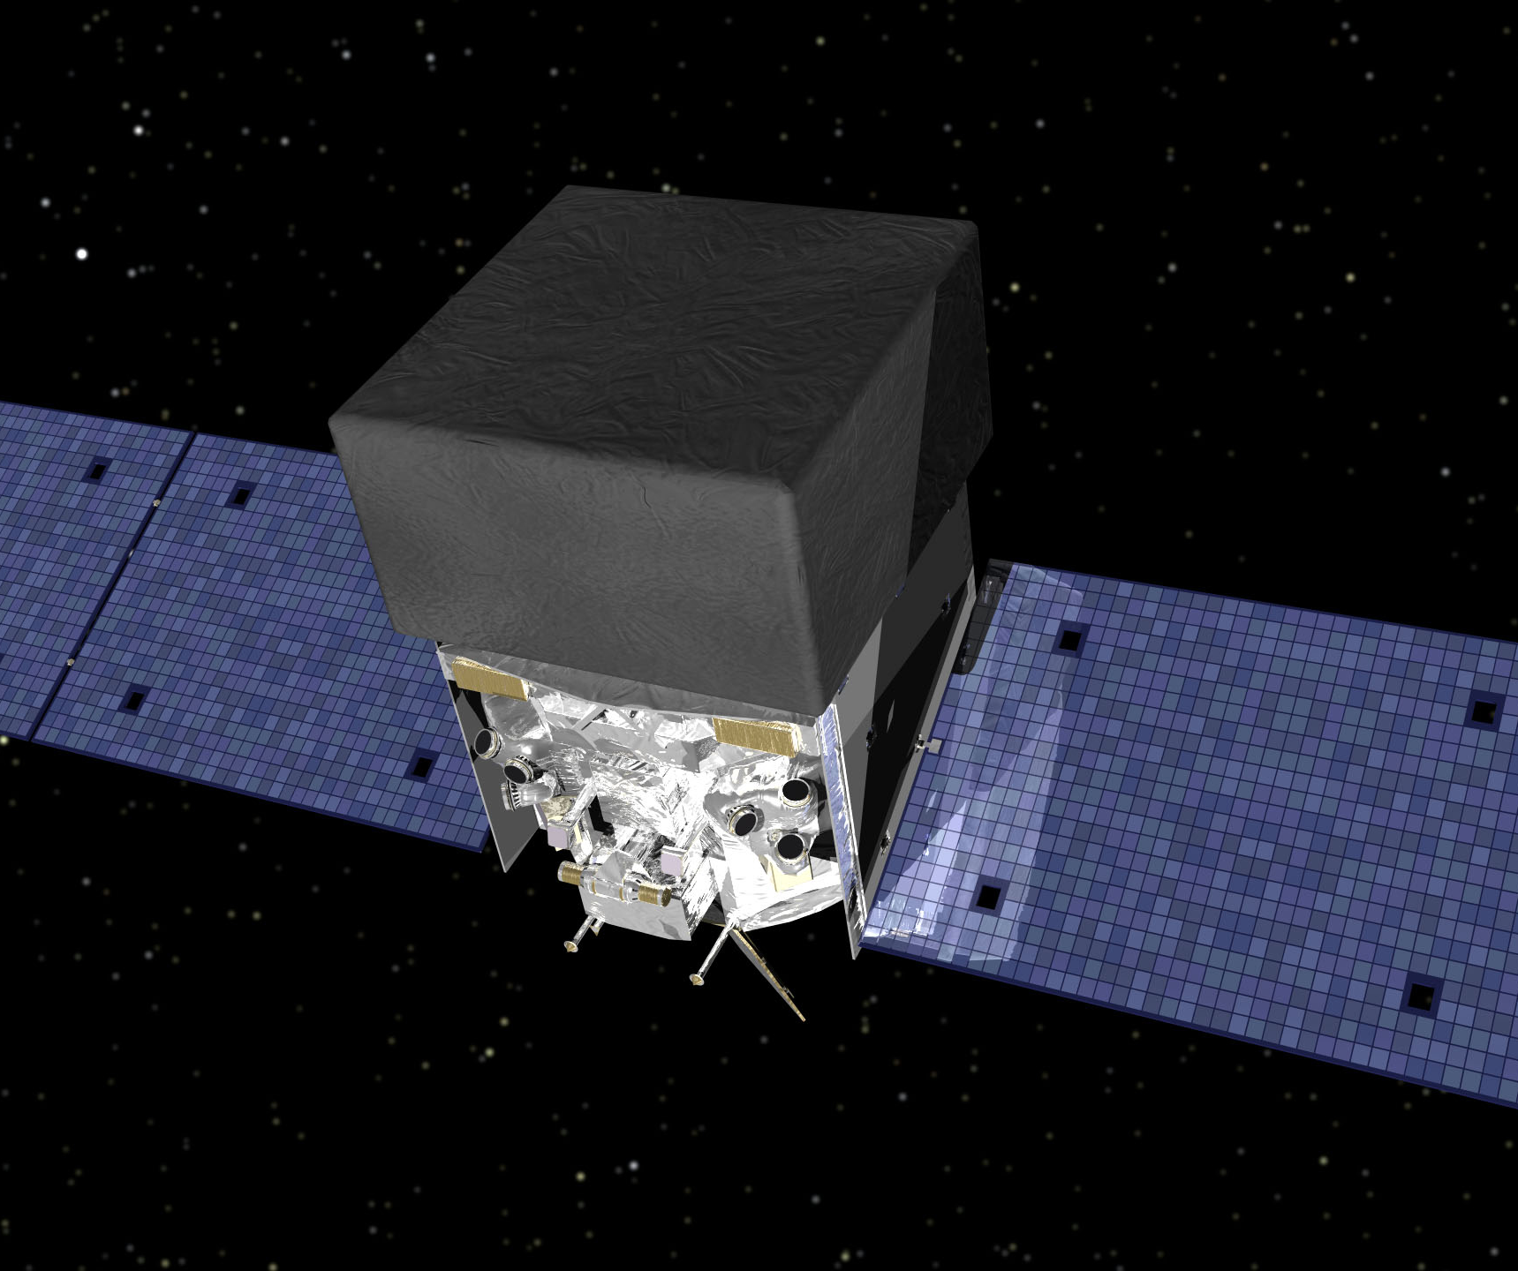
Fermi Space Telescope
Launched June 11, 2008 via Delta II Heavy rocket
Gamma ray telescope
Highest-energy form of light
Answers questions about black holes, pulsars, cosmic rays, etc.
August 2013 extended its mission
Deeper study of high-energy cosmos

Slide 15
Fermi Image
Note: brighter colors indicate brighter gamma-ray sources
Entire sky at energies greater than 1 GeV from 5 years of data

Slide 16
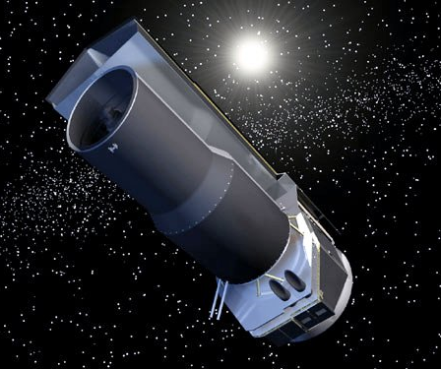
Spitzer Space Telescope
Launched August 25, 2003 via Delta II Heavy rocket
Final mission of NASA’s Great Observatories program
Detects infrared radiation
2 major components
Cryogenic Tube Assembly
85 cm telescope & 3 scientific instruments
Spacecraft
Controls telescope, provides power, communicates data
Planned retirement: January 2020

Slide 17
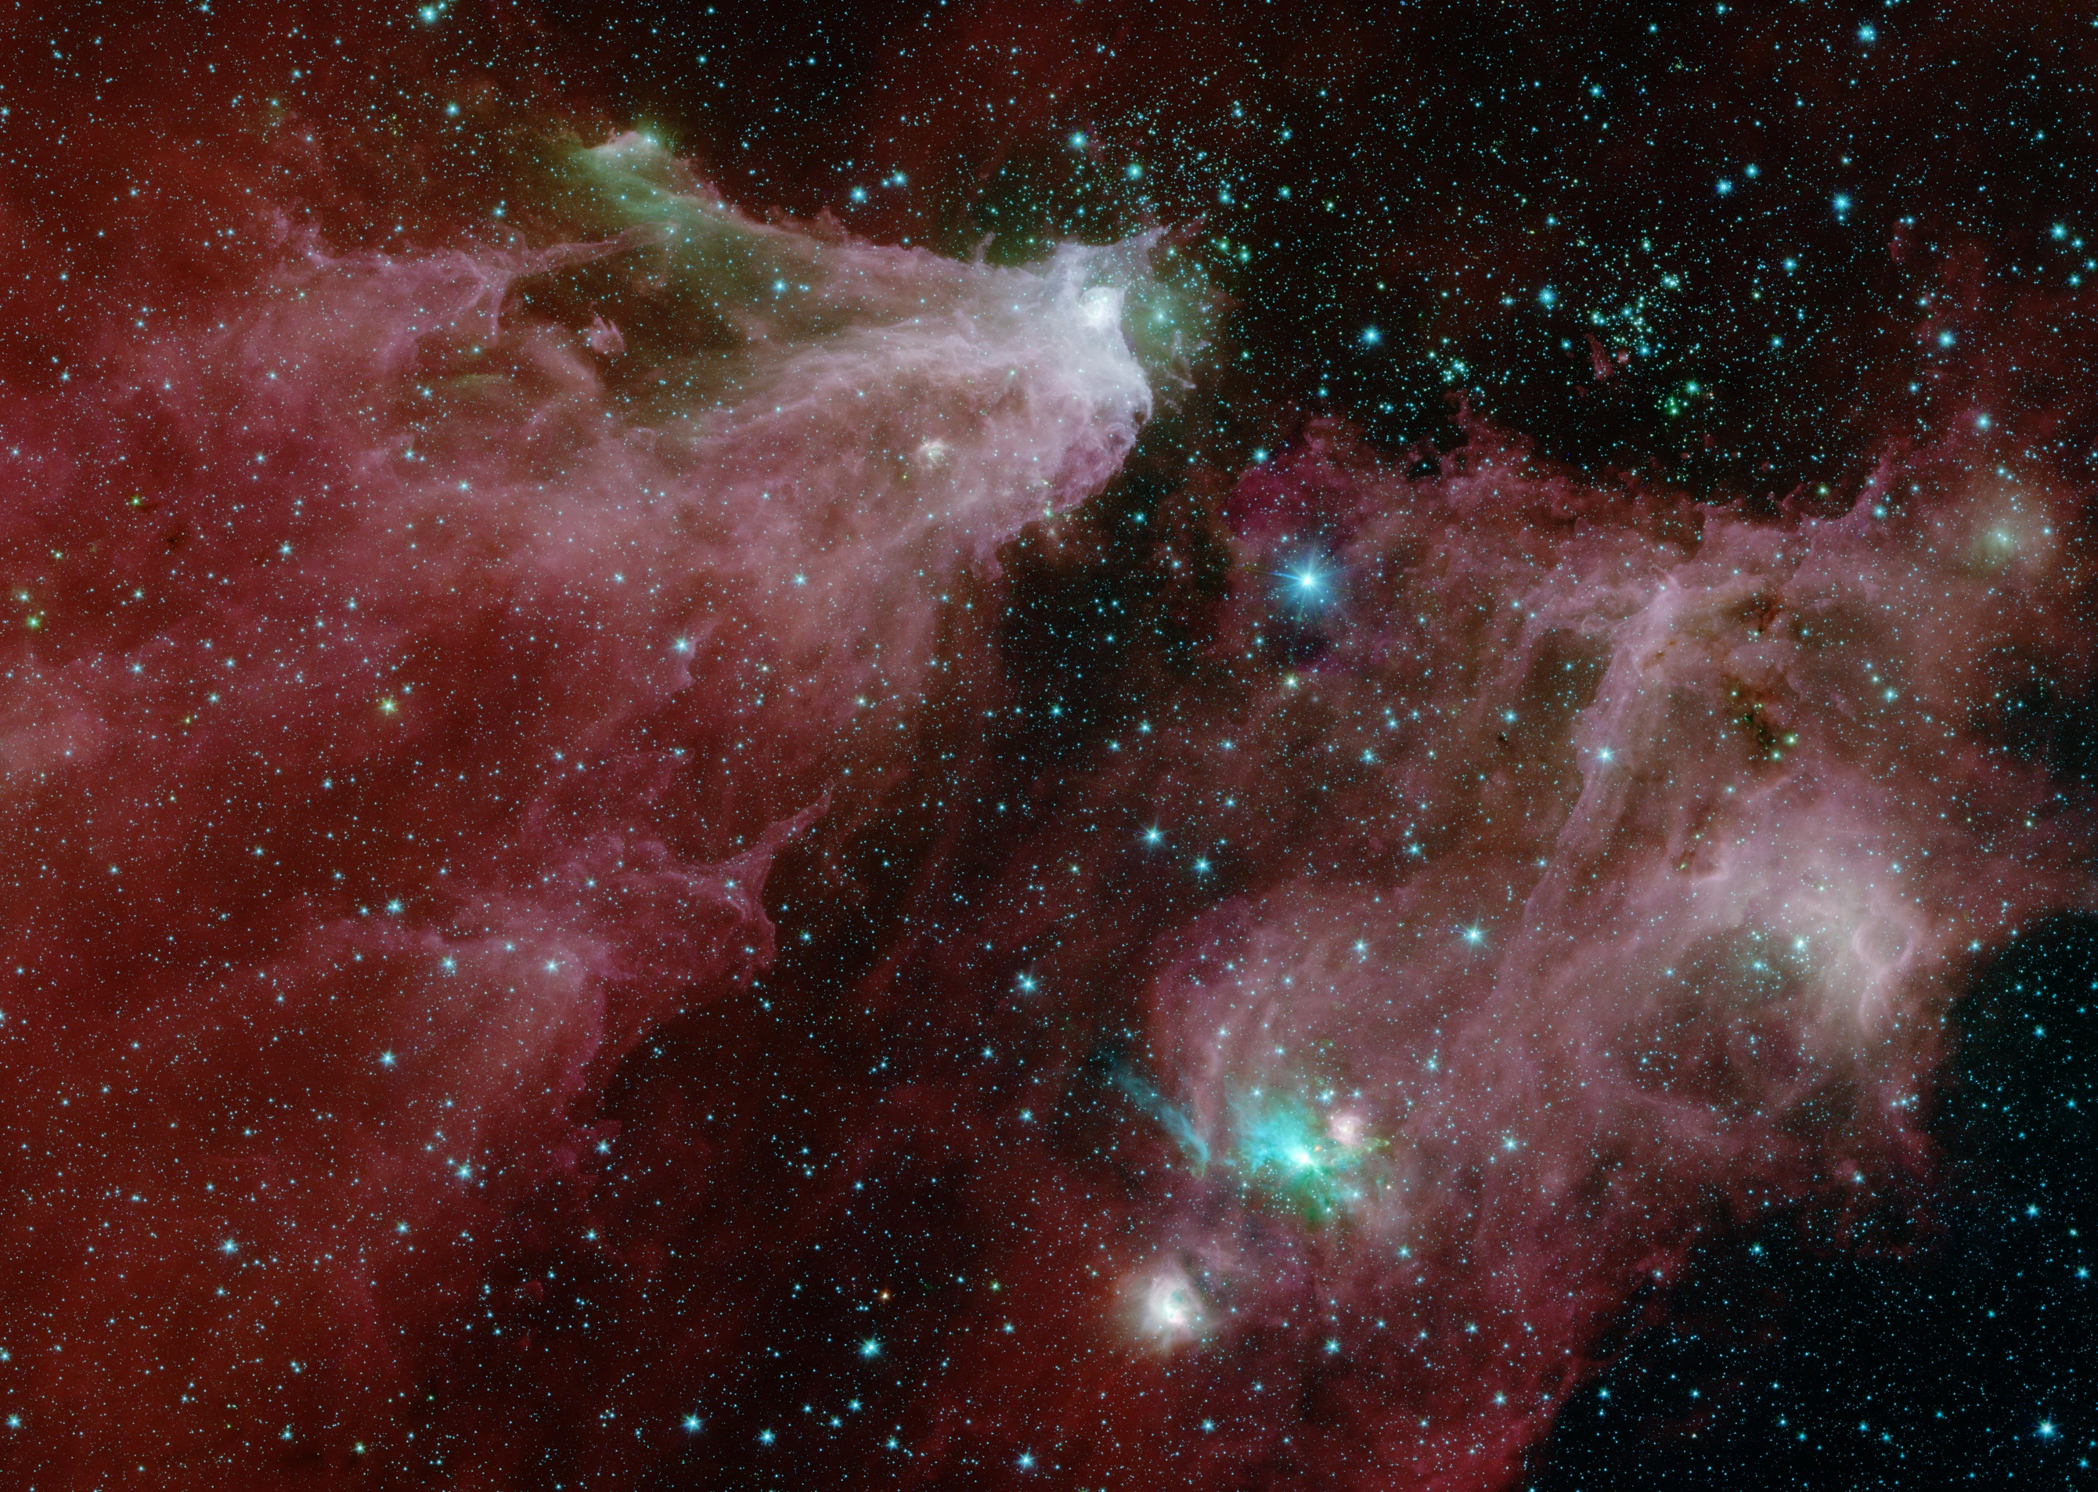
Spitzer Images
Cepheus C and B Region (IRAC only)
Cepheus C and B Region (IRAC and MIPS)

Slide 18
Future Space telescopes

Slide 19
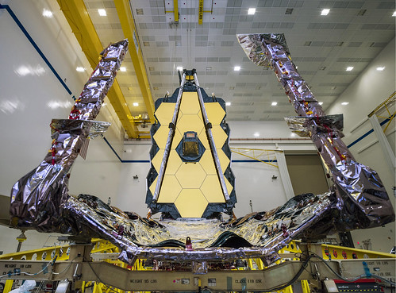
James Webb Space Telescope
Will launch from Ariane 5 rocket in 2021
“study every phase in the history of our Universe.”
Hunt for signs of life of nearby alien planets
Primary mirror made of 18 separate segments
Unfold and adjust after launch

Slide 20
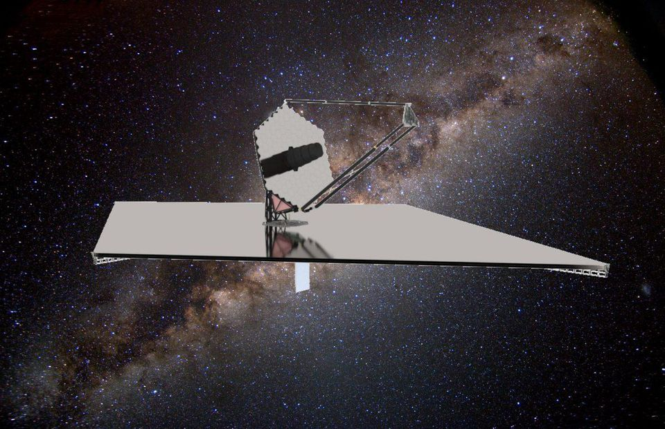
Large UV Optical Infrared Surveyor (LUVOIR)
Concept for highly capable, multi-wavelength observatory
Goal of characterizing exoplanets
ECLIPS coronagraph blocks out starlight to reveal faint Earth-like planets
Learn about planet’s color, radii, atmosphere, etc.

Slide 21
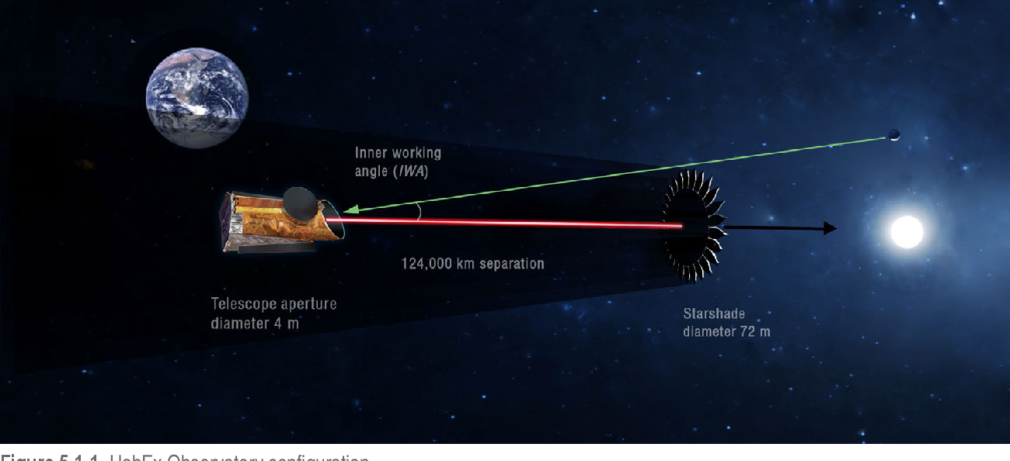
Habitable Exoplanet Observatory (HabEx)
Rough launch date: 2035
Concept for mission to directly image planetary systems
Primarily around sun-like stars
Main goal to directly image Earth-like planets
Search for signatures of habitability like water

Slide 22
References
https://www.nasa.gov/feature/goddard/2018/nasa-s-first-stellar-observatory-oao-2-turns-50 (OAO-1, OAO-2, OAO-3)
https://www.nasa.gov/directorates/heo/scan/images/history/December1968_2.html (OAO-2)
https://www.space.com/6716-major-space-telescopes.html
https://www.nasa.gov/mission_pages/hubble/story/index.html (HST + scope)
https://www.spacetelescope.org/images/archive/top100/ (HST images)
https://www.nasa.gov/mission_pages/chandra/astronomy/index.html (X-ray)
https://twitter.com/nasahistory/status/502477778340438017 (X-ray drawing)
https://www.nasa.gov/mission_pages/chandra/images/20th_anniversary_gallery.html (x-ray images)
https://www.nasa.gov/content/fermi/overview (Fermi + images)
https://www.nasa.gov/mission_pages/spitzer/infrared/index.html (Spitzer + scope)
https://www.jpl.nasa.gov/spaceimages/details.php?id=PIA23127 (Spitzer images)

Slide 23
References Part 2
https://jwst.nasa.gov/content/about/index.html (James Webb)
https://www.jwst.nasa.gov/ (JWST image)
https://airandspace.si.edu/collection-objects/telescope-oao-iii-princeton-experiment-package-copernicus (OAO-3)
https://www.jpl.nasa.gov/habex/ (HabEx)
https://asd.gsfc.nasa.gov/luvoir/ (LUVOIR)
https://www.semanticscholar.org/paper/The-Habitable-Exoplanet-Observatory-(HabEx)-Mission-Gaudi-Seager/90935edbc36b92ad14c5396f35d250b110e7a244/figure/13 (HabEx Image)
https://www.jpl.nasa.gov/habex/#science (HabEx info)

