Slide 1
Planetary Nebula
Ryan Szto

Slide 2
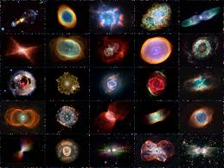
Definition and Formation
A type of a emission nebula
Outer gas layers of a dying star
Centered around white dwarf star
Smaller that other types of nebula
Not relate to the formation of planets
Name was coined by William Herschel
Short life span ~ few tens of thousands of yr.
Most stars within the size range of the sun will form planetary nebula
Notes:
-Planetary nebula are a type of emission nebula, expanding ionized gas that is emitted from late red giant stars
-The name is a misnomer as they do not deal with the formation of planets or exoplanets. The name is thought to be from the spherical shape of the nebula
-Possibly coined by William Herschel after the discovery of Uranus
-All planetary nebula are formed from the gasses emitted from late stars, as the nuclear fusion stops at the core, the star will eject its outer envelope. The hot core of the star then ionizes the surrounding cloud.
-All are relatively short lived, lasting only a few tens of thousands of years until it dissipates into the surrounding space.
-Research suggests that our sun has the possibility of forming a planetary nebula prior to death but it is still in question

Slide 3
How to observe Planetary Nebula
Most planetary nebula are very small and faint in comparison to other types.
Due to there composition
Rare among stars due to there short life span
(known stars to planetary nebula ~ $3∗{10}^{−8}:2$)
Cannot be seen with naked eye.
Most require high level of magnification to be seen with any great detail
Identified by filter on telescopes
Notes:
-Due to the composition of dispersed gas, these nebula are typically hard to spot and cannot be seen with the naked eye
-They are considered rare due to the short life span (out of ~200 billion stars there are about 3000 planetary nebula)
-The only way to determine if what you are observing is a planetary nebula is to use a filter that filters ionized oxygen. The nebula should become brighter when the filter is added.
-Given that they are so dim most require much larger telescopes or greater magnification that what we are designing for.
-Two exceptions are the nebula I am going to discuss next.

Slide 4
Summer triangle
Notes:
I will be referencing the summer triangle in this presentation for the locations of the planetary nebula I will be discussing. This image shows the 3 stars that comprise the triangle and the constellations closest to it.

Slide 5
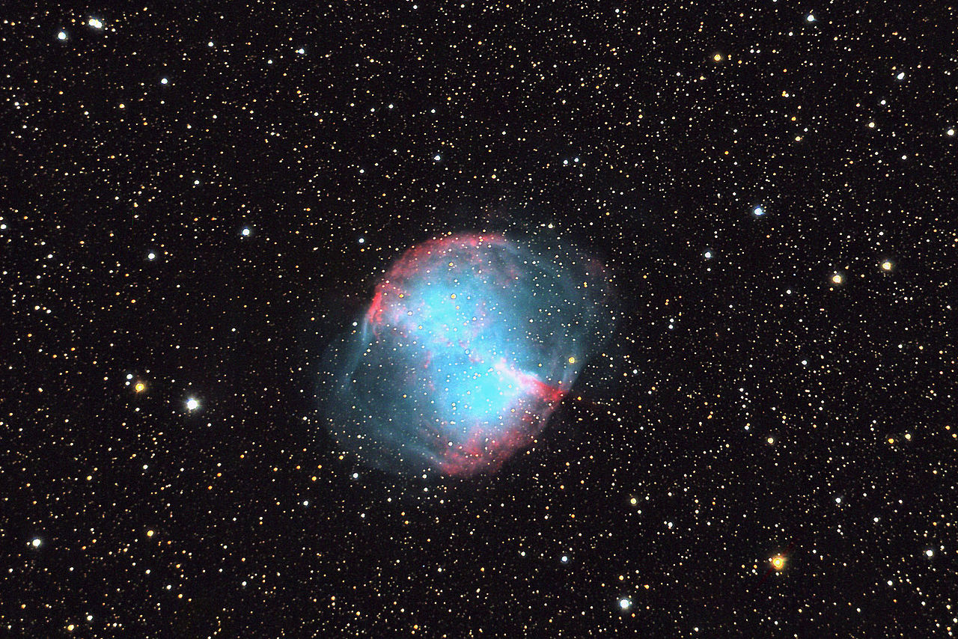
M27

Slide 6
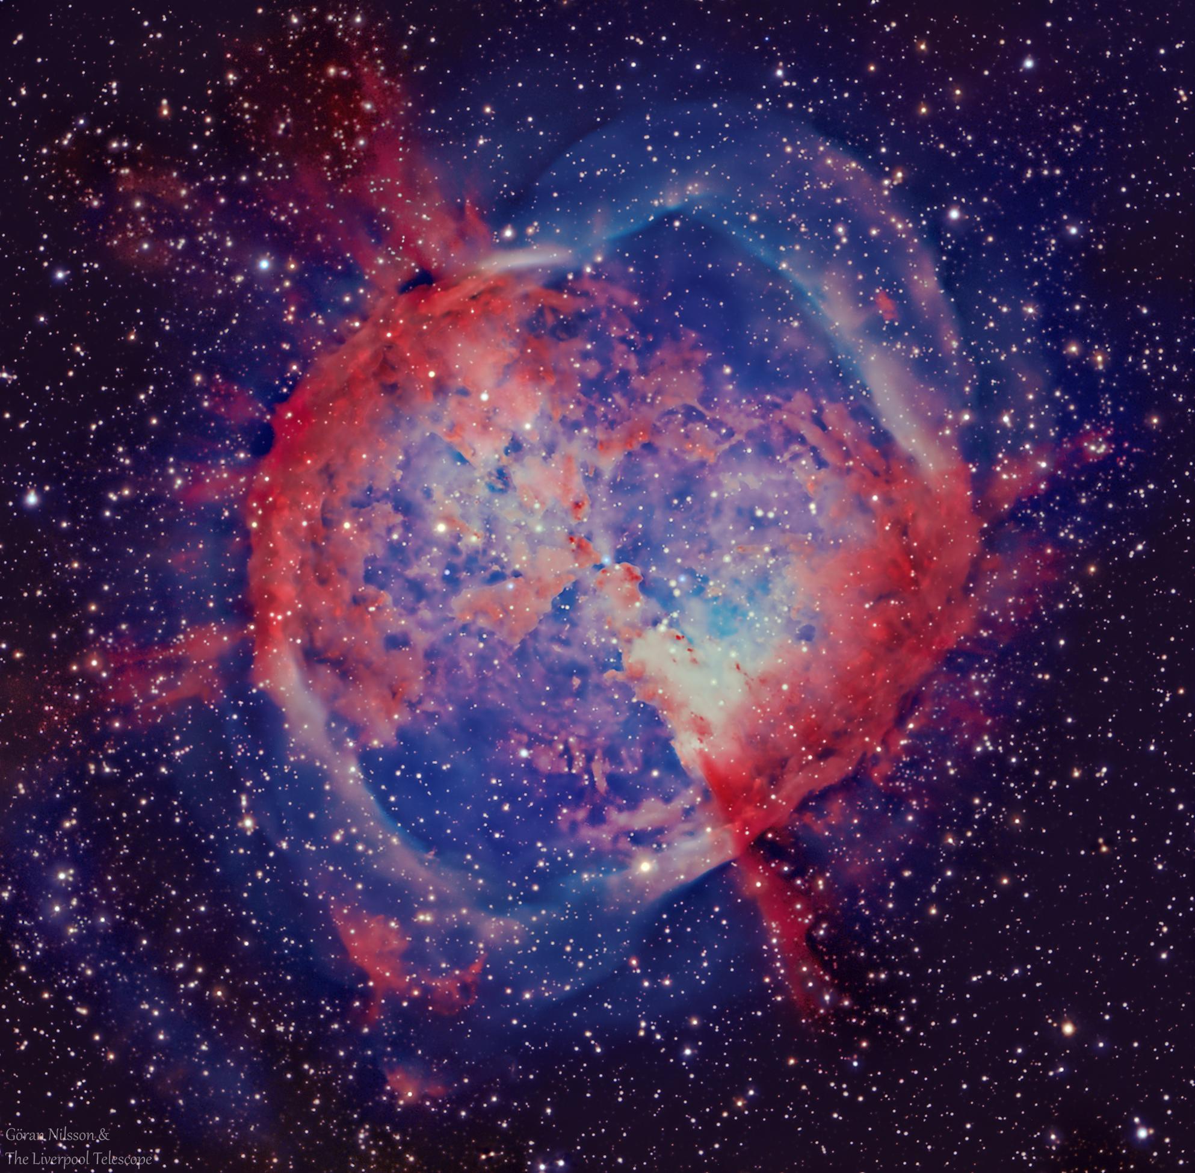
M27 Dumbbell Nebula
First discovered planetary nebula by Charles Messier
One of the 4 planetary nebula catalogued by Messier
Named by John Herschel
Can be seen with large binoculars and small telescopes
Best viewed during the summer nights
(within the summer triangle)
~1200 light years away (south of Vulpecula constellation)
Apparent size: 8 by 5.6 arcminutes
Brightness: magnitude of 7.5
Notes:
-dumbbell nebula was the first planetary nebula discovered by Charles Messier in 1764
-Named by John Herschel in 1828
-About 1,200 light years away within the constellation Vulpecula (the Fox)
-Unfortunately the nebula appears only white even in larger telescopes, but details can be seen through color astrophotography.
-Best seen during the summer months and is within the summer triangle.
-Apparent size is 8 by 5.6 arcminutes and a brightness magnitude of 7.5 second brightest planetary nebula in the sky
-This is also one of the four planetary nebula that was catalogued by Charles messier along with the little dumbbell, ring, and owl nebula.

Slide 7
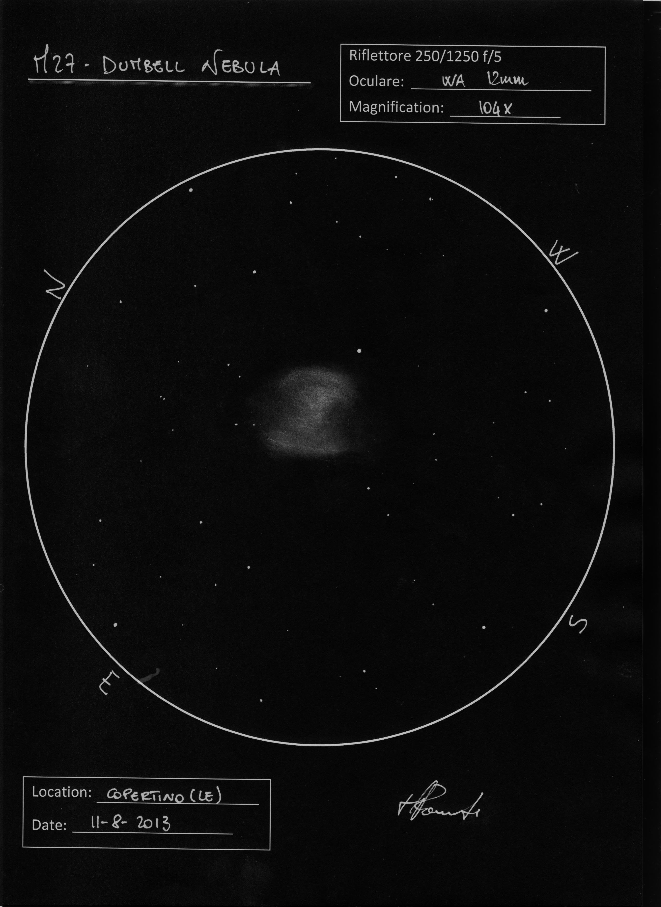
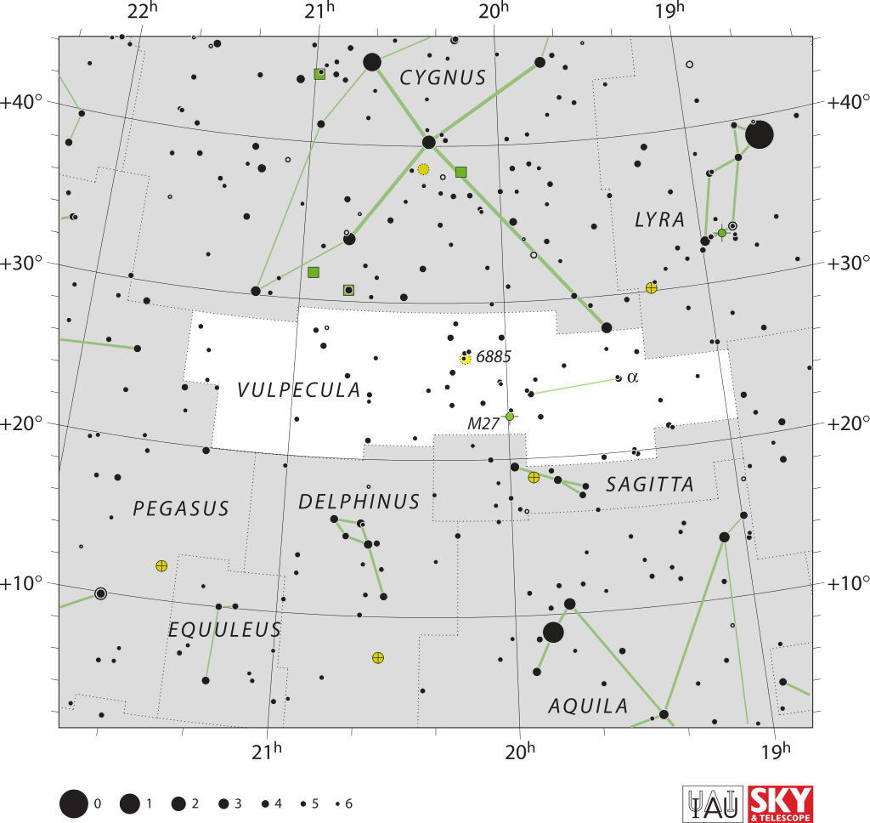

Slide 8
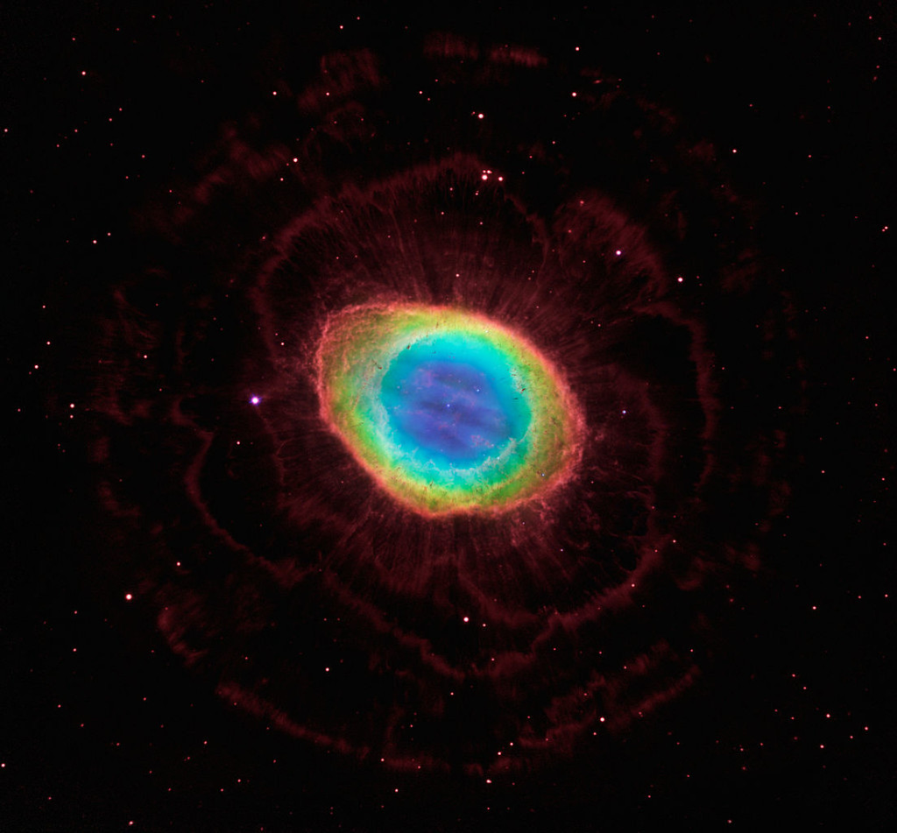
M57

Slide 9
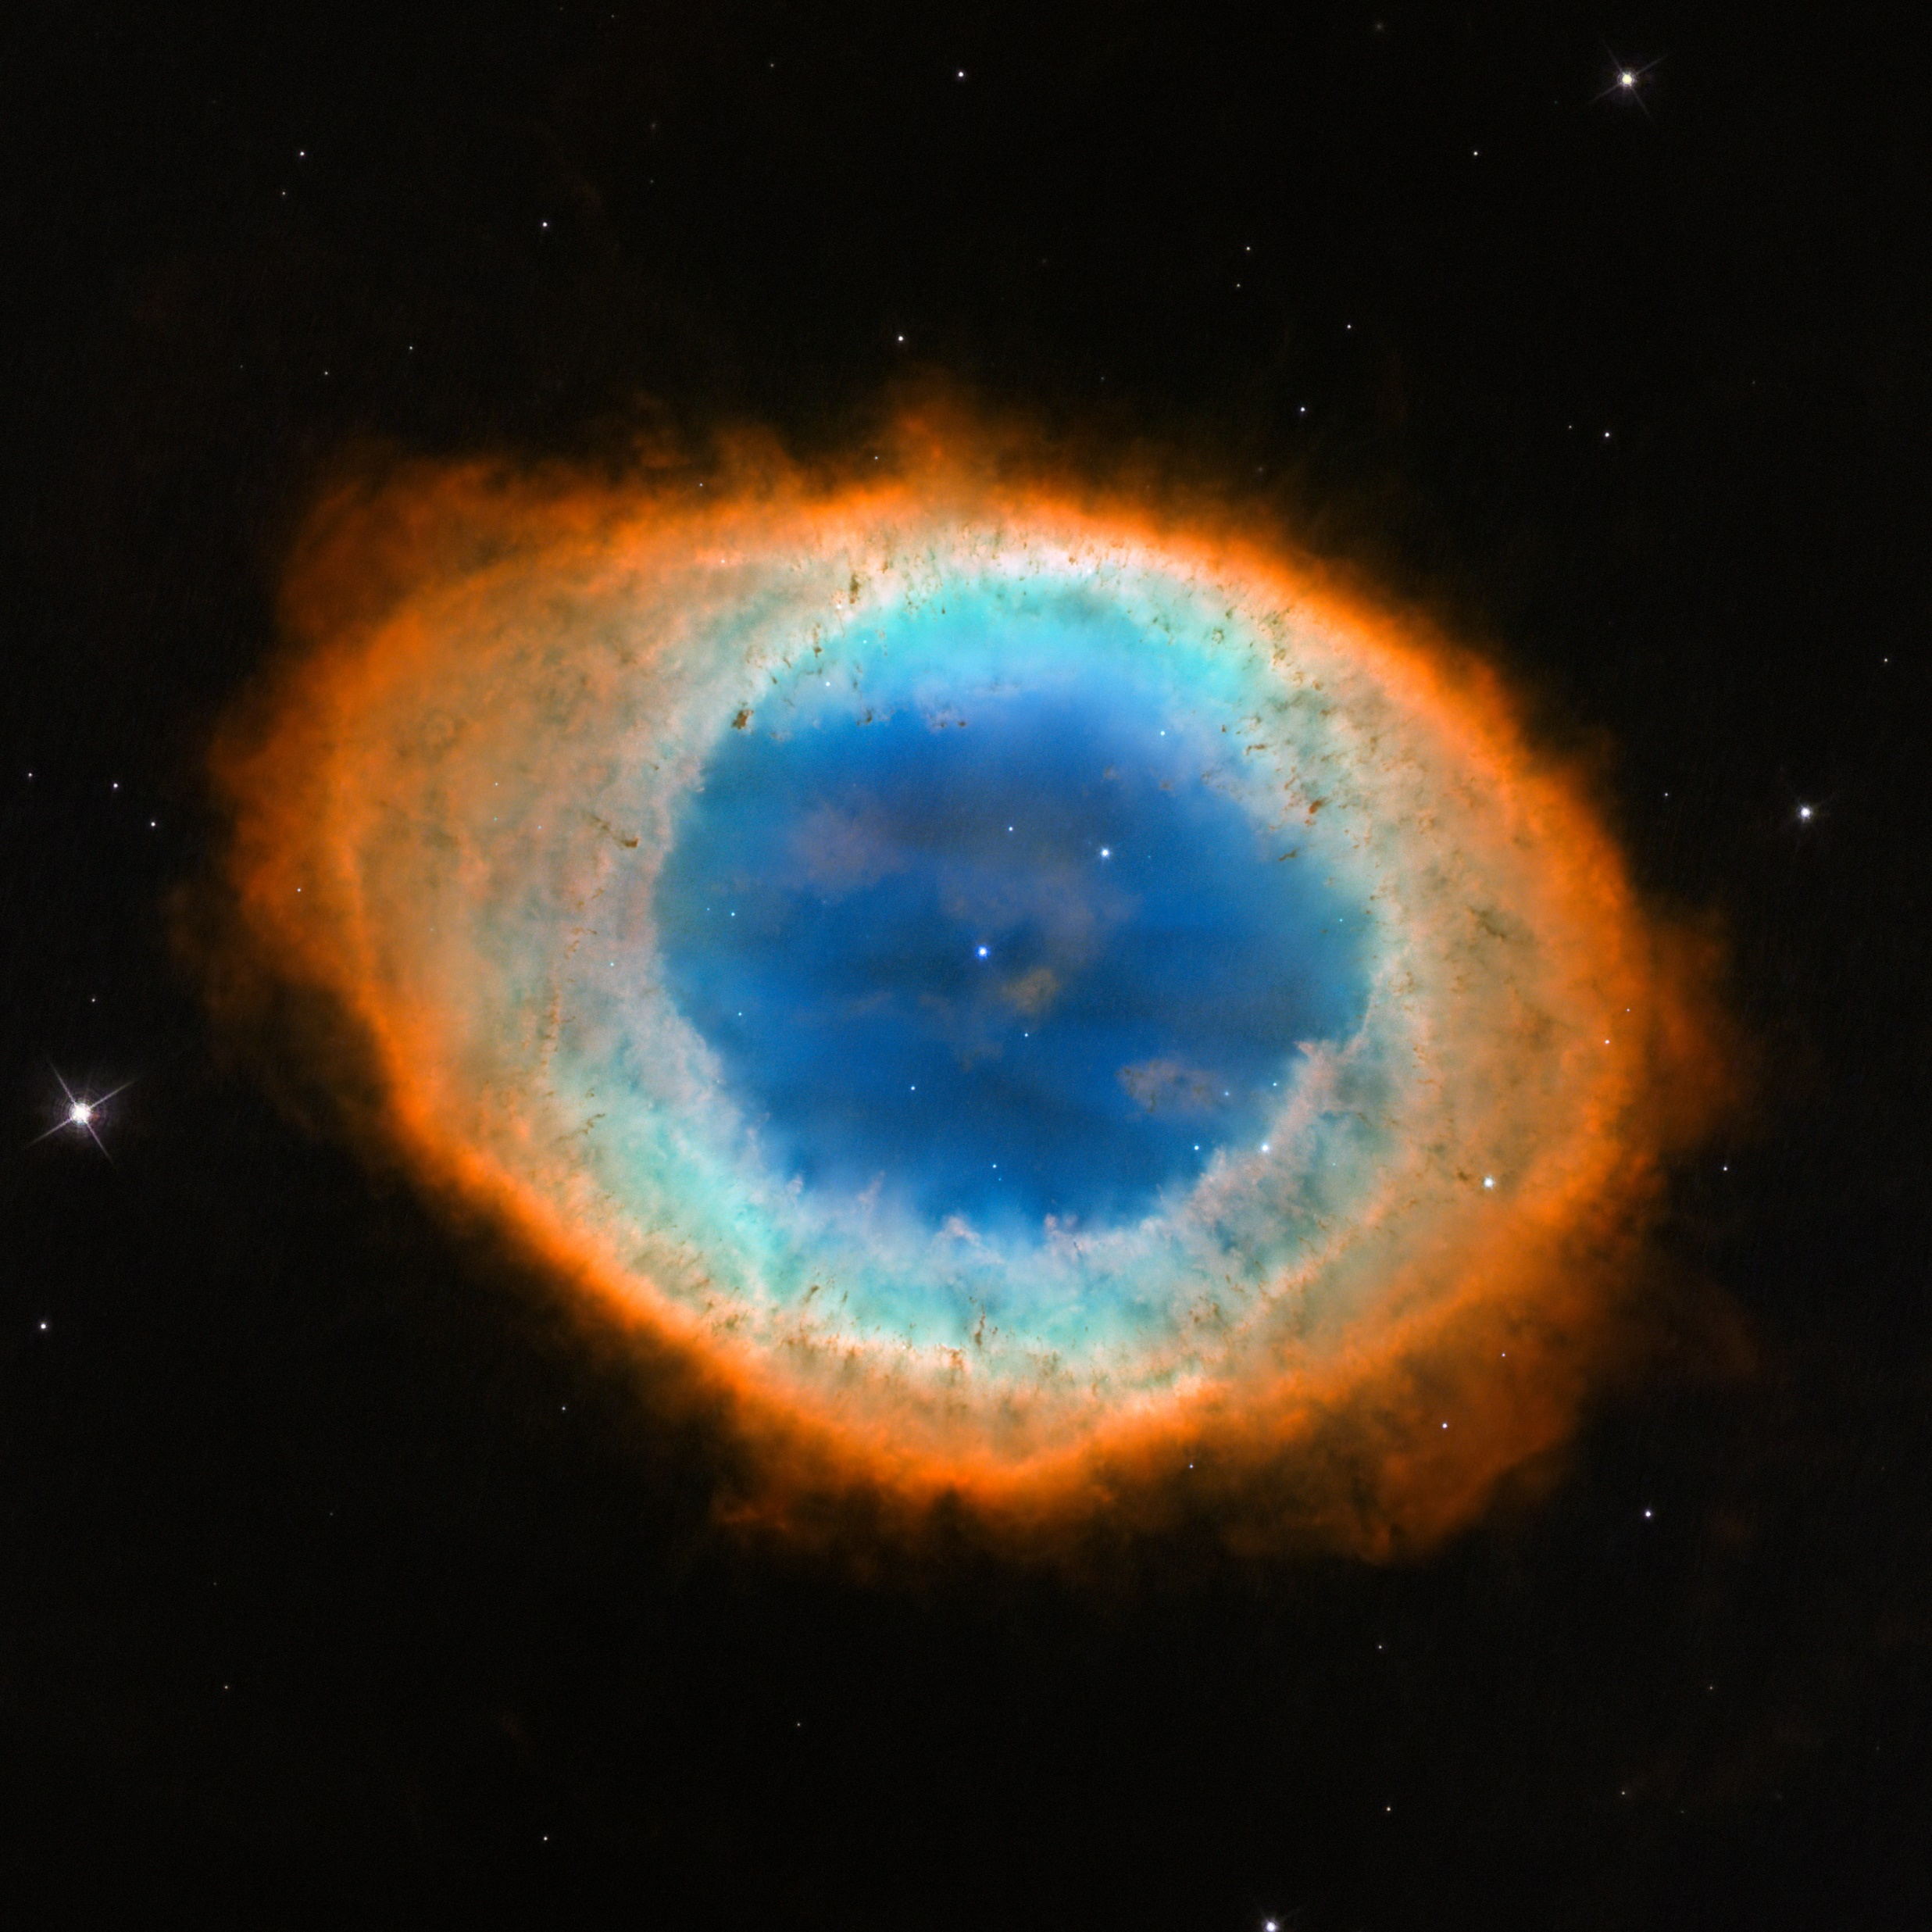
M57 Ring Nebula
Formed from a sun-like star
Can be seen with most medium sized telescopes
Rings are visible from Earth
Best seen during summer month
(Within the summer triangle)
About 2000 light years away (in constellation Lyra)
Apparent size: 1.4 by 1 arcminutes
Brightness: magnitude of 8.8
Rings viewed as layers due to central star layer and various elements at different temperatures
Notes:
-Comprised from the glowing remains from a sun like star
-Nebula is tilted toward earth so that the ring is visible from earth
-Best seen in 8in or larger telescopes, to small to be resolved by small binoculars
-about 2000 ly away within the constellation Lyra
-Apparent size of 1.4 by 1 arcminute and an apparent brightness of 8.8 (dimmer that Dumbbell)
-Can be seen south of Vega, the brightest star in Lyra and one of the stars in the summer triangle
-Elements such as ionized oxygen, molecular nitrogen, molecular sulfur and helium

Slide 10
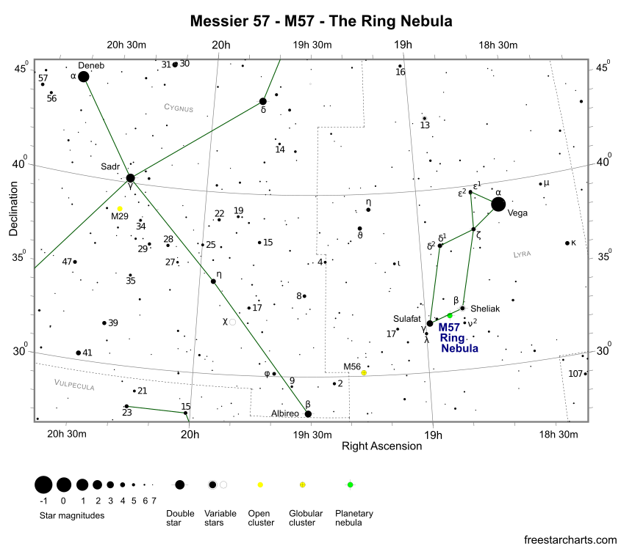

Slide 11
References
https://www.nasa.gov/feature/goddard/2017/messier-27-the-dumbbell-nebula
https://en.wikipedia.org/wiki/Planetary_nebula
https://www.messier-objects.com/messier-27-dumbbell-nebula/
https://www.nasa.gov/feature/goddard/2017/messier-57-the-ring-nebula
https://en.wikipedia.org/wiki/Ring_Nebula
https://www.messier-objects.com/messier-57-ring-nebula/
http://www.messier.seds.org/planetar.html

