Slide 1
Supernova Remnants (SNR)
Kai Weyland

Slide 2
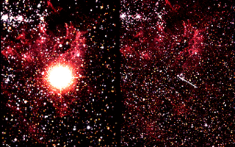
What is a Supernova?
The most powerful explosion known to man and can radiate more energy than the sun will produce in its lifetime
The blast is extremely bright, and can be seen across the universe, and even outshine galaxies
The shockwave of the blast spreads matter light years across
Are known as the primary source of heavy elements (heavier than iron) in the universe
Naturally occurring elements, such as Uranium and Gold
Stars can also create heavier elements through the process of nucleosynthesis
Nucleosynthesis requires a tremendous amount of energy which is why heavy elements can be less abundant.
Image of Supernova 1987A before and after it exploded

Slide 3
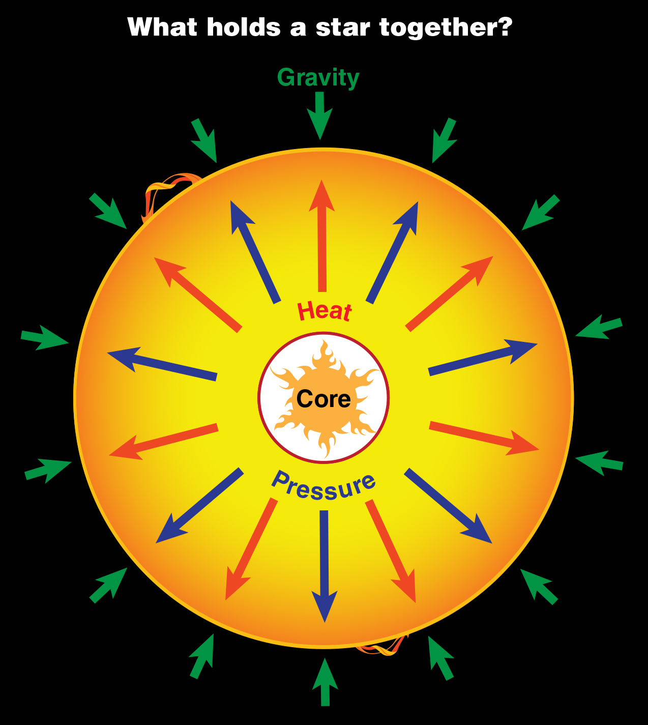
How do they form?
A supernova can happen in 2 ways
Type I) In a Binary Star System (Two Stars Orbiting each other) consisting of a white dwarf, and another star, the white dwarf will steal the matter of the other star overtime. When the mass of the white dwarf reaches a critical level, the star explodes into a supernova. This critical point is where the white dwarf accumulates too much mass.
Type II) When a large star nears the end of its life, it begins to run out of matter to fuse. Overtime, the core of the star builds up heavier and heavier elements. At the critical point, known as the Chandrasekar limit, the outward pressure inside the core begins to drop, and the gravitational force of the core causes the star to collapse in on itself, and create a huge explosion known as a supernova.
This collapse happens so quickly, it releases a shockwave which causes the outer part of the star to explode

Slide 4
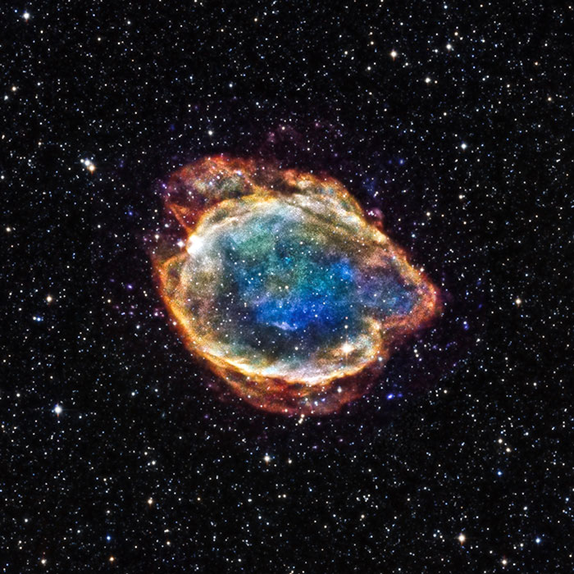
Why are the types Important?
These types of supernovas are important because scientists can use the brightness and luminosity to determine its distance away from Earth.
They use objects known as “Standard Candles” which are astrophysical objects with certain characteristics that allows scientists to determine its total luminosity.
Type 1a Supernovae are used by astronomers to find the distance to its galaxy, and how redshifted the galaxy is
Using this information, they can recreate a history of how far the galaxy moved during the time the light took to reach Earth. From this, they found that the universe is expanding at an accelerating rate.
Type 1a supernovae helped prove the existence of “dark energy” which is believed to be causing the universe to expand at an accelerating rate.

Slide 5
What happens after the explosion?
When supernovas explode, they release a tremendous amount of energy and matter
The spreading matter left behind are known as supernova remnants, and is a combination of light and heavy elements
In the center of the supernova remnants, the core of the star is very dense and is known as a neutron star
The supernova remnants are also referred to as nebula, or a cloud of space dust

Slide 6
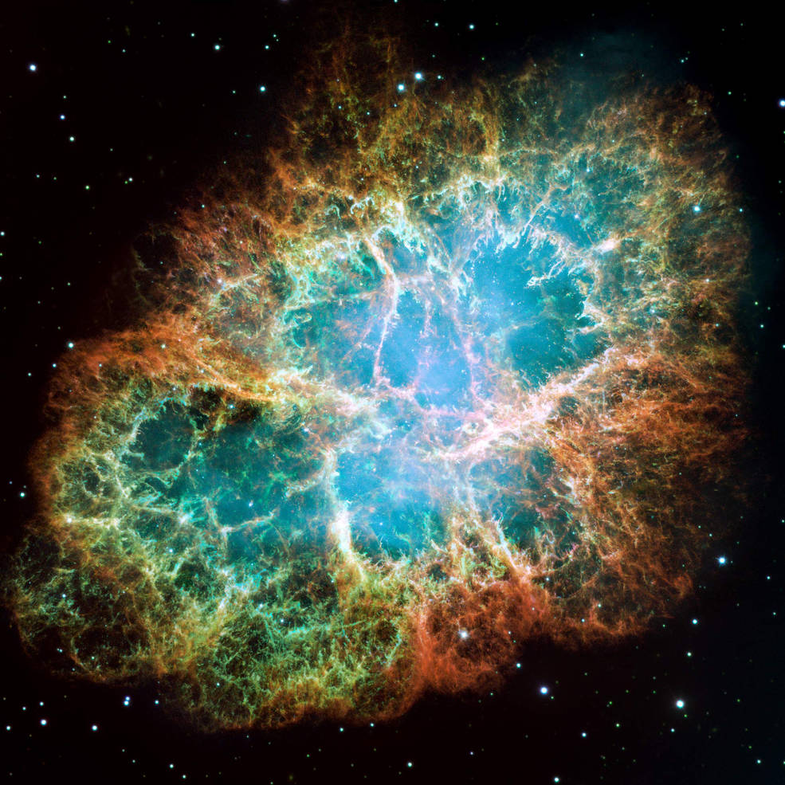
M1 Nebula (Crab Nebula)
The crab nebula is the oldest recorded supernova, being observed in 1054 by Chinese, and was observable during the daytime for almost a month.
Located in the constellation of Taurus
Today, we are able to observe the supernova remnants, shown on the image to the left.
Has an apparent magnitude of 8.6, and is located around 6,500 light years from Earth.

Slide 7
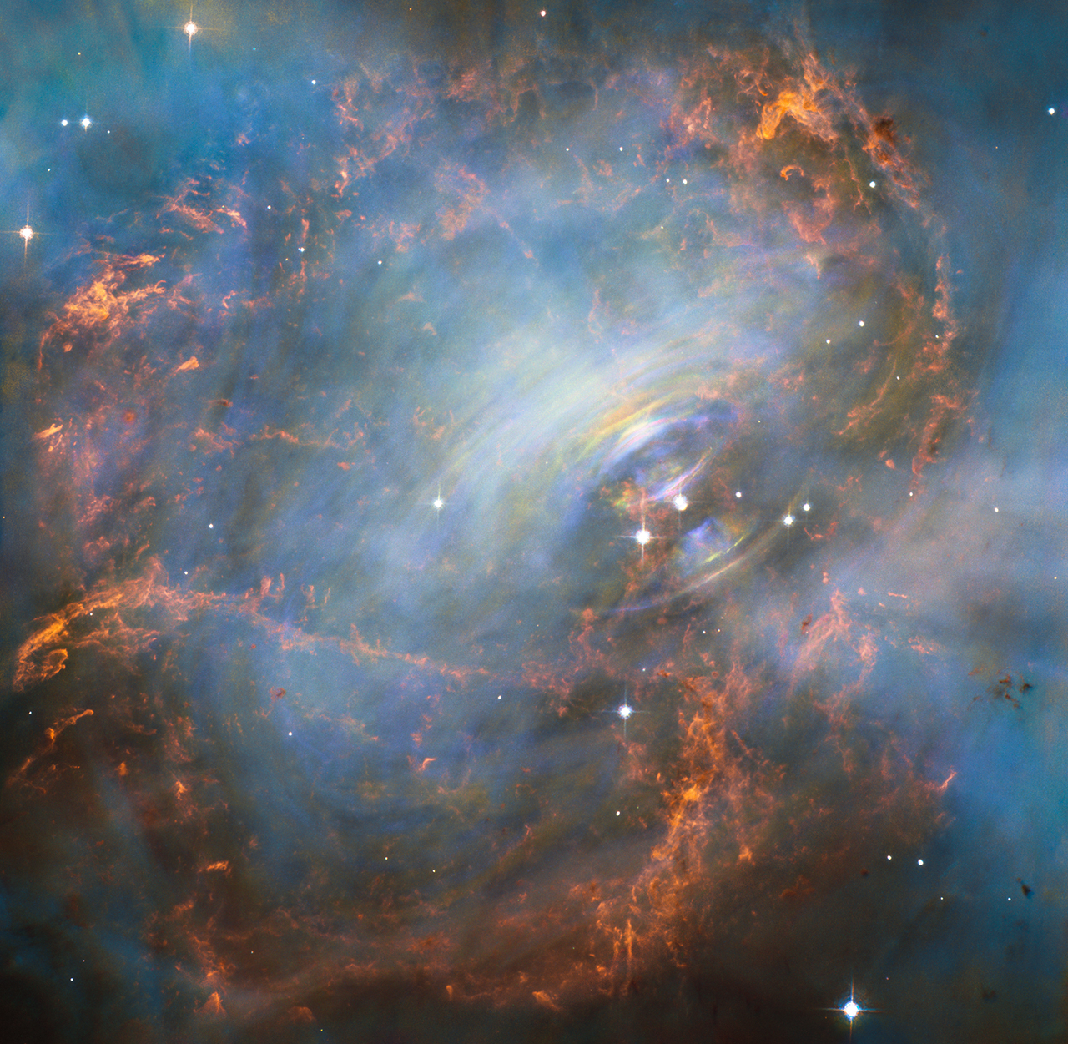
M1 Nebula (Cont)
This image of the M1 Nebula was taken by the hubble space telescope, over the course of 3 months
Although the colors of the image may not be accurate to the human eye, they also can provide information on the content of the nebula
Scientists have concluded that the orange veins consist of oxygen, the blue veins, hydrogen, and the red indicates ionized oxygen. There is also a small amount of green which they believe is sulfur
In the center of the nebula, there is a rapidly spinning neutron star, shown by the rings in the image.

Slide 8
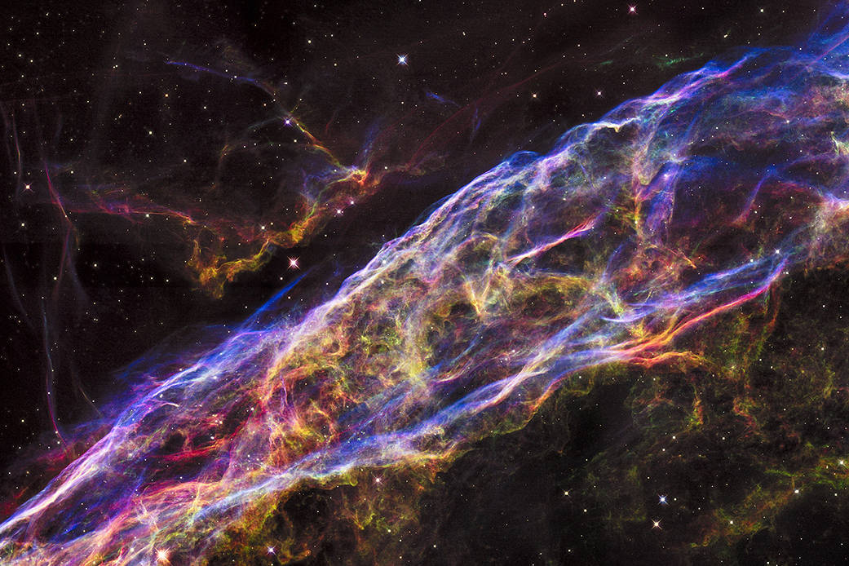
Veil Nebula
The Veil Nebula is a supernova remnant of a star that exploded around 8000 years ago
Around 110 light years across
Located about 1500 light years away from Earth, in the Cygnus constellation
Cannot be seen with the naked eye
Apparent Magnitude of 7.0, however the surface brightness is spread through its large area, making it difficult to see without a filter (OIII filter)

Slide 9
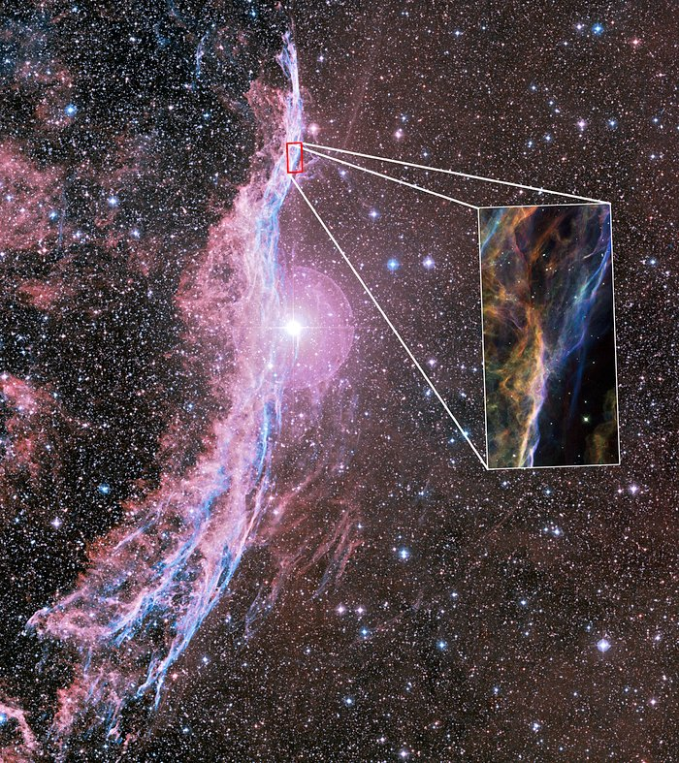
Veil Nebula (Cont)
Astronomers believe that before the star exploded, it gave off a very strong solar wind, and in combination with the supernova explosion, the veil nebula took a unique shape.
The nebula is so large that it has been broken into regions: Western Veil and Eastern Veil
The nebula is still changing and moving at speeds upwards of 600,000 km/hr
Captured by Hubble Space Telescope

Slide 10
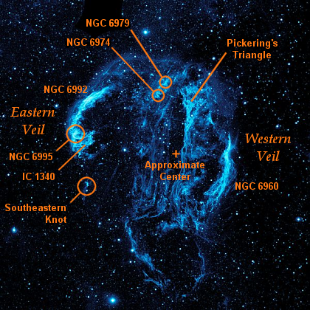

Slide 11
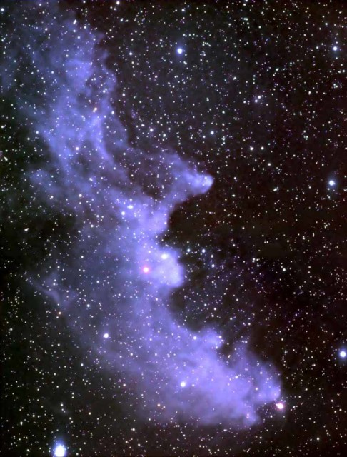
Witch Head Nebula (IC 2118)
Located about 1000 light years away from Earth
Not visible with the naked eye, very faint nebula
Has an apparent magnitude of 13
Found in the constellation Eridanus
Illuminated by the blue supergiant, Rigel, the 7th brightest star in the sky (120000 times brighter than the sun)
About 50 light years across
The blue in this nebula is the result of the blue supergiant illuminating the dust and gasses within the nebula

Slide 12
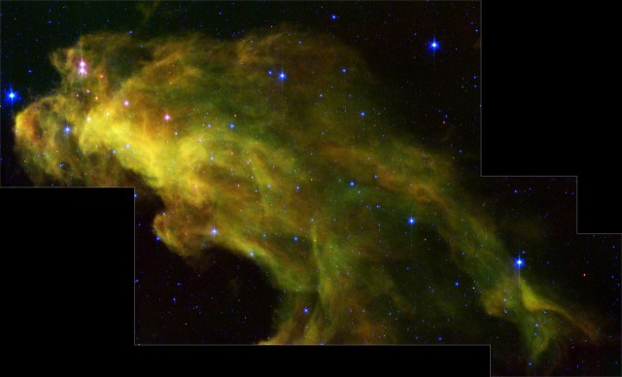
Witch Head Nebula (cont)
One of the most unique SNR as it is not only ancient, but also is illuminated by a nearby star without ionizing the matter
Its age means that the nebula is beginning to form stars, which is valuable information to scientists to understand how stars form in the universe
These newly formed stars have no visible light as the dust and gasses surrounding them absorb all visible light.
One of these newly formed stars is believed to have a ring of dust and gas around it which may be the process of plants forming

Slide 13
Sources
May, Sandra. “What Is a Supernova?” NASA, NASA, 1 June 2015, https://www.nasa.gov/audience/forstudents/5-8/features/nasa-knows/what-is-a-supernova.html.
Thompson, Andrea. “What Is a Supernova?” Space.com, Space, 9 Feb. 2018, https://www.space.com/6638-supernova.html.
Garner, Rob. “Messier 1 (The Crab Nebula).” NASA, NASA, 6 Oct. 2017, ht
tps://www.nasa.gov/feature/goddard/2017/messier-1-the-crab-nebula.
Admin. “Veil Nebula.” Constellation Guide, 19 Aug. 2014, https://www.constellation-guide.com/veil-nebula/.
Admin. “Veil Nebula.” Constellation Guide, 19 Aug. 2014, https://www.constellation-guide.com/veil-nebula/.
Martin, Ann. “How Do Supernovae Show Us That the Universe's Expansion Is Accelerating? (Advanced).” Home - Curious About Astronomy? Ask an Astronomer, http://curious.astro.cornell.edu/people-and-astronomy/85-the-universe/supernovae/general-questions/404-how-do-supernovae-show-us-that-the-universe-s-expansion-is-accelerating-advanced.

