Slide 1
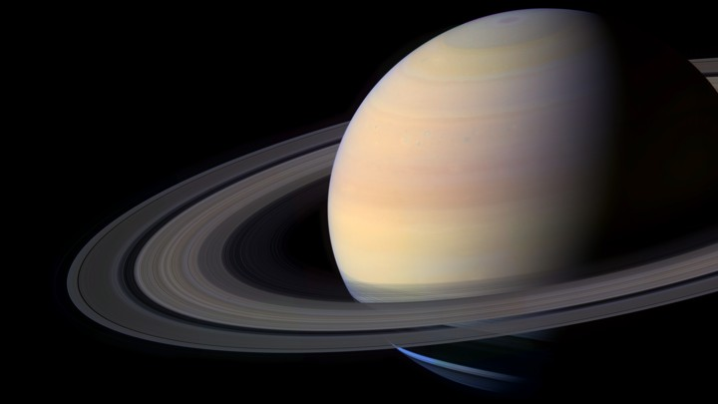
SATURN
ENCELADUS & TITAN
Ryan Helbling
October 8, 2019
EGR 491 – Telescope Design
Notes:
Photo Location: https://cdn.theatlantic.com/assets/media/img/mt/2016/01/Saturn3/lead_720_405.jpg?mod=1533691796

Slide 2
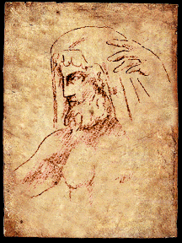
HISTORY
Named after Roman God
Chronos the God of Time, Titan God
Known since Prehistoric Times
Galileo was the first to view Saturn with a telescope. Later determines “arms.”
Dutch astronomer, Christian Huygens determines that arms are actually rings in 1659.
French, Jean-Dominique Cassini discovers major moons of Saturn in 1675.
Notes:
Image source: https://www.windows2universe.org/mythology/images/Saturn.gif

Slide 3
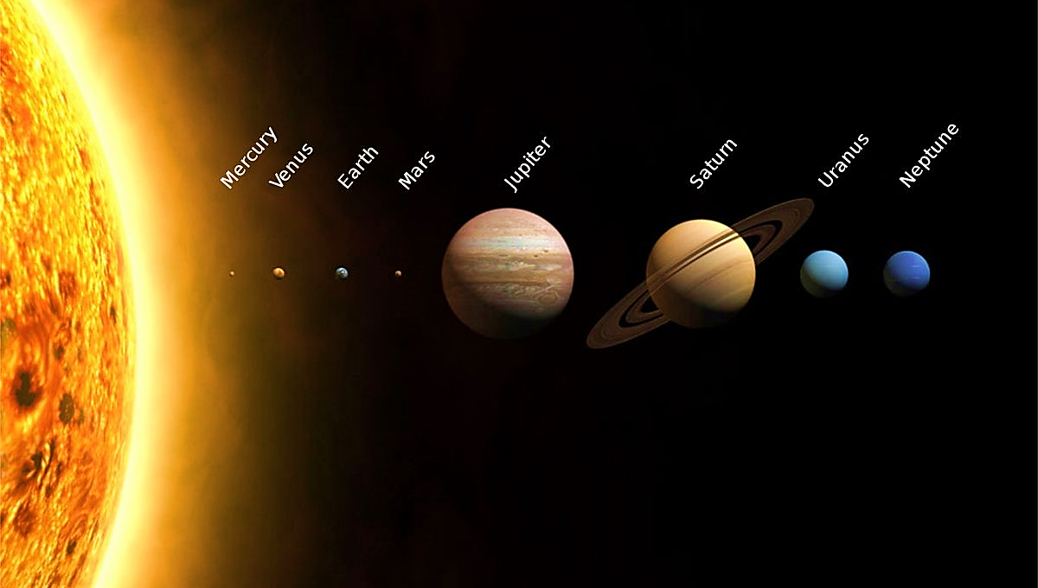
Diameter:
72,367 mi
QUICK FACTS
Rotation Time 10.7 hours
Distance from Sun: 886 x 10⁶ mi (9.5 AU)
7th Planet from Sun
Orbital Period 29.4 years
Notes:
Saturn is the seventh planet from the sun.
It lies beyond Jupiter at 886 million miles (9.5 astronomical units away from the sun).
If the sun were the size of a volleyball, Saturn would be about the size of an acorn and a football field away.
At just over 72,000 miles in diameter, Saturn is the second largest in our Solar System after Jupiter.
To put the size of Saturn in perspective, if Earth’s diameter was the size of nickel, Saturn’s would be the size of a volleyball.
It takes approximately 10.7 hours for Saturn to rotate, the second quickest rotation speed among planets in our solar system
One revolution around the sun takes Saturn almost 30 years.
Saturn’s axis is tilted 26.73 degrees with respect to its orbit. This causes Saturn to have seasons like Earth which has an orbital tilt of 23.5 degrees.
Saturn also has extreme weather and heavy winds that can be up to 1,600 ft/s
Image: https://www.syfy.com/sites/syfy/files/styles/1200x680/public/solarsystem_diagram.jpg

Slide 4
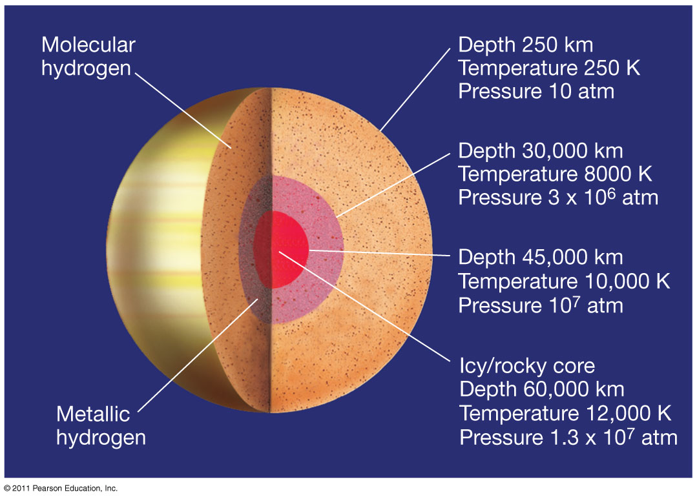
SATURN’S CORE

Slide 5
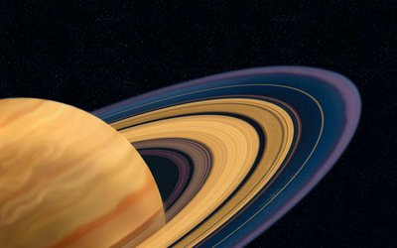
Rings
7
RINGS
Notes:
Saturn’s Rings are made up of pieces of comets, asteroids, and shattered moons. They are torn apart by Saturn’s powerful gravity and now float as chunks of ice and rock orbiting around Saturn.
Saturn has seven main rings with a diameters of up to175,000 miles which is more than twice the diameter of Jupiter, while only about 30 feet in height.
The rings were named in the order in which they were discovered.
From inside out the order is D ring, C ring, B ring, then the Cassini Division, the A ring, F ring, G ring and E ring.

Slide 6
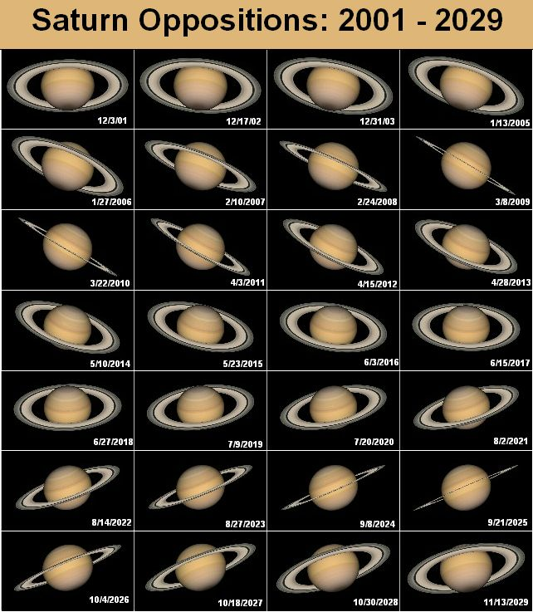
Viewing
Saturn
Notes:
https://earthsky.org/astronomy-essentials/viewing-saturns-rings-tips-for-beginners
https://cosmicpursuits.com/2560/guide-to-observing-saturn-in-2019/
https://www.space.com/29444-saturn-rings-moons-skywatching.html
This year Saturn reaches opposition in Sagittarius. It is moving in retrograde motion, from left to right against the background of the stars.
With a simple telescope you can often see Saturn’s two main rings: A and B at 25x magnification, but to see the distinction between them you often need a powerful telescope with 100x magnification or more.
Every 14-15 years. Saturns rings vanish from view as they are completely aligned. While this may seem like a major bummer, it is actually a valuable time to observe Saturn’s moons without an impediment.

Slide 7
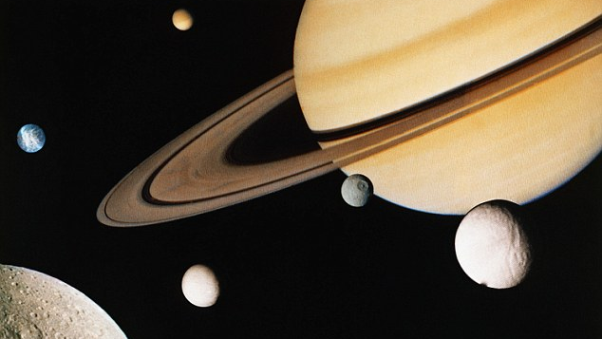
Saturn’s Moons 53 Confirmed | 9 Provisional
Notes:
Source: https://i.dailymail.co.uk/i/pix/2016/03/25/15/328D13D900000578-3509532-image-a-77_1458919587508.jpg

Slide 8
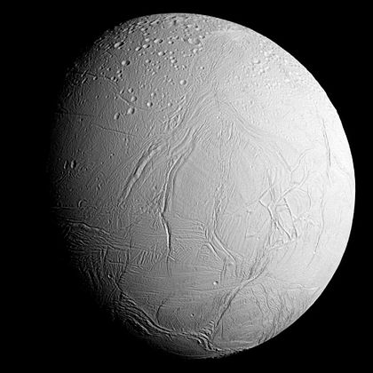
Enceladus
Notes:
Sixth Largest Moon of Saturn
Discovered in 1789 by William Herscel.
1/7 the diameter of Earths Moon
Moon was seen by Voyagers I and II, but Cassini saw it most closely in 2005 and revealed large water deposits on the moons surface.
Over 100 guysers have been identified.
Covered mostly in ice, at noon, the temperature only reaches -198 degrees celcius
https://upload.wikimedia.org/wikipedia/commons/thumb/8/83/PIA17202_-_Approaching_Enceladus.jpg/420px-PIA17202_-_Approaching_Enceladus.jpg

Slide 9
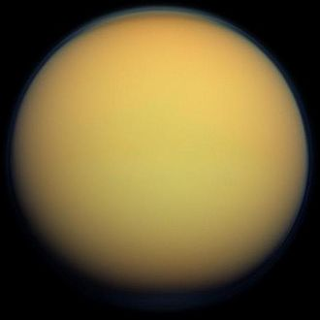
Titan
Notes:
Largest Moon of Saturn
Discovered by Huygens who discovered Saturn’s Rings
50% larger than Earth’s moon
Only moon to have a dense atmosphere. Mainly nitrogen.
Has a rocky core, mostly surrounded by ice
Climate with wind and rain makes it similar to Earth’s with dunes and lakes and rivers.
Exciting to scientists due to a potential for life!

Slide 10
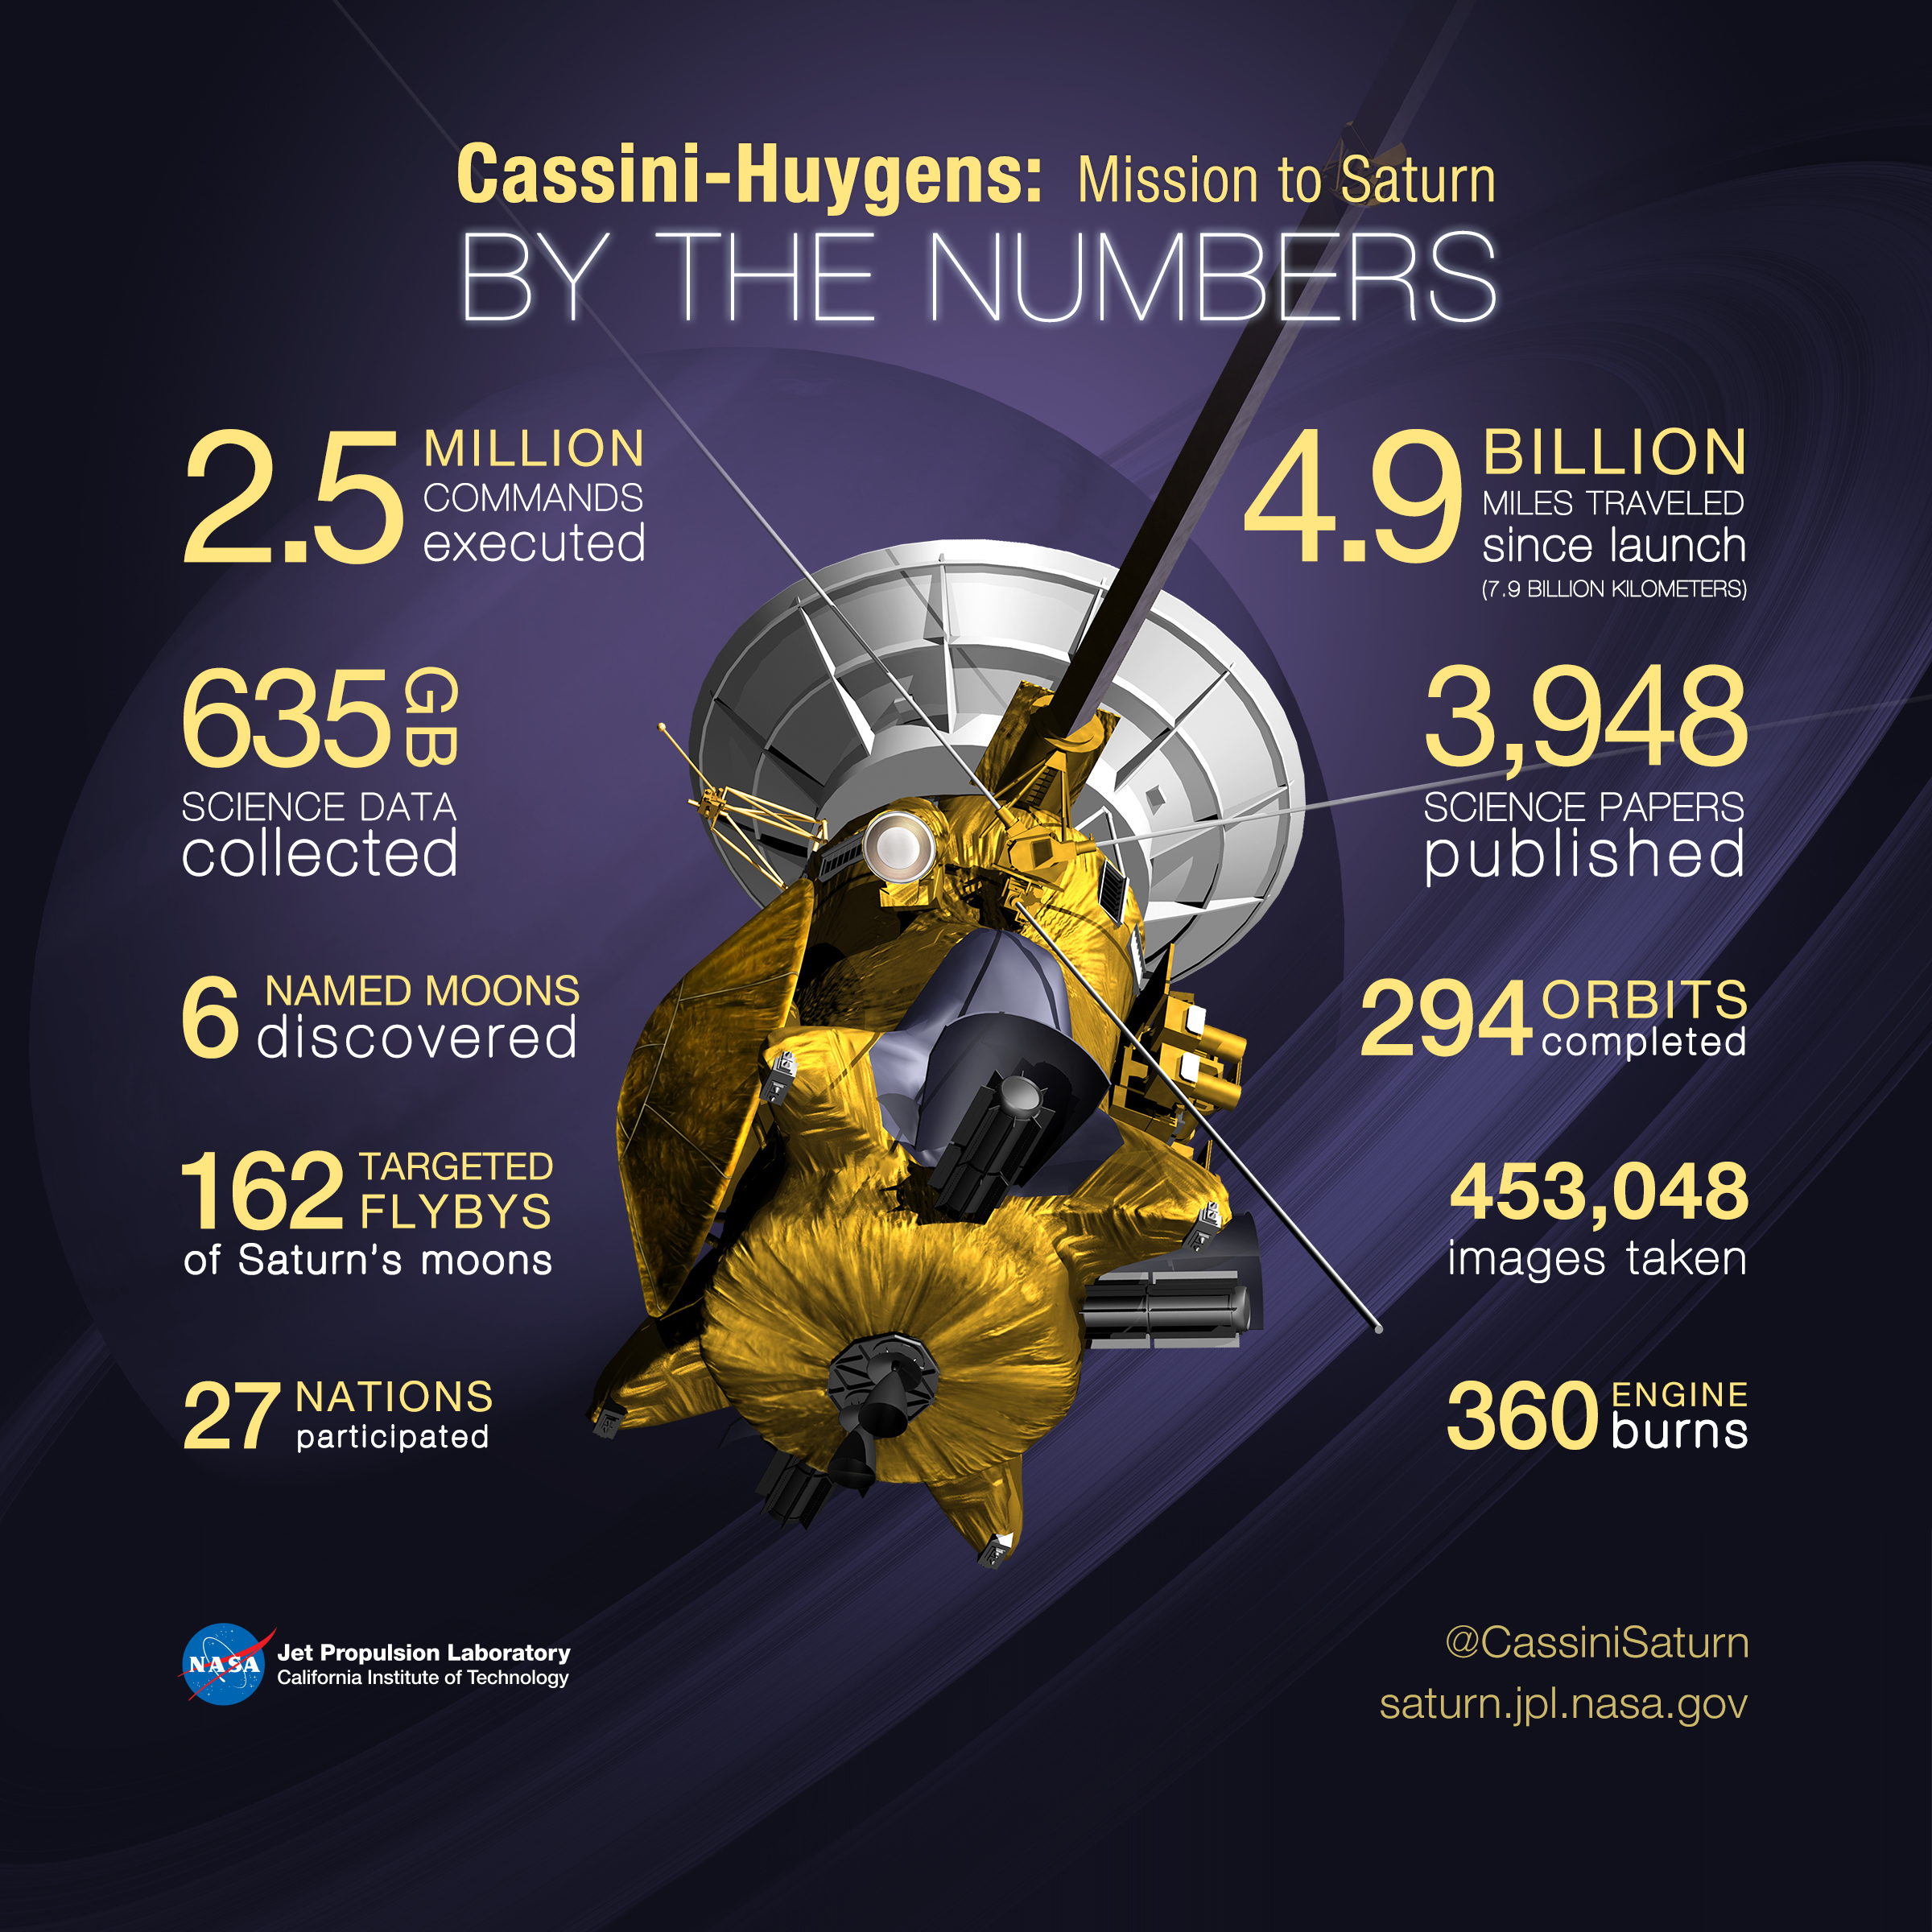
Cassini
https://www.youtube.com/watch?v=_5ZrSKpbdSg
Notes:
The Cassini spacecraft was launched in 1997 from Cape Canaveral in Florida as a joint mission between NASA and the European Space Agency. After studying Jupiter for six months it 2000 , it would begin to orbit Saturn for several years, taking photos of Saturn’s moons.
They also shot off the Huygen’s Probe to Titan in 2004 for further exploration.
On September 15, 2017 the Cassini mission ended and it plunged into Saturn’s atmosphere.

Slide 11
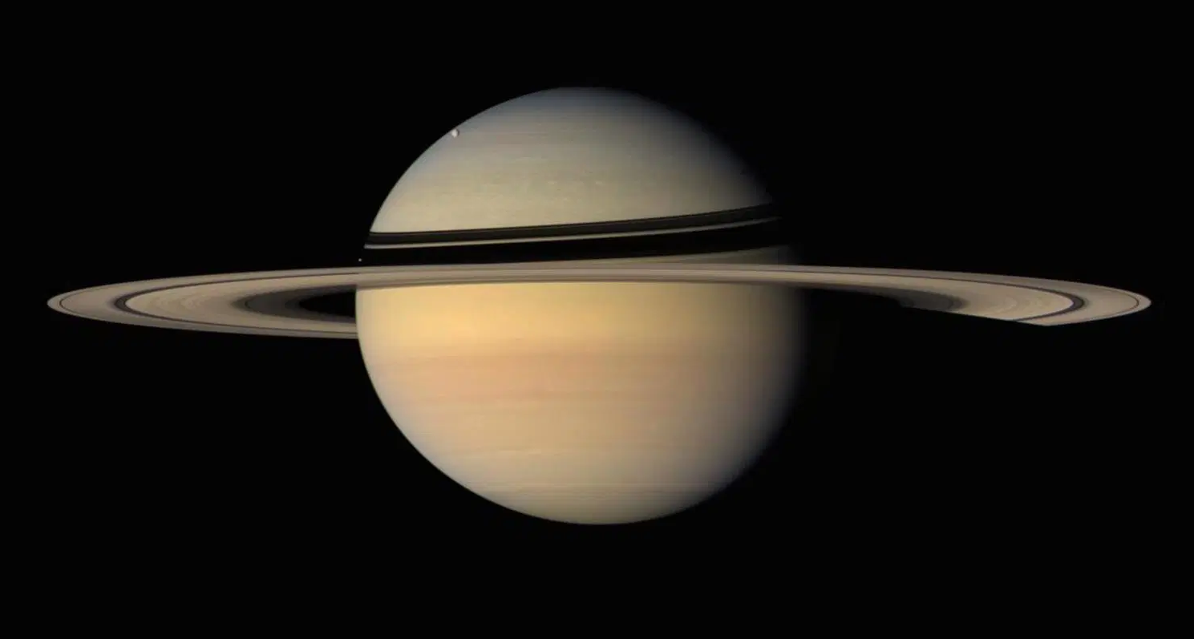
Questions?
Notes:
https://www.jpl.nasa.gov/missions/cassini-huygens/
https://solarsystem.nasa.gov/system/downloadable_items/2552_cassinihuygens_BTN_16_purple_final_01.jpg
https://www.nasa.gov/press-release/nasa-s-cassini-spacecraft-ends-its-historic-exploration-of-Saturn
https://science.nasa.gov/science-news/science-at-nasa/2008/18mar_Saturn
https://www.space.com/29444-saturn-rings-moons-skywatching.html
https://solarscience.msfc.nasa.gov/papers/hathadh/SolarSystemModel.pdf

Slide 12
https://cdn.theatlantic.com/assets/media/img/mt/2016/01/Saturn3/lead_720_405.jpg?mod=1533691796
https://www.windows2universe.org/mythology/images/Saturn.gif
https://www.syfy.com/sites/syfy/files/styles/1200x680/public/solarsystem_diagram.jpg
https://earthsky.org/astronomy-essentials/viewing-saturns-rings-tips-for-beginners
https://cosmicpursuits.com/2560/guide-to-observing-saturn-in-2019/
https://www.space.com/29444-saturn-rings-moons-skywatching.html
https://i.dailymail.co.uk/i/pix/2016/03/25/15/328D13D900000578-3509532-image-a-77_1458919587508.jpg
https://upload.wikimedia.org/wikipedia/commons/thumb/8/83/PIA17202_-_Approaching_Enceladus.jpg/420px-PIA17202_-_Approaching_Enceladus.jpg
https://upload.wikimedia.org/wikipedia/commons/thumb/8/83/PIA17202_-_Approaching_Enceladus.jpg/420px-PIA17202_-_Approaching_Enceladus.jpg

