Slide 1
“You can observe a lot just by watching” -Yogi Berra Sketch the night sky, midnight in August, looking near the southern horizon. Always include the date of your observations.

Slide 2
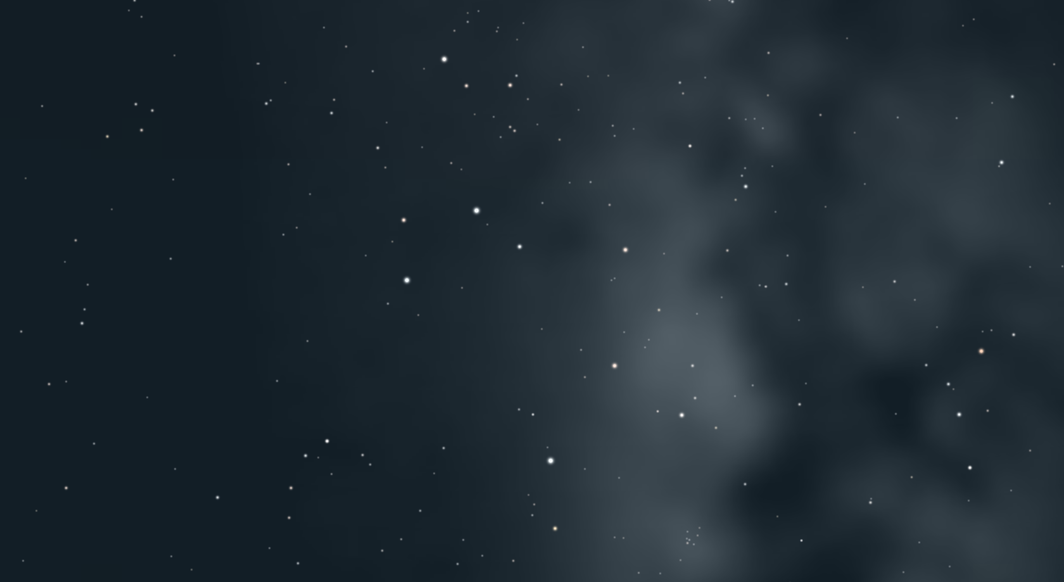

Slide 3
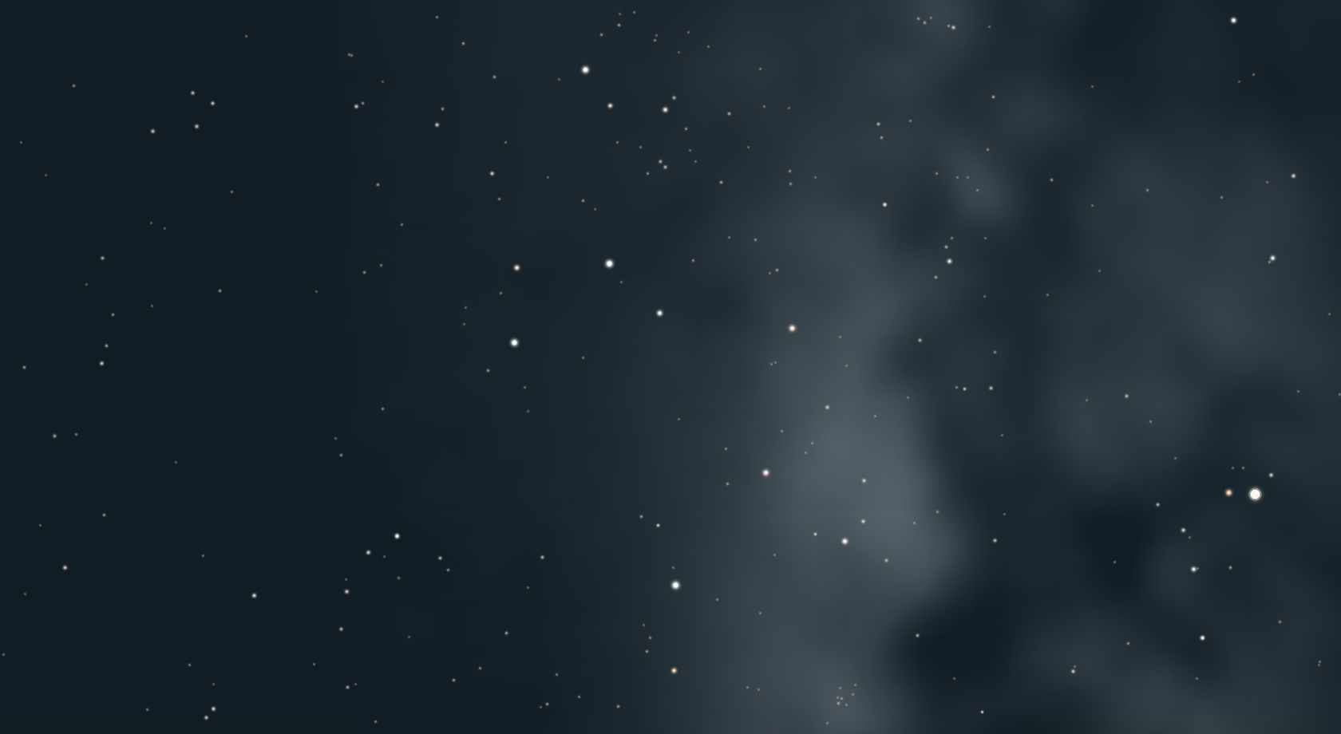

Slide 4
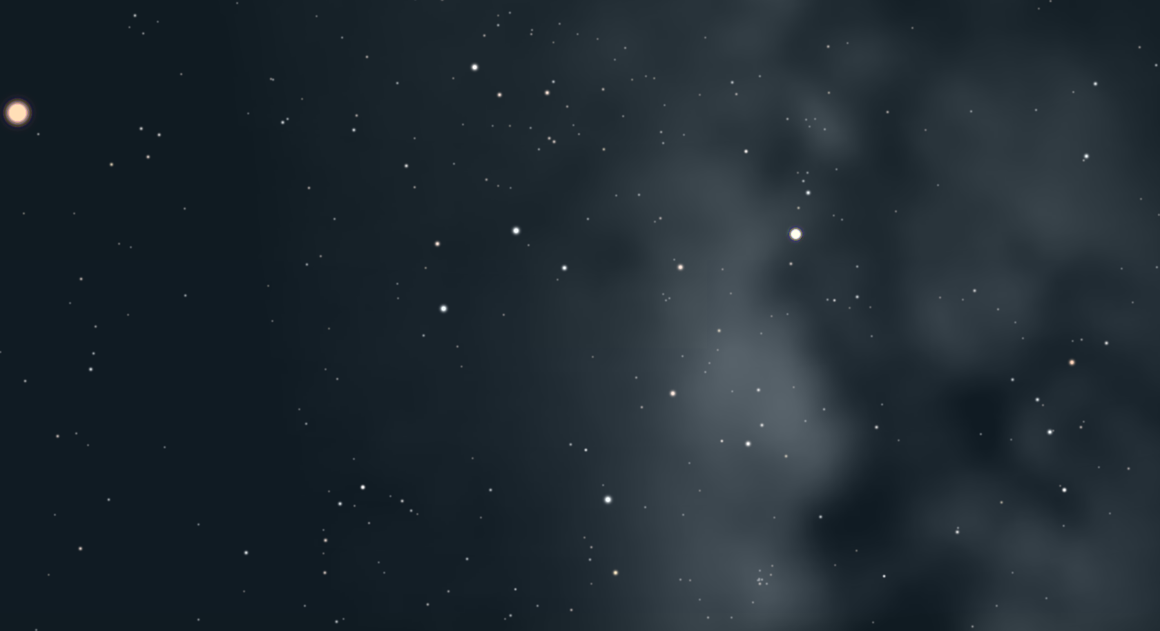

Slide 5
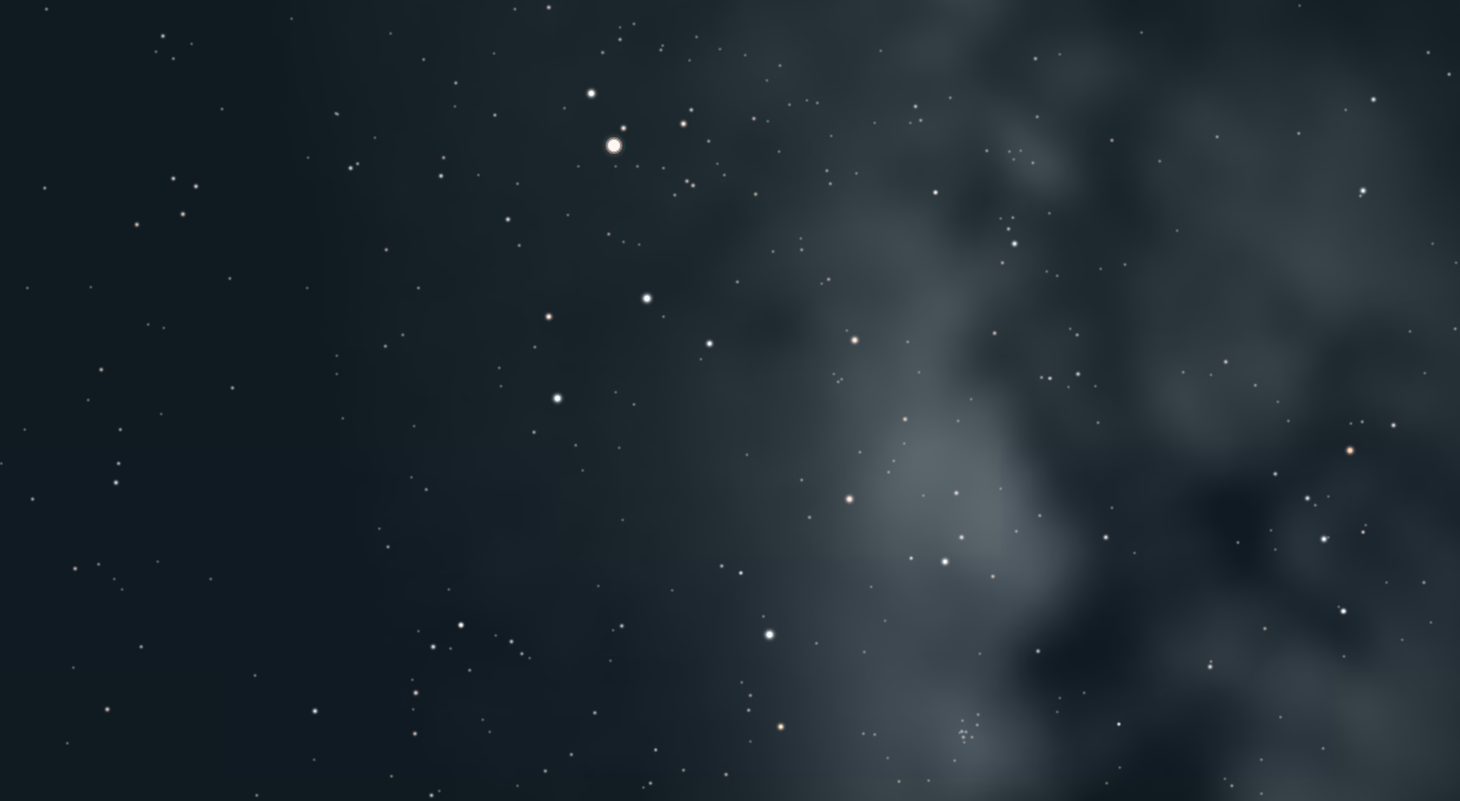

Slide 6
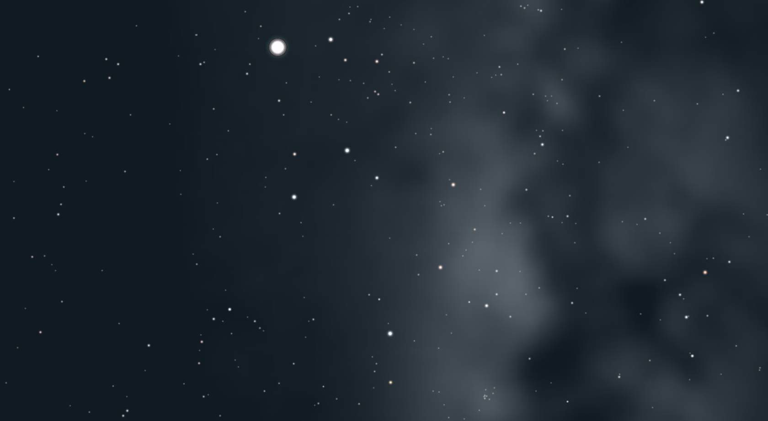

Slide 7
Sagittarius: 2016 – no planets visible 2017 – Saturn, upper right 2018 – Saturn above/right, Mars far left 2019 – Saturn above/left Jupiter far right 2020 – Jupiter left (Saturn out of view far left)

