Slide 1
Solar Telescopes
By: Tom Fritz

Slide 2
Overview
What are they?
Operation
Issues
Optics, Apertures, and Focal Length
Observation
Significant Solar Telescopes
Significant Observations

Slide 3
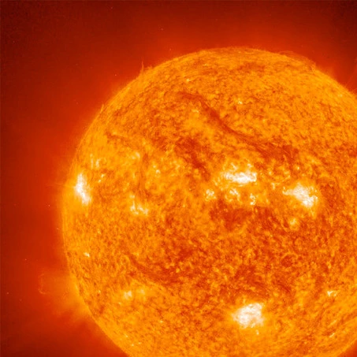
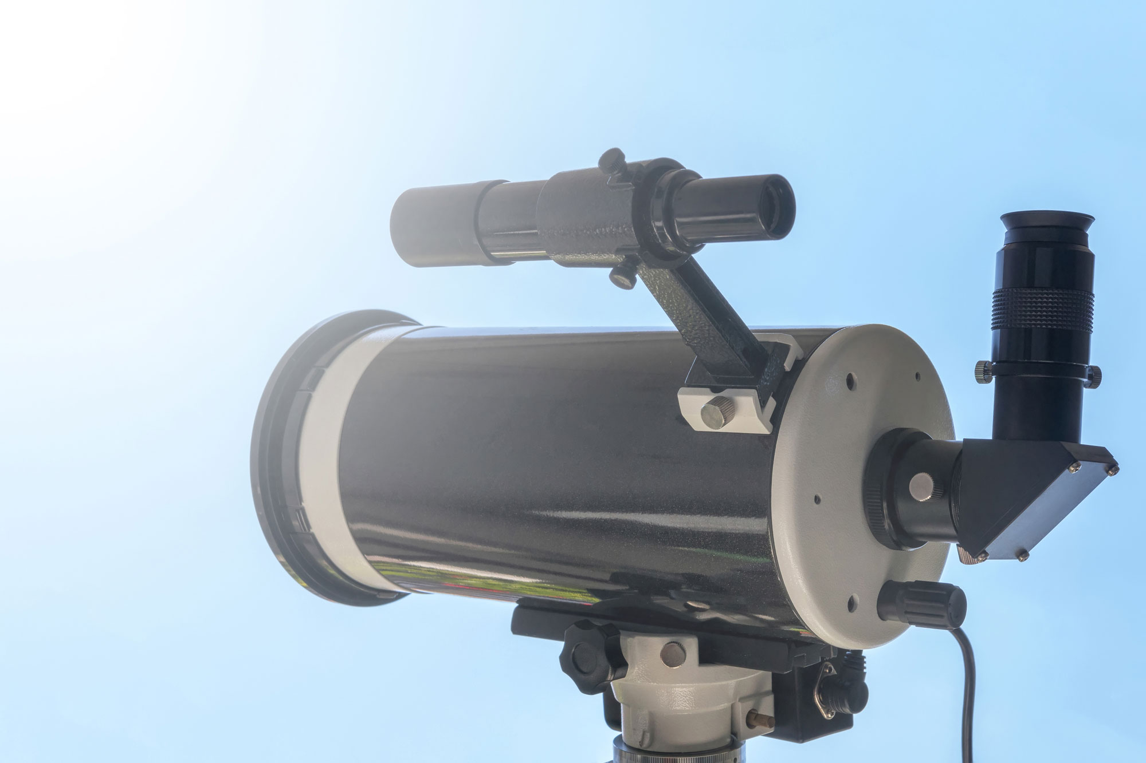
What are they?
Solar telescopes are telescopes used to observe the Sun
Usually detect light with wavelengths in visible spectrum
Also known as heliographs or photoheliographs

Slide 4
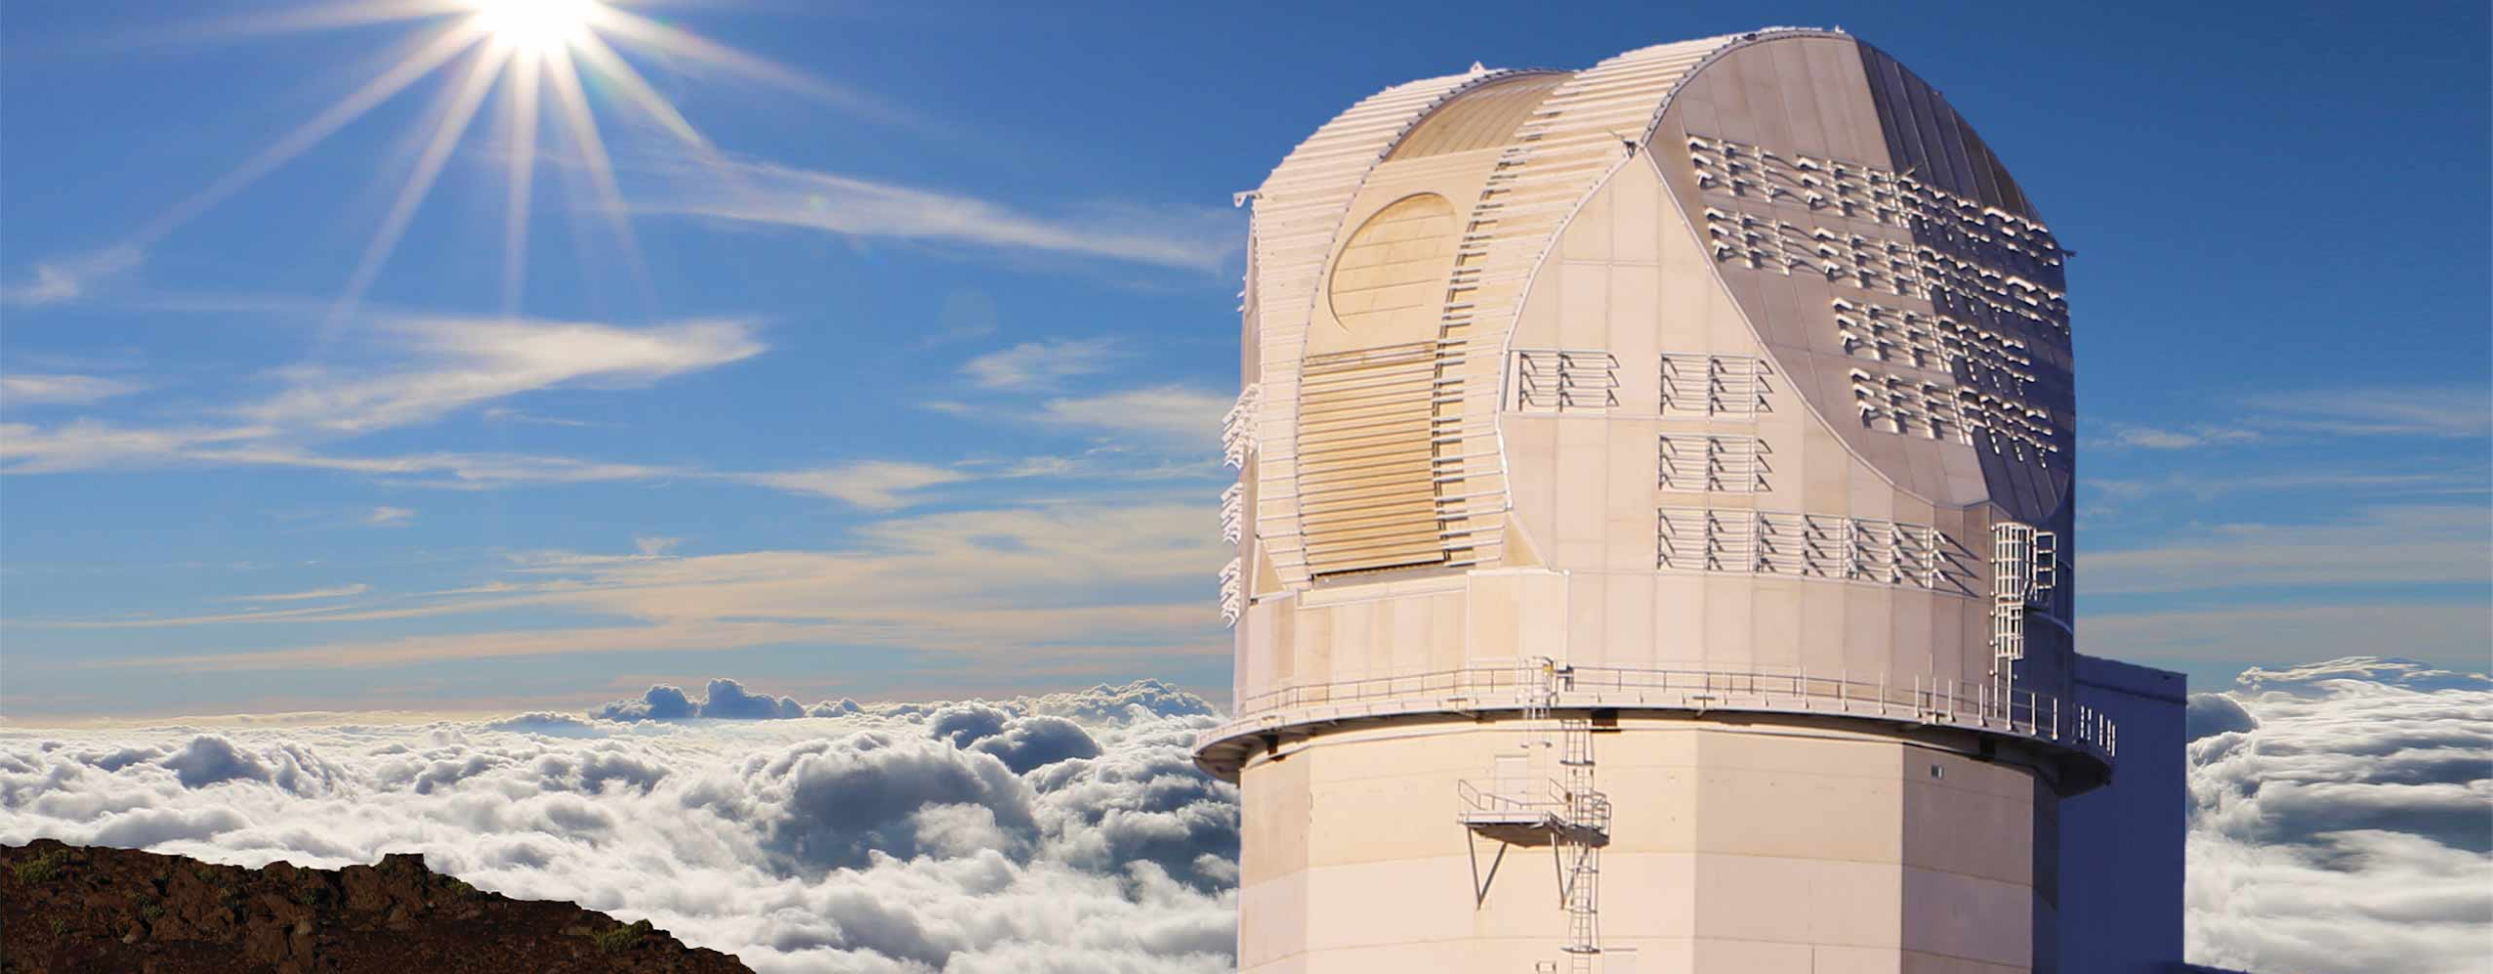
Operation
Operates quite like most telescopes
Lens that gathers and focuses solar light
Heat-stop
Mostly refracting telescopes
Converging lens
Eyepiece

Slide 5
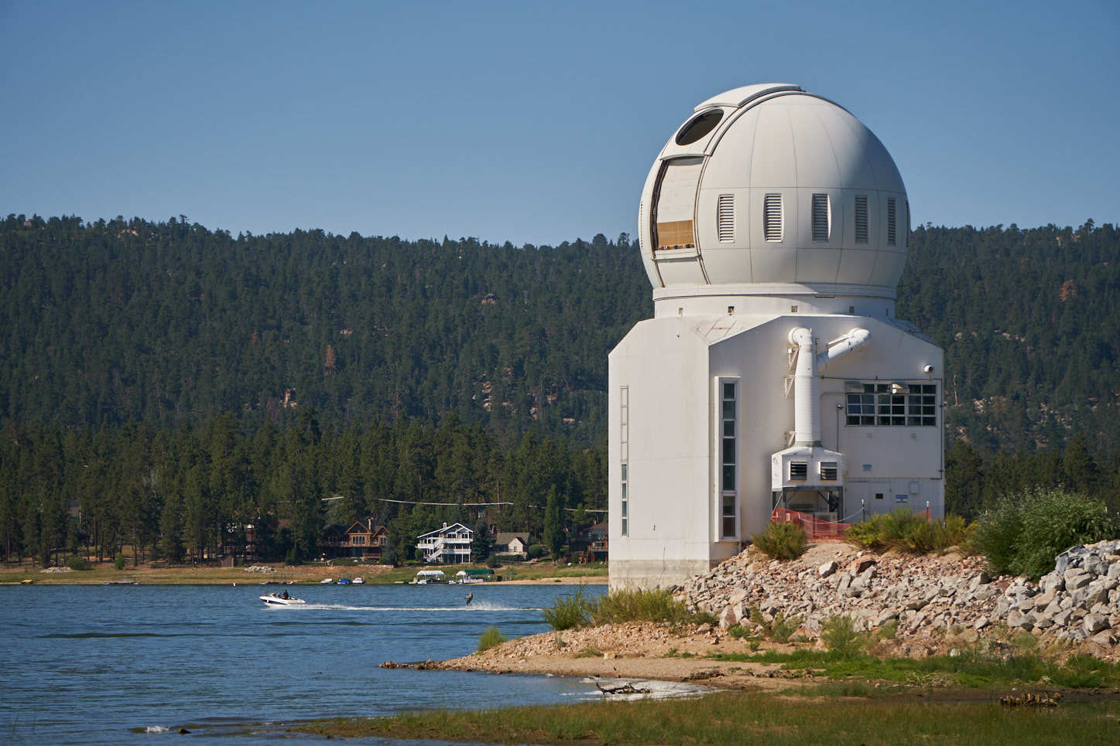
Problems with Solar Telescopes
Telescope must be used during the day which poses the risk of overheating the air and area around telescope
Solar light and radiation focused by the optics can cause excess heat
Heat can cause convection in the air in the path of the light
distortion

Slide 6
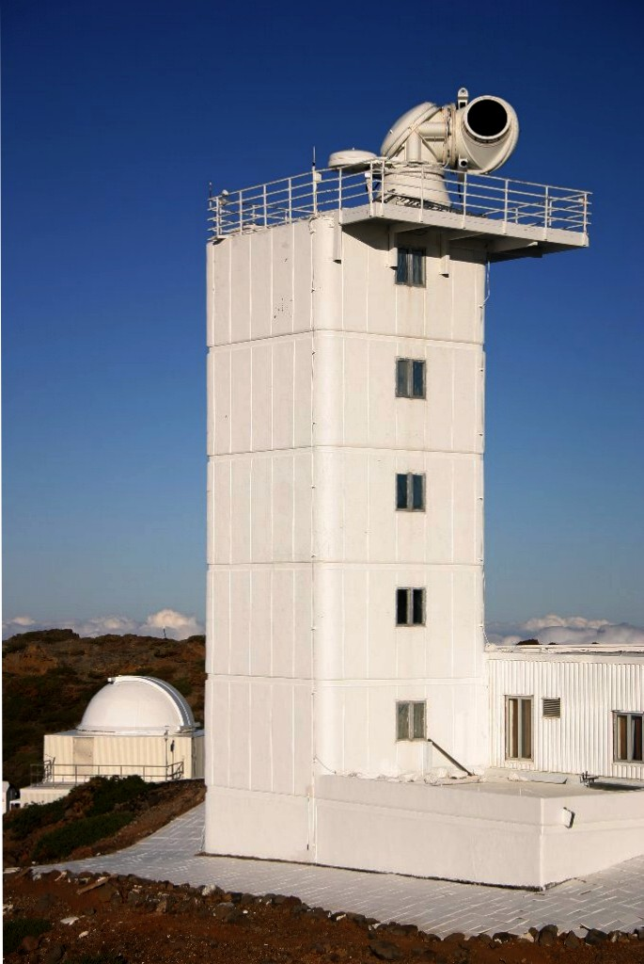
Cooling
Solar telescopes require special instruments as they must withstand the heat input from the solar radiation which causes turbulence
Must do this while also maintaining resolution
Mitigated by placing telescope in a tower or underground
Extra cooling usually achieved through auxillary heat exchangers

Slide 7
Issue with focused sunlight
Tightly-focused sunlight causes excess heat to be generated
Heat-stop must be integrated to prevent turbulence
Heat-stop limits field-of-view such that unneeded solar light is removed

Slide 8
Optics, Apertures and Focal Length
Optics are usually smaller than other light-collecting telescopes
Due to much higher amount of light coming from the Sun relative to other objects
Apertures range from a few centimeters to up to half a meter
Focal lengths are normally very long
Vacuum or helium are placed in the path of light
Reduces air motion caused by heat

Slide 9
Observation
Most observe at visible, UV and near infrared wavelengths
Solar X-ray astronomy
Heliostats
Used to keep track of Sun's path
Predetermined target
Compensate for movement of Sun
Easier to maintain focus on Sun

Slide 10
Significant Solar Telescopes

Slide 11
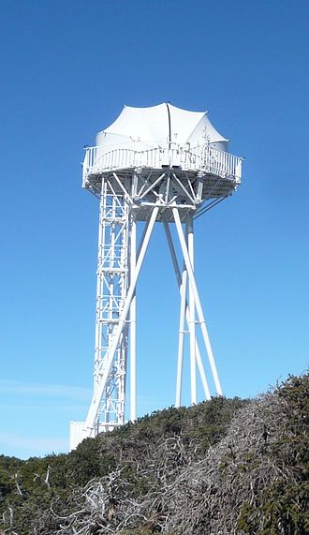
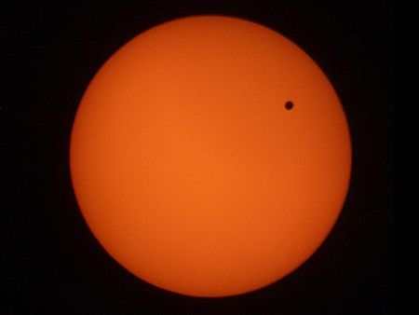
Dutch Open Telescope (DOT)
Located in Sweden
Built 1997
45 cm primary mirror
0.2 arcsec resolution
Built on stilt-like supports to decrease ground-heat interference
Recorded famous Venus transit in 2004

Slide 12
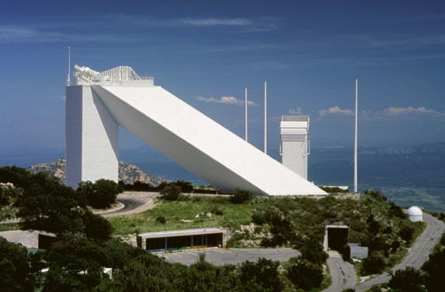
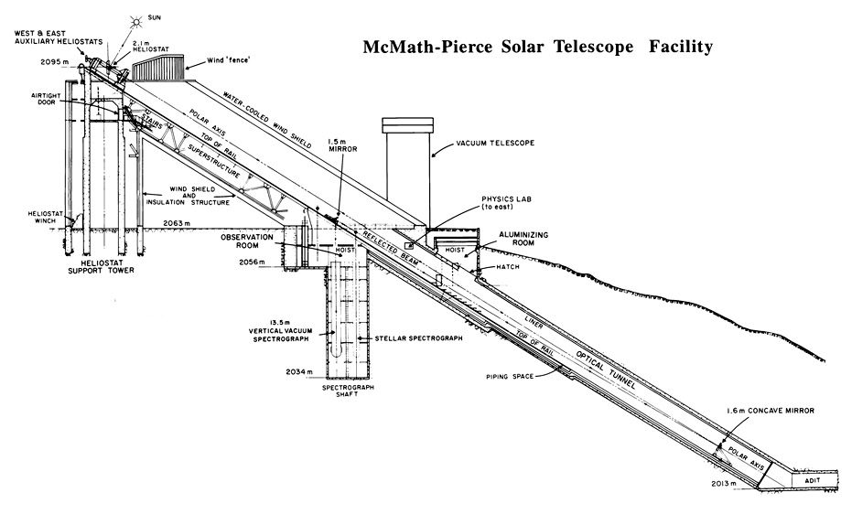
McMath-Pierce Solar Telescope
Kitt Peak, Arizona
Built 1962 - improved in 2018
1.6 meter f/54 primary mirror
Current largest unobstructed aperture telescope in the world
100 feet above ground, 200 below
Focused on studying sunspots

Slide 13
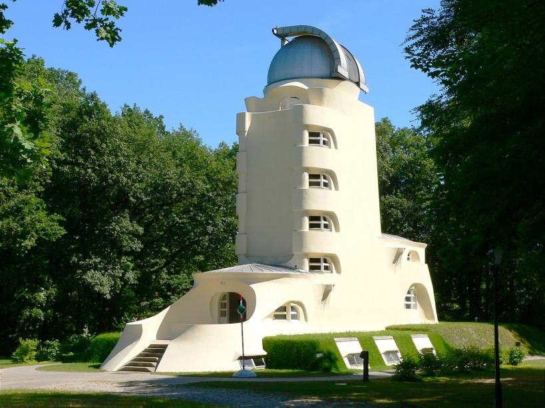
Einstein Tower
Potsdam, Germany
Built 1920 to research Einsteins claims on relativity
Relatively out-of-date
60 cm lens
Focal length 14 meters

Slide 14
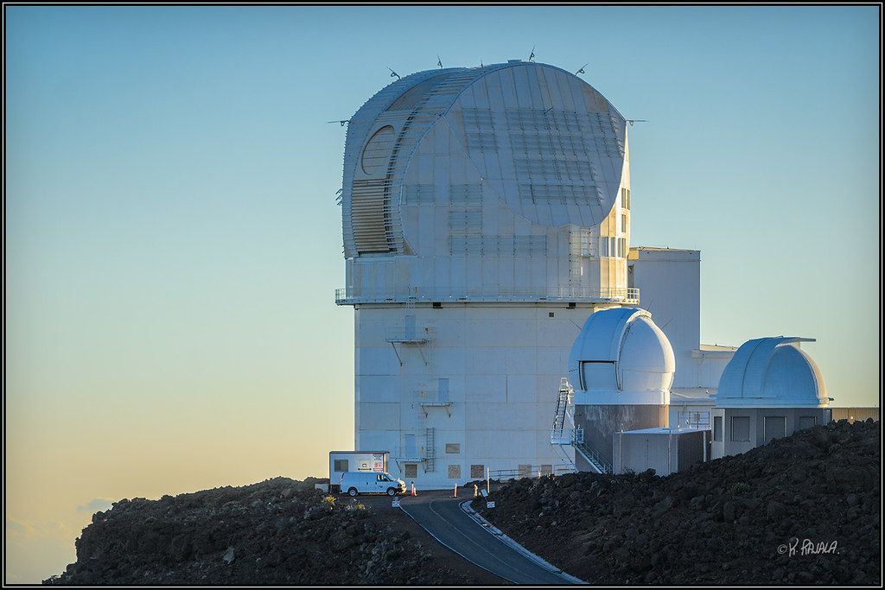
Daniel K. Inouye Solar Telescope (DKIST)
Maui, Hawaii
Planned completion in 2020
Soon to be world's largest
4.24 meter f/2 primary mirror - 4 meter aperture
Resolution up to one 20 km area of the Sun’s surface

Slide 15
Significant Observations

Slide 16
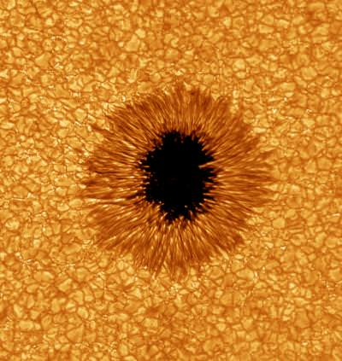
Sunspots
Sunspot numbers
Determining average sunspots
Began 1610
Galileo Galilei
Solar Telescopes instrumental in sunspot identification

Slide 17
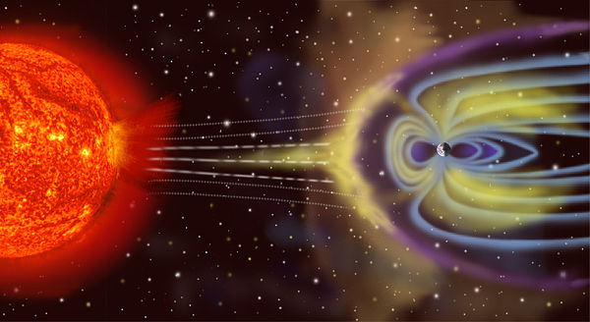
Space Weather
Solar wind, solar flares
Atmospheric conditions
magnetosphere , ionosphere conditions
Detection of geomagnetic storms
Disturbance of Earth magnetic field
Coronal Mass Ejection
Co-rotating Interaction Region
Electronic disruptions
Navigation systems
Satellites
Radiation
Animals

Slide 18
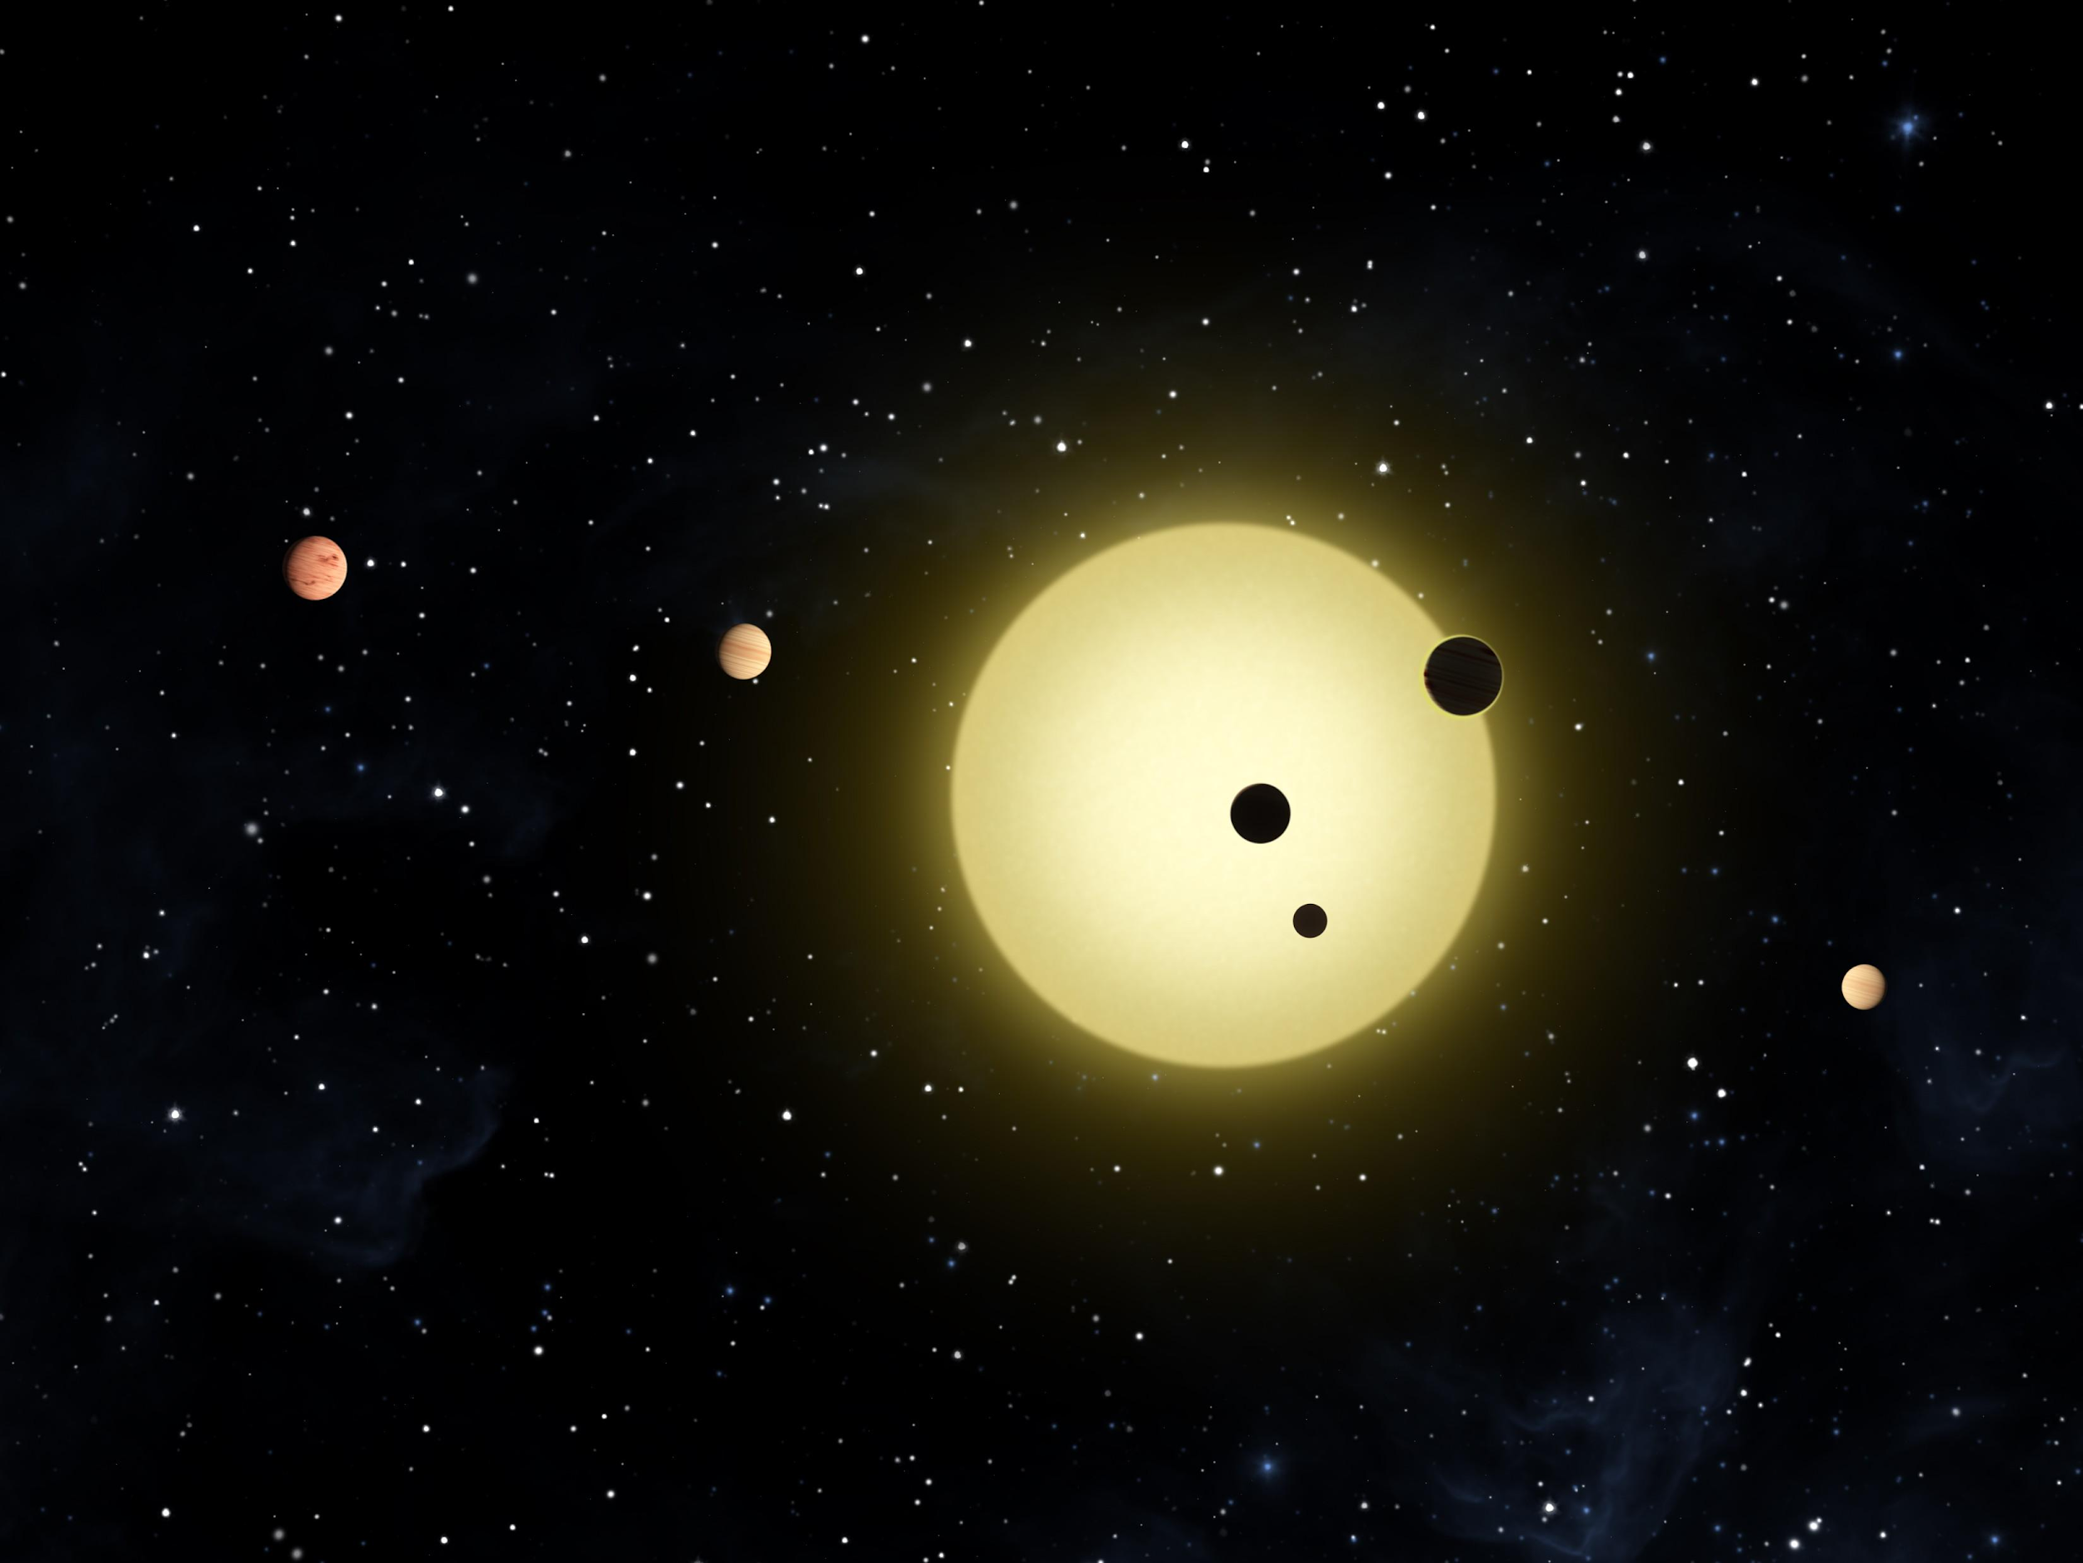
Planetary Transits
Crossing of planets across the path of the Sun relative to Earth
Exoplanet studies
Charting planets

Slide 19
Questions

Slide 20
References
https://en.wikipedia.org/wiki/Solar_telescope
http://www.scholarpedia.org/article/Solar_telescopes
https://www.spiedigitallibrary.org/conference-proceedings-of-spie/9911/99111U/Cooling-a-solar-telescope-enclosure-plate-coil-thermal-analysis/10.1117/12.2232160.short?SSO=1
https://www.hpctoday.com/best-practices/blasted-by-the-sun-thermacore-cools-the-worlds-largest-solar-telescope/
https://www.noao.edu/outreach/kptour/mcmath.html
https://solarscience.msfc.nasa.gov/SunspotCycle.shtml
https://www.archdaily.com/402033/ad-classics-the-einstein-tower-erich-mendelsohn
http://www.staff.science.uu.nl/~rutte101/dot/
http://adsabs.harvard.edu/full/1999ASPC..158...57R

