Slide 1
Stellar objects that are interesting to view
EGR 491/591 – Telescope Design, Dr. K. Lulay, November 7, 2019

Slide 2
“Stellar”
Objects that appear as points of light (not extended objects)
Most, but not all “stellar” objects are stars
This talk discusses a few of the more interesting to observe stellar objects:
Double/multiple stars
Carbon stars
Variable stars
Novae and Supernovae – transient event
Quasars

Slide 3
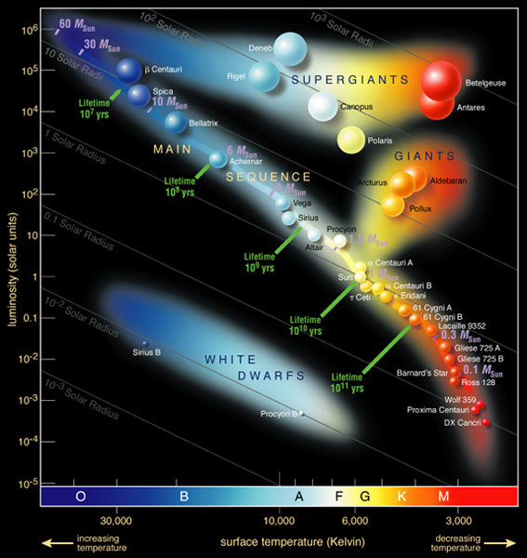
Stars
H-R Diagram:
brightness vs. surface temperature
Main Sequence Stars
Burn H at core
Supergiants: 8-10 solar masses (M☉), now burning He at core
Giants: >0.25 solar masses (M☉), once the core is depleted of hydrogen it contracts and heats up so that hydrogen starts to fuse in a shell around the core.
White dwarfs: a stellar core remnant

Slide 4
Double and Multiple Stars
Multiple stars: stars appear to be single points of light to unaided eye, but magnification will reveal 2 or more stars very close to each other
Why observe them?
Color contrast can be beautiful
Some are challenging to see – which can be fun to try

Slide 5
Double/multiple stars
True doubles (aka binary stars): stars that are gravitationally bound to each other
Apparent doubles: stars that only appear to be close as viewed from earth
Most stars comparable to the sun or larger are binary
“Split-abl” or not?
How far they are separated
Relative brightness – faint stars are difficult to see if next to bright ones
Telescope – bigger may better, may be worse

Slide 6
Popular examples for today
Mizar/Alcor – can be seen naked eye – or can it?
Epsilon Lyrae – “Double Double”, easy to find, challenging to “split”
Albireo – pretty contrasting colors

Slide 7
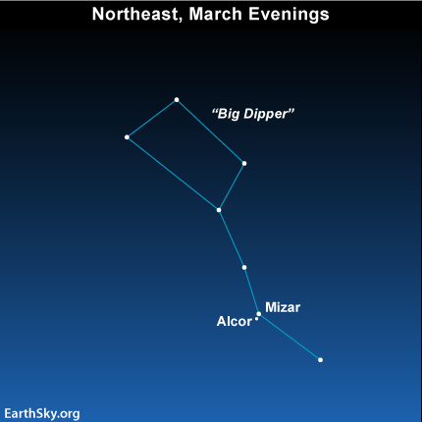
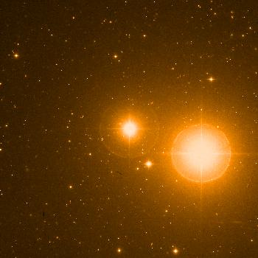
Mizar and Alcor (“Horse and Rider”)
Big Dipper Mid-handle stars
Mizar: 2.1 mag, Alcor: 4.0 mag
12’ separation: “Split-able” with good eyesight

Slide 8
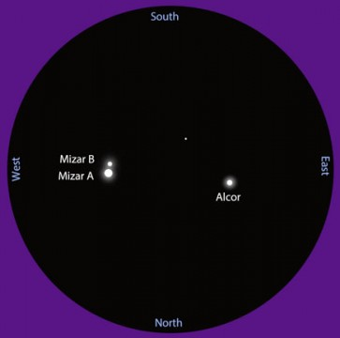
Model of the Mizar system (not to scale!) showing each of the three pairs that compose the sextuple. Bob King
Mizar and Alcor
Upon further inspection, Mizar appears as a double star itself
But wait, all three stars (Mizar A, Mizar B, Alcor, are double stars – 6 total!
All gravitationally bound
http://earthsky.org/brightest-stars/mizar-and-alcor-the-horse-and-rider
https://www.astronomytrek.com/star-facts-mizar-and-alcor/
https://www.skyandtelescope.com/astronomy-blogs/explore-night-bob-king/mizar-a-fresh-look-at-an-old-friend03252015/

Slide 9
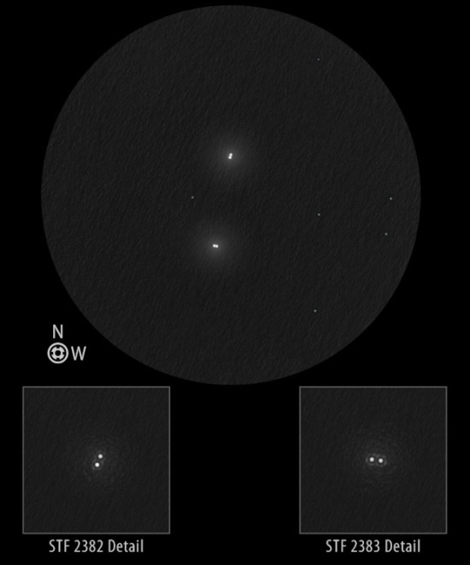
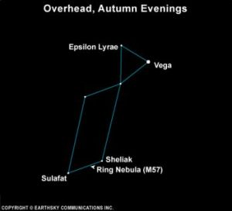
“Double Double” (ε Lyrae)
Epsilon lyrae – “double star” , 4.7 and 6.2 mag, 208” separation
But each of the “two” stars are doubles themselves
http://earthsky.org/brightest-stars/epsilon-lyrae-the-famous-double-double-star

Slide 10
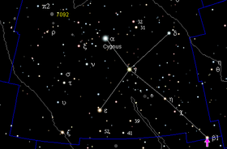
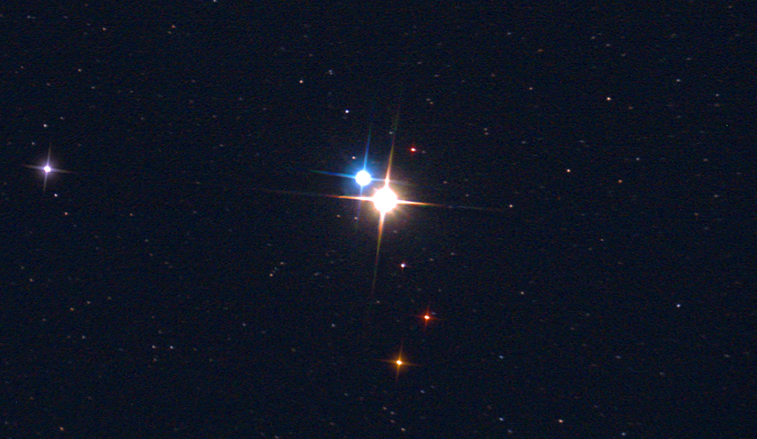
Albireo (β Cyg)
Albireo (β Cygnus)
Albireo is the “head” of Swan, mag. 3
Beautiful color contrast
Amber star (3.1 mag)
Blue-green star (5.1 mag)
35” separation (easily split)

Slide 11
Carbon Stars
Why observe? They have a nice red color – quite pretty
Luminous red giant stars whose atmosphere contains more carbon than oxygen
A red giant is a luminous giant star of low or intermediate mass (roughly 0.3–8 M☉) in a late phase of stellar evolution.
Best?
Herschel's Garnet Star (mu, m Cephei)
T Lyrae
UX Draconis
https://www.skyandtelescope.com/astronomy-blogs/carbon-stars-will-make-see-red1203201401/

Slide 12
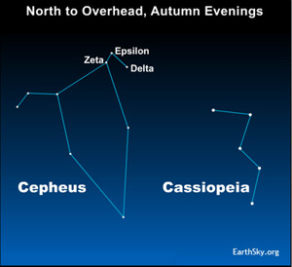
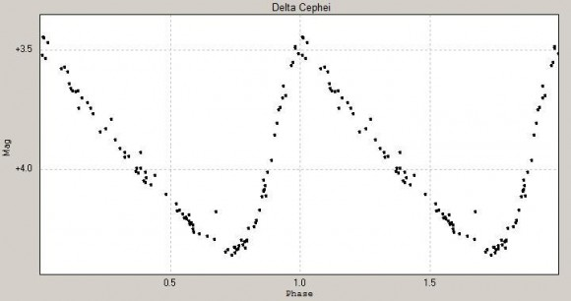
Delta Cephei - Cepheid Variables
Delta Cephei (δ Cep) is proto example of Cepheid variables – “Standard Candles” {Edwin Hubble}
Cepheid variable stars dependably change their brightness over regular intervals. The time period can range from about one to 100 days, depending on the star’s luminosity or intrinsic brightness.
The longer the cycle – the greater the intrinsic brightness of the star!!!
δ Cephei period of 5.366341 days, doubling in brightness
Interesting observe changes
http://earthsky.org/brightest-stars/delta-cephei-the-kings-famous-variable-star

Slide 13
Novae & Supernovae
Nova = “New”
Novae and Supernovae are “new stars” that appear for a few days or weeks.
Can be bright enough to see during the day.
A nova is a binary system, usually a normal star like the Sun and a small dense white dwarf. They orbit closely, and the white dwarf can draws hydrogen gas off the normal star. The fierce gravity of the white dwarf compresses the material, and if enough builds up on the surface it can fuse into helium, releasing a sudden and tremendous amount of energy. We see the star brighten quickly, and fade over time.

Slide 14
Supernovae (two types)
Type Ia supernova: similar to a nova: a binary system with a normal star and a white dwarf. If the gas coming from the normal star comes at just the right rate, it can pile up more efficiently than in a regular nova. When it finally fuses, the release of energy can be much larger than a nova, and can actually blow the white dwarf apart. “Standard Candle” {dark energy}
Type II supernova: involves a star with a mass greater than about 8 times the Sun's. The star fuses hydrogen into helium in the core. When hydrogen runs out, the helium fuses into carbon, the carbon into oxygen, and so on, until the core is mostly iron. Unlike the previous elements, iron does not release energy when it fuses. When the pressure builds enough to fuse iron, it robs the core of heat and electrons, both of which are needed to support the mass of the star. The core collapses, a flood of neutrinos is released, and the outer layers of the star explode outward in a supernova. MORE ENERGY THAN THE ENTIRE GALAXY IT IS IN!
http://www.badastronomy.com/mad/2000/supernova.html

Slide 15
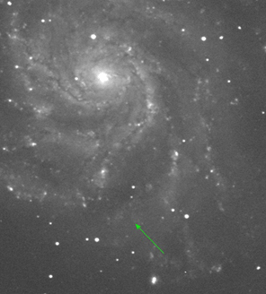
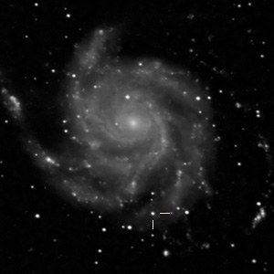
Supernova in M101
Magnitude 10, Type Ia,
visible with small telescopes for a few weeks in 2011
23 Million light years away, near Big Dipper handle
Why observe? Interesting to see changes and BIG explosions!
All of the stars visible are in our galaxy, except the supernova
Watch: https://www.youtube.com/watch?v=1d1BkdhtgXI

Slide 16
Quasars
Quasar = quasi-stellar object
The term "quasar" originated as a contraction of quasi-stellar [star-like] radio source, first identified during the 1950s as sources of radio-wave emission of unknown physical origin.
High-resolution images of quasars, particularly from the Hubble Space Telescope, have demonstrated that quasars occur in the centers of galaxies.
Very broad-spectrum electromagnetic radiation created by gaseous material falling into supermassive blackhole at galactic centers.
Watch: https://www.youtube.com/watch?v=fThGKOgSo5I

Slide 17
Quasars
Among the most luminous, powerful, and energetic objects known in the universe, emitting up to a thousand times the energy output of the entire Milky Way, which contains 200–400 billion stars!
Closest quasar is about 300 million light years away – 100 times further than Andromeda Galaxy!
A few are detectable with 8” to 10” telescopes.
A few at over 2 billion light years distance are detectable with 12” telescopes.
Why observe them? BILLIONS of LIGHT YEARS! that’s why!

