Slide 1
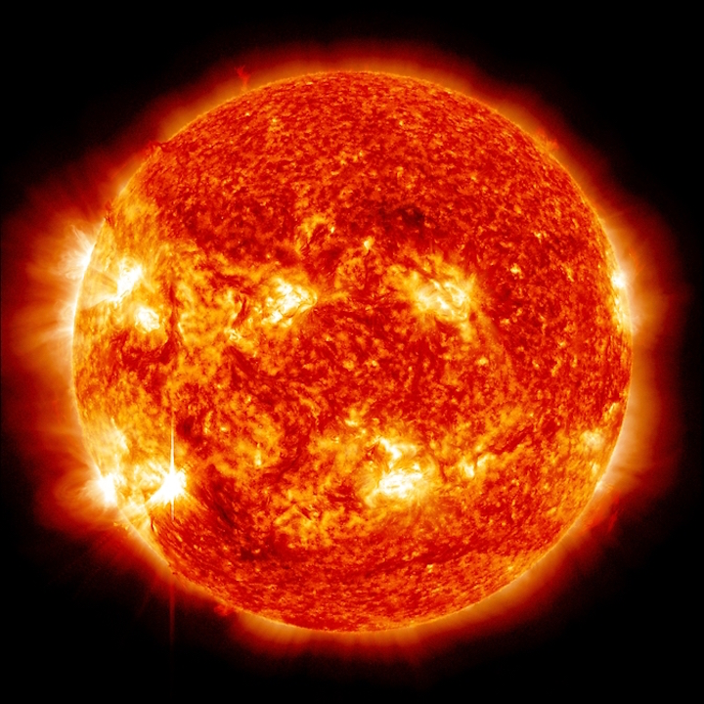
Our Sun
Our Sun
Charlie Wu
Sep 12, 2019
Charlie Wu

Slide 2
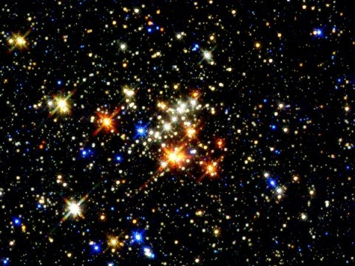
Stars
A star is a luminous ball of plasma, mostly hydrogen and helium, held together by its own gravity. Nuclear fusion reactions in its core support the star against gravity and produce photons and heat, as well as small amounts of heavier elements.
The Sun is the closest star to Earth.

Slide 3
Stages of stars
Our sun right now
Main sequence stage

Slide 4
General Information
The star at the center of the Solar System
The most important source of energy for life on Earth
Diameter ≈ 864,000 miles ≈ 109 times of Earth
Mass ≈ 330,000 times of Earth ≈ 99.86% of the entire Solar System
Hydrogen ~ 73%; Helium ~25%; Oxygen, carbon, neon, and iron ~2%

Slide 5
Formation
≈ 4.6 billion years ago
From gravitational collapse of matter with a region of a large molecular cloud.
Nuclear fusion started in its core.
Notes:
The gravitational collapse caused most of this matter gathered in the center, whereas the rest flattened into an orbiting disk that become the Solar System.
The central mass became so hot and dense that it eventually initiated nuclear fusion in its core, which most of stars form by this way.

Slide 6
Current Stage
The Sun is about halfway through its main-sequence stage
Fuses about 600 million tons of hydrogen into helium every second.
Converting 4 million tons of matter into energy every second.
Eventually become a red giant. (yellow dwarf right now)
Notes:
Generated energy takes between 10,000 and 170, 000 years to escape from its core.
When hydrogen fusion in its core has diminished to the point at which the Sun is no longer in hydrostatic equilibrium, its core will undergo a marked increase in density and temperature while its outer layers expand to eventually become a red giant, which will become sufficiently large to engulf the current orbits of Mercury and Venus, and render Earth uninhabitable.

Slide 7
Structure

Slide 8
Core
The innermost 20-25% of the Sun's radius
Where temperature (energies) and pressure are sufficient for nuclear fusion to occur
Hydrogen fuses into helium.

Slide 9
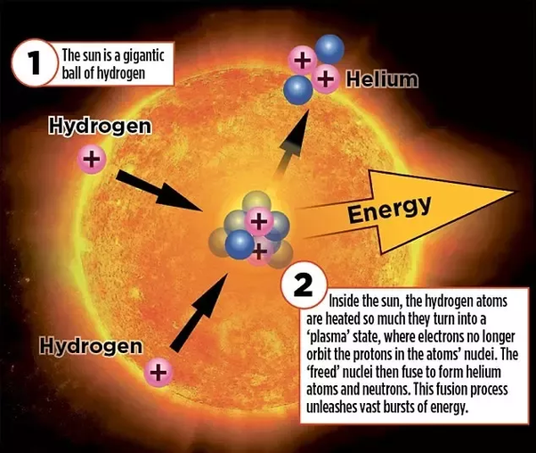
Nuclear Fusion

Slide 10
Radiative Zone
Between about 20-25% of the radius, and 70% of the radius.
The temperature drops from approximately 7 million to 2 million kelvins with increasing distance from the core.

Slide 11
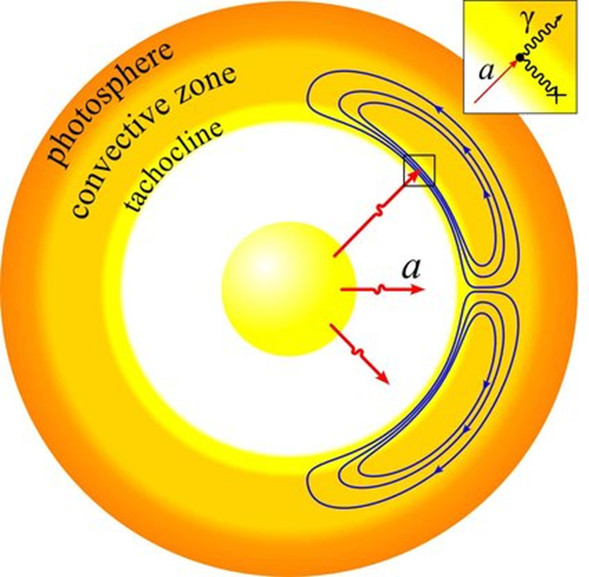
Tachocline
A transition layer that separates radiative zone and the convective zone.
It is hypothesized that a magnetic dynamo within this layer generates the Sun's magnetic field.

Slide 12
Convective Zone
Extends from 0.7 solar radii (500,000 km) to near the surface.
The spectrum of sunlight is at 5,777 K, emitting radiation at about 0.5 µm.
Notes:
The solar plasma is not dense enough or hot enough to transfer the heat energy of the interior outward via radiation. Instead, the density of the plasma is low enough to allow convective currents to develop and move the Sun's energy outward towards its surface.
The spectrum of sunlight has approximately the spectrum of a black-body radiating at 5,777 K, interspersed with atomic absorption lines from the tenuous layers above the photosphere.
A blackbody is an idealized physical body that absorbs all incident electromagnetic radiation, regardless of frequency or angle of incidence.

Slide 13
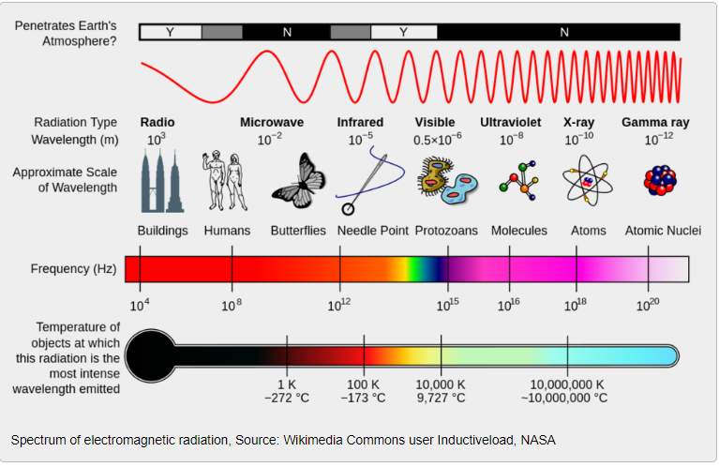
Spectrum
The electromagnetic spectrum is the range of all possible wavelengths of electromagnetic radiation, ranging from high energy gamma rays through visible light and down to low energy radio waves.

Slide 14
Black Body Spectrum Diagram

Slide 15
Spectrum of the Sun

Slide 16
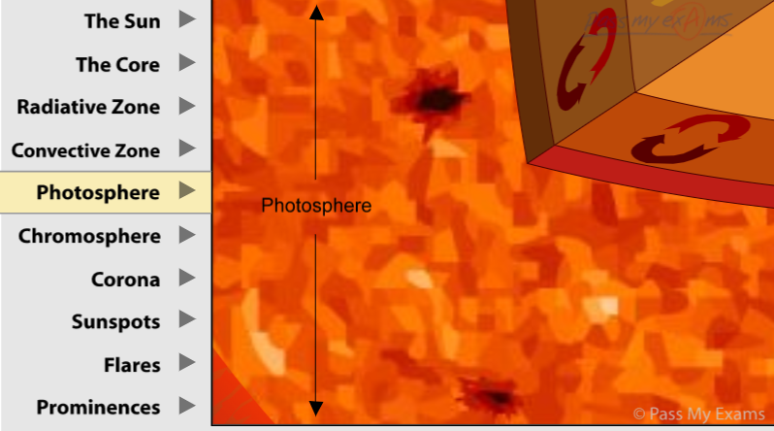
Photosphere
The visible surface of the Sun, the photosphere, is the layer below which the Sun becomes opaque to visible light.
Where sunlight is coming from.
Where granules and sunspots are.
Notes:
This the most interesting layer to us, since it is the layer what we can actually observe.
Photosphere means sphere of light. It is the lowest level of the sun’s atmosphere and is the visible surface of the sun seen from Earth. It is at the photosphere that the energy finally escapes from the sun and so it is significantly cooler than the interior with an approximate temperature of 6000 degree C. The surface of the photosphere is covered with a pattern of bright granny marking called granulations. These grainy markings are the result of convection currents that bring hot gases up from the interior. These granules continually form and disappear as hot gases flow out and measures several hundred miles across. Dark patches called sunspots can also be seen on the photosphere.

Slide 17
Sunspots
Cooler than their surroundings
Caused by disturbances in the Sun's magnetic field welling up to the photosphere
Sunspots increase and decrease through an average cycle of 11 years.
Notes:
A large sunspot might have a central temperature of 4,000 K (about 3,700° C or 6,700° F), much lower than the 5,800 K (about 5,500° C or 10,000° F)
Where the magnetic field is about 2,500 times stronger than Earth's, much higher than anywhere else on the Sun.
Sunspot also can be related to the solar flares, which is a phenomena that happens on Atmosphere of the Sun.

Slide 18
Sunspots activities with Earth’s climates?
Yes, but still debating on how much it affects
Times of maximum sunspot activity are associated with a very slight increase in the energy output from the sun
Ultraviolet radiation increases dramatically during high sunspot activity, which can have a large effect on the Earth's atmosphere.
Difficult to filer out the “noise”
Notes:
Data from National Weather Service
There is research which shows evidence that Earth's climate is sensitive to very weak changes in the Sun's energy output over time frames of 10s and 100s of years.
“noise” = complex interaction between our atmosphere, land and oceans

Slide 19
Solar Flares
Solar flares are huge explosions on the Sun. A flare appears as a sudden, intense brightening of a region on the Sun, typically lasting several minutes.
Flares occur when intense magnetic fields on the Sun become too tangled.
Notes:
Like a rubber band that snaps when it is twisted too far, the tangled magnetic fields release energy when they "snap".

Slide 20
Notes:
Youtube Video 1 minutes long

Slide 21
Coronal Mass Ejections
A Coronal Mass Ejection (CME) is an explosive outburst of solar wind plasma from the Sun.
Carries roughly a billion tons of material outward from the Sun
Hundreds of kilometers per second
contains particle radiation (mostly protons and electrons) and powerful magnetic fields

Slide 22
What will CME potentially cause?
Compresses the Earth’s dayside magnetic field while the nightside gets stretched out.
Auroral lights, drift to lower latitudes and become more brilliant.
The magnetic field can also expose Earth to deadly cosmic rays, astronauts in space may receive lethal doses of radiation
Severely disrupt power grids, satellites, communication networks
Notes:
When the plasma cloud hits our planet, a geomagnetic storm follows.
During a solar storm in 1989, cosmonauts aboard the Mir space station received their maximum yearly radiation dose in just a few hours!
The most severe one is during 1859, Carrington Event, after amateur astronomer Richard Carrington who observed the flares that triggered the storm, it was the most powerful geomagnetic storm ever recorded. Auroras were observed as far south as Hawai’i and the Caribbean. Witnesses at higher latitudes reported being able to read newspapers by the light of the aurora alone. Telegraph networks around globe catastrophically failed; operators received shocks and telegraph paper caught on fire.

Slide 24
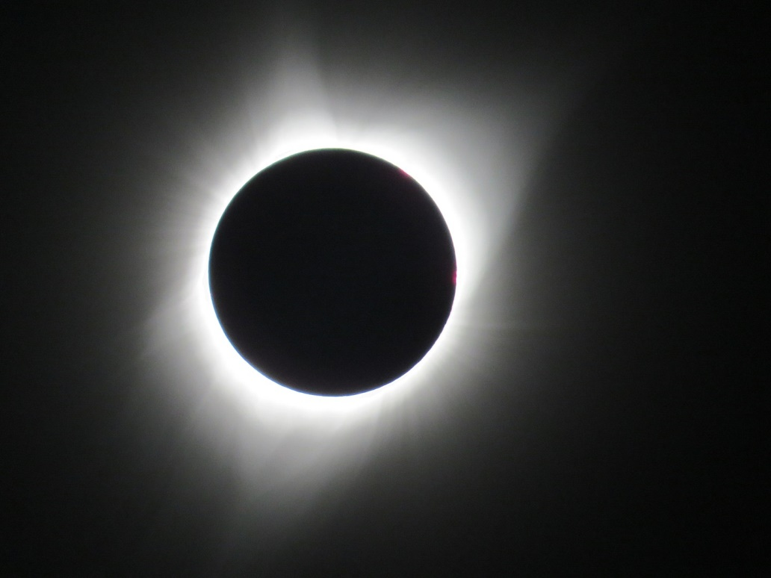
Atmosphere
Visible during solar eclipse.
Four distinct parts:
Chromosphere
Transition region
Corona
Heliosphere
Notes:
We can see part the atmosphere of the Sun during a total solar eclipse, when the disk of the Sun is covered by that of the Moon.
Chromosphere, Transition region, and the Corona are much hotter than the surface o the Sun, the reason is not well understood.
Chromosphere: Above the temperature minimum layer, about 2,000 km thick, dominated by a spectrum of emission and absorption lines. The temperature increases gradually with altitude, ranging up to around 20,000 K near the top.
Transition Region: a thin layer. the temperature rises rapidly from around 20,000 K in the upper chromosphere to coronal temperatures closer to 1,000,000 K.
Next layer
The Corona: average temperature at 1,000,000 – 2,000,000 K. However, the hottest region can get to 8,000,000 – 20,000,000 K. And it is where interesting phenomena happens, like Solar Flares and coronal mass ejections.
The Heliosphere: the outermost atmosphere of the Sun, filled with the solar wind.

Slide 25
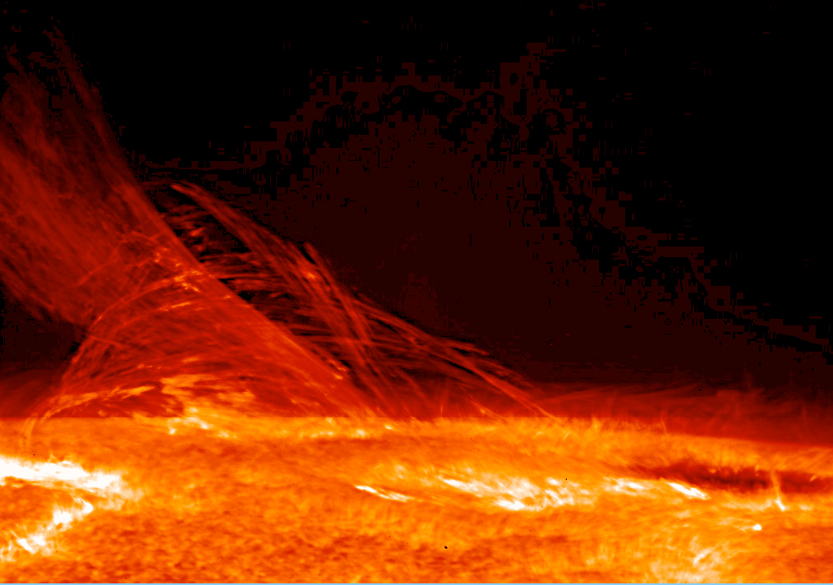
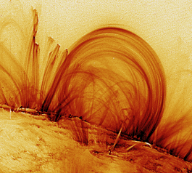
Solar Wind Plasma
Notes:
The solar wind is created by the outward expansion of plasma (a collection of charged particles) from the Sun's corona (outermost atmosphere). This plasma is continually heated to the point that the Sun's gravity can't hold it down. It then travels along the Sun's magnetic field lines that extend radially outward. As the Sun rotates (once every 27 days), it winds up its magnetic field lines above its polar regions into a large rotating spiral, creating a constant stream of "wind."

Slide 26
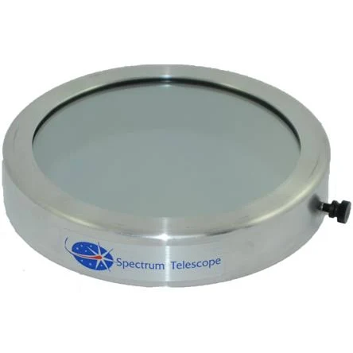
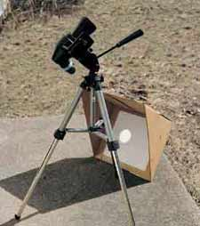
How can we observe?
Direct view with filters applied
Metallized Mylar plastic (turns Sun blue)
Metal-on-glass filters
Project on a piece of paper.

Slide 27
Orbit and location
The Sun lies close to the inner rim of the Milky Way's Orion Arm, in the Local Interstellar Cloud or the Gould Belt, at a distance of 25,000–28,000 light-years from the Galactic Center.
Here

Slide 28
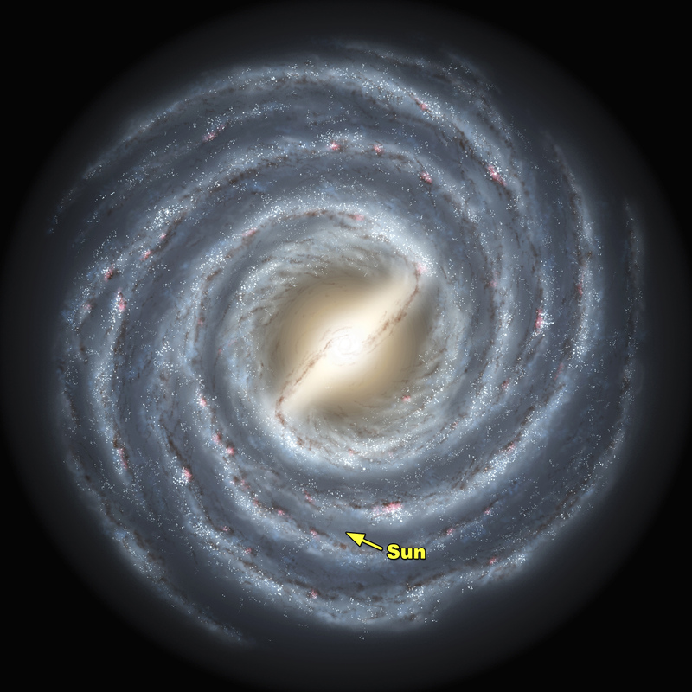

Slide 29
Citation
Abhyankar, K. D. "A Survey of the Solar Atmospheric Models." Bulletin of the Astronomical Soceity of India, vol.5, p.40 5 (1977): 40. Web.
Basu, Sarbani, and H. M. Antia. "Helioseismology and Solar Abundances." Physics Reports, Volume 457, Issue 5-6, p.217-283. 457 (2008): 217-83. Web.
Eisenhauer, F., et al. "SINFONI in the Galactic Center: Young Stars and Infrared Flares in the Central Light-Month." The Astrophysical Journal, Volume 628, Issue 1, pp.246-259. 628 (2005): 246-59. Web.
Erdélyi, R., and I. Ballai. "Heating of the Solar and Stellar Coronae: A Review." Astronomische Nachrichten, Vol.328, Issue 8, p.726-733 328 (2007): 726-33. Web.
Hathaway, David H. "The Solar Interior." Oct 1, 2015. Web. Sep 8, 2019 <https://solarscience.msfc.nasa.gov/interior.shtml>.
Woolfson, M. "The Origin and Evolution of the Solar System." Astronomy & Geophysics, Vol.41, Issue 1, p.12 41 (2000): 12. Web.
“National Schools' Observatory.” Life Cycle of a Star | National Schools' Observatory, https://www.schoolsobservatory.org/learn/astro/stars/cycle.
“Coronal Mass Ejection (CME).” Coronal Mass Ejection (CME) | UCAR Center for Science Education, https://scied.ucar.edu/coronal-mass-ejection.
“Sunspots.” Sunspots | UCAR Center for Science Education, https://scied.ucar.edu/sunspots.
“Solar Flare.” Solar Flare | UCAR Center for Science Education, https://scied.ucar.edu/solar-flare.

