Slide 1
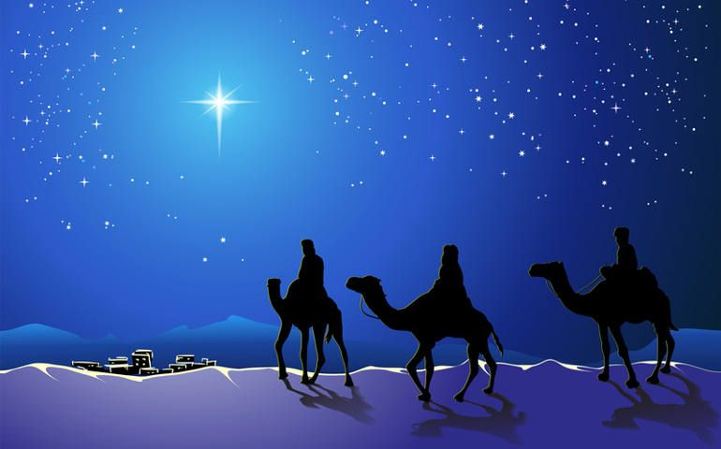
The “Star of Bethlehem” – What was it?
EGR491/591 Telescope Design
Fall 2019

Slide 2
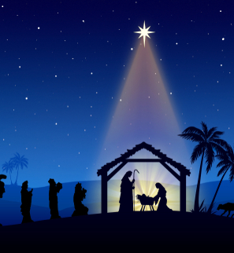
What is The Star of Bethlehem?
St. Matthew’s Gospel account regarding birth of Jesus discusses a star indicating Jesus’ birth
Involves the Three Wise Men/Kings/Magi
Astrology was forbidden to the Jews and Christians – yet, the Magi’s story is recorded in the gospel
Has intrigued people for centuries as to what it was
Two major “problems”:
Only the Magi appear to notice it
Matthew’s account has confusing descriptions

Slide 3
Overview
Discuss the “problems” with the descriptions in Matthew’s gospel
Look at some proposed ideas as to what the star was
Who were the Magi?
What is astrology – what is important for astrology
Michael Molnar’s conclusion
Explains what the Magi saw
Addresses the “problems” with Matthew’s gospel account

Slide 4
Matthew, 2:1-16
¹After Jesus was born in Bethlehem in Judea, during the time of King Herod, Magi^{[a]} from the east came to Jerusalem ² and asked, “Where is the one who has been born king of the Jews? We saw his star when it rose and have come to worship him.”
³ When King Herod heard this he was disturbed, and all Jerusalem with him. ⁴ When he had called together all the people’s chief priests and teachers of the law, he asked them where the Messiah was to be born. ⁵ “In Bethlehem in Judea,” they replied, “for this is what the prophet has written:
⁶ “‘But you, Bethlehem, in the land of Judah, are by no means least among the rulers of Judah; for out of you will come a ruler who will shepherd my people Israel.’^{[b]}”
⁷ Then Herod called the Magi secretly and found out from them the exact time the star had appeared. ⁸ He sent them to Bethlehem and said, “Go and search carefully for the child. As soon as you find him, report to me, so that I too may go and worship him.”
⁹ After they had heard the king, they went on their way, and the star they had seen when it rose went ahead of them until it stopped over the place where the child was. ¹⁰ When they saw the star, they were overjoyed. ¹¹ On coming to the house, they saw the child with his mother Mary, and they bowed down and worshiped him. Then they opened their treasures and presented him with gifts of gold, frankincense and myrrh.

Slide 5
Troubling highlights of Matthew, 2:1-16
Magi from the east …
…”We saw his star when it rose and have come to worship him.”
...When King Herod heard this he was disturbed…
…the star they had seen when it rose went ahead of them until it stopped over the place where the child was.
King Herod’s response indicates he clearly did not notice the star.
If the Magi are traveling west, how is a star in the east “ahead” of them?
How can a star “stop” or “come to rest”?

Slide 6
When was Jesus born?
The Gregorian calendar date is based on the birth of Jesus
BC = Before Christ
AD = anno domini, Latin for “in the year of the Lord,”
525 AD was when BC/AD was established – based on an estimate as to when Christ was born. 1BC should be the year before Jesus was born
Based on biblical details (such as the rule of King Herod), historians now believe Jesus was born sometime 6 BC to 4 BC (or a few years either side)

Slide 7
Theorized astronomical events
Johannes Kepler (17th cent.) speculated about tight conjunctions of Jupiter and Saturn in 7 BC – making “nova-like” brightness. Modern calculations show the conjunction to be 1 full degree – not “nova-like”
A comet or nova, was seen by Chinese and Korean stargazers in about 5 BC. Comets were generally viewed as bad omens, not signs of a king’s birth
A nova or comet was recorded in China in about 4 BC. But there is no indication this occurred at a special time or location in the sky to suggest the birth of a king to astrologers “from the east.”
None of these explain why Herod did not notice it, nor fit the biblical descriptions.
https://en.wikipedia.org/wiki/Star_of_Bethlehem

Slide 8
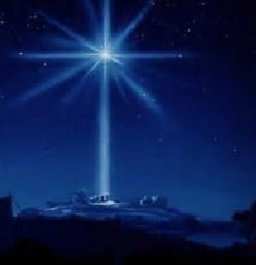
Two dominant perspectives
To “fit the data”, two dominant perspectives:
No star like object can fit the data: it is a mythological story only
It was a suspension of laws of nature (a miracle)
Michael Molnar offers a third option: a real astronomical event that was interpreted as important by only a few (the Magi)

Slide 9
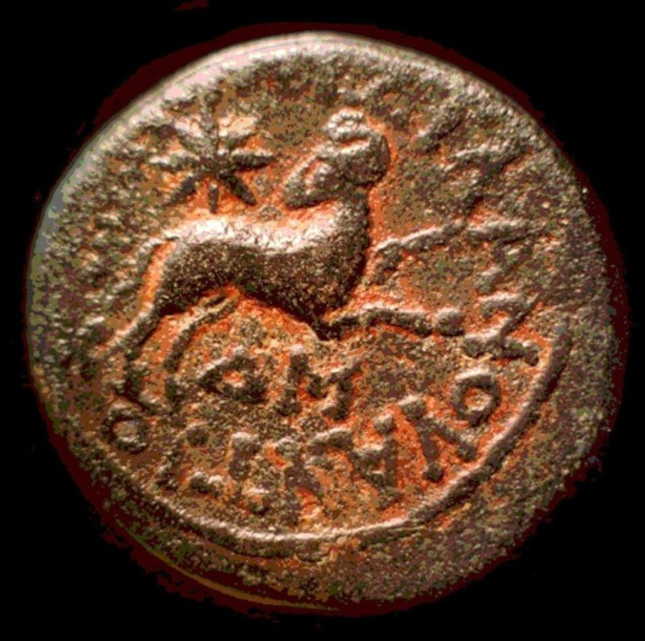
The Star of Bethlehem: The Legacy of the Magi, by Michael Molnar
Michael Molnar, theory originated when he purchased a Roman coin of Antioch. It revealed that Aries the Ram was the sign of the Jews and that “special” star appeared in that sign of the zodiac.
https://www.michaelmolnar.com/

Slide 10
Who were the Magi?
Were likely to have been respected “wise men” who practiced Greek astrology.
They lived east of Judea
There is no biblical account of there being three magi, but rather three gifts: gold, frankincense, myrrh

Slide 11
What to look for?
The problem with “super star” theories (nova, comet, etc.) – these would have been noticed by everyone, not just the Magi
Magi were not interested in “super stars”…they were reading the sky

Slide 12
Astrology
Magi (root of the word “magic”) were important individuals – they were astrologers thought capable of identifying important events
Birth of kings and rulers
Death of kings and rulers
Catastrophic events or great events (losing or winning battles)
Not “daily horiscopes”
Sun, Moon, Planets, Stars… are “stars”
Alignments of “stars” with each other and within zodiacal signs are very significant

Slide 13
Astrological/Astronomical events and terms
Conjunctions: when two non-stellar objects appear close to each other.
Occultation: an event when one object is hidden by another object that passes between it and the observer.
Retrograde motion (outer planets appear to move “backward” with respect to background stars). Change direction = “comes to rest” (or “stood over”)
Comes to rest

Slide 14
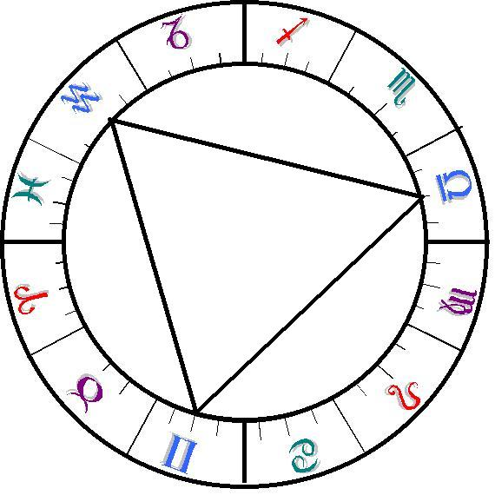
Astrological importance
Conjunctions between planets, the moon, the sun
Occultations are very important – especially with sun at its rising. Occultations amplify the effect of conjunctions.
Helical rising: when a planet rises in the east just before the sun. When the planet and sun are in the same zodiac sign and there is a helical rising, this is a very potent astrological event!
Trines: three zodiacal constellations separated by 120 degrees. Specific planets are “rulers” of specific trines.

Slide 15
The “stars” align in Trine I
Trine I: Aries, Leo, Sagittarius
The 3 rulers of Trine I: Sun, Jupiter, Saturn
Indicating royal birth in Judea: all 3 rulers in Aries
But this alone is not sufficient to indicate a great king is to be born…

Slide 16
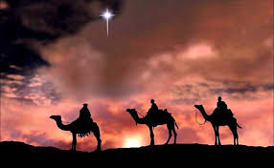
6 BC
April: The Rulers of Trine I (Sun, Jupiter and Saturn) are in Aries
Indicating the birth of a king in Judea
April 17: a new moon (adds importance to astrological events)
April 17: Jupiter has a helical rising
April 17: just before sunrise, the Moon Occults Jupiter “in the east”
August of that year, Jupiter became stationary and then "went before" through Aries where it became stationary again on December 19, 6 BC.

Slide 17
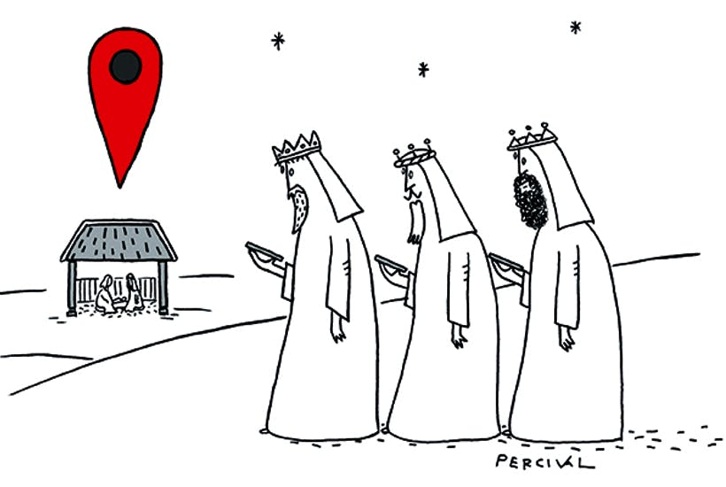
Recap of problems in Matthew’s gospel account:
King Herod’s response indicates he clearly did not notice the star.
If the Magi are traveling west, how is a star in the east “ahead” of them?
How can a star “stop” or “come to rest”?

Slide 18
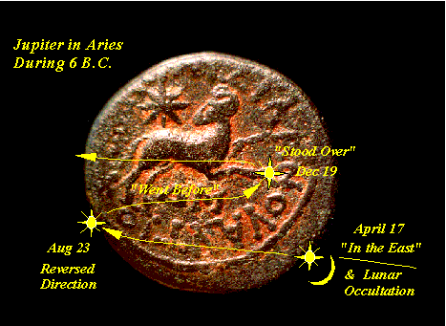
Magi were astrologers….
Magi from the east …
…”We saw his star when it rose and have come to worship him.” Jupiter rising in the east, April 17, 6BC
...When King Herod heard this he was disturbed…
The Magi noticed something that Herod had not
…the star they had seen when it rose went ahead of them until it stopped over the place where the child was.
The Magi would have been traveling by daylight, and would not be able to see star while they traveled. “Ahead” or “follow” implies being directed by something, not literally in front of.
“Stopped” or “stood still” refers to retrograde motion (planet stops to change direction)

Slide 19
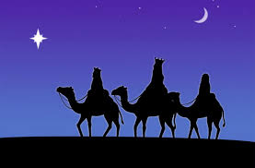
Conclusion
Michael Molnar offers interesting insight to first century Greek astrology. His theory suggests:
The Star of Bethlehem was a real event – not a single “star”, not a myth, not a “supernatural star”
The Star of Bethlehem that the Magi followed was an “event”:
The Three Rulers of Trine I were in Aries (the sign of Judea)
Jupiter’ helical rising was occulted by the Moon at Sunrise on April 17, 6 BC – indicating the birth of a king in Judea (frightening King Herod)
Jupiter “came to rest” (retrograde motion) in August, 6 BC – signifying to the Magi they had arrived at the birth site of the King.

