Slide 1
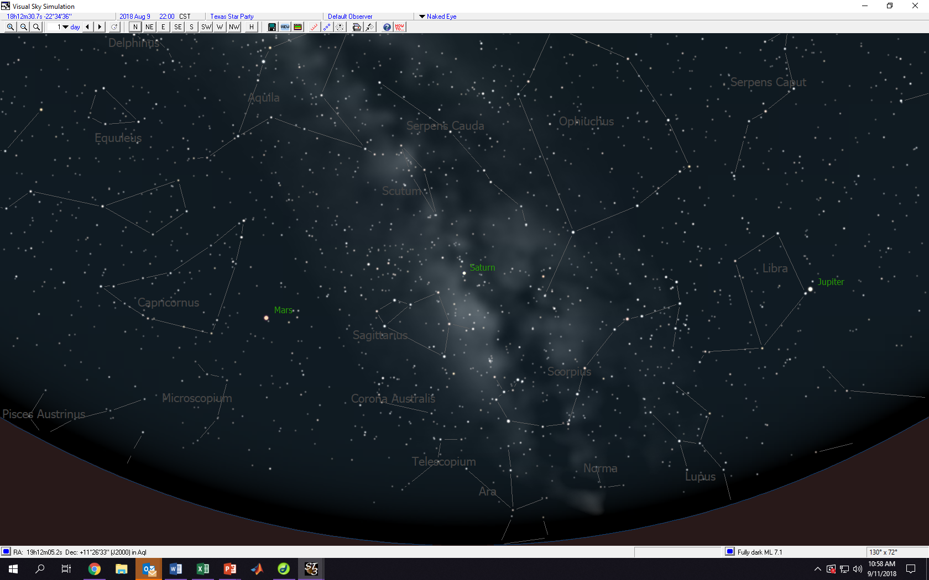

Slide 2
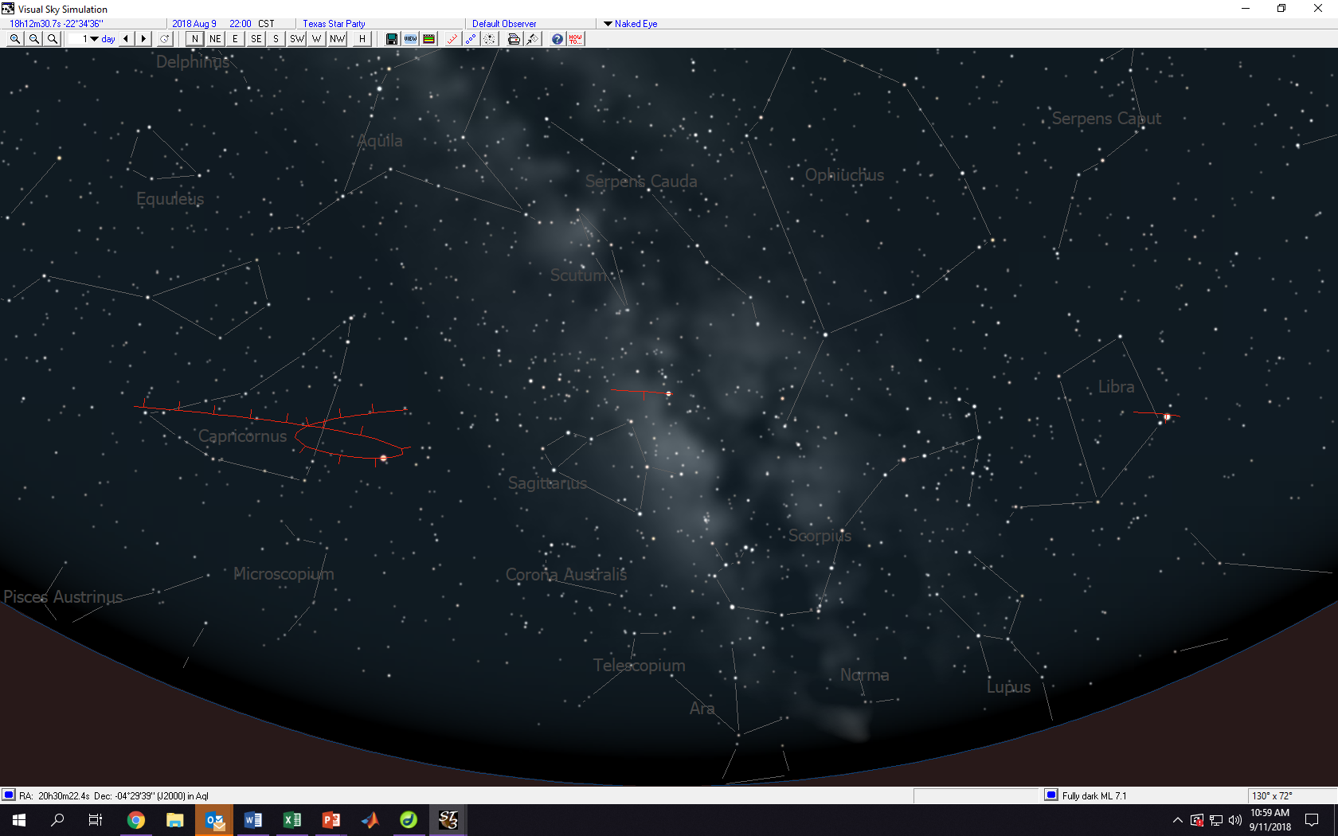

Slide 3
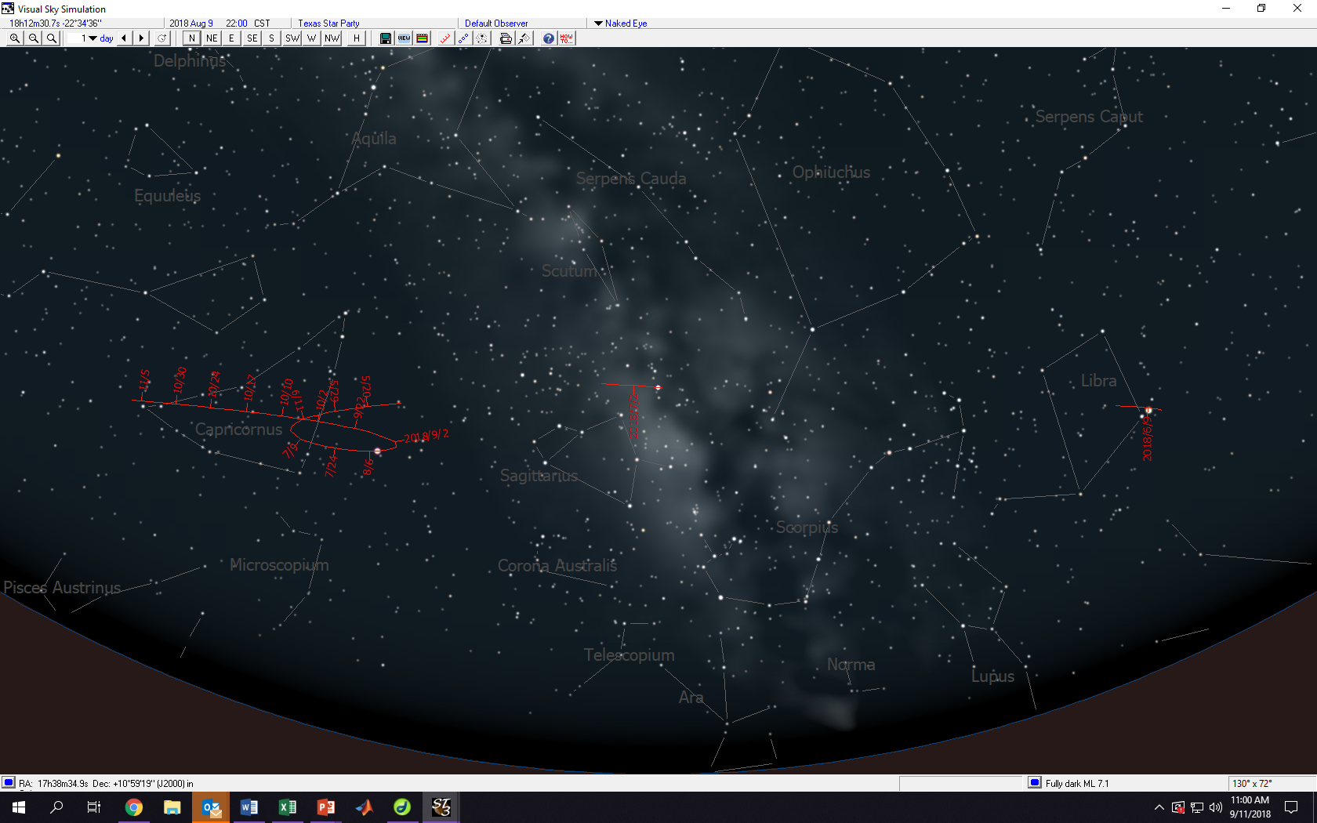
6 month trace of Mars, Saturn and Jupiter starting August 6, 2018

Slide 4
To see Mars retrograde:
https://www.youtube.com/watch?v=72FrZz_zJFU
https://www.youtube.com/watch?v=TK9ozJYELR8
Optional – explains Ptolemy’s model: https://www.youtube.com/watch?v=1nVSzzYCAYk

