Slide 1
Dimensioning & tolerancing
Deborah Munro, Ph.D.

Slide 2
Overview: Why do we dimension? Why do we tolerance? Why GD&T?
Most machining, assembly, and construction is still done while not in front of a CAD model
Provides information to the machinist as to our design intent
Provides information as to how critical a dimension is to the design intent
Provides information that cannot be conveyed by a CAD model
Provides geometric intent not conveyed elsewhere

Slide 3
Basic Dimensioning Rules
A dimension can only be called out once.
Smaller lengths should be closer to the part, larger ones farther out.
Dimension from one side or a key location (hole center) to avoid error stack up.
Do not dimension to hidden lines!
Use section views as needed to avoid this
Dimensions should be logically laid out and grouped by features
Dimension only on part drawings, not assemblies

Slide 4
Basic Tolerancing Rules
Use the default tolerance blocks as much as possible, with decimal places for tolerancing
Be as generous as possible with your tolerances
Use non-symmetric tolerancing to show design intent
When in doubt, ask a machinist what tolerances they can hold!

Slide 5
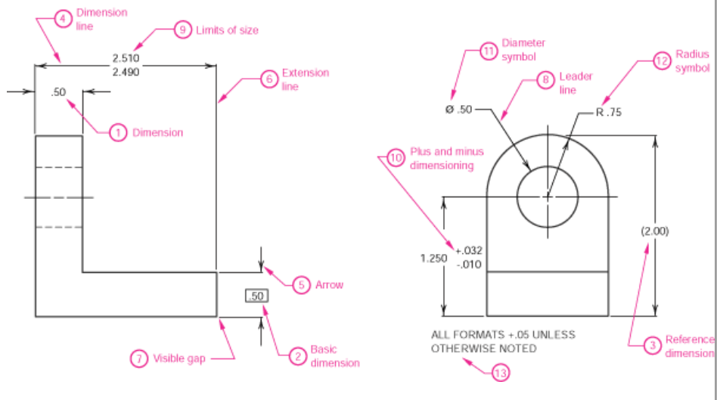
Types of Dimensions

Slide 6
Geometric Dimensioning & Tolerancing
Used when it’s “not the tolerance” that you want to control
Parallel, Perpendicular, Concentric, Flat, Position
Requires a datum reference
Requires a tolerance on GD&T
Modifiers: MMC, LMC
http://en.wikipedia.org/wiki/Geometric_dimensioning_and_tolerancing

Slide 7
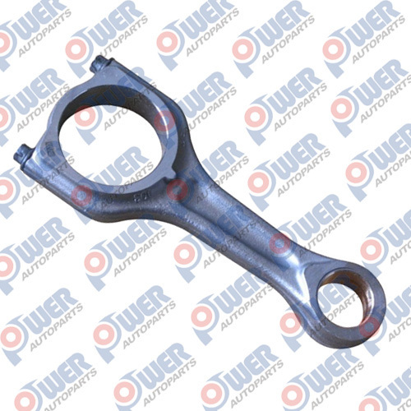
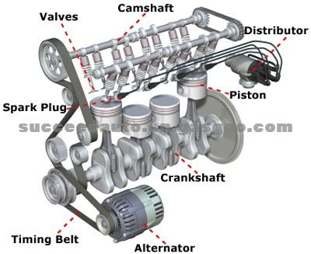
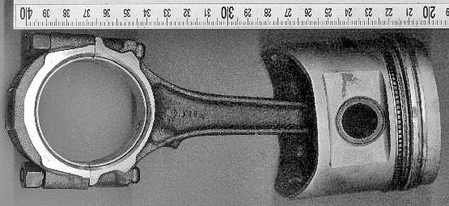
Example: Pistons

Slide 8
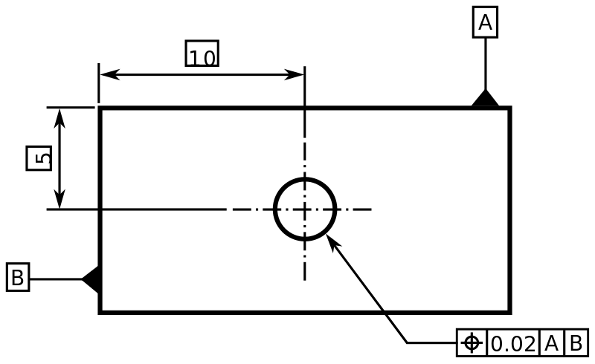
(True) Position

Slide 9
Definition of Positional Tolerance
Positional tolerance controls the location of an axis, median plane or surface of a feature. This
is a term used for the positioning of cylindrical features (holes, shafts etc.), Line features, Point
features and Slot features etc. These features are always related to basic dimensions or datum
within the stated tolerance and generally at maximum material condition (MMC).
Positional tolerance is normally used for the interchangeability characteristic of non-spinning
mating parts for maximum productivity. It defines a zone within which the axis, median plane or
surface of a feature is permitted to vary from a true position.
True position is established with basic dimensions from a datum reference frame or from other
features that are related to the datum reference frame. All dimensions must be basic and are
considered theoretically exact. The tolerance for the deviation of the feature from basic is found
in the position feature control frame.

Slide 10
Summary
Only dimension once
Dimension everything
Tolerance beyond decimal places only when needed
Use GD&T to control things tolerances won’t
Use notes and callouts when appropriate
Don’t dimension to hidden lines
Provide overall part size reference dimensions

