Slide 1
Engineering drawings
Deborah Munro, Ph.D.

Slide 2
Overview: What is an Engr Dwg?
Controlled document, “the engineering report”
Contains all necessary information
Provides a visual reference of the part or assembly
Tracks revisions
Provides a bill of materials

Slide 3
Necessary content
3 orthographic projections
Title Block
Revision history
Bill of Materials
Fully dimensioned, toleranced, and bulleted drawing
Isometric view

Slide 4
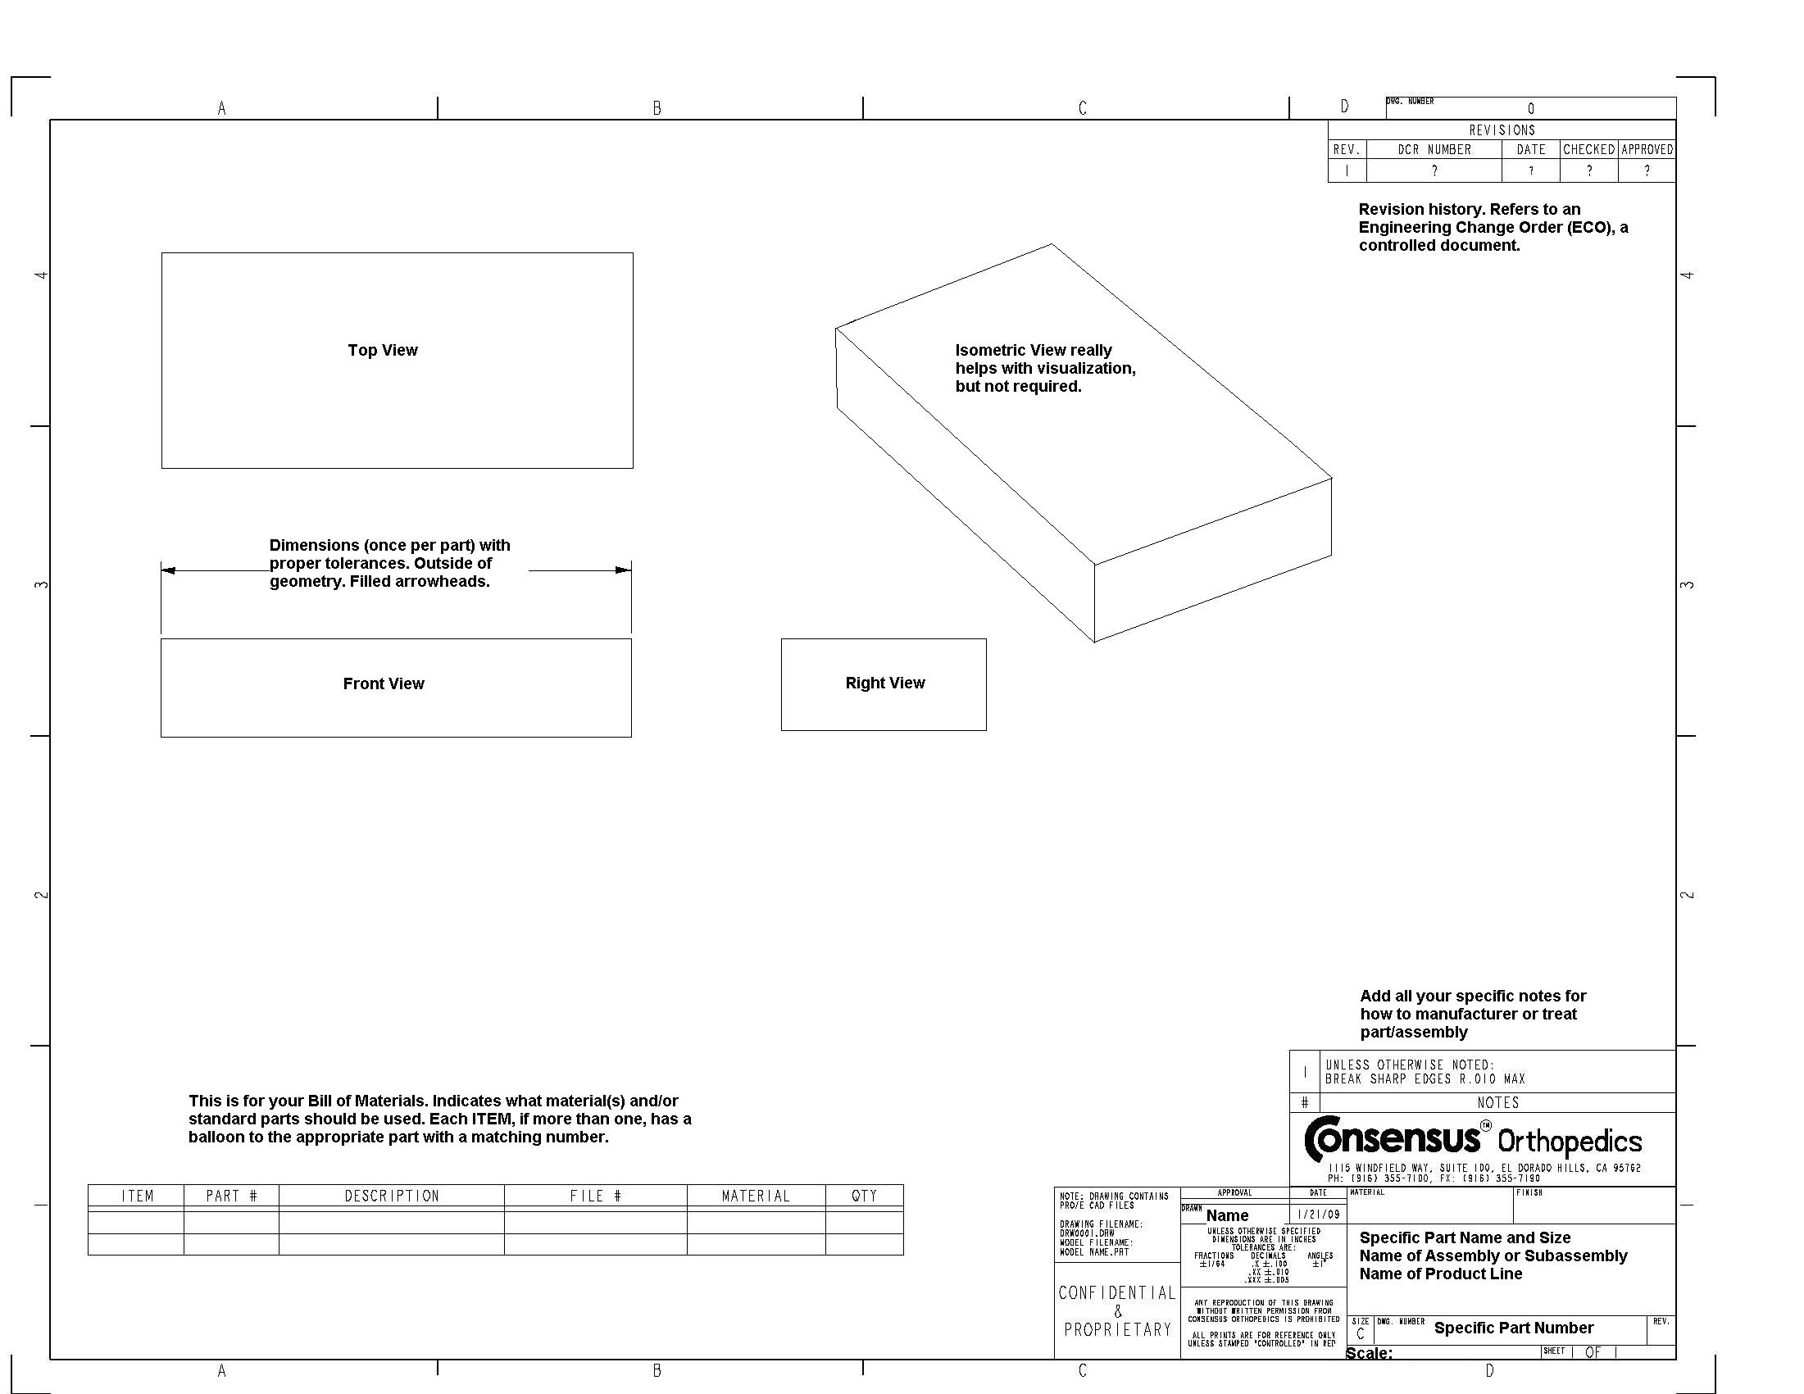

Slide 5
Title Block
Specific Part Name and Size, Name of Subassembly, Name of Product Line
Specific Part Number (Contains only numbers)
Scale (1, 2, 5, 10 only)
Revision (1, 2, 3 prerelease, A, B, C after release)
Drawn by with date & signatures (EGR, QA, MFG)
Default tolerances (.XX = .01, .XXX = .005 for inch)
Confidentiality statements

Slide 6
Bill of Materials
Raw material
Purchased components
Modified from stock components
Other subassemblies or components
All placed in a bulleted, numbered list, with quantities
Corresponding bullets on assembly, usually cross-section or exploded view

Slide 7
Revision History
Prior revisions
Engineering Change Order (ECO) numbers
Dates
Checked by?
Approved by?
ECO is a separate document with written commentary and all the redlined drawings in the change order
Any other documentation that prompted revisions

Slide 8
Dimensioning and Tolerancing
Overall size dimensions, even if as (reference)
Only one dimension per feature!!
Think about how it will be measured by inspector
Decimal places control default tolerancing
Special tolerancing only if critical
Notes with numbers and description at bottom of drawing if needed for special processes
Geometric dimensioning & tolerancing if needed (ANSI Y14.5)

Slide 9
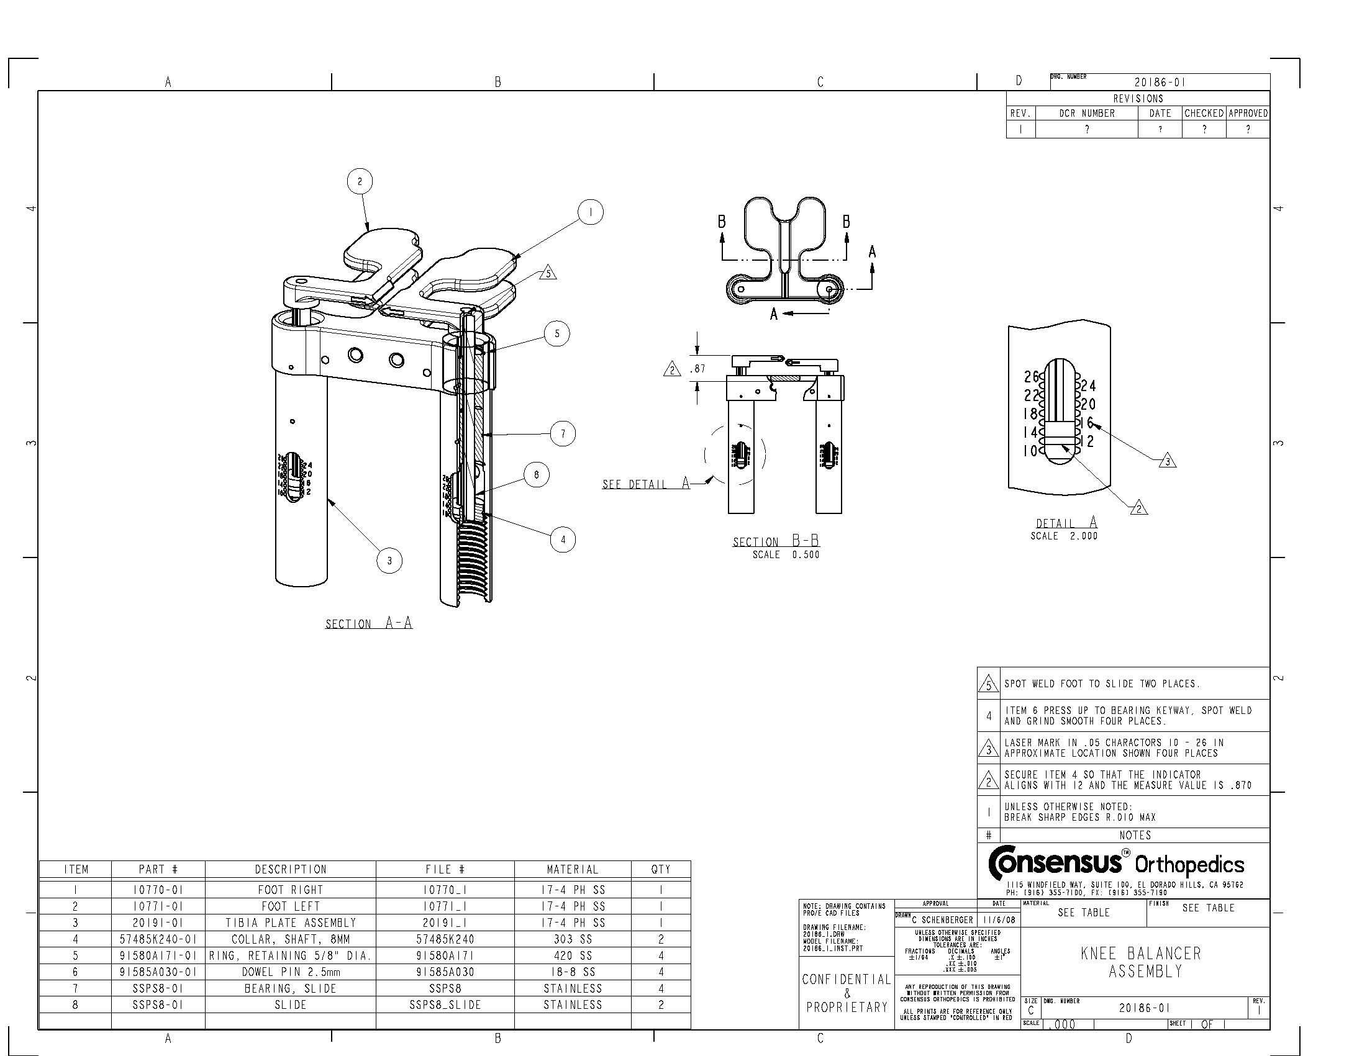

Slide 10
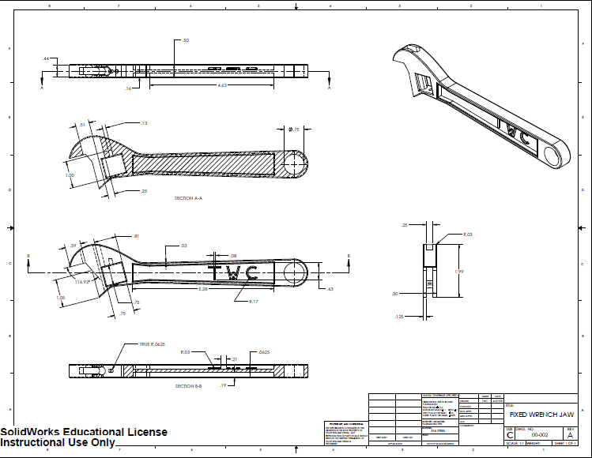

Slide 11
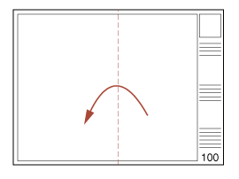
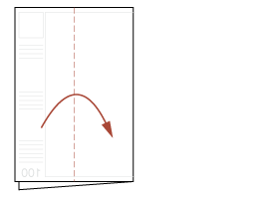
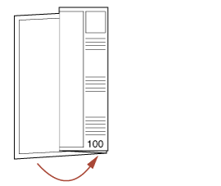
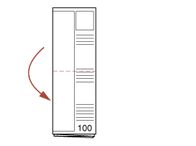
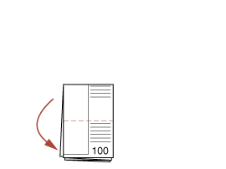
How to Fold an Engineering Drawing
http://archtoolbox.com/representation/graphic-symbols/84-foldlargedrawing.html
Want the title block to show
Want finished work to measure 8.5 x 11

Slide 12
Miscellaneous Drawing Etiquette
All dimensions must be shown.
Tangent lines should not be shown.
All hidden lines must be shown, except on ISO view
Threading should not be shown
Do not dimension to hidden lines. Make section views as needed.
Do not put dimensions on an assembly drawing.
Give overall reference dimensions as needed.
Show centerlines in all views.

Slide 13
I have totally forgotten SolidWorks!
SolidWorks is based off part components:
Drawings and assemblies have small file sizes, because all the dimensional content is in the part file.
You can “make assembly/drawing from part”
If you make “smart dimensions” in your part file, you can simply show those in your drawing.
SolidWorks has built-in drawing formats that you can edit, using “edit sheet”
Let’s open SolidWorks and refresh our memories!

Slide 14
Summary
3 orthographic views, plus isometric view
Fully dimensioned with tolerances
Title Block
Bill of Materials
Revision history
Notes, if desired

