Slide 1
World War II Boeing produced one B-17 every hour, 24 hours/day, 7 days/week

Slide 2
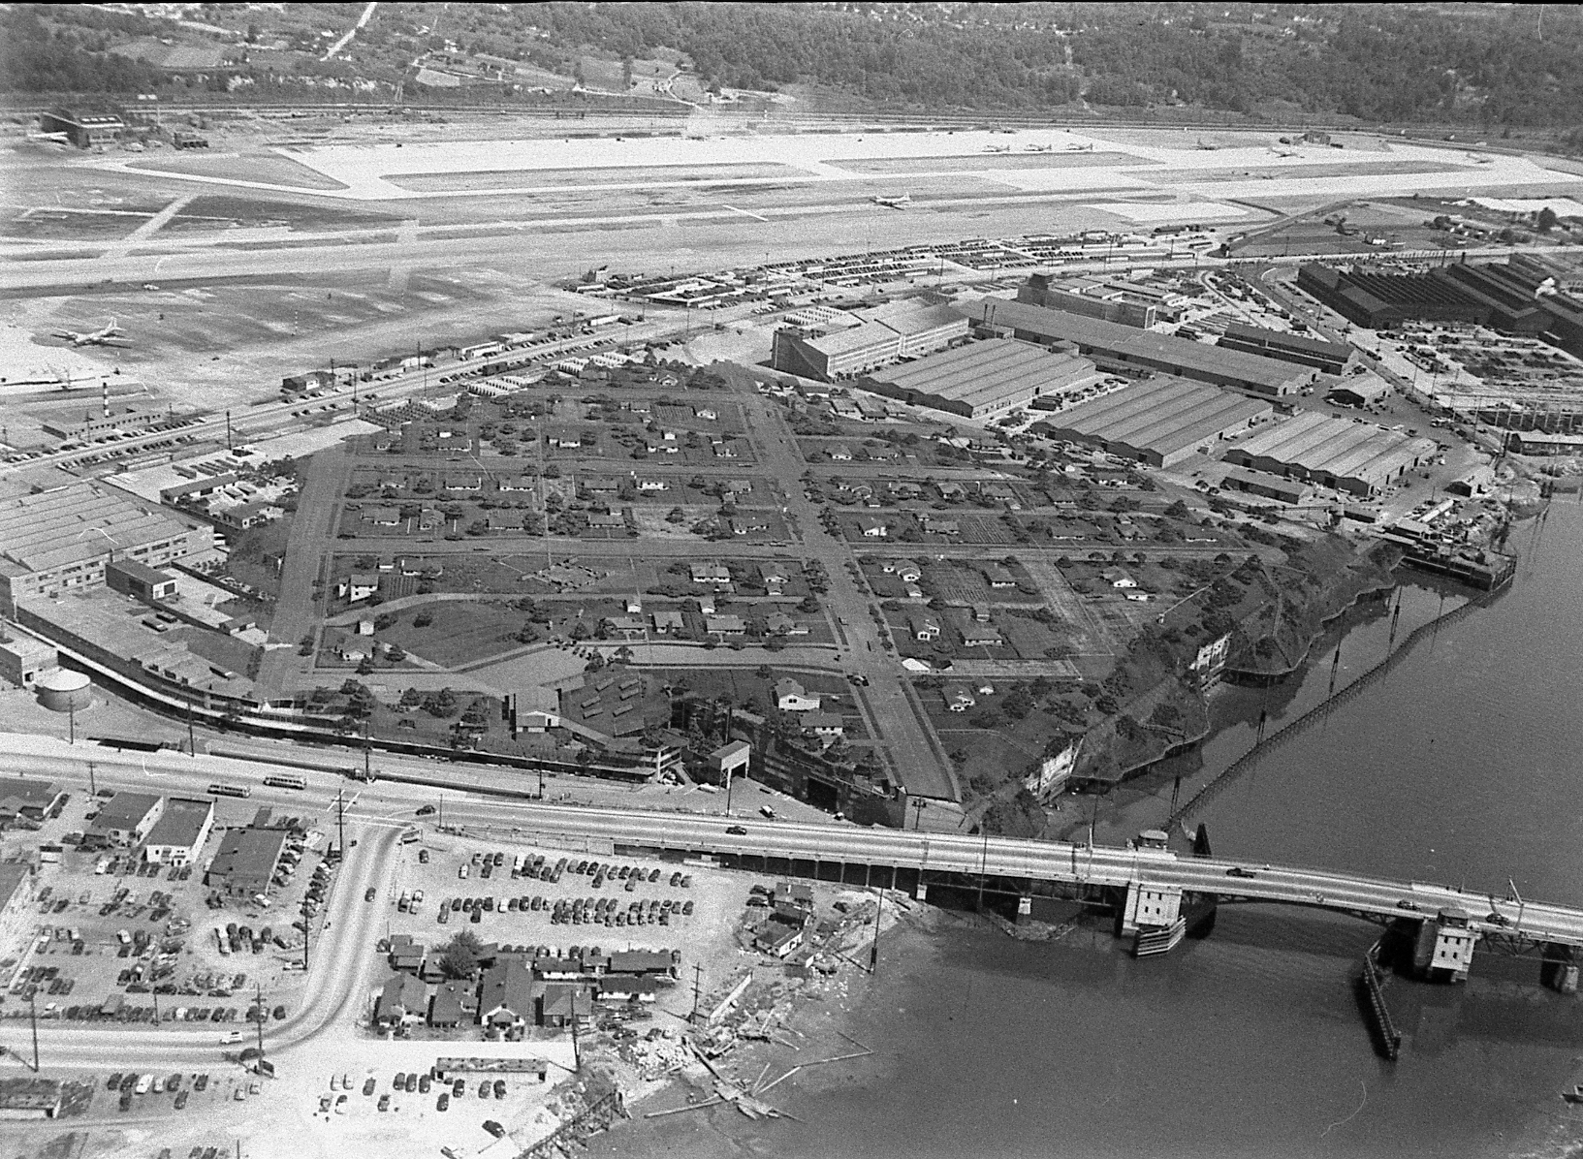
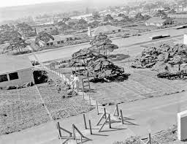

Slide 3
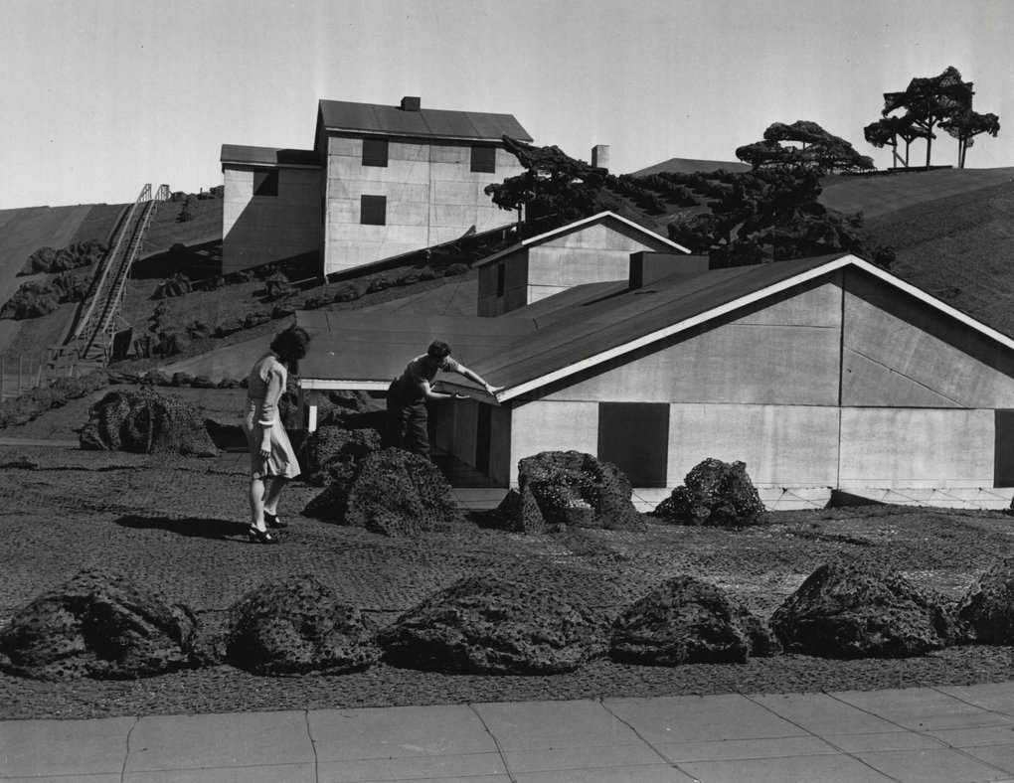

Slide 4
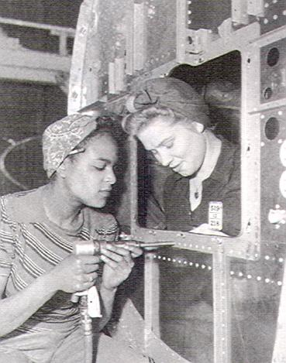
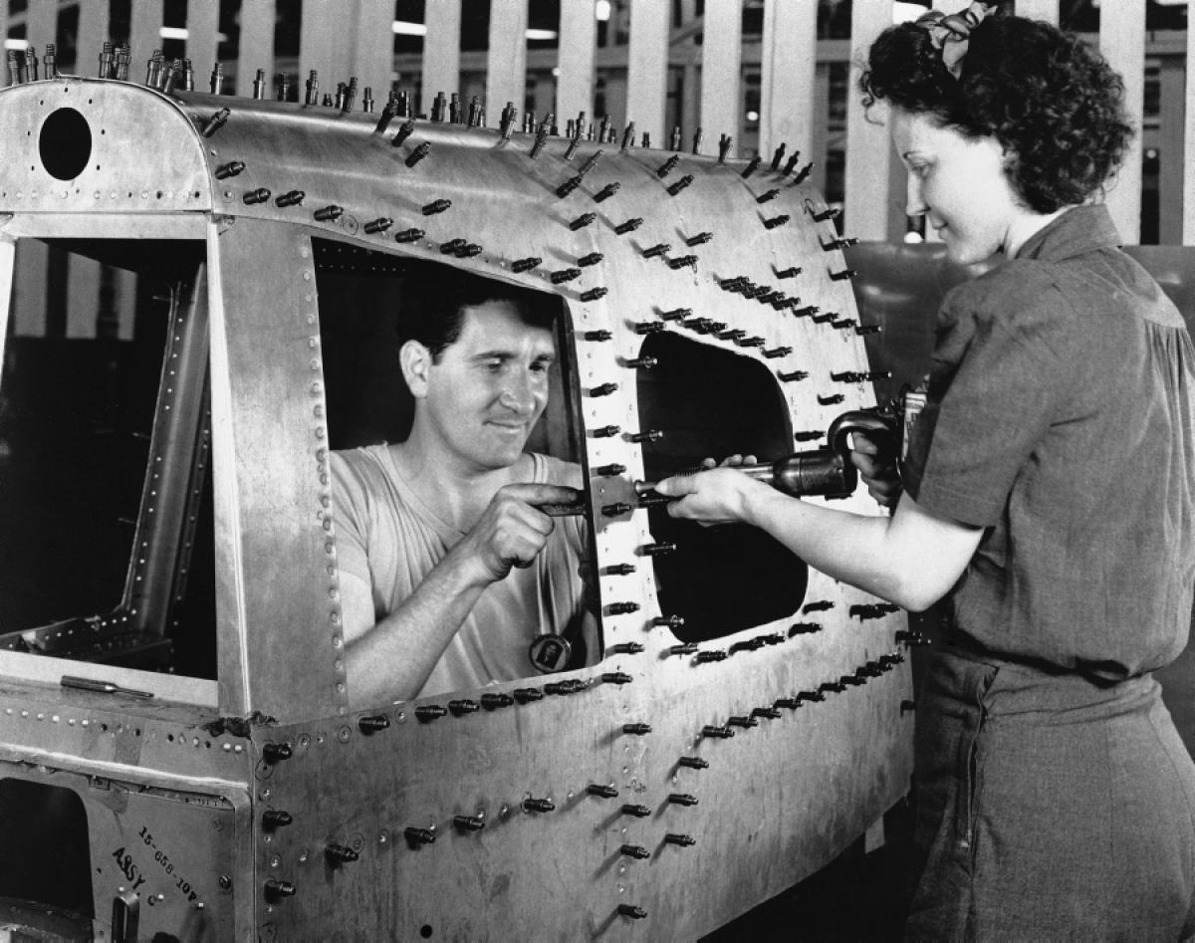
Naomi Parker-Fraley, a Tulsa, Okla., native, passed away on Saturday at age 96 while in hospice care in Longview, Wash., her family said. (January, 2018)

Slide 5
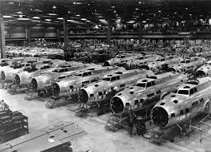

Slide 6
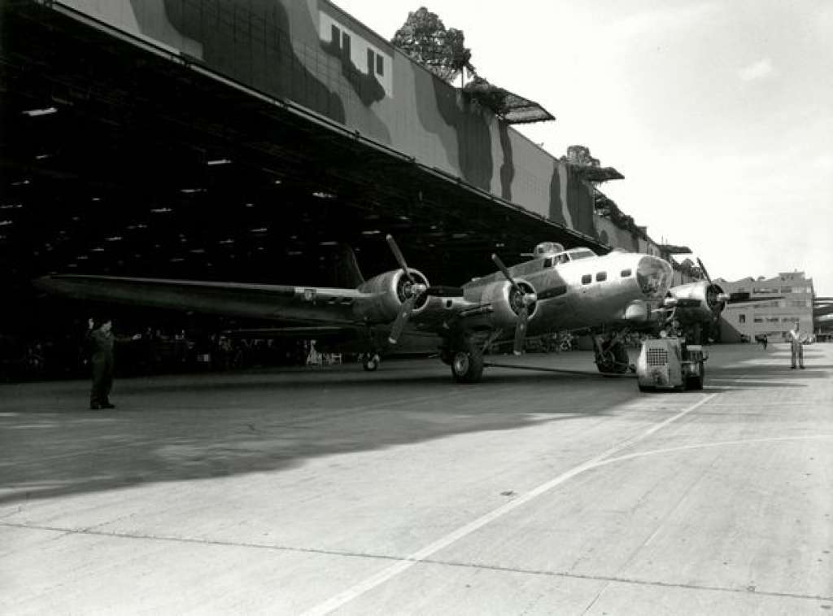

Slide 7
Boeing B29 – pressurized cabin (1,122 built in Renton)

Slide 8
World War II Ends….
De Havilland DH 106 Comet – first commercial jet aircraft
Jet aircraft can fly faster and higher than propeller aircraft, allowing for shorter travel times, and allowing the airplane to get above inclement weather.
Comet History through mid-1952:
Designed after WWII (1946) – based on technology developed during the war
First prototype: July 1949
Test flight began: April 1951
Cruise altitude: 35,000 feet (twice any other commercial plane)
Airworthiness Certificate: 1952 (issued by Air Registration Board, Great Britain)
Passenger service began: 2nd May, 1952
The US’s first commercial jet aircraft was the Boeing 707, introduced in 1958

Slide 9
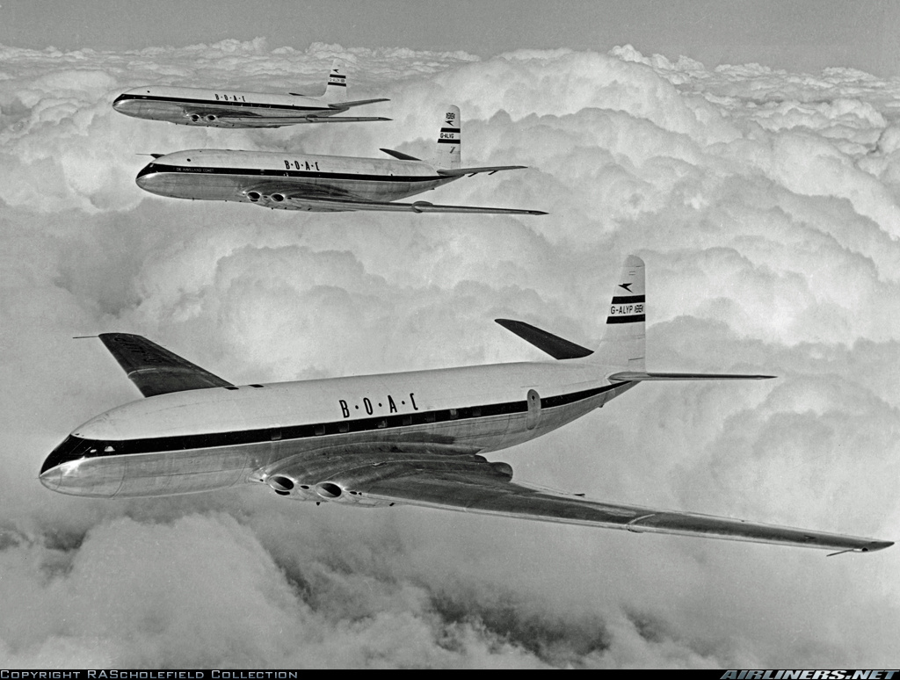
Comet

Slide 10
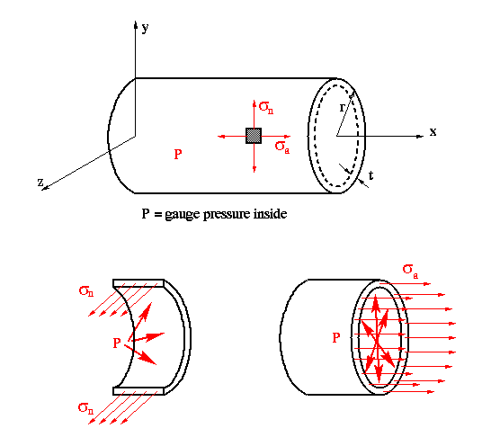
Pressure Vessel Loads

Slide 11
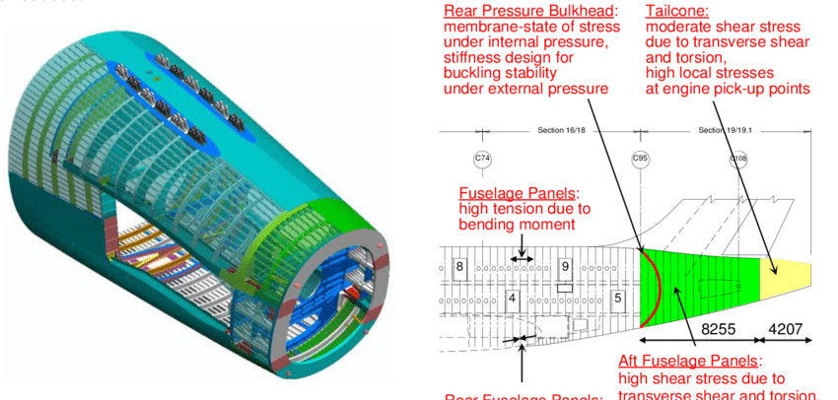
Fuselage is a Pressure Vessel and a Beam

Slide 12
Fatigue Testing:
 | Recommendations | de Havilland
Static testing | 2P | Already conducted
Proof testing | 1.33P
Fatigue | 0 to 1.25P 15,000 times | 0P to 1P 16,000 times*

Slide 13
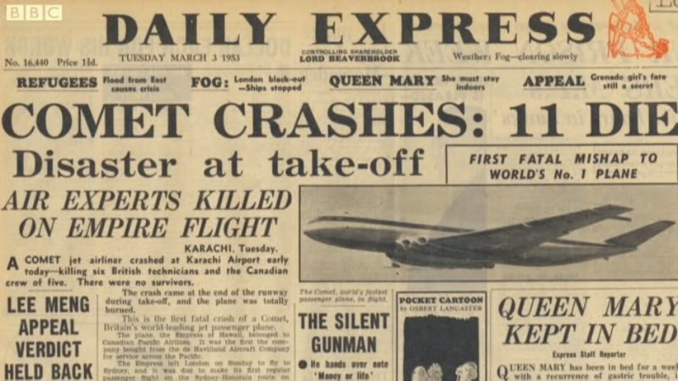

Slide 14
Accidents, lots of them…

Slide 15
Post Mid-1952 History
Summary of crashes involving the de Havilland Comet 1 and 1A airplanes:
Date | Registration | S/N | Operator | Location | Cause
26 Oct 1952 | G-ALYZ | 6012 | B.O.A.C. | Rome, Italy | Aircraft
03 Mar 1953 | CF-CUN | 6014 | Canadian Pacific | Karachi, Pakistan | Aircraft
02 May 1953 | G-ALYV | 6008 | B.O.A.C | Calcutta, India | Aircraft
25 Jun 1953 | F-BGSC | 6019 | UAT | Dakar, Senegal | Pilot
10 Jan 1954 | G-ALYP | 6003 | B.O.A.C. | Elba, Italy | Aircraft
08 Apr 1954 | G-ALYY | 6011 | South African Airways | Stromboli (near Naples), Italy | Aircraft

Slide 16
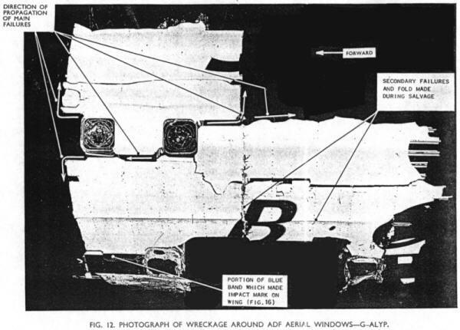
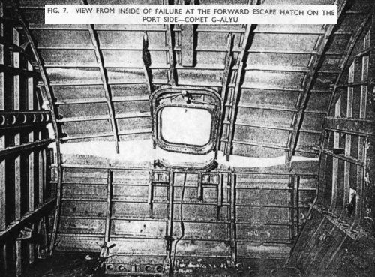

Slide 18
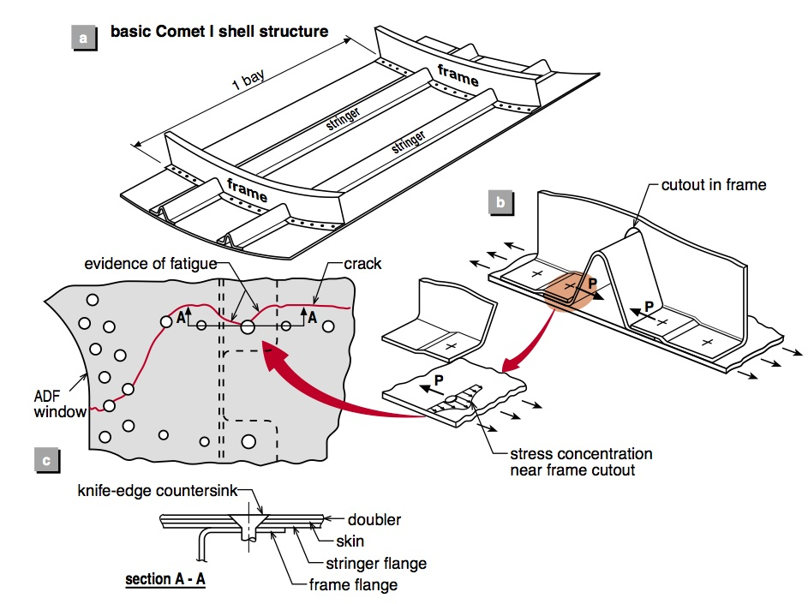
https://aerospaceengineeringblog.com/dehavilland-comet-crash/

